Slide 1
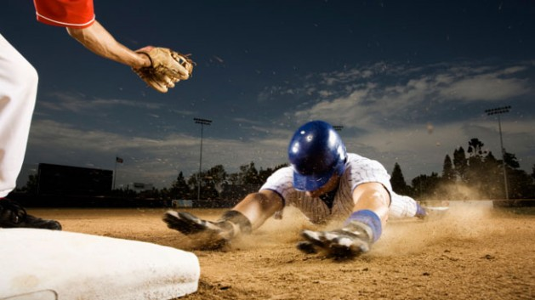
Stealing Bases
Presented by:
Mireille Nehme
Nathalie ouellette
Samuel van noppen
Wyatt Baldwin

Slide 2
Content
BAseball Overview
Goal
Data
Technologies & tools
Analysis
Results
Future analysis
Image source: https://www.stack.com/a/base-stealing/

Slide 3
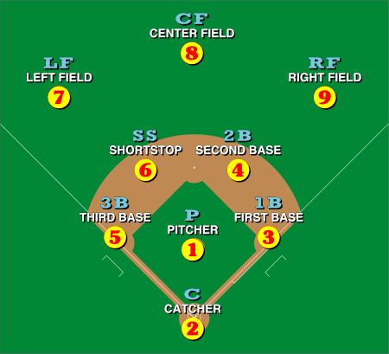
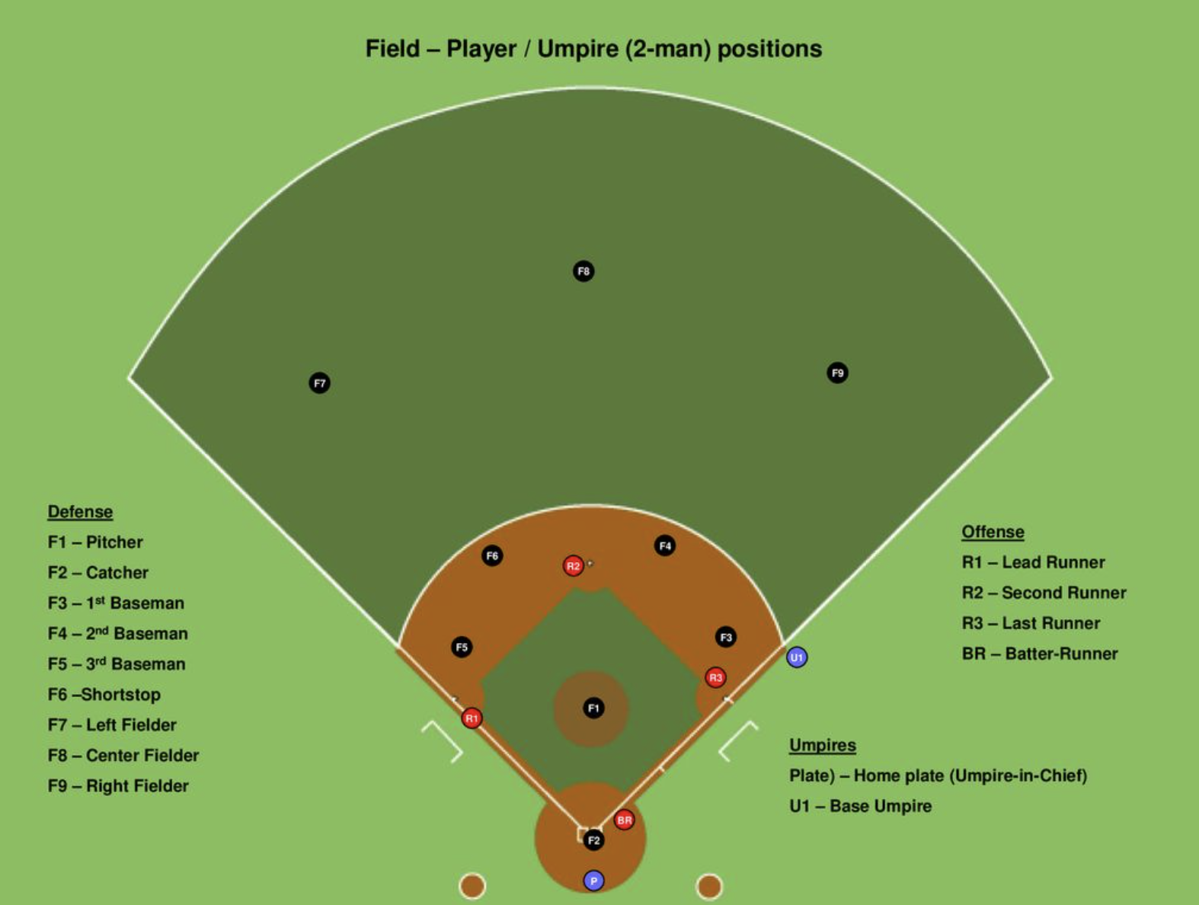
Baseball overview
Notes:
9 players per team

Slide 4
Stealing Bases
Notes:
9 players per team

Slide 5
Goal
Can a machine learning model accurately predict whether an MLB runner will be able to successfully steal a base based on their running speed, the pitcher's average pitch speed, and the catcher's pop time?

Slide 6
Data
data source
Data description

Slide 7
Analysis

