Slide 1

</>
CodeSage AI
A domain-specific coding assistant — review, debug, optimise, explain.
Code generation
Bug hunting
Version-aware
Voice + vision
Role-aware
Built with LangChain 1.x · Streamlit · OpenAI
Mir Hadi Ali
Notes:
CodeSage AI is a coding-only assistant. Everything in this deck is running software, not a mockup.

Slide 2

The problem with a generic AI wrapper
Three failures that make an assistant untrustworthy for real code
1
2
3
It answers anything
It lives in the past
It invents problems
Wire a model to a chat box and it will happily write a recipe. Nothing makes it a coding tool except the label on the page.
Ask about React 19 and you get React 17 habits — forwardRef, Context.Provider — stated with total confidence. Training data is mostly old tutorials.
Asked to review working code, a weak model pads the list: calls a used import unused, swaps a modern API for an older one it recognises.
CodeSage was built to fix all three — and each fix is enforced in code, not just asked for in a prompt.

Slide 3
What CodeSage AI is
A custom GPT with a hard boundary around one domain: code
1
Custom
An engineered system prompt, eight task modes, assignable expert roles, model and temperature control, conversation memory and response caching.
2
Domain-specific
Not merely told to be a coding assistant — enforced as one. Off-topic questions and non-tech roles are turned away before a request is ever billed.
3
Grounded
A built-in pack of current-version facts is injected when a stack is mentioned, so answers follow today's APIs instead of the average of old blog posts.
Ask it for a biryani recipe and it declines — politely — then lists what it can do instead.

Slide 4
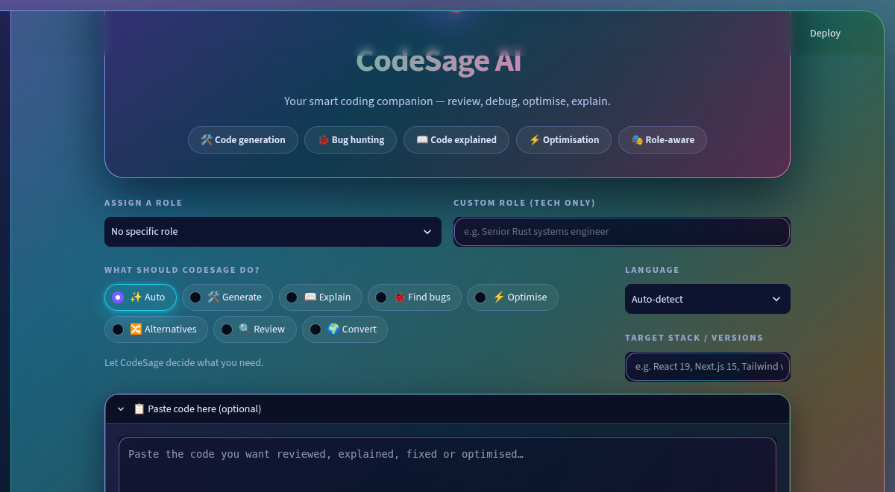
The interface
Running software — animated aurora scene, glass panels, live streaming answers
Sidebar
Bring-your-own API key, 11 models with guidance, caching, session stats.
Roles
Combine several tech personas; non-tech roles are declined.
Code panel
Paste code, drop a screenshot, or pin your stack versions.
Command bar
Rotating aurora border that brightens on focus.

Slide 5
Eight ways to ask
The mode rewrites the system prompt, so answers change shape — not just tone
Auto
Generate
Explain
Find bugs
Reads the request and picks the right shape itself.
Describe a task, get complete runnable code.
Line-by-line walkthrough, jargon defined.
Real defects, each with a failing scenario.
Optimise
Alternatives
Review
Convert
Faster version plus what actually improved.
Two or three approaches, and which to pick.
Correctness, readability, security — with a verdict.
Translate idiomatically between languages.

Slide 6
How it stays on topic
Two stages, cheapest first — most messages never cost an extra API call
1
Heuristics
2
Classifier
3
Redirect
No API call
Only if unclear
Friendly, not blunt
Pasted code, fenced blocks, stack traces, exception names and ~200 technical keywords are admitted instantly. Greetings and follow-ups pass too, so chat feels natural.
Genuinely ambiguous messages go to one tiny model call that answers CODING or OTHER. Nothing else reaches it.
Off-topic questions get a warm decline that names what CodeSage can do instead — and the model is never called at all.
Fails open by design
If the classifier errors, the message is allowed through. A real coding question is never blocked because of an API hiccup — a false refusal is worse than a false pass.

Slide 7
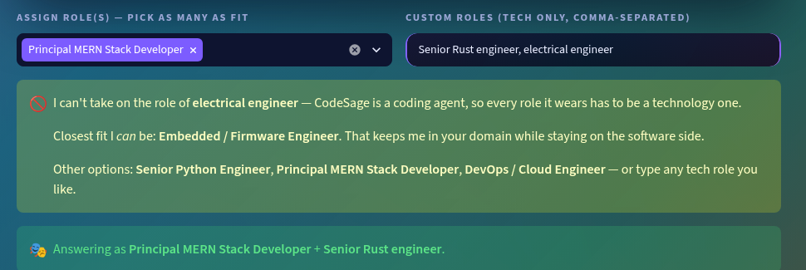
Wear any hat — as long as it is a tech one
Combine several roles at once; non-coding roles are declined with a nearby alternative
The hard part: “engineer”
Strong signals decide — firmware, django, mern, kubernetes accept a role outright.
Generic titles never decide — engineer, manager, consultant go to the classifier.
So “electrical engineer who writes embedded firmware” is accepted — plain “electrical engineer” is not.
Lawyer
Chef
Cardiologist
Mechanical eng.
→ Legal-tech Software Engineer
→ Food-delivery Platform Developer
→ Health-tech Backend Developer
→ Robotics & Simulation Engineer

Slide 8
It knows about today's versions
Mention a stack and current-version facts are injected as authoritative context
Without grounding
With the version pack
“Use forwardRef to pass a ref”
“Wrap it in Context.Provider”
“Add defaultProps for the fallback”
“ref is a normal prop — forwardRef is no longer needed”
“Render <Context> directly as the provider”
“cookies() is async in Next 15; fetch is no longer cached”
All three were removed or replaced in React 19 — and stated with total confidence.
Fifteen stacks covered, from React and Next.js to Django, Svelte and LangChain itself.
Pin your stack
Auto-detection
Visible grounding
Type “React 19, Next.js 15” and those versions become the target.
Mention a stack, or paste code using it, and its notes load automatically.
A pinned line shows which version notes are in play, so it is never invisible.

Slide 9
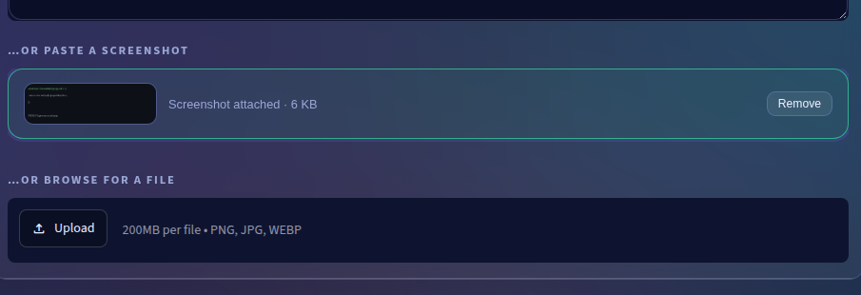
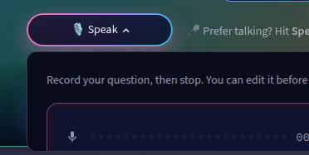
Three ways in: type, paste, or talk
Because retyping a stack trace from a screenshot is nobody's idea of help
Paste a screenshot
Or say it out loud
Clipboard paste
Vision reading
Coding vocabulary
st.file_uploader cannot accept a paste, so a small custom component catches the event and returns the image — no npm build, no extra package.
Code is read out of the image at high detail and transcribed back into a fenced block, so you copy the fix instead of retyping it.
Speech models mangle code terms. A vocabulary prompt biases the transcript, so “useEffect” does not come back as “use effect”.

Slide 10
Engineered for trust, not just answers
Every rule below exists because something actually went wrong in testing
1
Verdict first
2
Never regress
A review opens with “No real bugs found” or “N issues found”. An issue only counts if it can name the inputs that make the code misbehave.
Do not call an API invalid unless certain; do not swap a modern call for an older familiar one. Check the replacement returns the same shape.
3
Verify before claiming
4
No repetition loops
Never call an import unused without scanning the file. Never call a signature wrong when the surrounding code shows it is deliberate.
A live detector cuts the stream if the model gets stuck repeating itself, with a token ceiling and a frequency penalty behind it.
Plus a model guide in the sidebar — because picking a weak model for a review is the single biggest cause of a bad answer.

Slide 11
How a question flows through it
LangChain 1.x with LCEL — prompt | llm | parser
Question
›
Scope guard
›
Prompt build
›
ChatOpenAI
›
Streamed answer
The prompt assembled at step 3 carries the role persona, the mode instruction, the language hint, current-version notes for any stack detected, your pasted code and the recent conversation.
config.py
prompts.py
chains.py
guard.py
Settings, models, modes, roles
System rules + templates
ChatOpenAI, LCEL, streaming
Coding-only scope guard
roles.py
tech_notes.py
voice.py
cache_manager.py
Tech-only role validation
Current-version pack
Speech to text
In-memory + SQLite cache

Slide 12
Run it in four lines
py -3.12 -m venv venv
.\venv\Scripts\Activate.ps1
pip install -r requirements.txt
streamlit run app.py
Then just paste your key
No .env needed — every visitor brings their own OpenAI key in the sidebar, so a public deployment never spends the owner's credits.
8 modes
11 models
15 stacks
3 input types
CodeSage AI · a coding assistant that knows what it is for.

