Slide 1

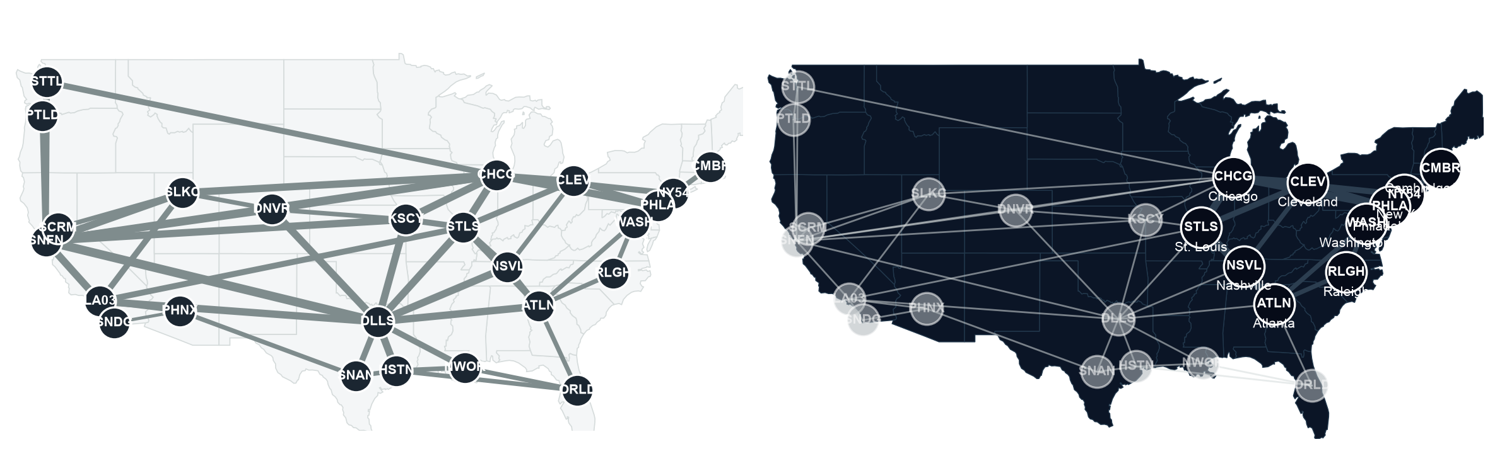
QUBIT HACKATHON 2026 · AT&T CHALLENGE
Routing AT&T's backbone
on 28 qubits
Candidate-route encoding, Fortz–Thorup congestion cost,
QAOA on Classiq — checked against exact ground truth.
[ team · members ]

Slide 2
THE PROBLEM
Today's routing overloads AT&T's real backbone
105%
peak link utilization under today's lowest-delay routing
1
link carrying more traffic than its capacity
5.8×
Fortz–Thorup congestion cost Φ* against an uncongested network
Real topology and geography from the Internet Topology Zoo's record of AT&T's published OC-768 map. Latency derived from great-circle distance; capacity and traffic synthesized, method documented.
02

Slide 3
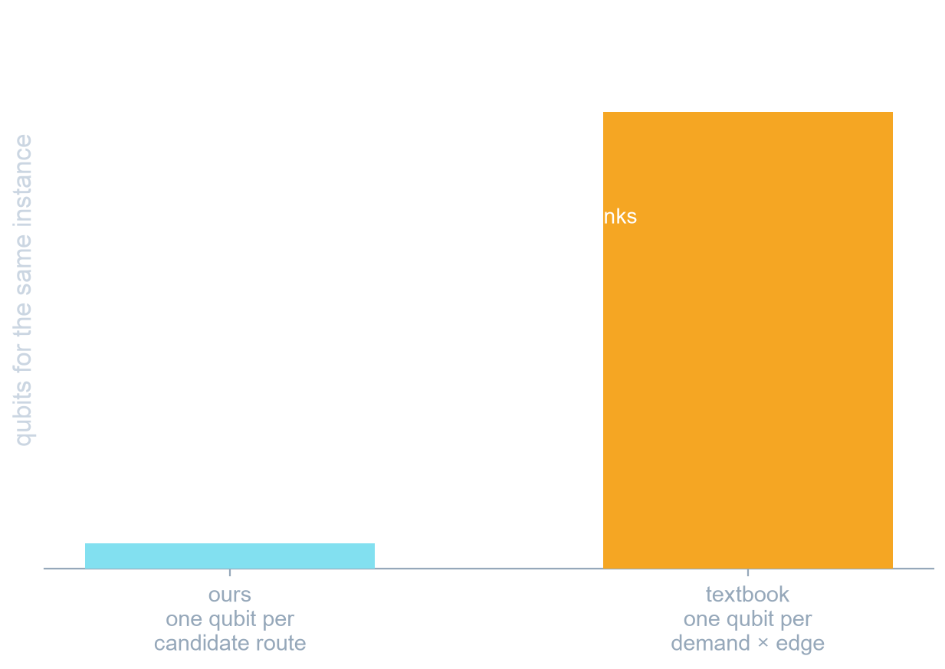
ENCODING
28 qubits where the textbook encoding needs 504
Classical enumeration first
Yen's algorithm across four metrics — delay, cost, hops, spare capacity — proposes a shortlist of link-disjoint routes per demand. Validated against networkx on 900 PoP pairs, zero mismatches.
Qubits track decisions, not wires
N = Σ|P_k| = demands × routes. It does not grow with the 36 directed links, so the same circuit width covers a much larger network.
Penalty degree stays quadratic
The demand-edge encoding needs a degree-D capacity penalty (cubic at three demands) and per-node flow conservation. One-hot over routes needs neither.
The trade, stated plainly
Solution quality is capped by the candidate sets. That is the hybrid split we chose deliberately.
03

Slide 4
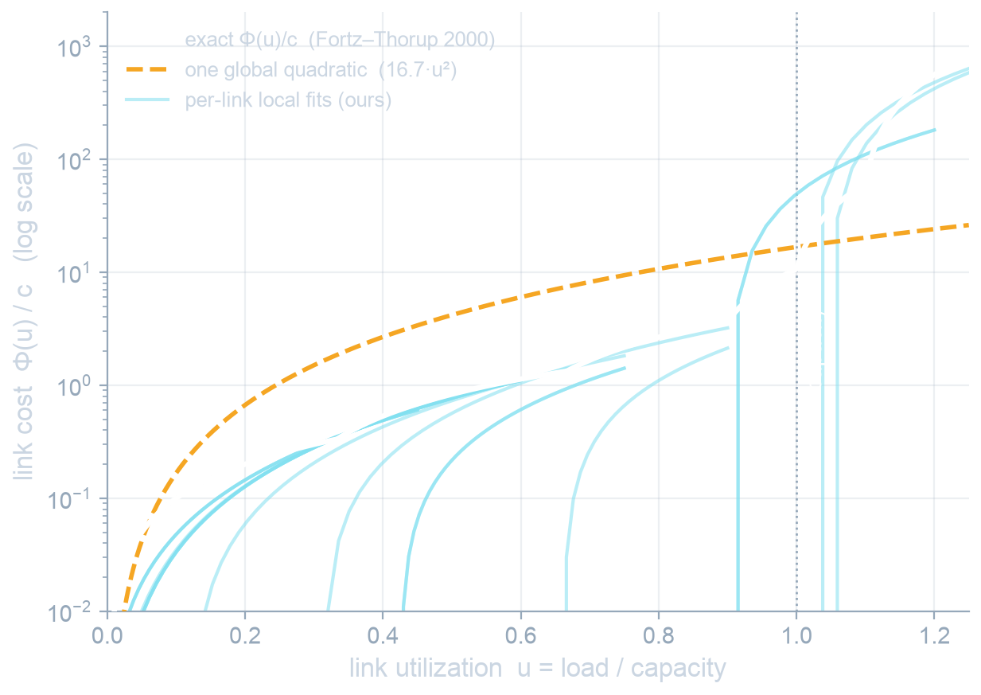
THE FORMULATION PROBLEM WE HAD TO SOLVE
Fitting Fortz–Thorup per link keeps the capacity cliff
Capacity is a cliff, not a slope
Fortz & Thorup's cost per link steps through slopes 1, 3, 10, 70, 500, 5000. Below a third of capacity it is nearly free; past capacity it is catastrophic.
One global quadratic flattens it
Fitted over all utilizations it becomes 16.7·u² — which minimizes total squared load, not peak load. On this instance its optimum leaves the hot link at 105% and never clears it.
Per-link local fits keep it
H already carries a per-link linear term and u_e is linear in x, so fitting each link over the load band it can actually reach stays a QUBO — no slack qubits — and restores the cliff.
Bounds come from the candidate sets, never from a solution.
04

Slide 5
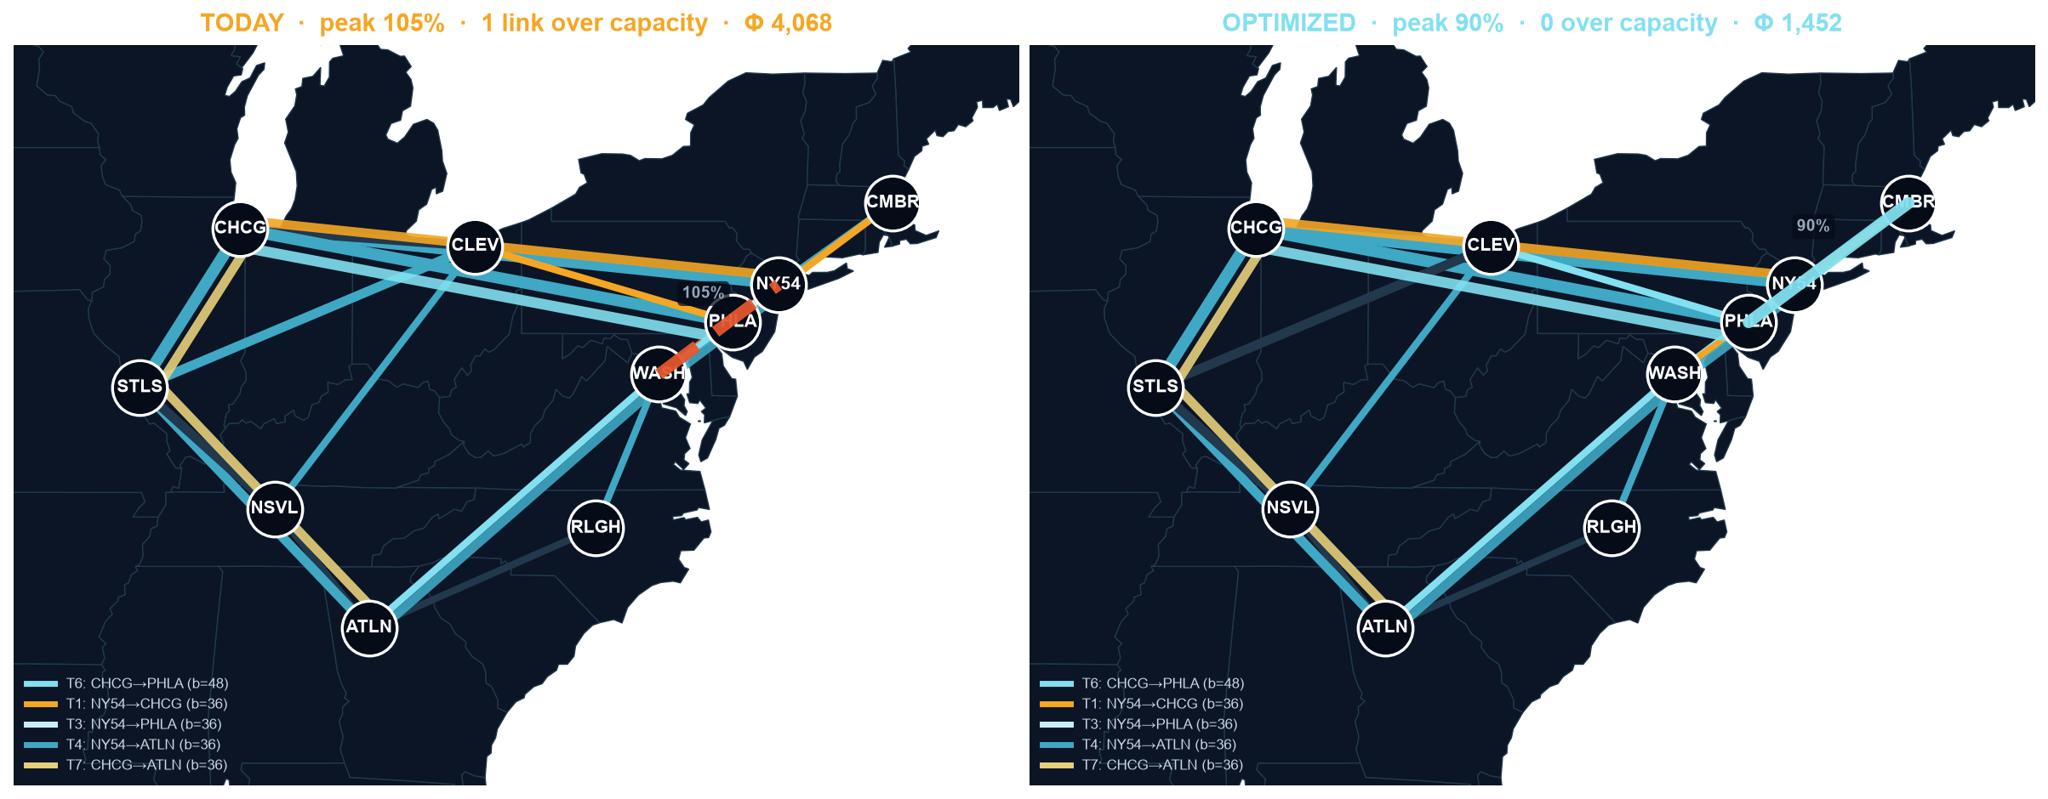
THE RESULT ON THE REAL INSTANCE
105% → 90% peak, zero violations, on the real backbone
105% → 90%
1 → 0
5.84 → 2.03
16,384
peak utilization
links over capacity
Fortz–Thorup Φ*
assignments searched exactly
Same candidate routes, same exact solver — the gain comes from the objective, not from the quantum step.
05

Slide 6
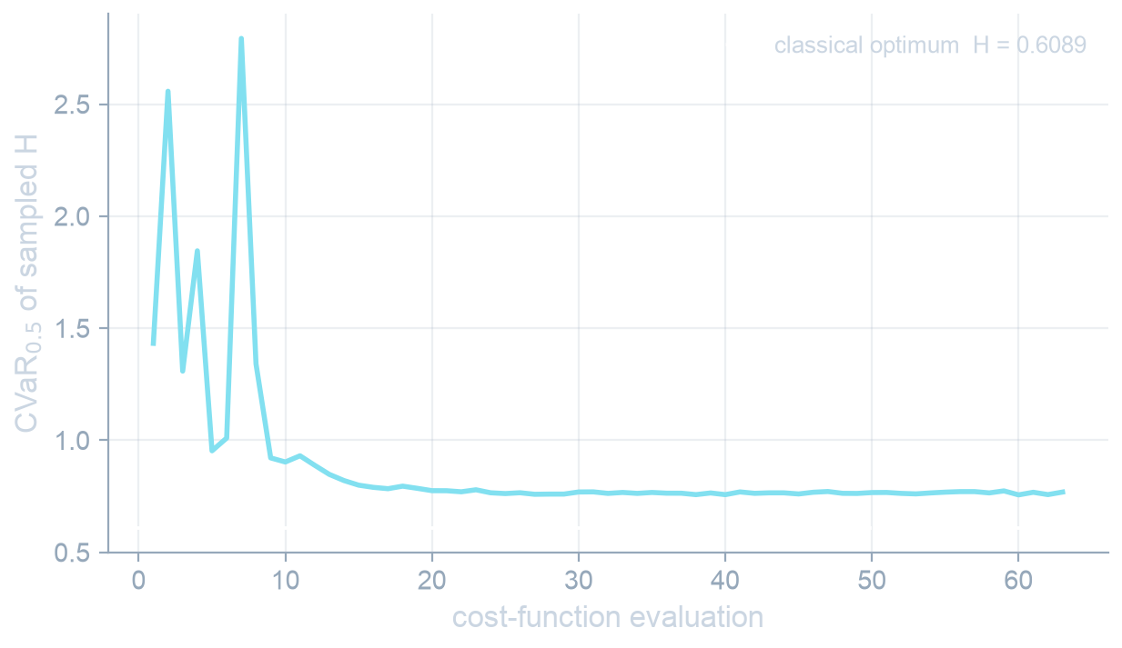
THE QUANTUM STEP, CHECKED
QAOA returns the optimum where we can verify it
57%
of sampled probability lands on feasible states, against 5.3% for uniform sampling (11×)
7e-08
cost gap to the exhaustively verified optimum over all 27 assignments
9 qubits · 3 layers · depth 101 · 144 two-qubit gates
CVaR at q=0.5 (Barkoutsos et al.) · COBYLA · 2048 shots · seed 42 · Classiq simulator
Deliberately small: nine qubits is where every quantum claim can be checked against exact ground truth. We claim no speedup.
06

Slide 7
WHERE IT STOPS, MEASURED
At 28 qubits the wall is feasibility, not the circuit
The pipeline runs end to end
28 qubits synthesized on Classiq to depth 75 with 150 two-qubit gates, executed on the simulator. The CVaR of sampled H falls by 18.5 (-20.3 to -38.7; the per-link fit drops constant terms, so H is not positive), meaning the optimizer is learning.
WHAT WE WILL NOT CLAIM
• A quantum speedup. At these sizes exact classical search wins, and we say so.
• A quantum result on the 28-qubit instance. The clean routing there is classical, from exhaustive search over the same QUBO.
• That the congestion win is quantum. It comes from the objective, solved by brute force.
No feasible sample came back
With 14 demands choosing between two routes, the one-hot subspace is 2^14 of 2^28 states — 0.006% of the Hilbert space. A depth-1 X mixer spreads amplitude across all of it.
The fix is known, not hand-waving
An XY mixer confines evolution to the feasible subspace by construction; a binary encoding needs log2(K) qubits per demand, rounded up, and removes one-hot entirely. Both drop into one function of qaoa.py.
Reporting the boundary is the point: it is what tells you which mixer to build next.
07

Slide 8
HOW IT IS BUILT
One cost function: circuit, brute force, decoder
QAOA proposes, classical validation selects
@qfunc
def main(params, x):
allocate(x)
hadamard_transform(x)
repeat(num_layers, lambda i: (
phase(cost_fn(x), params[2*i]),
mixer_layer(params[2*i+1], x),
))
The decoder gates every sample on one-hot feasibility and capacity before any KPI comparison, then returns the best feasible routing. Nothing infeasible can leave the pipeline.
49 tests, one of them exhaustive
Including a bitstring-by-bitstring check of the cost polynomial against an independent implementation on a four-qubit instance.
Classiq's phase() compiles the same Python cost function that brute force minimizes and the decoder scores samples with — so the Hamiltonian and the classical objective cannot drift apart.
Only qaoa.py imports classiq
Model, QUBO, decoding and plotting stay pure Python, so the solver is swappable — MILP or QPU — without touching the formulation.
08

Slide 9
THE ONE SENTENCE
We priced AT&T's own congestion cost into 28 qubits —
a textbook encoding needs 504 — and checked every
answer against exact ground truth.
28 vs 504 qubits
peak 105% → 90%
1 → 0 links over capacity
Φ* 5.8 → 2.0
feasible mass 57% vs 5.3% uniform
0 gap to the verified optimum
49 tests
Next: XY mixer for feasible-subspace evolution · MILP baseline · Fortz–Thorup LP bound · QPU run

Slide 10
BACKUP
Everything that did not earn a place in five minutes.

Slide 11
BACKUP · INSTANCE CALIBRATION
An unroutable instance is a capacity result, not an optimization
INSTANCE
DEMANDS
TODAY
BEST ACHIEVABLE
VERDICT
east10_dense
14
281% · 9 over
506% · 6 over
oversubscribed — no clean assignment exists
east10_tuned
14
105% · 1 over
90% · 0 over
contested and solvable — 112 of 16,384 clean
`fill` caps each demand at a fraction of the widest bottleneck open to it. At 0.9 any two demands sharing a link overload it however they are routed; at 0.3 they compete instead, and the optimizer has something to win. Both instances are the same 10 real PoPs.

Slide 12
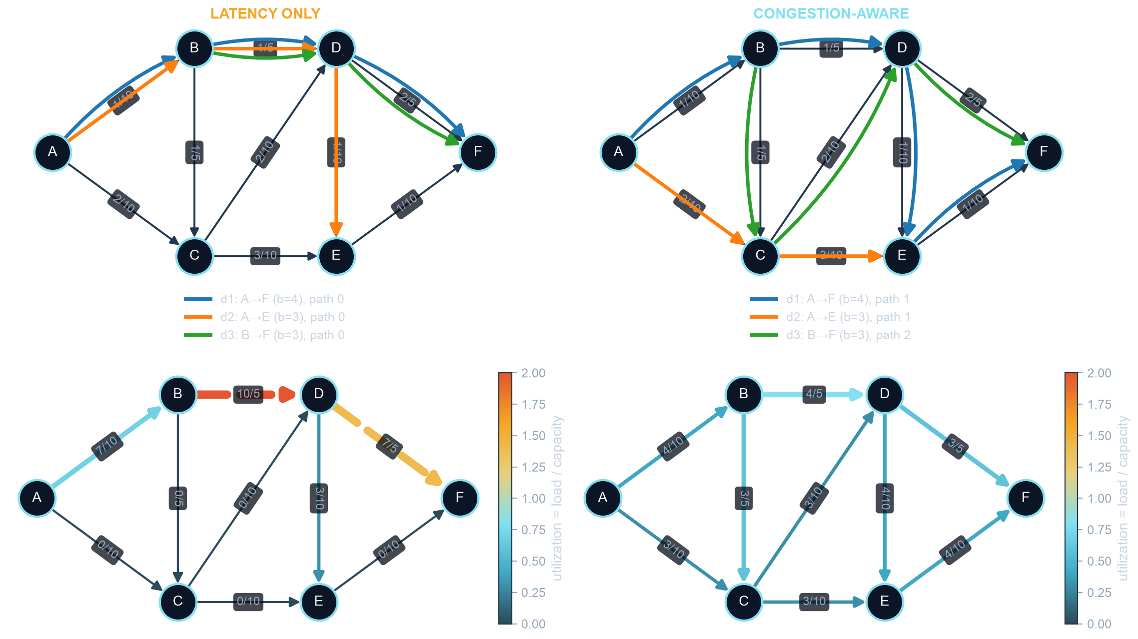
BACKUP · THE VERIFIED INSTANCE
Nine qubits, three demands, every answer checkable by hand
Both columns are decoded under one coefficient set and share a single utilization colour scale, so the panels are directly comparable. Priority π=3 on the premium demand is what makes it win the contested link.

