Slide 1
COVID Dataset Analysis Project
Mir-Mammad (Miri) Javad-zada

Slide 2

Project Overview
Comprehensive analysis of a large COVID dataset from Kaggle.
Over one million patient records analyzed for deep insights.

Slide 3
Objectives & Setup
Data Exploration and Cleaning.
In-depth Analysis and Visualization.
Conducting Statistical Testing.
Developing Predictive Models.
Requires few pip libraries: pandas, jupyter notebook (optional), matplotlib, seaborn, scikit-learn.

Slide 4
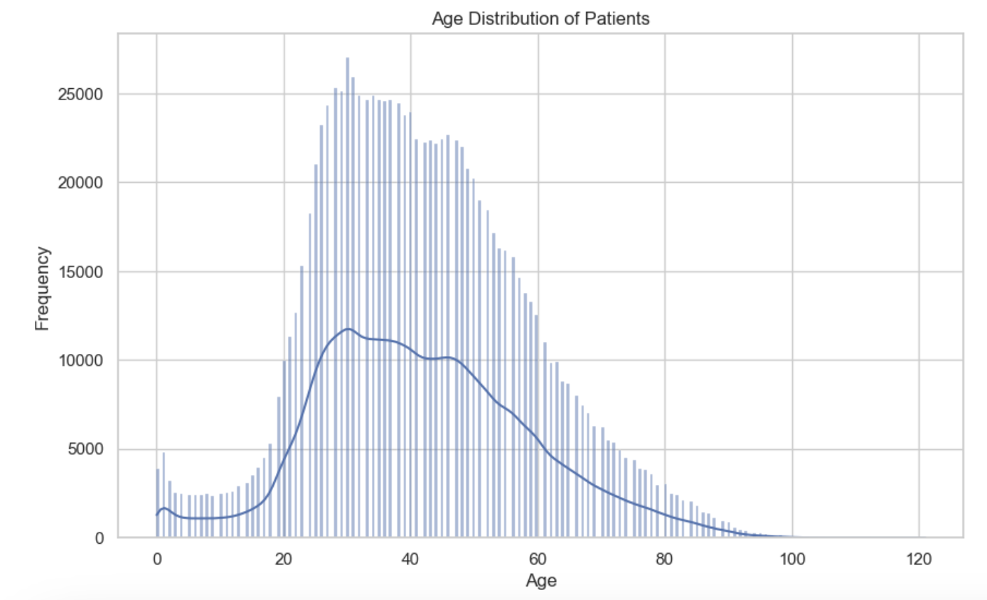
Data Analysis and Visualization
Analysis of patient demographics: age.
Notes:
The bars represent the actual data points, with each bar's height reflecting the number of patients within that particular age range. The distribution of the bars indicates that most patients are between approximately 20 and 70 years old, with the highest concentration around 50 to 60 years old.
The Kernel Density Estimate (KDE) line is the smooth curve that flows through the top area of the bars, showing the probability density of the ages. It indicates the same peak around the 50- to 60-year-old mark and confirms the skewness to the right, as it tails off more gradually than it rises.

Slide 5
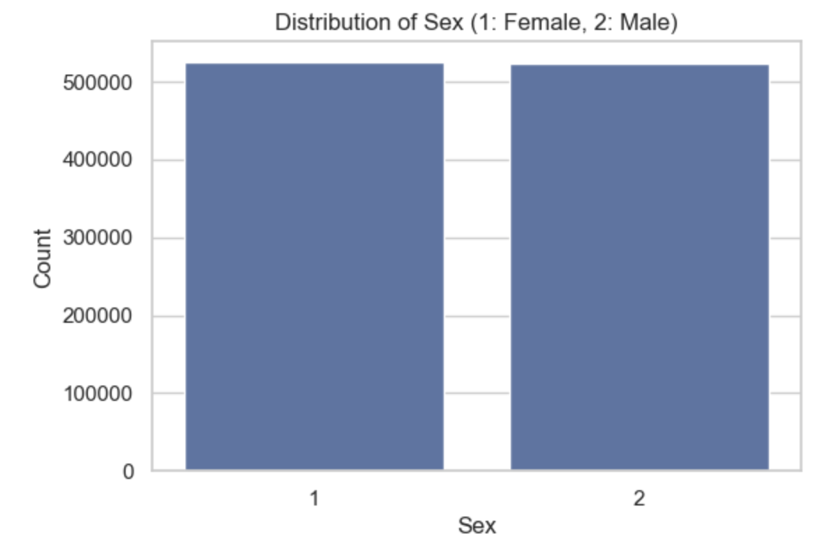
Data Analysis and Visualization
Analysis of patient demographics: sex distribution.

Slide 6
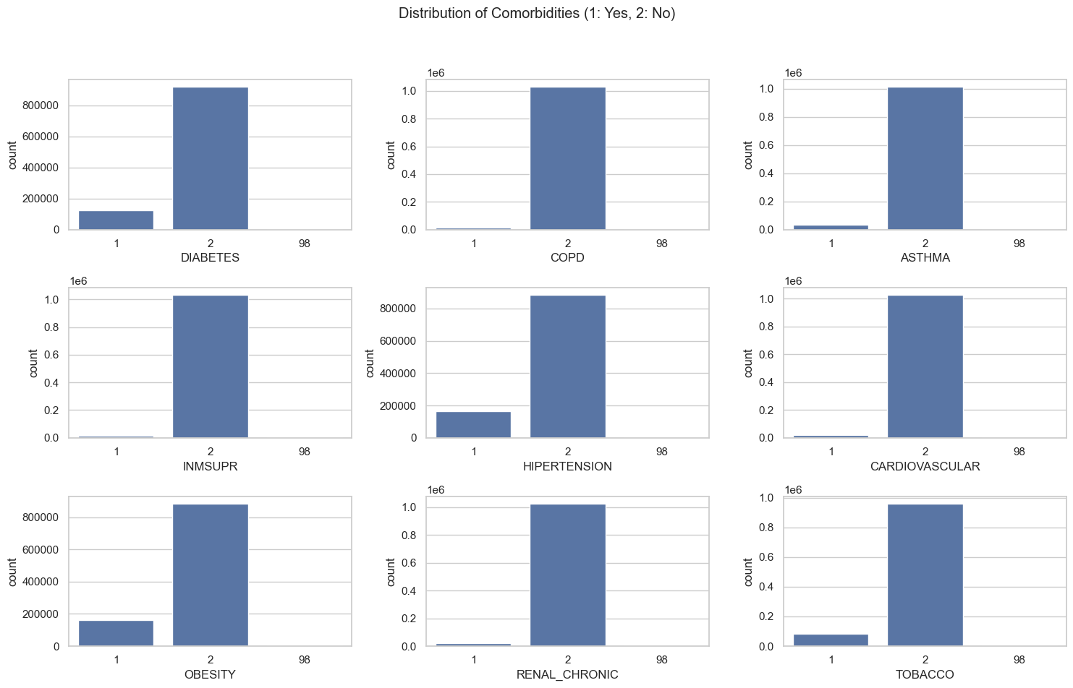
Data Analysis and Visualization
Prevalence of comorbidities (e.g., diabetes, COPD, asthma).

Slide 7
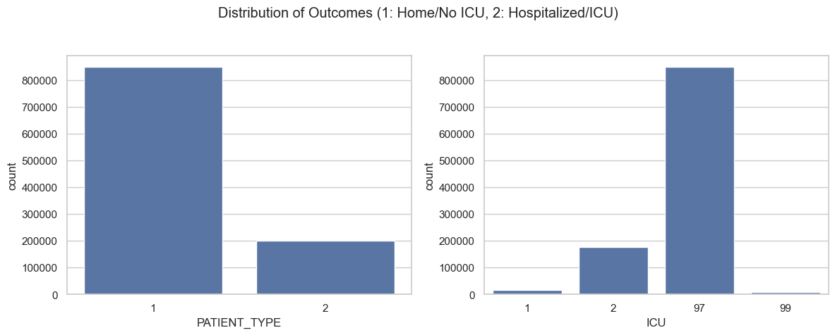
Data Analysis and Visualization
Outcomes visualized: hospitalization rates, ICU admissions.

Slide 8
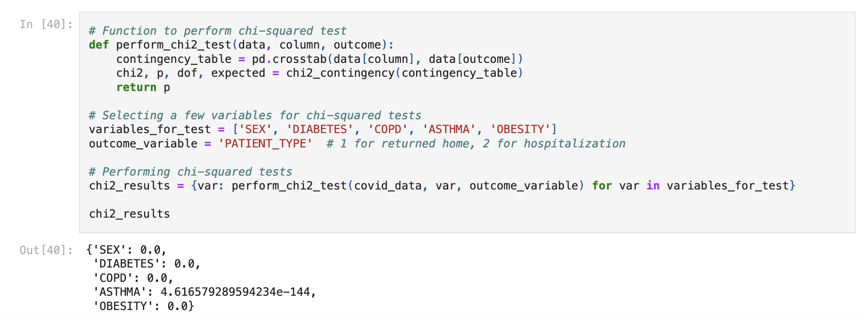
Chi-squared
Notes:
I have performed chi-squared tests and then applied it to a set of categorical variables to determine if there is a statistically significant association between these variables and a specific outcome.
A p-value of 0.0 indicates a very strong association between the variable and the outcome variable (to the limits of floating-point precision in Python). For instance, SEX, DIABETES, COPD (Chronic obstructive pulmonary disease), and OBESITY all show a p-value of 0.0, suggesting strong associations with PATIENT_TYPE. The ASTHMA variable has a p-value that is extremely small but not zero, indicating a statistically significant association, although not as strong as the others (still, it is practically zero given the scale).

Slide 9
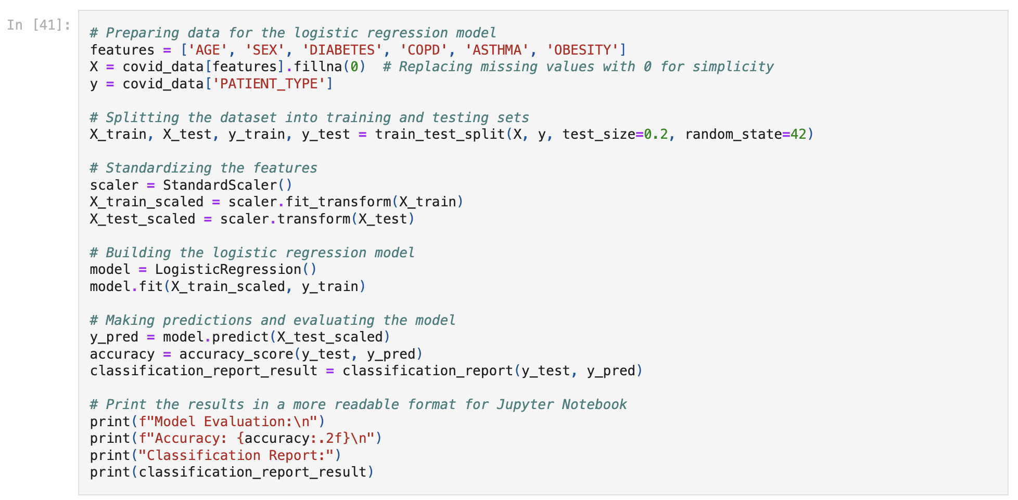
Preparing data for the logistic regression model
Notes:
I chose ['AGE', 'SEX', 'DIABETES', 'COPD’(Chronic obstructive pulmonary disease), 'ASTHMA', 'OBESITY’] as a list of features
X: A subset of covid_data including only the columns specified in features. Missing values are replaced with 0, which is a simplistic way to handle missing data.
y: The outcome variable PATIENT_TYPE from covid_data, which is what the model will try to predict.
the dataset is split into training (X_train, y_train) and testing (X_test, y_test) sets using train_test_split, with 20% of the data reserved for testing (as indicated by test_size=0.2). The random_state parameter is set for reproducibility of the results.
A StandardScaler is used to standardize the features in the training set (X_train_scaled), ensuring that each feature contributes equally to the model by giving them a mean of 0 and a standard deviation of 1.
The same scaler is then applied to the test set (X_test_scaled) to transform the data in the same way.
A LogisticRegression model is instantiated and trained using the scaled training data
Predictions are made on the scaled test data (X_test_scaled).
Model accuracy is calculated using accuracy_score, which compares the predicted values (y_pred) with the actual values (y_test).
A classification_report is generated, providing a detailed analysis of the model's precision, recall, and F1-score for each class, as well as macro and weighted averages.

Slide 10
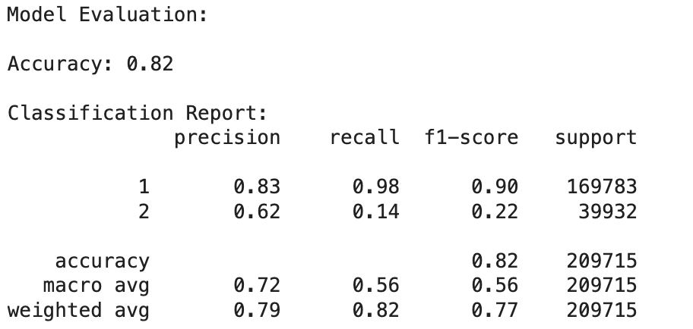
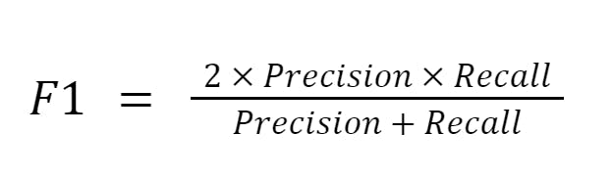
Preparing data for the logistic regression model
Notes:
The model's accuracy is showing an accuracy of 82%.
The F1 score is a measure used in statistics and machine learning to assess the accuracy of a classification model, which categorizes data into different classes. It is particularly useful when the classes are imbalanced, meaning one class may have many more instances than the other(s).
The classification report is also printed, which provides detailed performance metrics for each class:
Class 1 (patients who returned home) has a high precision and recall, leading to a high F1-score.
Class 2 (patients who needed hospitalization) has lower precision and recall, and thus a lower F1-score.
The macro avg shows the average precision, recall, and F1-score without considering the proportion of each class, whereas the weighted avg accounts for class imbalance by weighting the metrics by the number of true instances for each class.
Overall, the logistic regression model performs well in predicting patients who returned home (Class 1) but is not as effective in predicting those who needed hospitalization (Class 2), as indicated by the lower metrics for Class 2. This could be due to a class imbalance or other factors in the data that make it harder to predict this outcome.

Slide 11
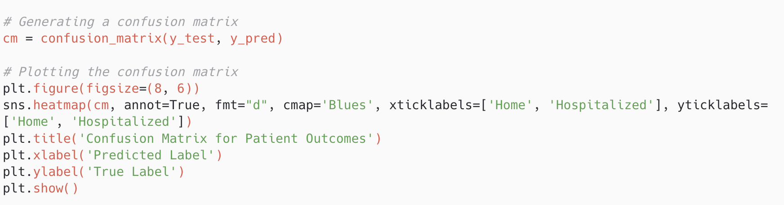
Generating a confusion matrix
Notes:
A Confusion Matrix is a table used to evaluate the performance of a classification algorithm.
It visualizes the accuracy of a model by comparing the actual vs. predicted values.
Composition of the Matrix:
The matrix is a 2x2 table for binary classification. Each cell represents the count of predictions for each possible outcome of the model.
The columns represent the predicted class outcomes (Predicted Label), while the rows represent the actual class outcomes (True Label).

Slide 12
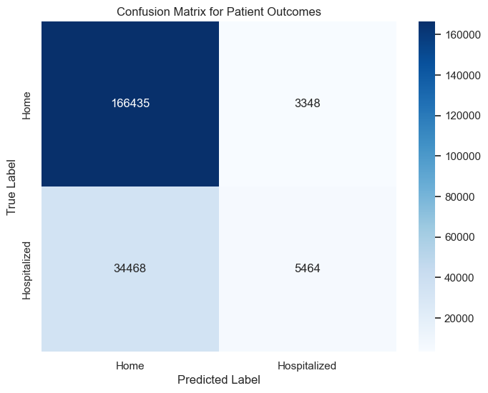
Generating a confusion matrix
Notes:
The x-axis (horizontal) represents the predicted labels that the model has output.
The y-axis (vertical) represents the true labels from the dataset.
Each cell in the matrix represents the count of predictions for each combination of actual and predicted outcomes.
The top left cell shows the number of true positives (TP): 166,435. This is the number of patients that were actually sent home and predicted correctly by the model to be sent home.
The bottom left cell shows the number of false negatives (FN): 34,468. These are the patients that were hospitalized but the model incorrectly predicted would be sent home.
The top right cell shows the number of false positives (FP): 3,348. These are the patients that were actually sent home but the model incorrectly predicted would be hospitalized.
The bottom right cell shows the number of true negatives (TN): 5,464. This is the number of patients that were hospitalized and the model predicted correctly.
The model is better at predicting the Home class than the Hospitalized class. This is indicated by the high number of true positives compared to true negatives.
There is a relatively large number of false negatives, suggesting the model tends to incorrectly predict that some patients would not require hospitalization when they actually do.
The accuracy of the model can be calculated by adding the true positives and true negatives and dividing by the total number of observations. The recall or sensitivity for the Home class is high, whereas it's low for the Hospitalized class. The precision for the Home class will be high as well, given the high true positive rate and the lower false positive rate.

Slide 13
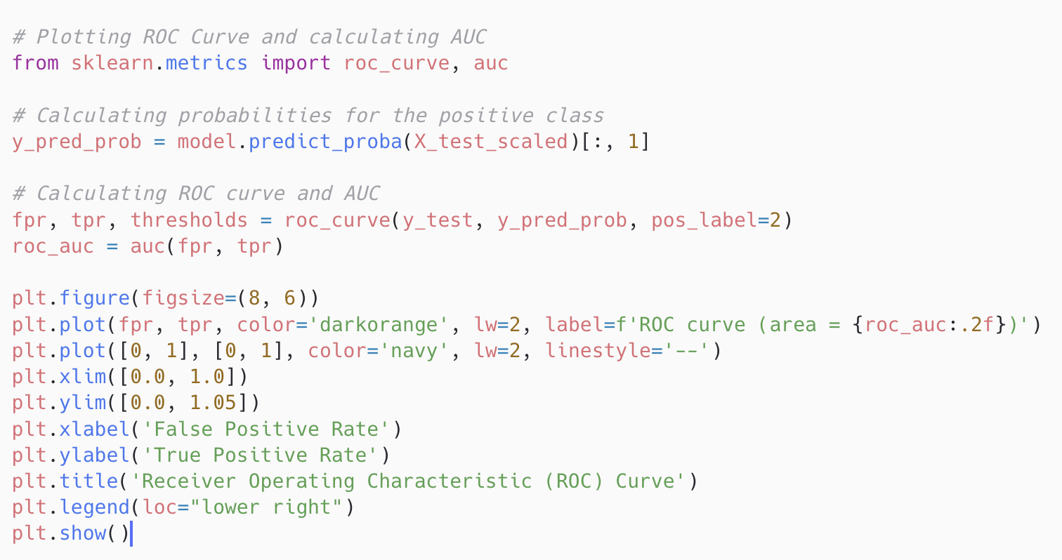
ROC Curve
Notes:
ROC stands for Receiver Operating Characteristic.
The curve is a graphical representation of a classification model's diagnostic ability.
It plots the True Positive Rate (TPR) against the False Positive Rate (FPR) at various threshold settings.
True Positive Rate (Sensitivity):
The TPR is on the y-axis; it's the ratio of correctly predicted positive instances to all actual positives.
High sensitivity means the model is good at catching positive cases.
False Positive Rate (1 - Specificity):
The FPR is on the x-axis; it represents the proportion of incorrect positive predictions among all negative instances.
A model with low specificity will falsely predict many negatives as positive

Slide 14
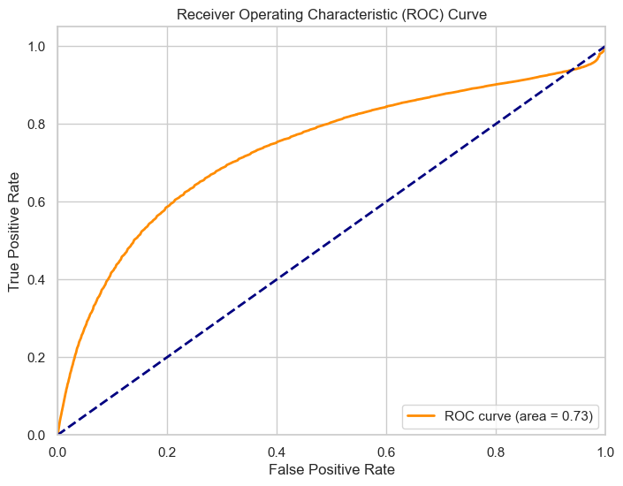
ROC Curve
Notes:
The orange curve represents the model's performance across different thresholds, depicting the trade-off between the True Positive Rate (TPR) and the False Positive Rate (FPR). The TPR is shown on the y-axis, indicating the proportion of actual positives that were correctly identified by the model, while the FPR is plotted on the x-axis, showing the proportion of actual negatives that were incorrectly labeled as positives. The dashed blue line represents a baseline classifier that predicts outcomes randomly; an effective model's ROC curve should lie above this line, indicating better-than-random performance. The area under the ROC curve (AUC) is a single scalar value which summarizes the model's effectiveness; here, the AUC is 0.73. This suggests that the model has a good ability to distinguish between the classes, with a higher AUC indicating better model performance. An AUC of 1.0 would represent a perfect model, while an AUC of 0.5 would denote a model with no discriminative power, equivalent to random guessing.

Slide 15
Testing Different Models
Model | Accuracy | AUC
Linear Regression | 0.809589 | 0.734158
Random Forest | 0.825930 | 0.779909
Gradient Boosting | 0.827156 | 0.781847
K-Nearest Neighbors | 0.813261 | 0.704024
Notes:
Then I decided to test different ML models and turns out gradient boosting was the best one

Slide 16
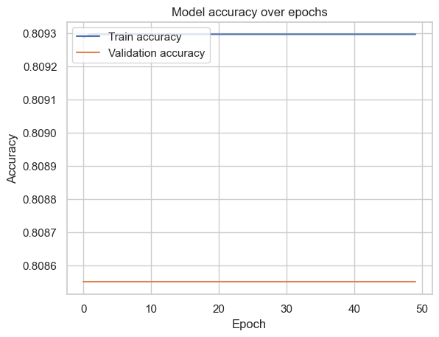
What if We Implement Deep Learning?
Notes:
The plot displays the training and validation accuracy of a deep learning model over 50 epochs. The model, defined in the provided code, is a sequential neural network consisting of densely connected layers and dropout for regularization to prevent overfitting. Specifically, it has two hidden layers with 128 and 64 neurons respectively, both followed by dropout layers set at 50% rate, and uses the Rectified Linear activation function. The output layer employs a sigmoid activation suitable for binary classification.
As shown in the plot, both training and validation accuracies are stable throughout the training process, but they are extremely close, and there is a very narrow margin between them. This closeness suggests the model is not overfitting to the training data, as overfitting would typically be indicated by a high training accuracy coupled with a much lower validation accuracy. However, the accuracies are quite static and do not show improvement over time, which might imply that the model is underfitting. The model achieves a final accuracy as reported in the code, but based on the plot, it does not seem to learn or improve from the data as epochs progress, indicating that the model's capacity may be insufficient to capture the complexity of the dataset or that further training beyond 50 epochs is unnecessary.
I would say that theaccuracy of approximately 0.81, is competitive with the machine learning models. It outperforms the K-Nearest Neighbors (KNN) model but falls short of the Random Forest and Gradient Boosting models.

Slide 17
Limitations
Data Size and Complexity
Model Architecture
Feature Engineering
Hyperparameter Tuning
Class Imbalance
Notes:
Data Size and Complexity: The deep learning model may require more data to significantly outperform traditional machine learning models. Given the current dataset, it might not have enough examples to learn complex patterns effectively.
Model Architecture: The chosen neural network architecture is relatively simple. Complex problems may require deeper networks or different types of layers to capture the relationships in the data better.
Feature Engineering: The project relied on raw features without extensive feature engineering, which could be pivotal in improving model performance, especially for traditional ML models.
Hyperparameter Tuning: There was limited exploration of hyperparameter space for all models. Finer tuning could potentially lead to better performance.
Class Imbalance: If there is a class imbalance in the dataset, it was not specifically addressed in the models' training process, which can bias the predictions.

