Slide 1
The Impact of Familial Alzheimer's Disease Mutations on Gene Expression in Glutamatergic Forebrain Neurons
Miri Javad-zada

Slide 2
Intro
The most common cause of dementia.
Often linked to mutations in genes like PSEN1.
Result in an increased accumulation of toxic plaques in the brain.
L150P contributes to the disease’s early onset and progression
How do specific fAD mutations in the PSEN1 gene affect the gene expression in glutamatergic forebrain neurons.
Notes:
Fad is the most common cause of dementia and is Often linked to mutations in genes like PSEN1.
PSEN1 mutations result in an increased accumulation of toxic amyloid plaques in the brain, a hallmark of Alzheimer’s disease.
The L150P mutation in the PSEN1 gene is a specific point mutation, where the normal leucine (L) at position 150 is replaced by proline (P), leading to alterations in the protein’s function and contributing to the disease’s early onset and progression
My question of interest is, how do specific familial Alzheimer’s disease (fAD) mutations in the PSEN1 gene affect the gene expression in forebrain neurons, and how might these changes contribute to the pathogenesis of Alzheimer’s disease? I hypothesized that L150P mutation has a particular impact on the expression of genes related to the extracellular matrix

Slide 3
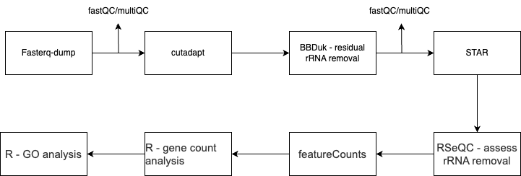
Methods

Slide 4
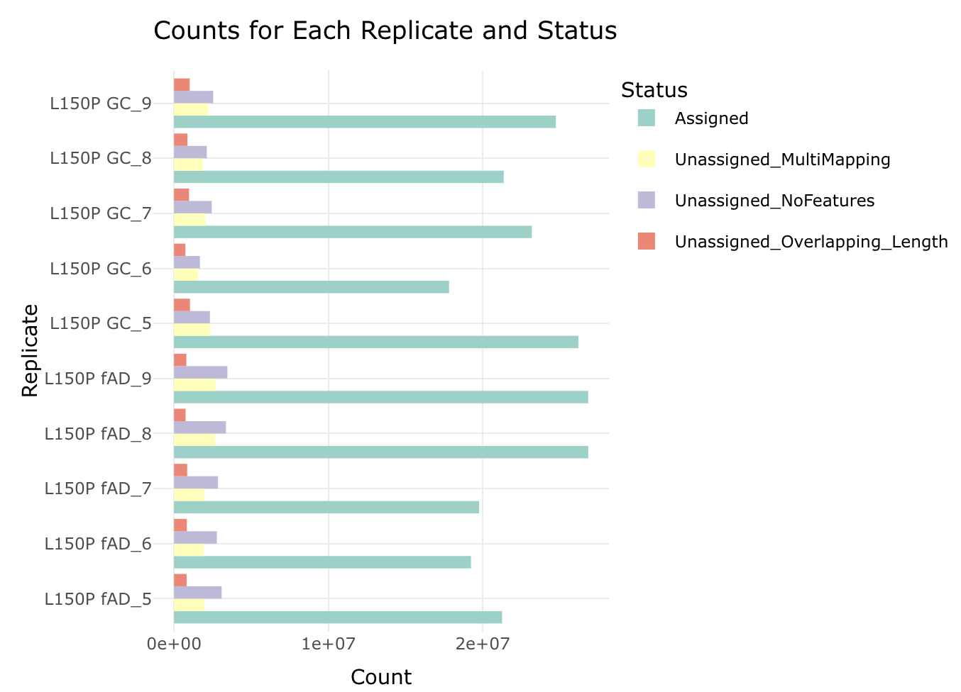
Results
Notes:
GC – gene corrected vi CRIPSR CAS9

Slide 5
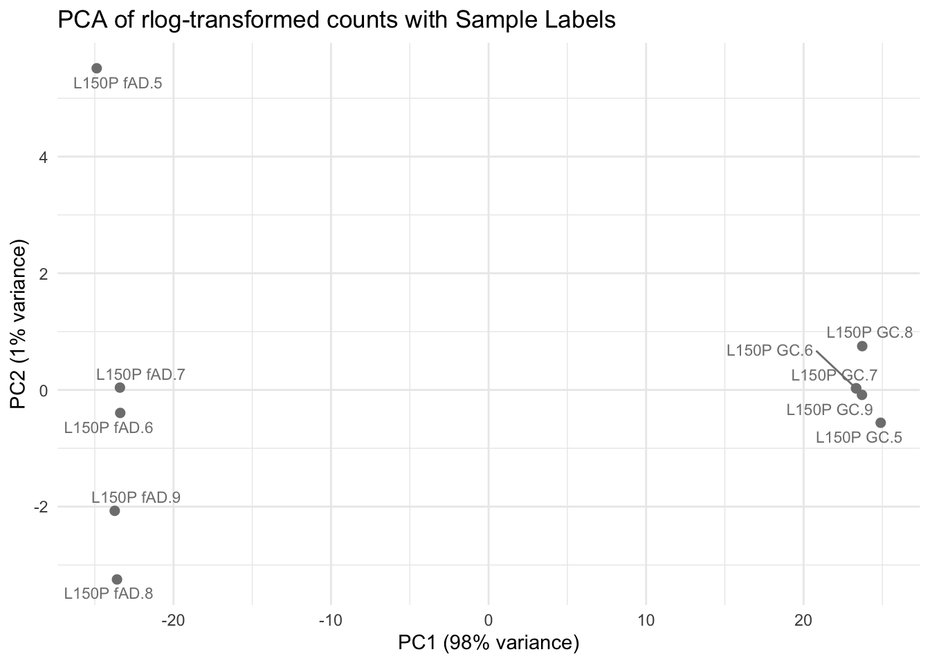
Results
Notes:
PCA plot just to verify that L150P mutation has potential to drive transcriptional changes.

Slide 6
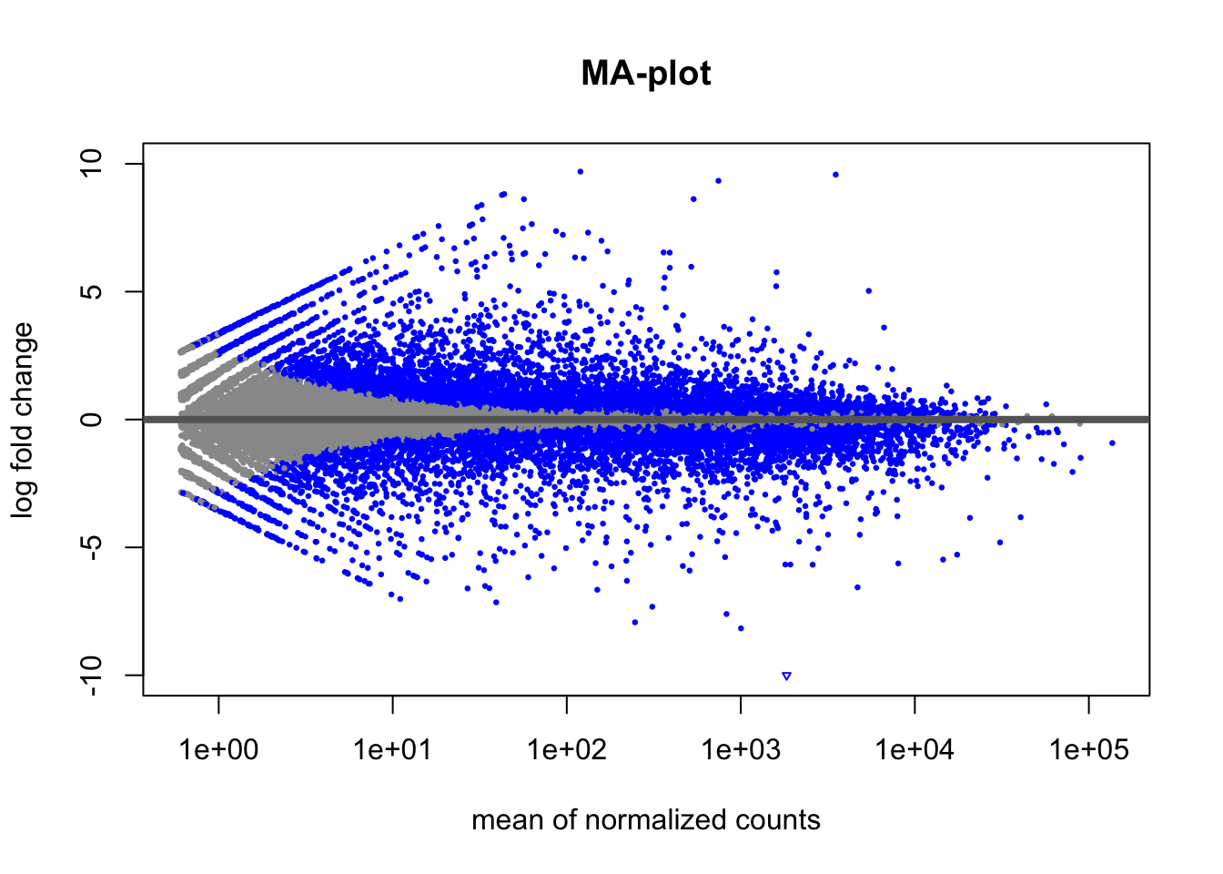
Results
Notes:
The blue points represent genes that are significantly differentially expressed, with their dispersion reflecting the strength and direction of differential expression. The majority of genes do not exhibit significant changes in expression (grey points), indicating stable expression across the conditions compared.

Slide 7
Results
Notes:
Out of around 75 thousand genes, around 4 thousand were differentially expressed and significant

Slide 8
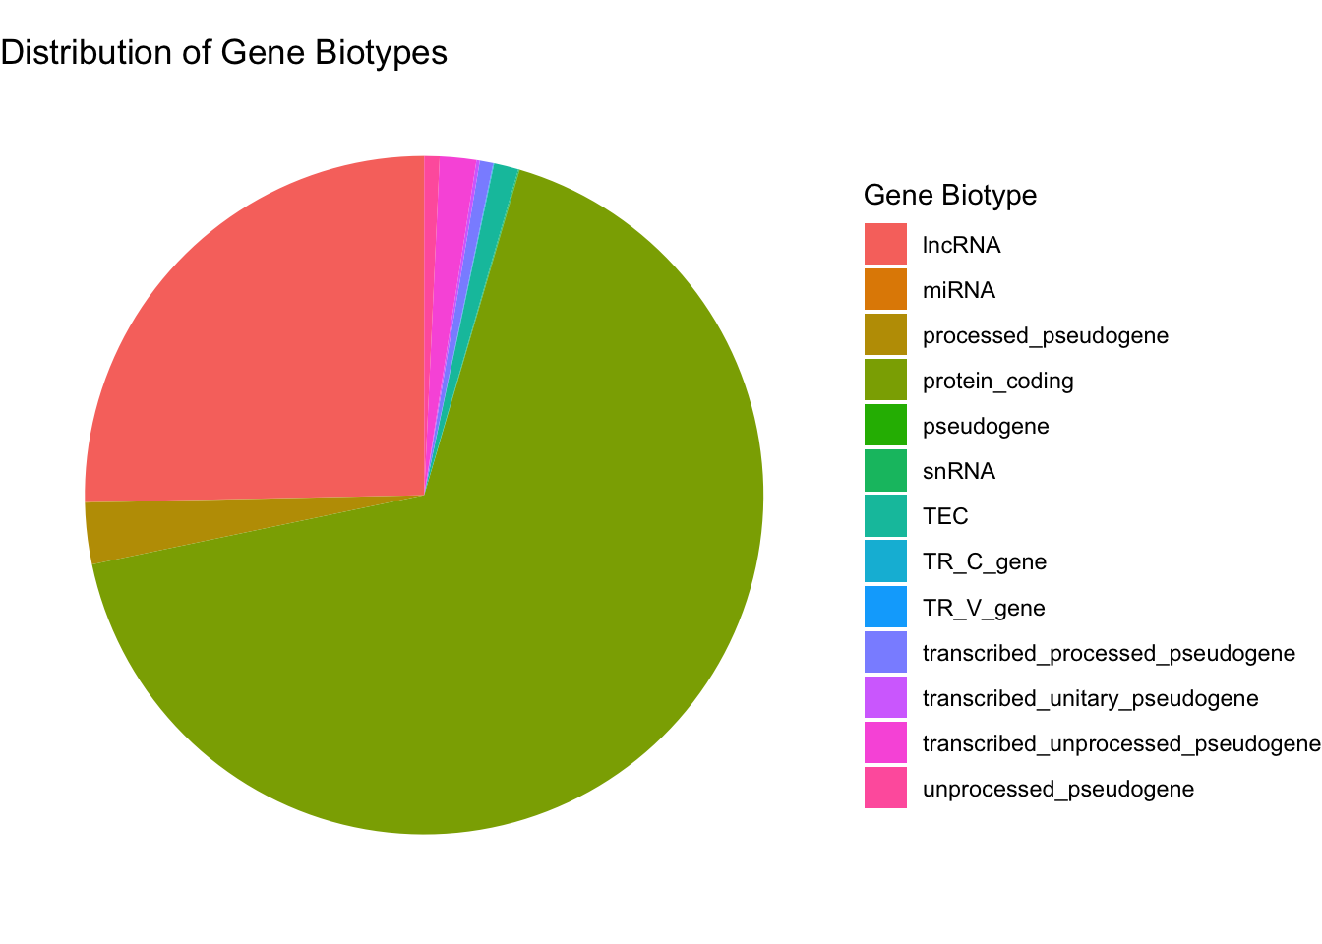
Results
Notes:
I was interested in protein-coding genes so I have filtered out all non protein-coding genes and here is the summary.
Eventually I got left with 2.9 thousand protein coding, significant, differentially expressed genes. Wordy

Slide 9
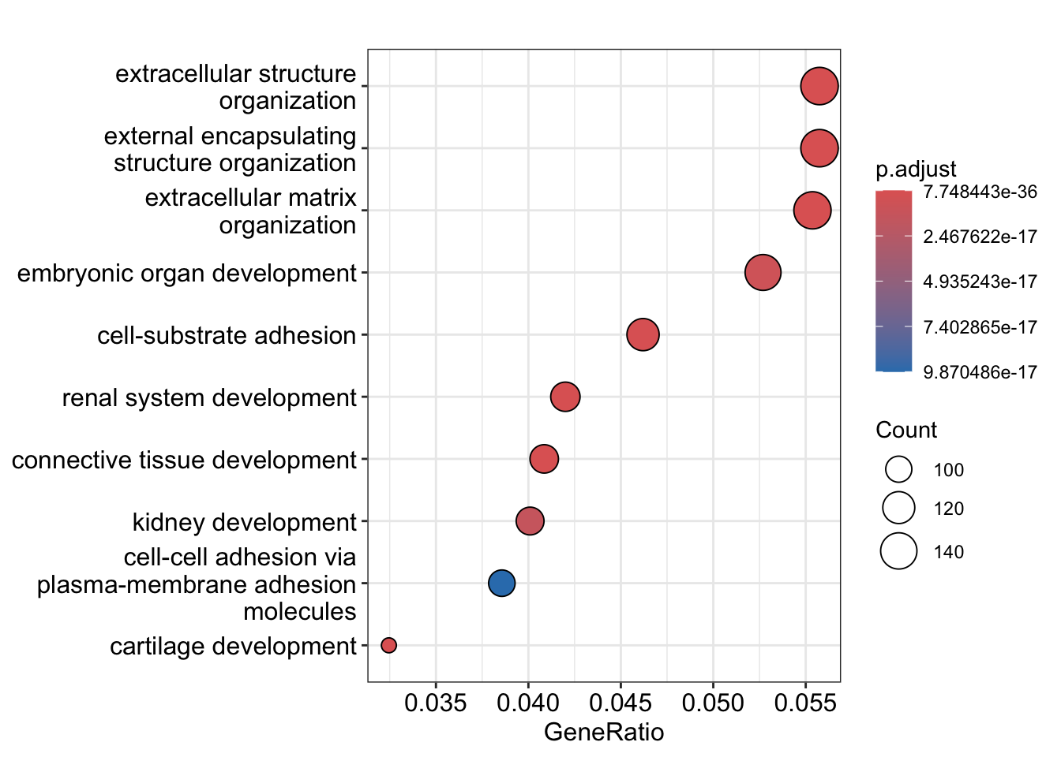
Results - Biological Processes
Notes:
These are my Gene ontology plots for Biological Processes,

Slide 10
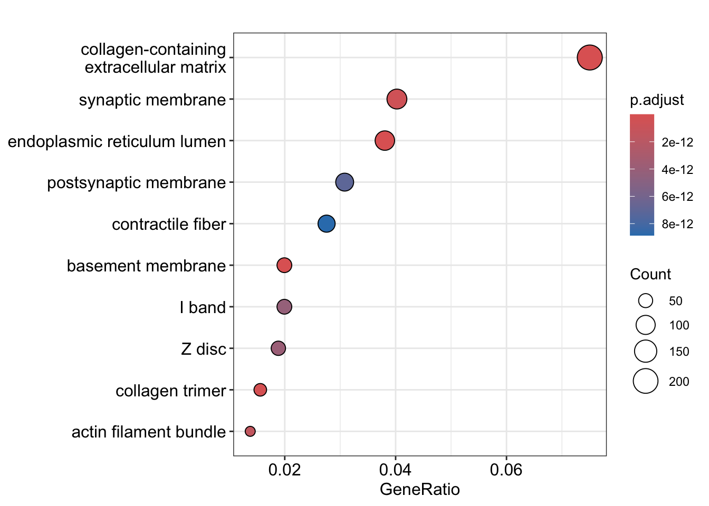
Results - Cellular component
Notes:
Cellular component

Slide 11
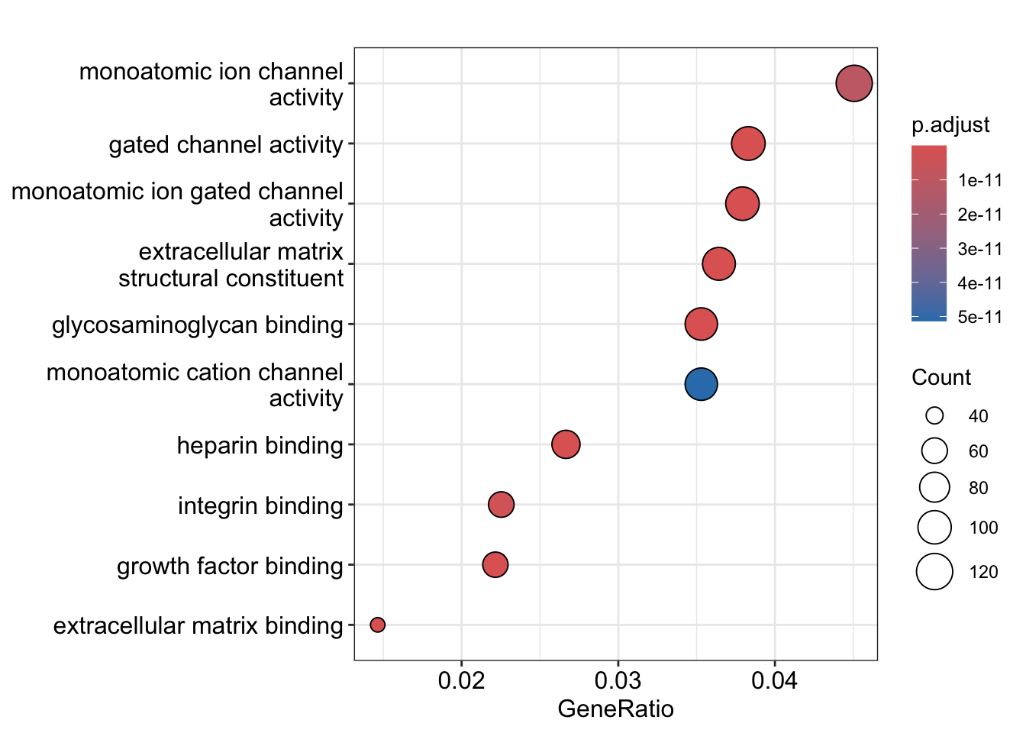
Results - Molecular function
Notes:
And molecular function

Slide 12
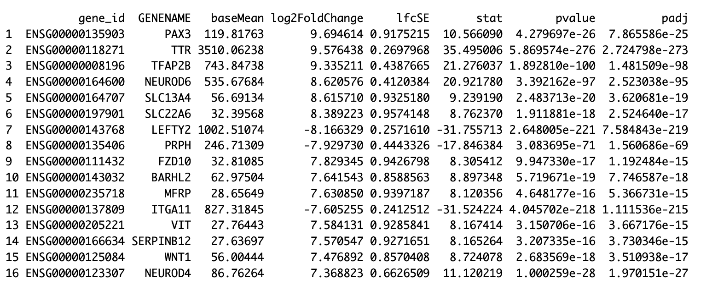
Results
Gene Ontology (GO) enrichment analysis highlighted significant dysregulation in biological processes and cellular components related to the extracellular matrix.
Among genes:
ITGA11
WNT1 & FZD10
TTR
SERPINB12
Notes:
Gene Ontology (GO) enrichment analysis highlighted significant dysregulation in biological processes and cellular components related to the extracellular matrix, confirming our hypothesis. Key GO terms such as extracellular matrix organization, collagen-containing extracellular matrix, and extracellular structure organization were among the most significantly enriched.
I would like to highlight the following downregulated genes:
ITGA11 - play a crucial role in cell-matrix adhesion and are involved in the structural organization of the ECM
The second pair – are part of WNT pathway that is vital for various developmental processes, including those that influence ECM maintenance and cell interactions with their environment
TTR - It can bind and stabilize amyloid-beta, potentially reducing amyloid plaque formation, which is a hallmark of Alzheimer’s disease
And the last one takes part in regulating protein breakdown that maintains the matrix’s integrity

Slide 13
Limitations
Not the most “optimal” code.
Custom annotation file.
Analyzing protein-coding genes only.
Small sample size (5 fAD vs 5 control )
Notes:
I believe some of my script or code chunks could be rewritten in a simpler and faster manner. Sometimes, I overthink, and a small, easy problem turns into 50 lines of code.
Custom annotation file is the reason why I have so many genes. It combines GENCODE and FANTOM-CAT annotations. Overall, it follows the standard GFF2 protocol, but not all gene IDs are formatted consistently. Most of them are Ensembl identifiers, but approximately 15-20% are CAGE identifiers, which are not widely used, resulting in a lack of tools or libraries in R for mapping CAGE to Ensembl identifiers. I had to import the annotation file and write code that would extract reference gene IDs and map CAGE ones to Ensembl in order to analyze my dataset properly.
I have only looked at protein-coding genes, but there is even more information behind the scenes

