Slide 1

How hand-crafted features improve transformer networks
Miriam Anschütz, Georg Groh
Technische Universität München
Department of Informatics
Research Group Social Computing
Potsdam, 12th September 2022
Notes:
When you watch a movie; do you tend to indentify and sympathesize with the underdogs? Well, I do…

Slide 2



Shared task objective
[1]
1
7
Goal: Predict complexity of text
Data: German sentences
Targets: Continuous complexity scores between 1 and 7
Notes:
Dataset hand-labeled
1 low complexity

Slide 3
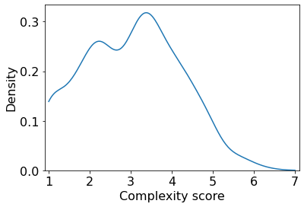
Discussion: Dataset challenges
The director of the Nobel Institute represents the secretary of the committee.
Complexity Score: 1.0
Notes:
Only 2 with complexity > 6

Slide 4

Selection of hand-crafted features for prediction
Sentence length
Readability formulae
Depth of dependency tree
…
Notes:
Vector of 6 formulae, 6 statistics

Slide 5
Results: Support vector regression (SVR) with hand-crafted features
Notes:
Fitted SVR!
Evaluation with Mapped RMSE,
Reduce bias / oddest -> mapped score
0,65

Slide 6
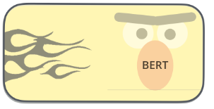
State of the art: Transformer end-to-end models
[2]
Input sentence
Complexity score
Distil
Notes:
Models like BERT, T5, ..
No preprocessing
Fine-tuning

Slide 7

State of the art: Transformer end-to-end models
[2]
Distil

Slide 8
Results: Hand-crafted features vs. Transformer
Notes:
See expected result
0.399
0.404
0.460

Slide 9
Transformer model: Explaining predictions
This process is called glacier recession or glacier melt.
Notes:
Base value -> each word shifts into either direction
Correct score 2.27
Process not complex

Slide 10


What about combining the feature spaces?

Slide 11
Combined feature spaces: approach
Readability formulae
Sentence length
…
Input sentence
[2]
Notes:
Remove classification head

Slide 12
Results: Performance of combined model
Notes:
Why SVR again? Distil with statistics worse

Slide 13
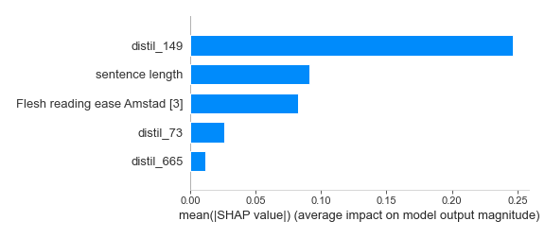
Analysis: Relevant features in combined model
[4]
Notes:
Masking perturbations of features -> measure how much prediction changes
Distil -> index in vector
Top 5 features

Slide 14

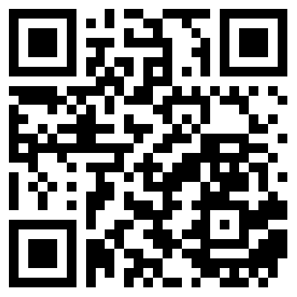

Conclusion: Feature ensemble most successful
4.
Check our code on GitHub!
Notes:
Feature ensemble 4. place

Slide 15
References
https://qulab.github.io/text_complexity_challlenge/assets/logo2.png
https://jalammar.github.io/illustrated-bert/
Toni Amstad. 1978. Wie verständlich sind unsere Zeitungen? Ph.D. thesis, Universität Zürich.
Scott M Lundberg and Su-In Lee. 2017. A unified approach to interpreting model predictions. In I. Guyon, U. V. Luxburg, S. Bengio, H. Wallach, R. Fergus, S. Vishwanathan, and R. Garnett, editors, Advances in Neural Information Processing Systems 30, pages 4765–4774. Curran Associates, Inc.

Slide 16
Appendix: Hand-crafted features
Readability formulae:
Flesh reading ease
Wiener Sachtextformel 1-4
SMOG
Statistical features
Sentence length
Maximal dependency tree depth
%words with ≥ 6 letters
Average number of syllables
%words with 1 syllable
%words with ≥ 3 syllables

Slide 17
Appendix: Including hand-crafted in DistilBERT model

