Slide 1
Install R

Slide 2
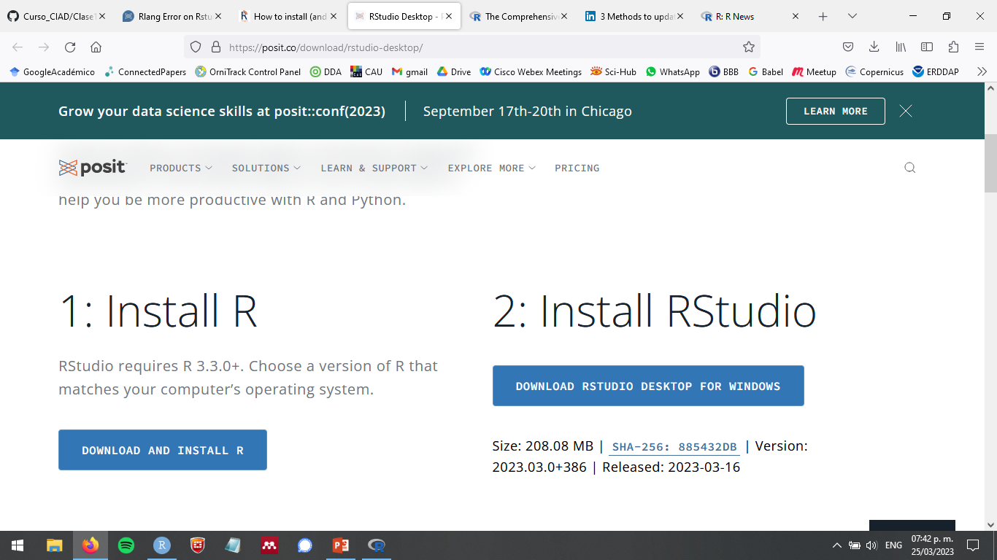

Slide 3
Update R

Slide 4
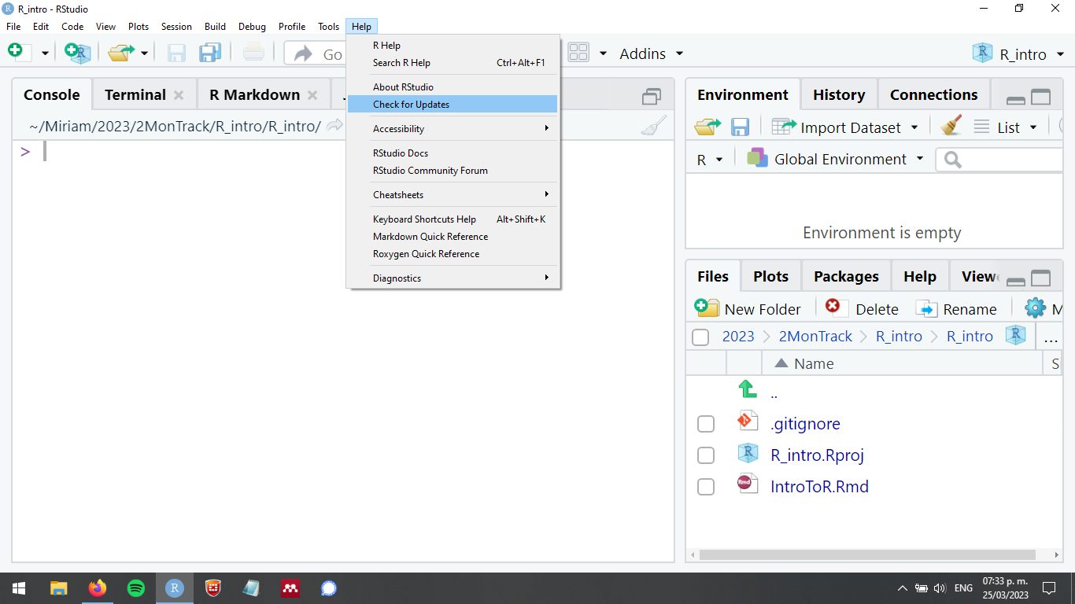

Slide 5
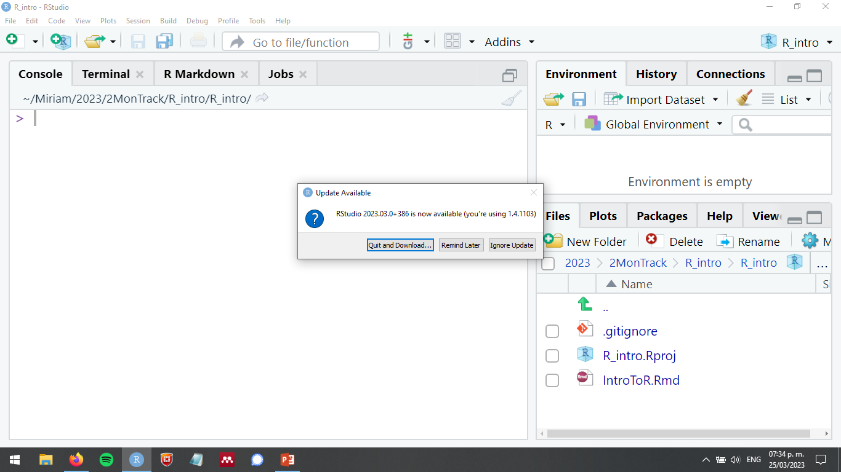

Slide 6
https://posit.co/download/rstudio-desktop/

Slide 7
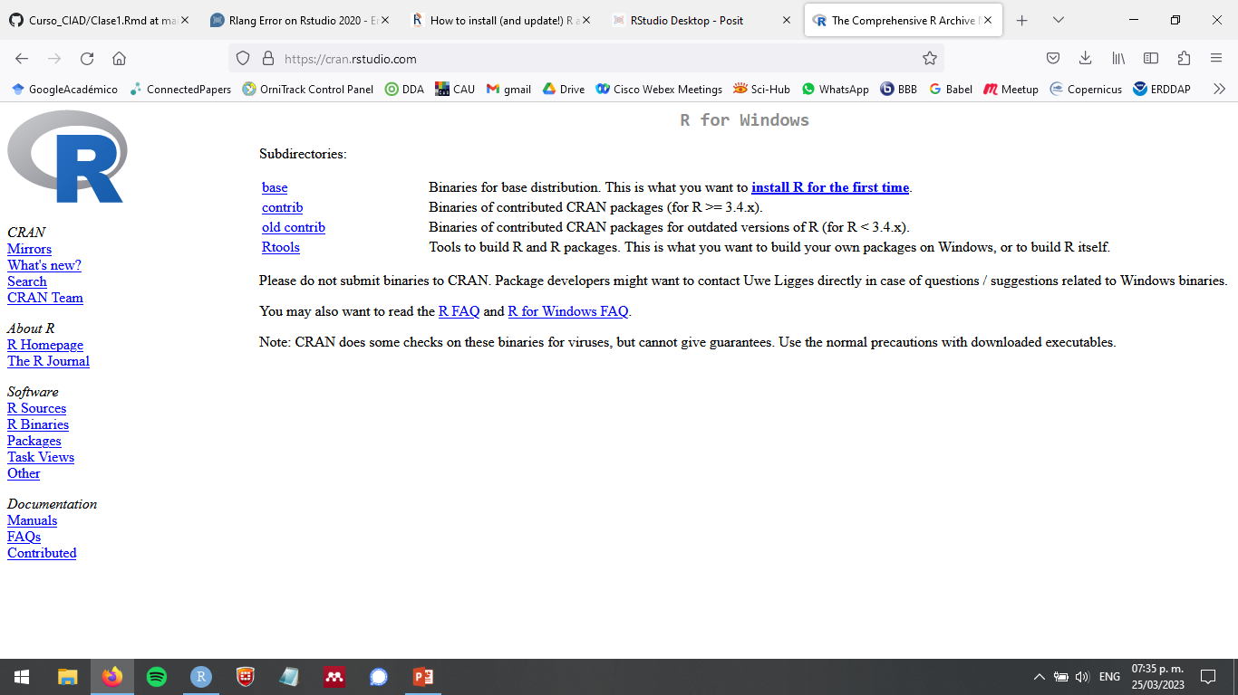

Slide 8
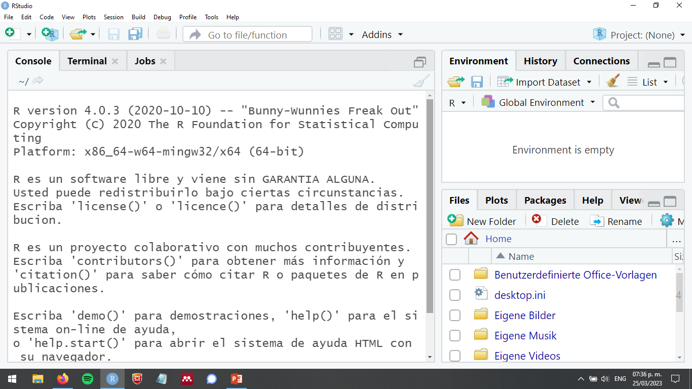

Slide 9
install.packages("installr")
library(installr)
updateR()

Slide 10
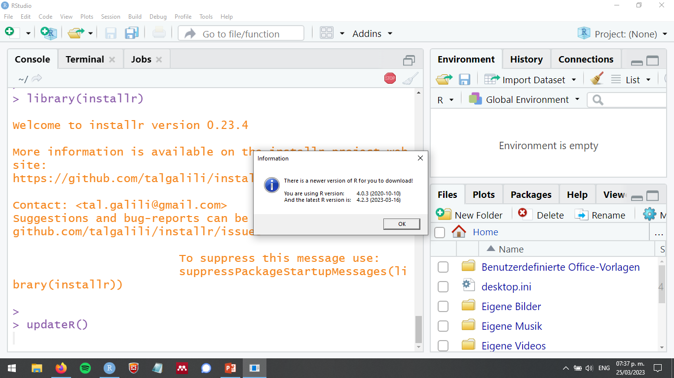

Slide 11
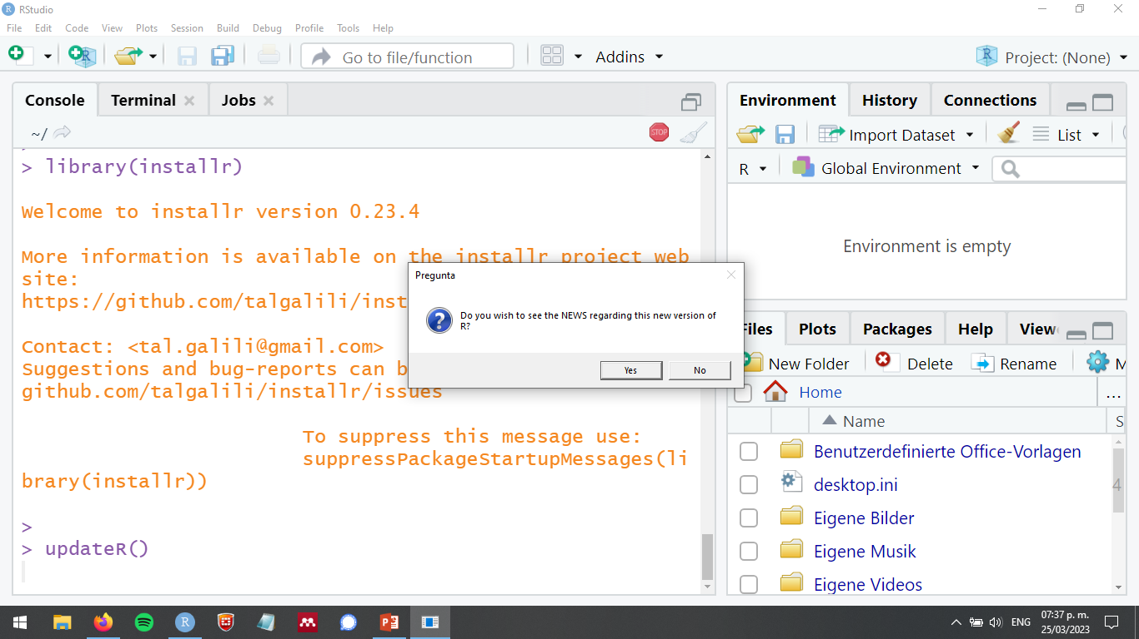

Slide 12
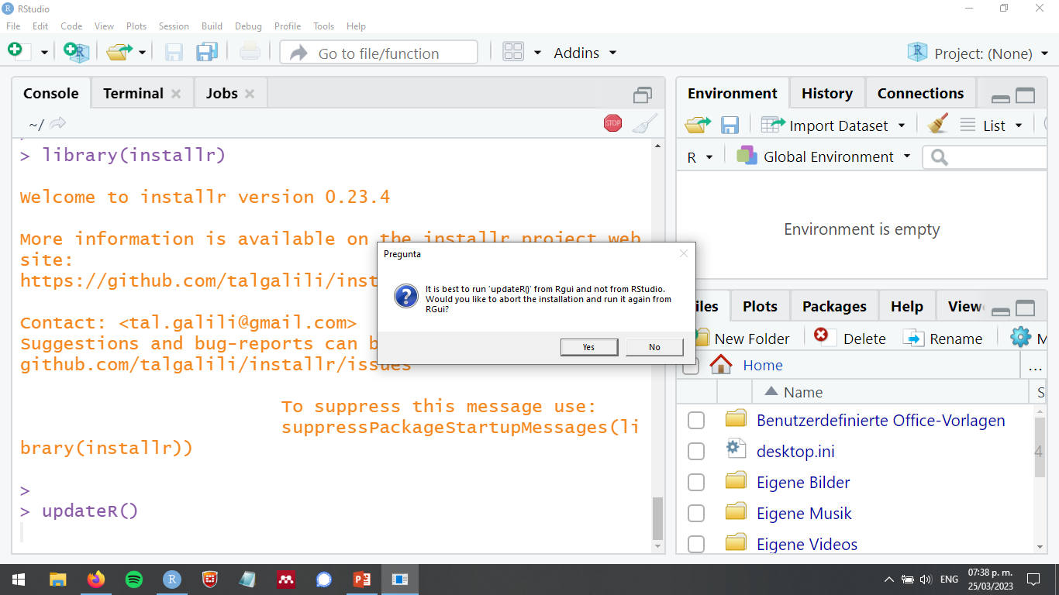

Slide 13
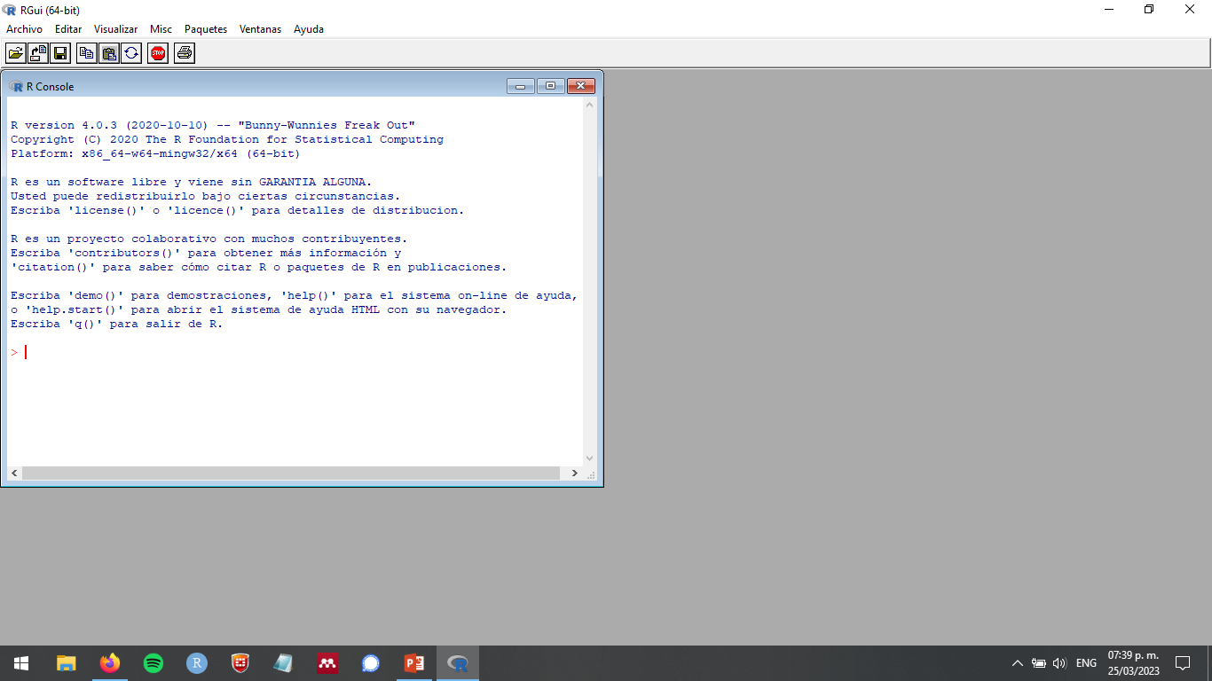

Slide 14
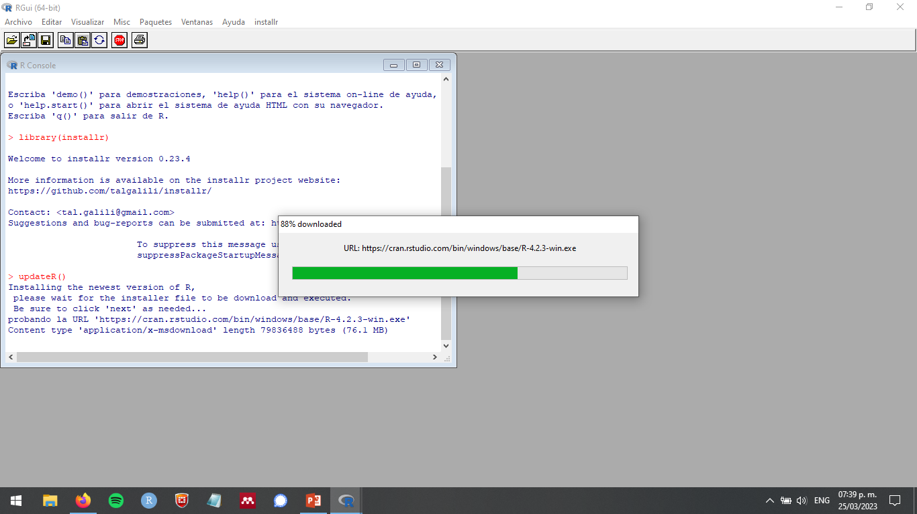

Slide 15
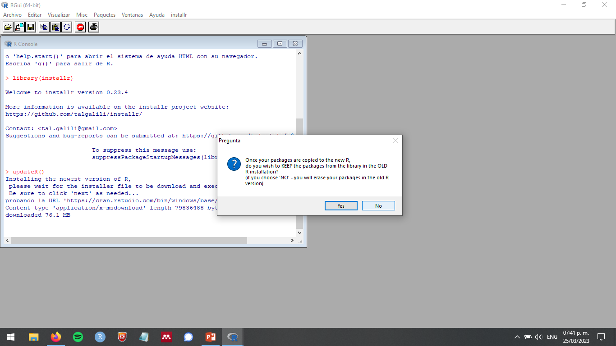

Slide 16
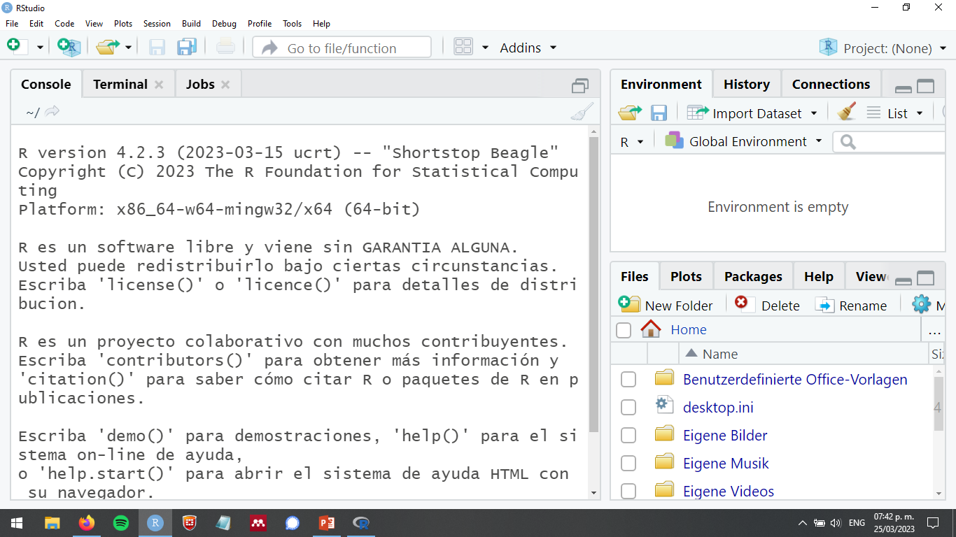

Slide 17
Update RStudio

Slide 18
“sessionInfo()”
https://bookdown.org/pdr_higgins/rmrwr/updating-r-rstudio-and-your-packages.html

Slide 19
“sessionInfo()”

