Slide 1
AI
ChatGPT and other tools
Feb 2025
Miriam Lerma & Dagmar Cimiotti

Slide 2

Artificial Intelligence
The term ‘artificial intelligence’ (AI) was first coined by John McCarthy at a conference in Dartmouth in 1956. Since then, a lot has happened.
Large language models (LLM) are a type of AI and have enormous value across the entire value chain of research.
They have potential applications in the automation of research techniques
Generating a hypothesis (ChatGPT)
Searching for content and get the sources (“grey” literature, laws, scientific publications; perplexity.ai)
Searching scientifically published content (scite, connectedpapers)
- Assist in writing scripts for QGIS (Quantum GIS) and R programming, and Excel-questions (ChatGPT)
Detecting plagiarism (quillbot)
Improving readability (Grammarly, ChatGPT)
Translating (deepl)
Creating pictures for presentations / posters (Image Creator from Bing)
Picture: Made with Image Creator from Bing.com
Source: ResearchToAction
Notes:
There are more possibilities. Just a selection.
https://www.researchtoaction.org/2024/04/ai-in-research-its-uses-and-limitations/

Slide 3
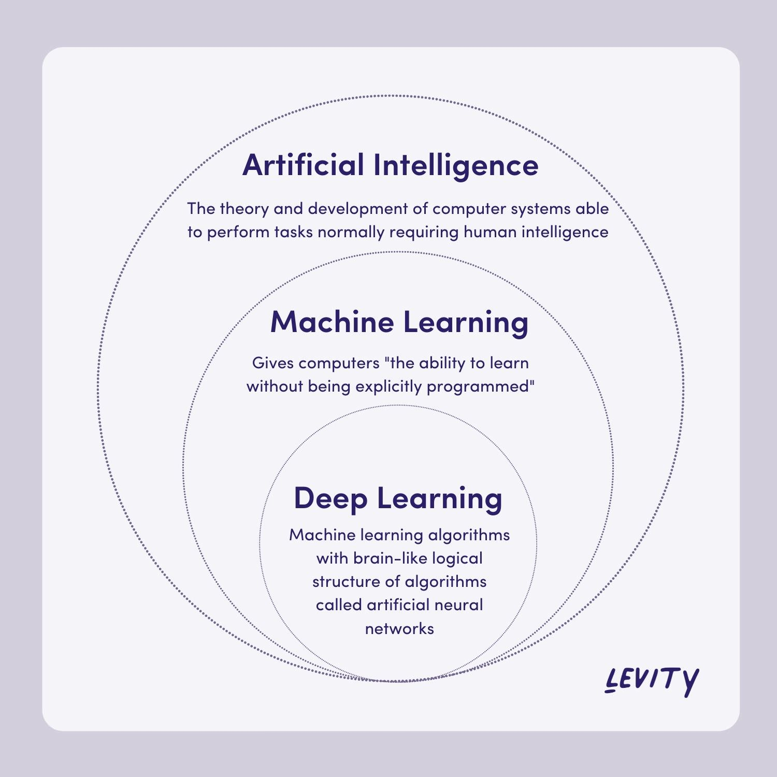
Limitations
AI relies heavily on the quality of input data and researchers need to be mindful of this fact.
Biased or incomplete datasets can lead to inaccurate insights.
Additionally, it can be extremely difficult – and sometimes impossible – to know how complex machine learning models have arrived at a particular decision.
This is known as the ‘black box’ problem and means it can be challenging for humans to understand how the model arrived at a particular conclusion or prediction based on its input data.
Source: ResearchToAction, brilworks
Notes:
https://www.researchtoaction.org/2024/04/ai-in-research-its-uses-and-limitations/

Slide 4

ChatGPT?
OpenAI announced the groundbreaking release of ChatGPT in 2022, an online chatbot that enables users to interact with the GPT-3.5 language model.
ChatGPT is a type of narrow AI (also known as weak AI) because it is designed to perform specific tasks, such as natural language processing and generation, within a defined scope. It does not possess general intelligence or self-awareness, and its capabilities are limited to the tasks it's trained on, such as answering questions and generating text based on input.
ChatGPT creators include Ilya Sutskever, chief scientist and cofounder OpenAI. His company was showered with billions of dollars by Microsoft. Among founders are Elon Musk and Amazon Web Services.
TedTalk
Notes:
https://www.researchtoaction.org/2024/04/ai-in-research-its-uses-and-limitations/

Slide 5
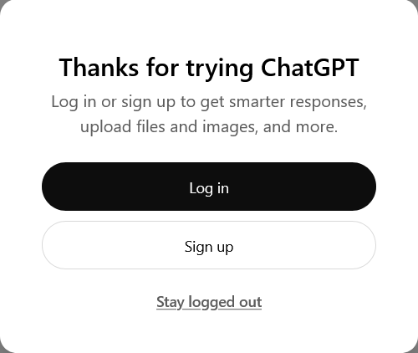
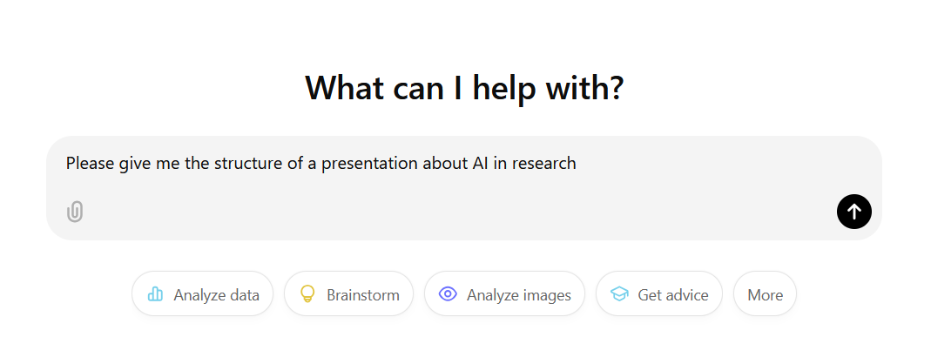
Trying ChatGPT
Options:
Link: webpage https://chatgpt.com/
- Newest update: Jan. 2025 (Version ChatGPT 4omini)
- Free
Why „Log in?“
→ More personalysed and continous support (timeline).
Not really necessary.

Slide 6
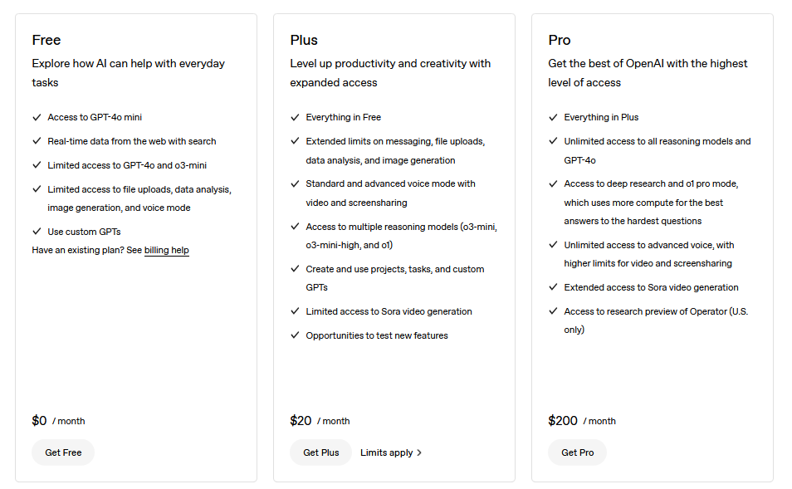
Trying ChatGPT
Options:
Link: webpage https://chatgpt.com/
ChatGPT Plus:
Necessary to log in
23 EUR
Always newest ChatGPT version possible
More “thinking processes” before answering
Still fast and working when too many people use ChatGPT

Slide 7

Trying ChatGPT
Options:
Link: webpage https://chatgpt.com/
ChatGPT Plus
App:
Just nicer to handle on smartphone. Same functions as web version.

Slide 8
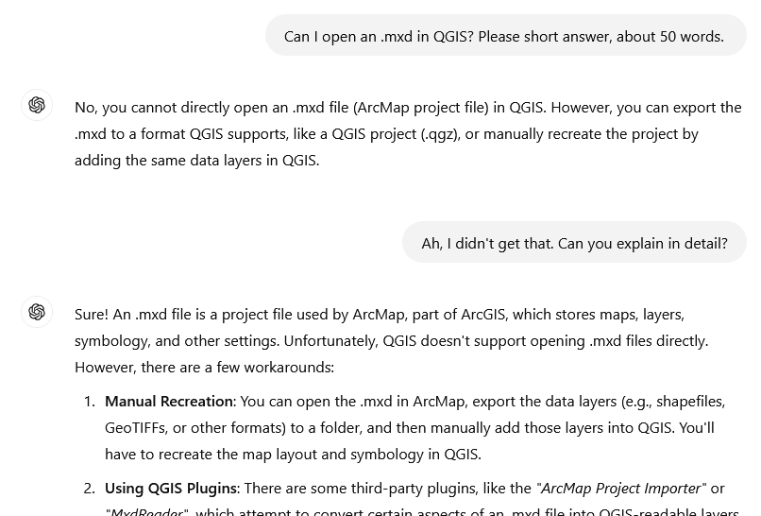
Trying ChatGPT
For tutorials and problem solving:
- Incredibly helpful and time saving

Slide 9
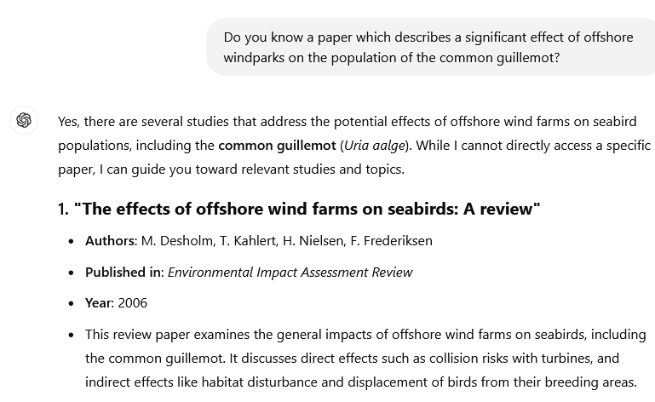
Mistakes in ChatGPT
For literature search:
- Journal exists
- Authors exist
Paper: Doesn‘t exist
Source: https://chatgpt.com

Slide 10
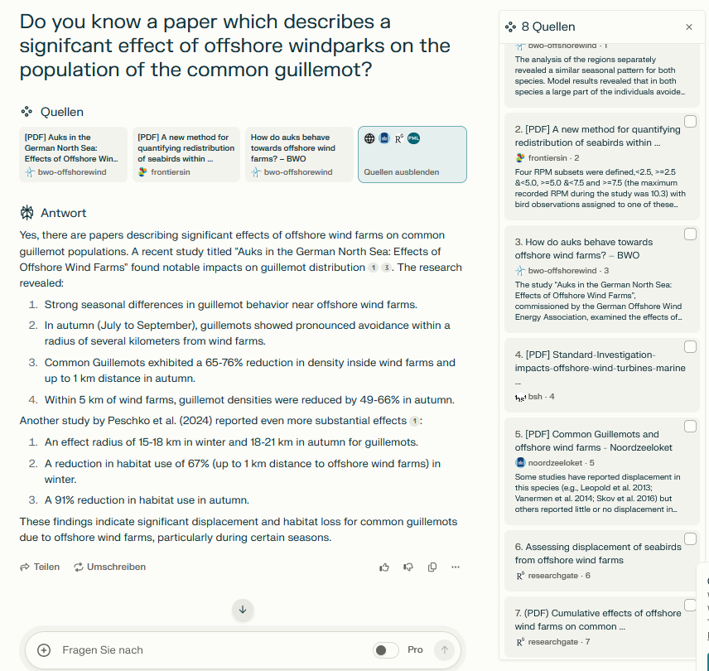
Perplexity.ai
For literature search:
Includes grey literature
Peer-review and grey literature seem to be considered equally relevant
Gives data-resources with links

Slide 11
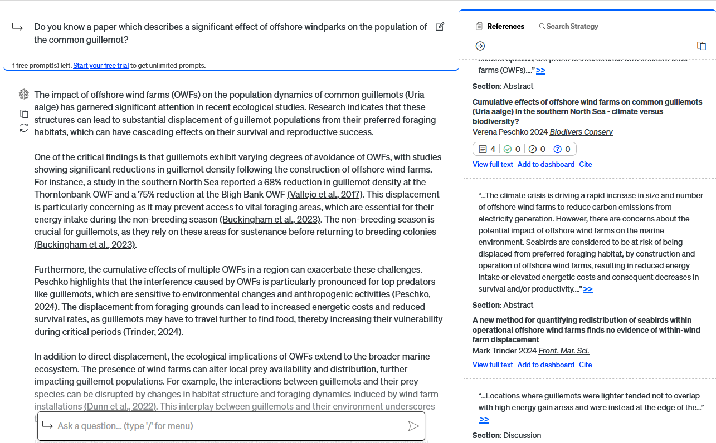
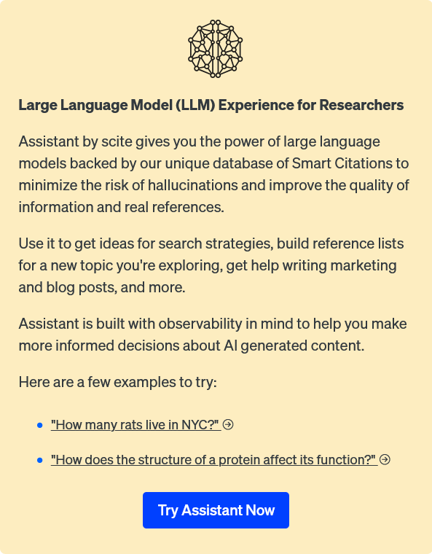
Scite.ai
For literature search:
Helpful but limited in the number of free prompts
Information still needs to be double-checked

Slide 12
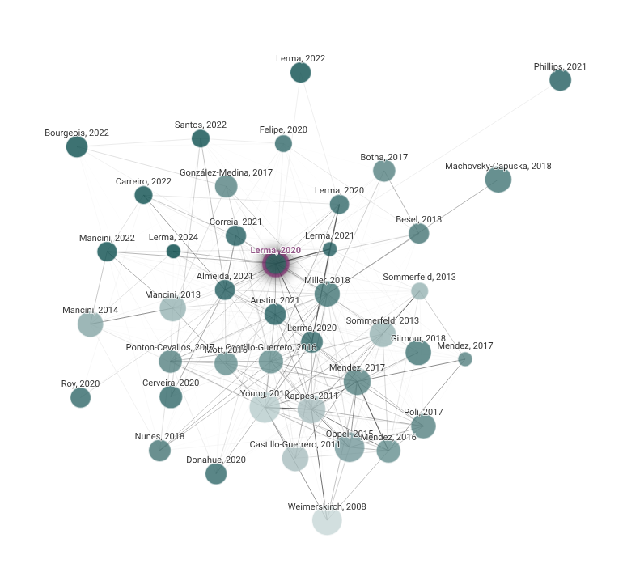
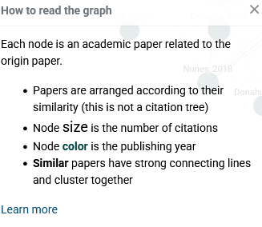
Connected papers
For literature search:
Helpful for literature search, but most (if not all) literature must have a doi.
Source: Connected papers

Slide 13


AI Europe alternatives
- Mistral AI (France)
- Aleph alpha (Germany)
Source: arte

Slide 14
In Research: Journals
Declaration of generative AI in scientific writing
Authors must declare the use of generative AI in scientific writing upon submission of the paper. The following guidance refers only to the writing process, and not to the use of AI tools to analyze and draw insights from data as part of the research process:
Generative AI and AI-assisted technologies should only be used in the writing process to improve the readability and language of the manuscript.
The technology must be applied with human oversight and control and authors should carefully review and edit the result, as AI can generate authoritative-sounding output that can be incorrect, incomplete or biased. Authors are ultimately responsible and accountable for the contents of the work.
Authors must not list or cite AI and AI-assisted technologies as an author or co-author on the manuscript since authorship implies responsibilities and tasks that can only be attributed to and performed by humans.
The use of generative AI and AI-assisted technologies in scientific writing must be declared by adding a statement at the end of the manuscript when the paper is first submitted. The statement will appear in the published work and should be placed in a new section before the references list.
Source: Journal of Experimental Marine Biology and Ecology
Notes:
https://www.sciencedirect.com/journal/journal-of-experimental-marine-biology-and-ecology/publish/guide-for-authors

Slide 15
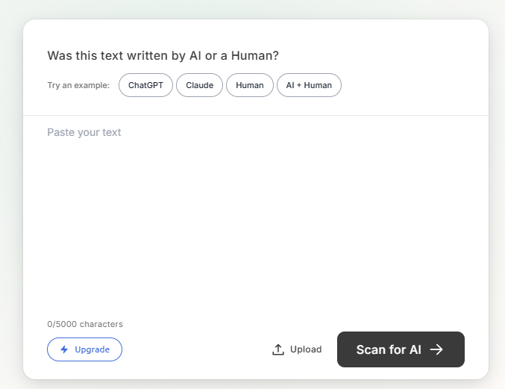
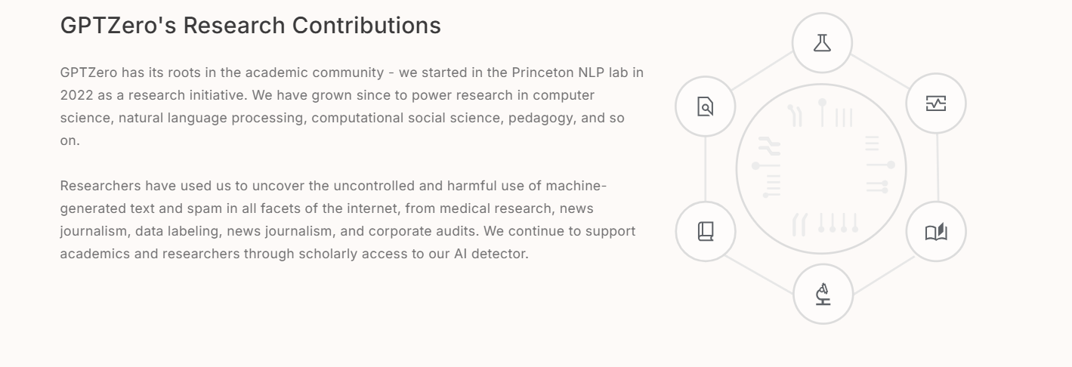
In Research: Reviewers
Reviews can be discarded if they are found to be primarily generated by an AI software.
Journals are using AI detectors to identify if the review was human generated. For example: gptzero
Notes:
(https://gptzero.me/),

Slide 16

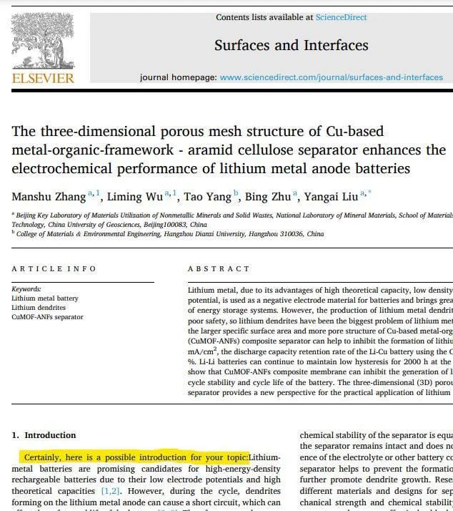
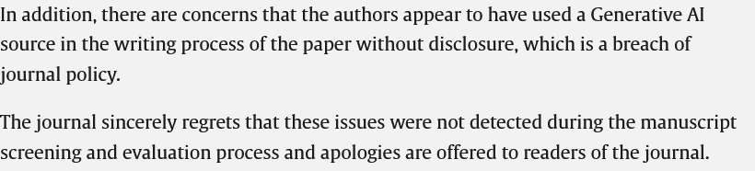
In Research: Authors
Authors should be careful when using this technology and carefully review and edit the result. Authors are ultimately responsible and accountable for the contents of the work.
Source: Surfaces and interfaces
Notes:
https://www.sciencedirect.com/science/article/pii/S2468023024002402

Slide 17
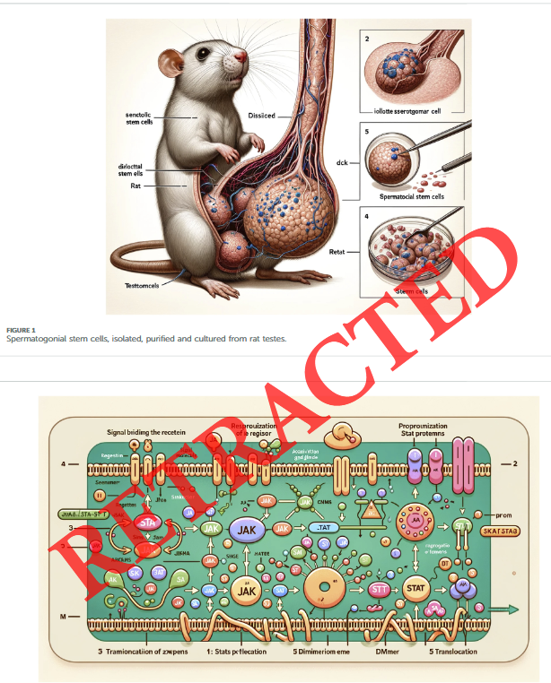



In Research: Authors
Images generated using AI also had been retracted.
There are negative implications while using misleading images.
Source: Frontiers, Nature.

Slide 18
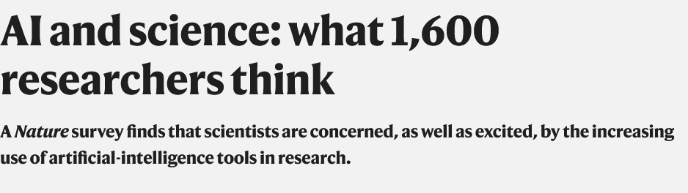
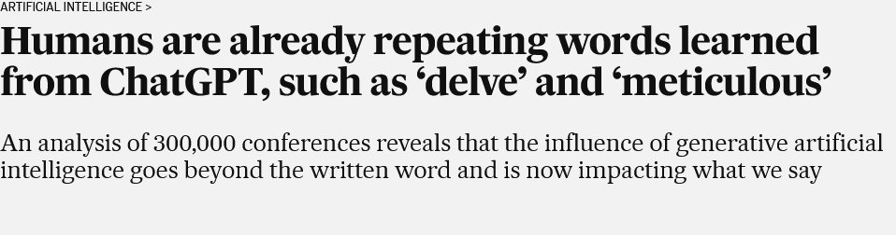
Potential
ChatGPT and its counterparts are here to stay. For this reason, it is crucial to understand its capabilities in the research field, as well as its limitations and potential ethical shortcomings.
Source: Nature
Source: ResearchToAction

Slide 19
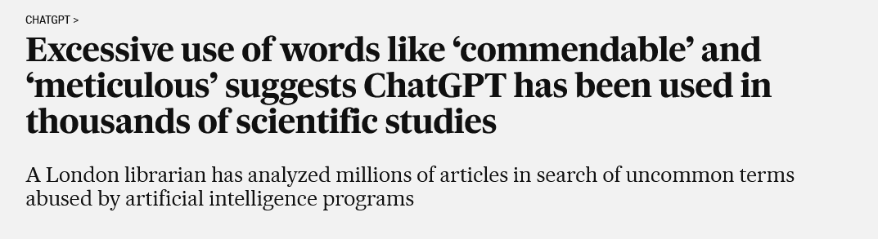
Change in language
Source: El Pais Newspaper
Notes:
https://english.elpais.com/technology/2024-10-24/humans-are-already-repeating-words-learned-from-chatgpt-such-as-delve-and-meticulous.html

Slide 20
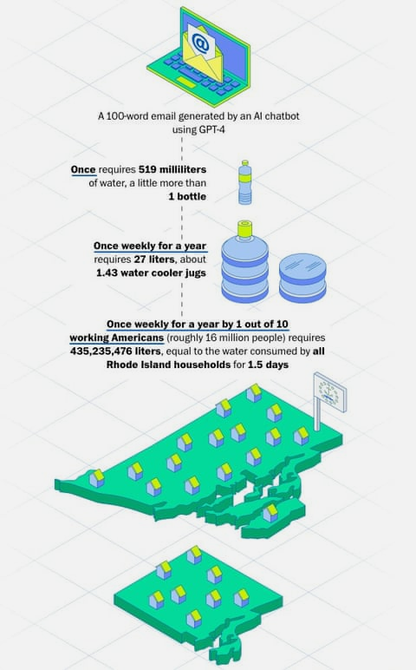
Environmental impacts
There is a negative side to the explosion of AI and its associated infrastructure, according to a growing body of research.
The proliferating data centers that house AI servers produce electronic waste.
They are large consumers of water, which is becoming scarce in many places.
They rely on critical minerals and rare elements, which are often mined unsustainably.
And they use massive amounts of electricity, spurring the emission of planet-warming greenhouse gases.
Source: UNEP
Source: The Guardian (Washington post)
Notes:
https://www.unep.org/news-and-stories/story/ai-has-environmental-problem-heres-what-world-can-do-about

Slide 21

Take-home messages
AI tools are here to stay, and many researchers are already using them.
AI tools save us a lot of time, but we must be careful when evaluating the responses they give us; critical thinking becomes key. Do not blindly trust the information—always double-check.
We must also be mindful of using these technologies, as they have a real impact on the environment.

