Slide 1

Where to publish?
A guide from by an ornithologist to ornithologists

Slide 2
Does your manuscript fit the scope of the journal?
Yes
No
The institution can cover the fees, or the authors are part of the society publishing and do not need to cover fees.
Do you have coverage of the publication fees?
No
Does the journal offer waivers?
Yes
No
Is doi, peer-reviewed and impact factor an academic evaluation’s requirement?
No
Search for a journal that fits your scope
Go ahead, send it!
We want to read you!
Consider that you might incur in additional cost
Consider that it might still reach your expected audience
Yes
Yes
Do you have limited time for publishing?
No
Yes
Check the times from submission to publication
Go ahead, send it! We want to read you!
Go ahead, send it! We want to read you!
Decision Tree: Choosing the Right Journal
Selecting the right journal for your manuscript can be a complex and time-consuming process, as it depends on various factors specific to your work. To assist with this decision, I’ve provided a schematic representation that outlines key considerations, helping you navigate the process more effectively.

Slide 3
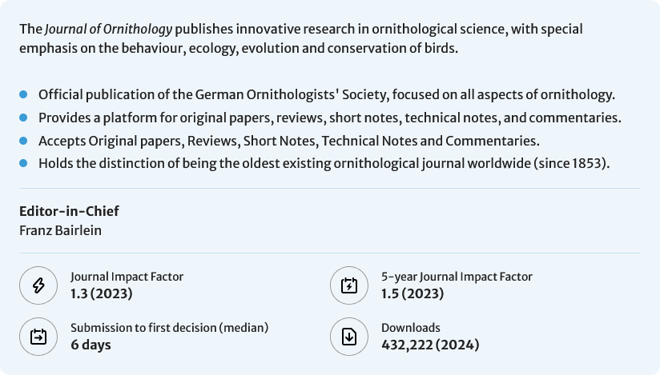
1. Scope of the journal
Limit your search to journals that publish research on your topics of interest, such as conservation, ecology, and ornithology.
Additionally, you may consult your list of references to identify which journals have consistently published on these subjects.
Note that some journals, despite having a history of publishing on certain topics, may have shifted their focus over time and may no longer align with their current areas of interest.

Slide 4
2. Open access
Some journals use a hybrid model, while others are fully open access. The primary advantage of open access (OA) is that it allows everyone to access your publication without encountering paywalls, ensuring wider visibility and accessibility of your research.
In the case of open access journals, authors are required to cover the publication fees. These fees can vary significantly, with some journals, such as those published by Springer, charging around €3,000, while others, like Nature, can charge up to €10,000.
Finding an appropriate journal for publication can be challenging if you lack the necessary funding to cover these costs.
Notes:
https://thepublicationplan.com/2024/08/27/are-article-processing-charges-really-increasing/

Slide 5

2. Open access
If you are in Germany, for example, at Kiel University, this institution is part of the DEAL project, which covers publication fees for certain journals. To the best of my knowledge, these fees are covered using library funds.
Is your institution part of the DEAL project? You can check the lists provided by Wiley or Elsevier.
If you are from countries in Latin America (like myself), some journals offer waivers or discounts on publication fees. It is advisable to check with Wiley.
If you published after leaving the University, but your work was made during your stay you might still be eligible. After submitting the paper, the university might contact you just to make sure you work was made while affiliated.

Slide 6
2. Open access
Here is a list of the journals covered by the project DEAL:
Wiley
Elsevier
Springer Nature
The provided links downloads an Excel sheet containing the list of eligible journals.
Keep in mind that the lists are periodically updated.

Slide 7
3. Impact factor
The use of the impact factor is very debatable. It may provide an indication of the potential audience your paper could reach. As well, it might increase career prospects and academic credibility.
For some academic evaluations, publishing in high-impact journals may be a key consideration. High impact publications increase the chances of securing funding, as funders often evaluate researches based on their success in publishing in these journals.
Many journals have their impact factor listed in their webpage.

Slide 8
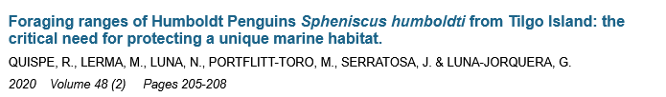
4. DOI and Peer-review
A DOI (digital object identifier) is a unique alphanumeric string associated to a document making it easily accessible and identifiable on the internet.
Peer-review is the process where experts from a specific field evaluate the quality of a peer's research assessing their validity and quality. Usually, two or three reviewers are assigned to a manuscript.
Some journals do not have doi, and therefore they might not be considered during academic evaluations, even if they went into peer-review.
If doi is crucial for credibility during academic evaluations, you should consider if the journals has a doi before sending your manuscript.
However, consider that journals that do not provide doi might still reach your expected audience.

Slide 9
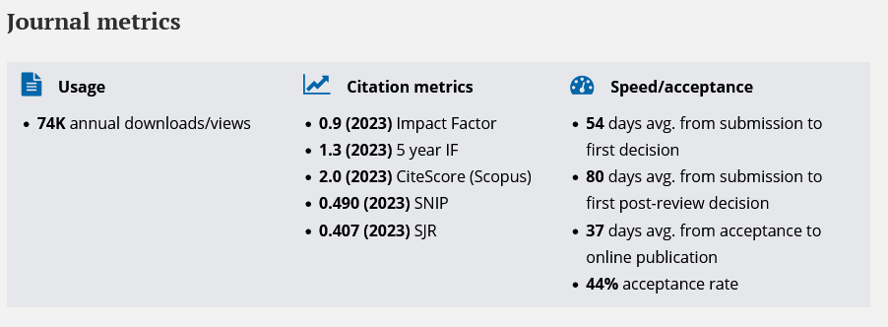
5. Publication time
The publication frequency of a journal can significantly impact how long you'll have to wait for your paper to be published after submission.
Journals that publish less frequently, such as annually or quarterly, typically have a longer wait time from submission to acceptance and eventual publication.
Check the journal's website for details on the average time to acceptance and publication. Usually, you can find the information of days to acceptance on the journal page.
This can help you set expectations and plan accordingly, especially if you're working on a tight timeline.

Slide 10
Personal experience
1. Scope: Based on the topic, I have targeted journals in Ornithology, Ecotoxicology, Physiology, or Ecology.
2. Open access: I prefer open access when the institution covers it. If this is not possible, I have asked for waivers (particularly on Latin American studies). If this is not possible, submitting to a a journal that has no publication fees is also an option – although it might be behind a pay-wall once published.
3. Doi, peer-review and impact factor: I prefer journals that offer doi. Peer-review is a most. For impact factor, most ornithological journals are very specific and therefore have a relatively low impact factor.
4. Times: The time for submission to acceptance varies greatly, some manuscripts have taken more than one (almost two) years to be published. Patience is key.
Journal | Manuscript | IF | Situation
Ardea | Brown booby | 1.08 | Behind paywall
Waterbirds | American oystercatcher | 0.86 | Behind paywall
Bulletin Environmental Contamination and Toxicology | Blue-footed booby: Hg | 1.22 | Behind paywall
Journal of Sea Research | Blue-footed booby: Zn | 1.72 | Behind paywall
Marine Biology | Masked booby: ENSO, Rapa Nui | 2.39 | Open access
Behavioral Ecology and Sociobiology | Masked booby: Breeding stage | 2.38 | Open access
Marine Ornithology | Humboldt penguins: tracking | 0.89 | Accessible
Journal of Comparative Physiology B | Blue-footed booby: Metabolites | 2.14 | Open access
Emu | Humboldt penguins: physiology | 1.43 | Behind paywall
Ecology and evolution | Masked and Red-footed booby: stable isotopes | 3.17 | Open access
Notes:
https://github.com/loreabad6/doaj-geo

Slide 11
Does your manuscript fit the scope of the journal?
Yes
No
The institution can cover the fees, or the authors are part of the society publishing and do not need to cover fees.
Do you have coverage of the publication fees?
No
Does the journal offer waivers?
Yes
No
Is doi, peer-reviewed and impact factor an academic evaluation’s requirement?
No
Search for a journal that fits your scope
Journal of Field Ornithology
Consider that you might incur in additional cost
Marine ornithology
Yes
Yes
Do you have limited time for publishing?
No
Yes
Check the times from submission to publication
Marine Biology
Emu
Decision Tree: Choosing the Right Journal
Each journal has its own strengths and limitations. Let's explore some examples of ornithology-related journals, just as a general example.

Slide 12
List of journals
Below is a list of journals. The list includes the columns: Journal (including the link); Project deal (Y-covered, N- not covered); OA (Open access) fee; Scope of the journal. Please use this list as reference. Agreements are constantly changing, as well as the OA fees and the Impact factors. Please always check at the journal webpage.
Journal | Project Deal | OA fee | IF |  | Scope and notes
Journal of Field Ornithology | N – option for waiver | 1250 € | 1.86 |  | Especially interested in the Neotropics and those involving participation by nonprofessional ornithologists.
Journal of Animal Ecology | Y – Wiley list 2025 |  | 5.60 |  | Generate ecological insights beyond the specific study system, or address broad or pressing ecological questions
Pacific Science | N |  | 1.80 |  | Multidisciplinary research on the biological and physical sciences of the Pacific basin, such ecology
Ornithology | N¹ | 3718 $ | 2.00 |  | Ornithological studies and advances our understanding of living or extinct bird species
Wilson Journal of Ornithology | N¹ | 2990 $ | 0.40 |  | Behavior, physiology, population and community ecology, evolution, biogeography, taxonomy, and conservation
Acta ornithologica | N |  | 1.05 |  | Covers all fields of ornithology.
Ornithological applications | N¹ | 3718 $ | 2.60 |  | Scientific theory, ornithological knowledge, and methods to the conservation and management of birds
Ornithologia Neotropical | N | 70 $ | 0.29 |  | Ornithological research in the Neotropical region, which includes from Mexico south to Argentina and Chile
Tropical Zoology | N |  | 0.70 |  | Ecology and conservation of all terrestrial and aquatic animal Phyla from tropical and subtropical areas
Journal of Ornithology | Y² – Springer list 2025 |  | 1.47 |  | Research in ornithological science, with emphasis on the behaviour, ecology, evolution and conservation of birds
Austral ecology | Y – Wiley list 2025 | 2780 € | 1.71 |  | Fundamental and applied ecology in the Southern Hemisphere, such as Chile
Marine ecology | Y – Wiley list 2025 | 2970 € | 1.73 |  | International marine biology includes many species.
Oecologia | Y² – Springer list 2025 | 2890 € | 3.01 |  | International journal dedicated to publishing innovative ecological research
Ornithology research | Y² – Springer list 2025 | 2690 € | 1.40 |  | Focusing on the biology of birds and new methodologies in the field. Brazilian society of Ornithology.
Ecosphere | Y – Wiley list 2025 | 1970 € | 3.34 |  | Research relating to every area of ecology
Oikos | Y – Wiley list 2025 | 2730 € | 4.25 |  | Empirical and theoretical research that spans across diverse taxa, systems, and disciplines
Ecology | Y – Wiley list 2025 | 3310 € | 6.43 |  | For ecologists, by ecologists
Ecology letters | Y – Wiley list 2025 | 4400 € | 17.60 |  | Broad-scope ecology consider all taxa, in any biome and geographic area
Bird study | N |  | 0.70 |  | Bird Study concentrates on birds that occur in the Western Palearctic
Ibis | Y – Wiley list 2025 | 3750 € | 1.94 |  | Ornithological science, with special emphasis on the behaviour, ecology, evolution and conservation of birds
Bird Conservation International | N² | 2970 € | 1.85 |  | Worldwide research and action for the conservation of birds and the habitats upon which they depend.
Ardeola | N³ |  | 1.47 |  | Trabajos originales sobre todos los campos de la ornitología y noticias ornitológicas
Avian Research | N⁴ |  | 1.60 |  | The journal was previously published under the title Chinese Birds, now covering all aspects of ornithology
Movement ecology | Y – Springer list 2025 | 2290 € | 4.62 |  | Any taxa and any movement phenomena (e.g. foraging, dispersal and seasonal migration)
Journal of Avian Biology | Y – Wiley list 2025 |  | 2.48 |  | Innovative, hypothesis-driven research on the biology of birds
Marine Ecology Progress Series | N | 2500 € | 2.82 |  | Worldwide forum for all aspects of marine ecology, fundamental and applied
The Auk - Now Ornithology | Deprecated |  |  |  | Now Ornithology
The Condor - Now Ornithological applications | Deprecated |  |  |  | Now Ornithological applications
¹Society members can publish fee or charge; ²For articles that are not published Gold Open Access, APCs (Article processing charges) do not apply; ³ Sin coste para los autores; ⁴Authors do not need to pay an APC, fees are covered by sponsors.
Notes:
https://github.com/loreabad6/doaj-geo

Slide 13


Geographical scope
Selecting the scope also involves considering the location of your research.
Read in the journal scope if they have geographic preferences.
Bird study
Ibis
Ornithology
Marine ecology
Avian Research
Journal of Ornithology
Journal of Field Ornithology
Tropical Zoology
Pacific Science
Ornithology research
Austral ecology

Slide 14
Rejection
Do not feel discouraged if your paper gets rejected, rejection is common.
Rejection might not reflect the quality of the work but rather the journal’s scope, or specific reviewers’ feedback. Do not take it personally.
Check that your paper fits the scope of the journal (and if you can, see if you can identify a pattern in the research topics that the journal is currently publishing).
If the manuscript includes reviewer's comments, consider that they can really improve the manuscript and present questions not considered before.
You might need to publish to finishing your degree, keep your funding, or maintain your position. Rejection might set you back, but persistence might pay off at the end. Be careful to not fall into predatory journals.

Slide 15
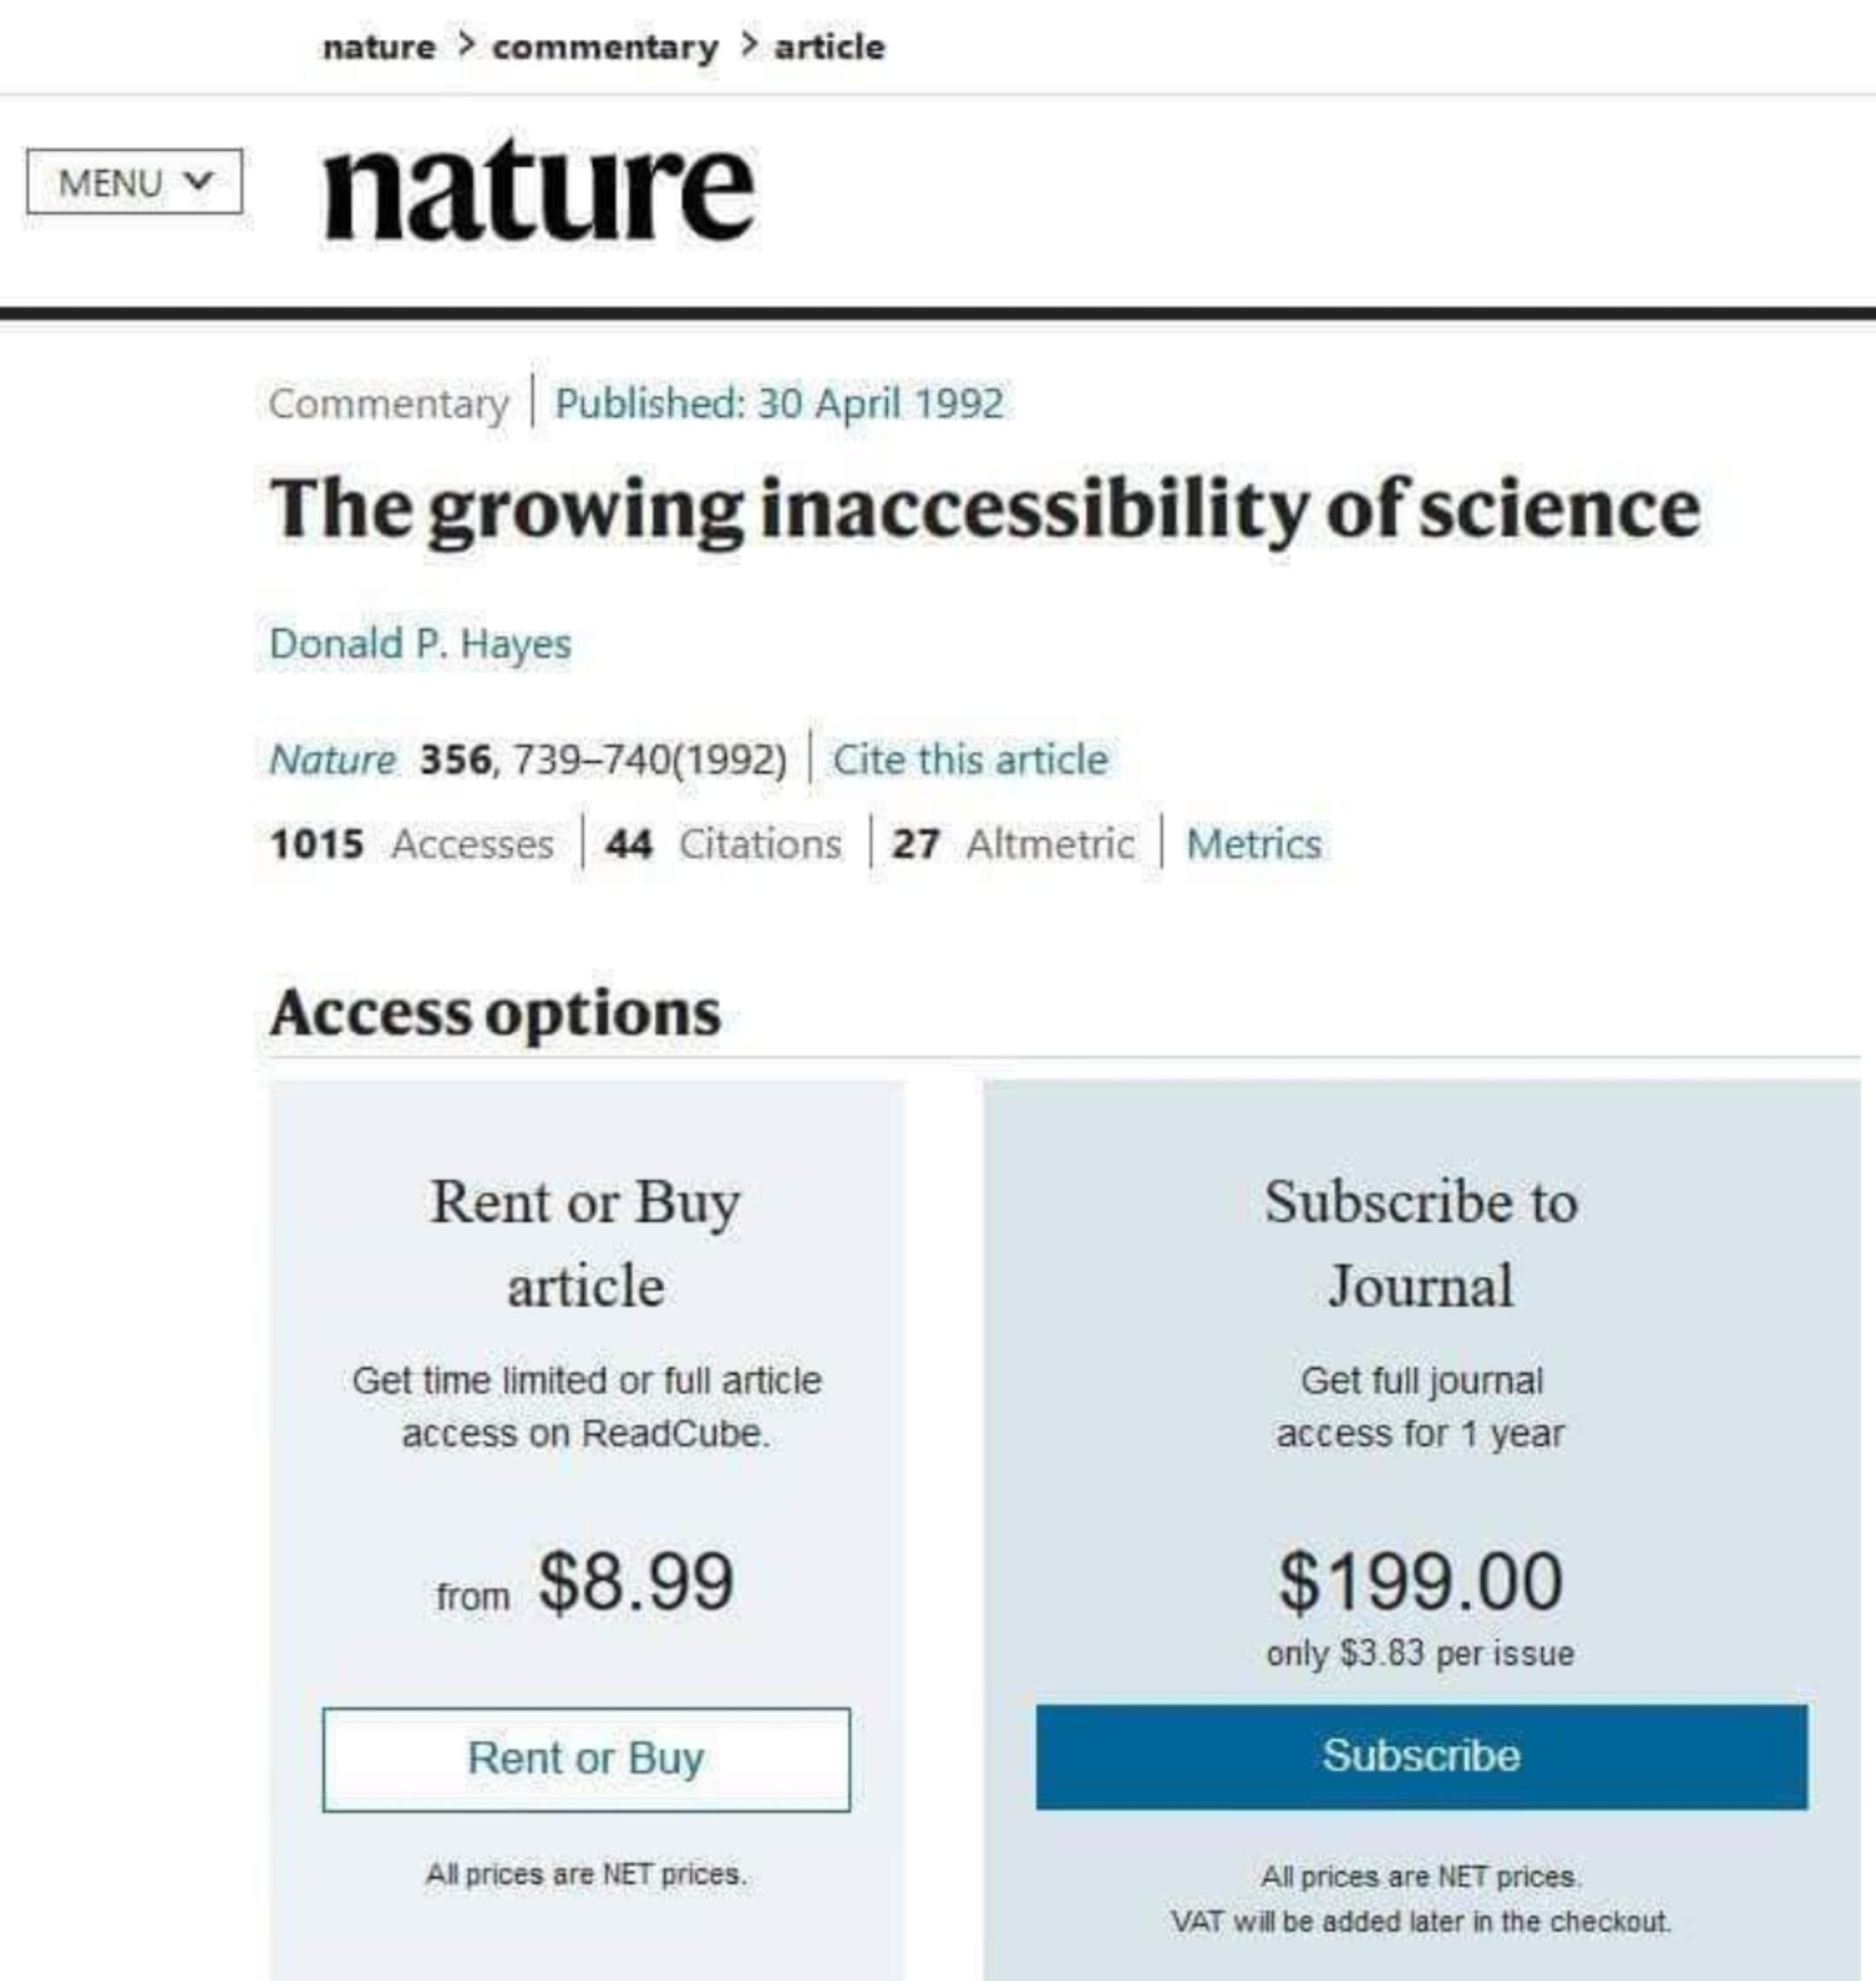
Keep informing yourself
That I am not complaining here about publications fees and paywalls; doesn’t mean I don’t have an opinion.
It is discouraging not to be able to publish because of the fee; or not being able to read your own paper afterwards because is behind a paywall.
Interesting links:
The cost of publishing
It is an industry like no other, with profit margins to rival Google
A business model that has become unsustainable
Put your publication money where your mouth is
Writing and publishing a scientific paper
Changes in scientific publishing and possible impact on authors’ choice of journals

