Slide 1
Elements / images for the different parts of the enrichment Apps
In DarkEnrichApp (DESeq object) (1)
In TablApp (with padj and/or log2FC) (2)
In TablApp (with padj and log2FC + express matrix) (2’)
In ListApp (only list of genes) (3)

Slide 2
Preview
Images:
- PCA plot (1,2’)
- Box/violin plot (1,2’)
- Heatmap (1,2’)
- Cluster (1,2’)
- Top 6 / top unique gene (1,2’)
- KaryoPlot (1,2,3)
- Volcano plot (1,2)
- MA plot (1,2’)
Elements:
- Box with all / down / up genes (1,2)
- Circles + cutoff values filters (1,2)
- Coldata (1)
- Expression values tables (1,2,3*)
*Adapted

Slide 3
Kegg terms
Images:
- Barplot x3 (1,2,3)
- Chordplot (1,2,3)
- Dotplot (1,2,3)
- Heatmap + colour FC (1,2)
- Heatmap no colour FC (1,2,3)
- Netplot static / interactive (1,2,3)
3 tabs (all / down / up) (1,2)
3 tabs for the 3 annotations (1,2,3)
Elements:
- Table with GO annotations (1,2,3)

Slide 4
Go terms
3 tabs (all / down / up) (1,2)
Elements:
- Table with KEGG annotations (1,2,3)
Images:
- Barplot x3 (1,2,3)
- Dotplot (1,2,3)
- Circle plot (1,2)
- Score bar (1,2)

Slide 5
GSEA
Elements:
- Table with GSEA annotations (1,2,3)
Images:
- GSEA plot (1,2,3)

Slide 6
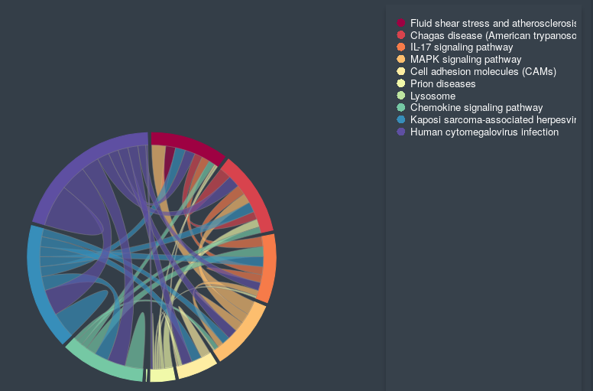
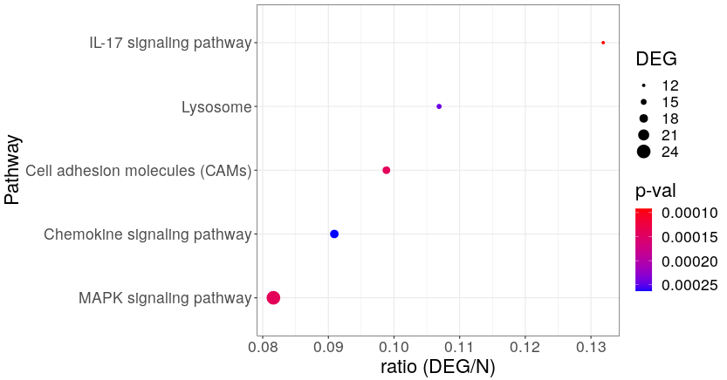
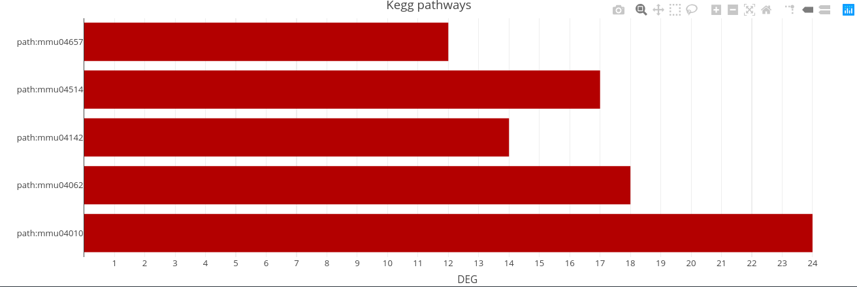
Kegg pathways

Slide 7
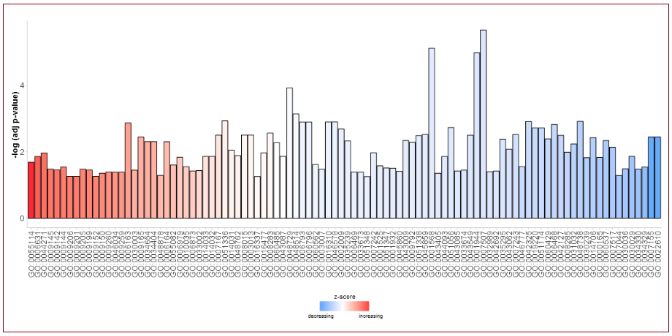
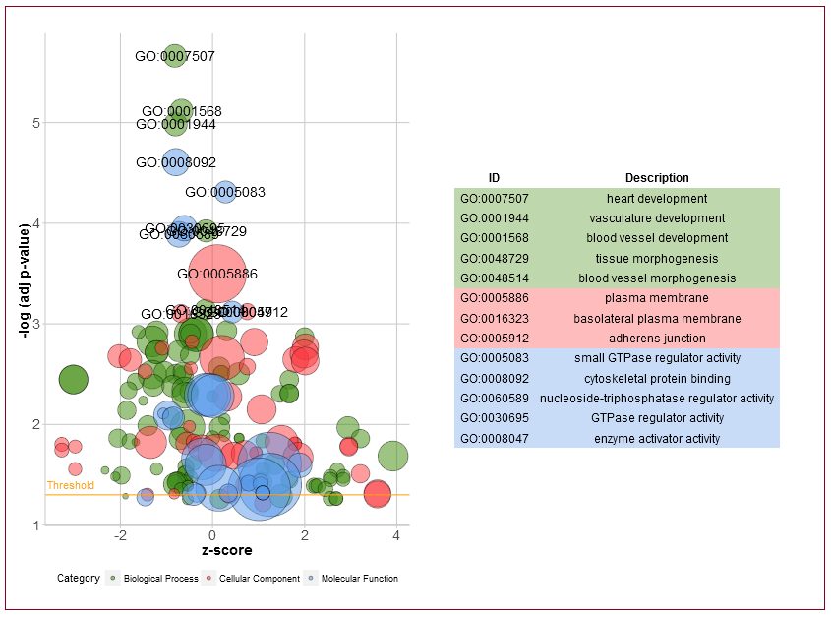
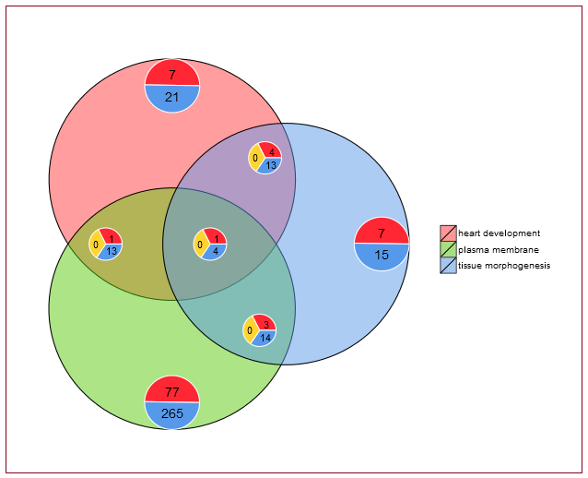
Go terms

Slide 8
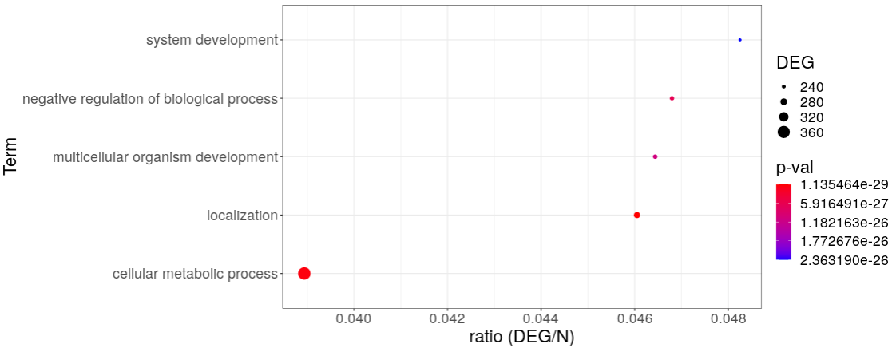
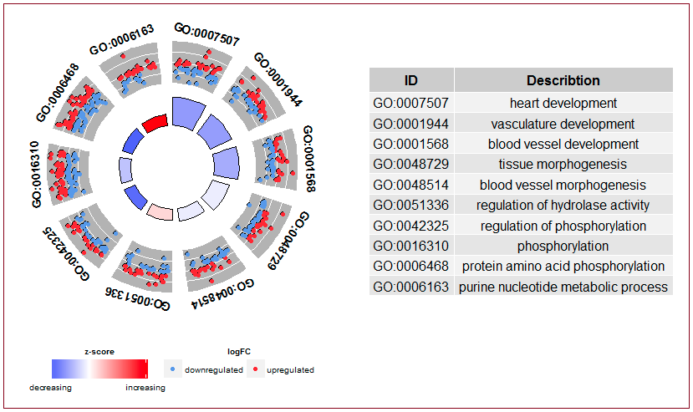

Slide 9
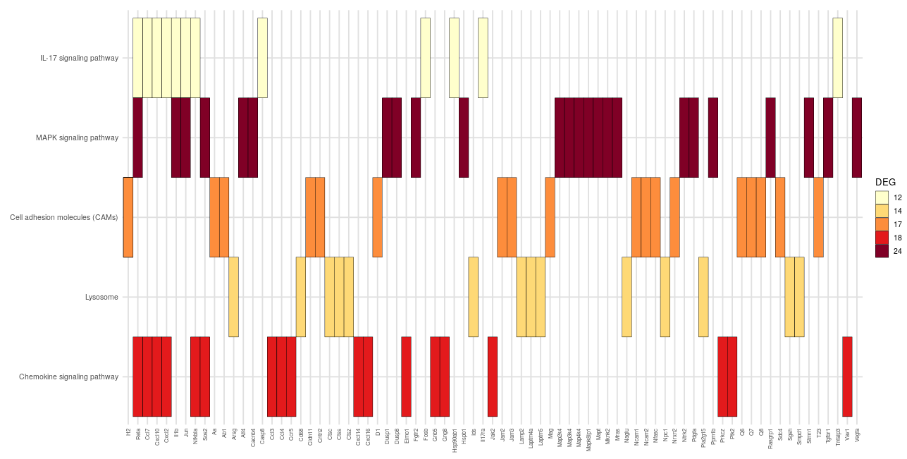
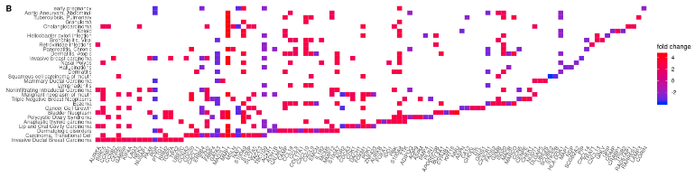
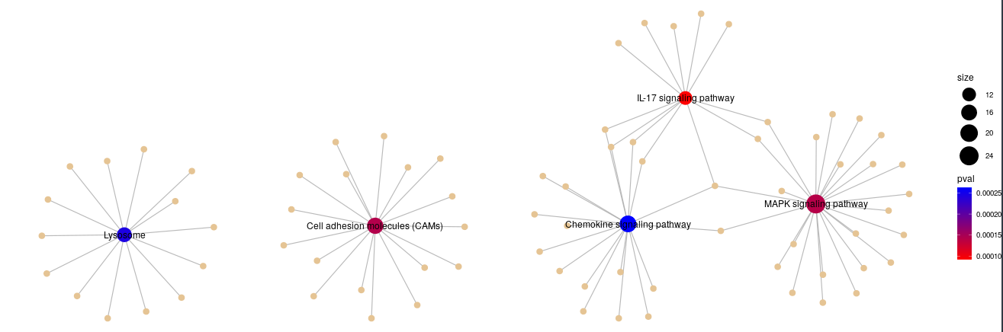
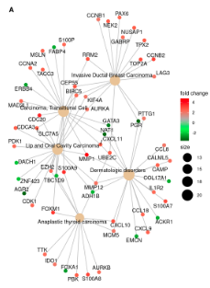

Slide 10
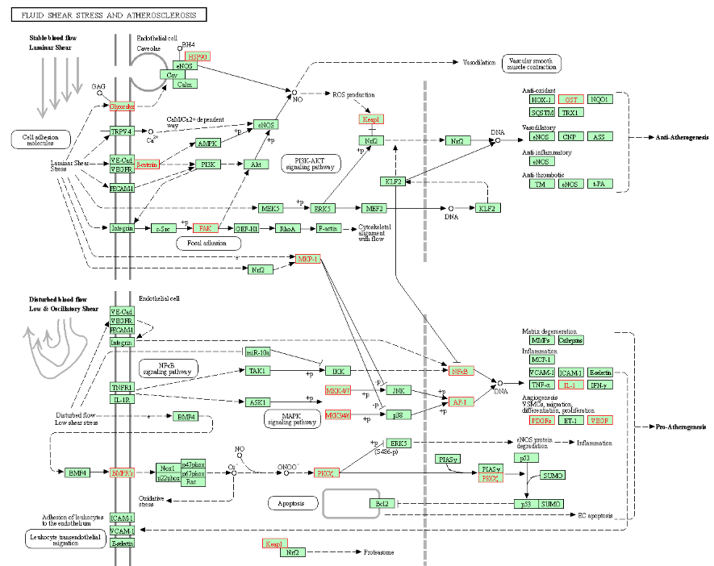

Slide 11
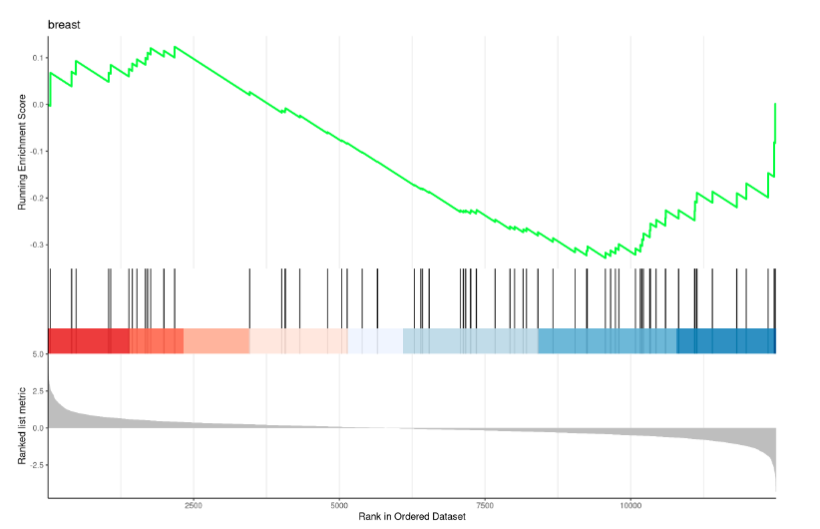
GSEA

