Slide 1
Analysis of Revenue (related) Data at AAVAIL
Key Take Aways

Slide 2
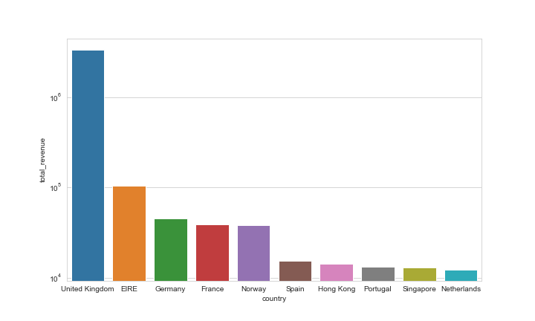
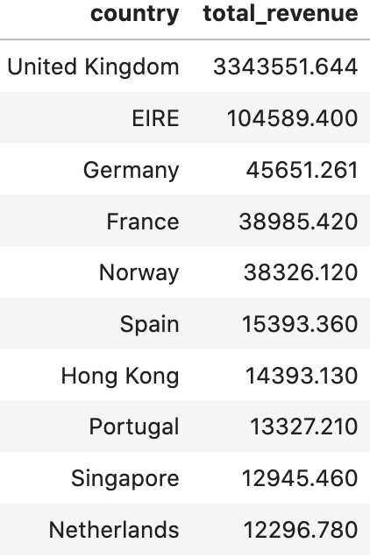
Top 10 Countries with the Highest Total Revenue from 2017-11 to 2019-07
The total revenue of the top 10 countries is widely spread between 3343551.644 $ (United Kingdom) and 12296.78 $ (Netherlands).

Slide 3
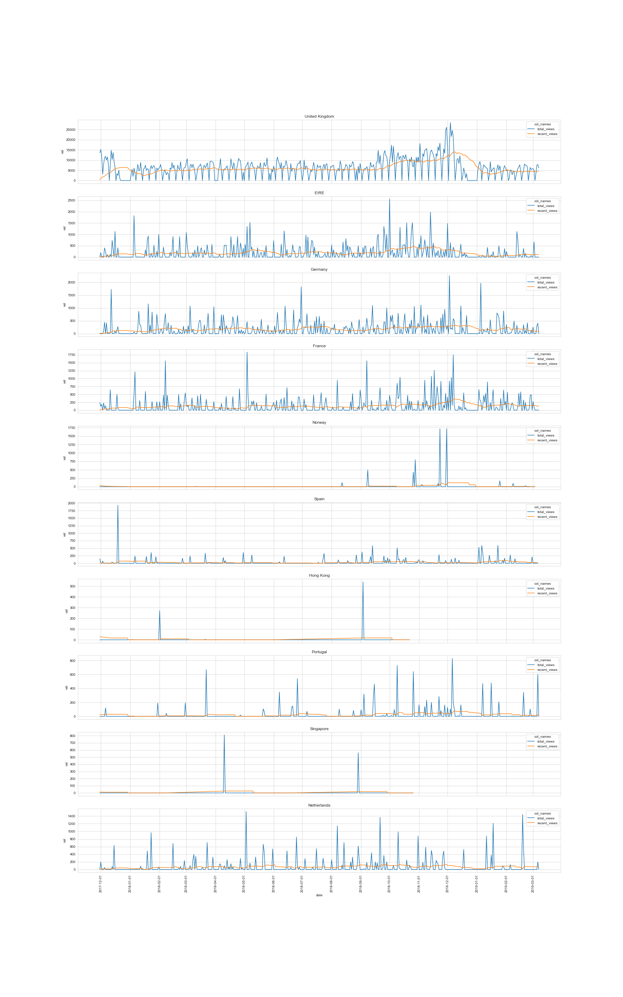
Streaming Activity in the Top 10 Countries
The spread in total revenue is based on a high variability in streaming activity. See for example the comparison of the total number of views per day for the countries United Kingdom and France.
The views averaged over the past 30 days (organge line) show a similar course in both countries.

Slide 4
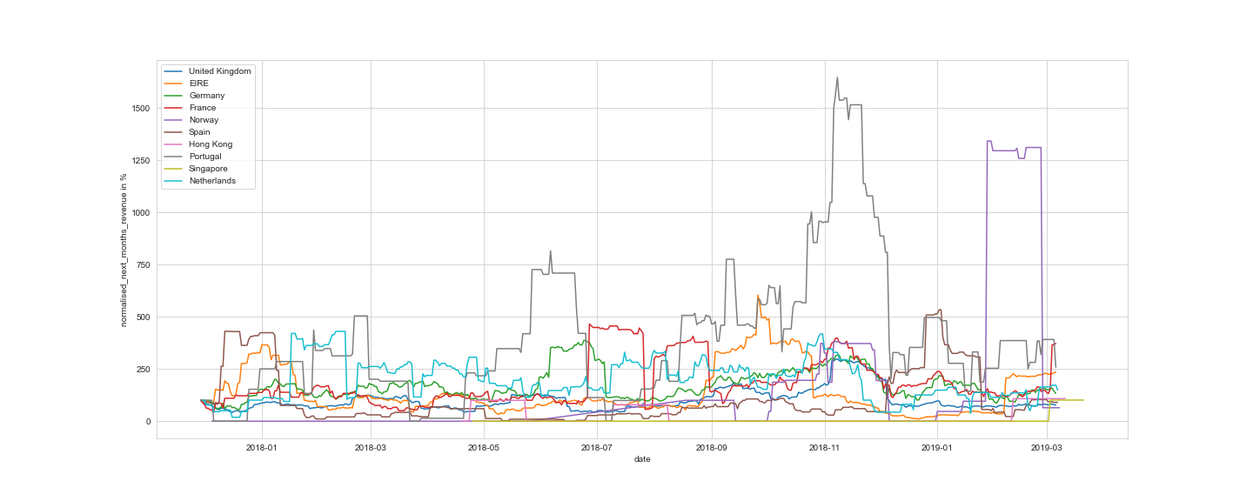
Normalised Monthly Revenue per Country All Time series are the percentages of Their First non-Zero Entry (Ignoring Missing Values)
Some countries show similar effects in the target variable over time, e.g., United Kingdom, Germany, and France in December and November 2018 or EIRE and Spain in December 2017 and Janurary 2018
The volatility in the target variable of Portugal and Norway is high in comparison to the remaining countries

Slide 5
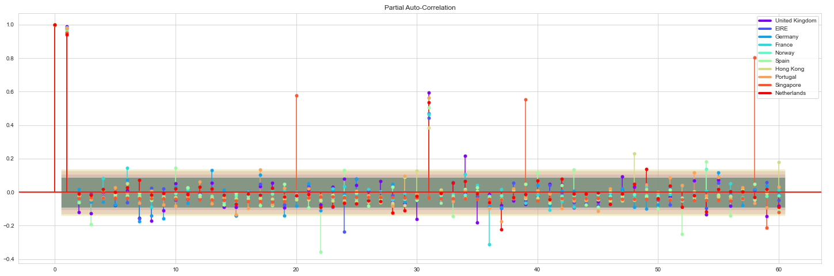
Partial Autocorrelation In the Target Variable The Partial autocorrelation At lag K is the correlation that Results after removing the effect of any correlations die to the terms at shorter lags
For the majority of countries the partial autocorrelation is significantly large at time lags k=1 and k=31. The latter could be an indicator of monthly periodicity.

