Slide 1


Altman Z-Score &
Piotroski F-Score
Financial-strength factors and the distress anomaly
Evidence from the Global Factor Data (Jensen-Kelly-Pedersen, 2023)
Mirko Balli · Lorenzo Attanasio
Group 25 · 5376 Asset / Risk Management I
WU Vienna · 2026

Slide 2

PART A - FACTOR SELECTION
Two Lenses on Financial Strength
From the Global Factor Data we pick two fundamentals-based quality factors. The contrarian instinct says: buy distressed firms and profit from their recovery. We test whether the market actually rewards that bet.
Altman Z-Score 1968
Distance to bankruptcy from five balance-sheet ratios. Captures the LEVEL of health: how safe is the firm today?
Research question
Is financial strength priced in the cross-section, and does betting on distress pay off?
Piotroski F-Score 2000
Nine binary accounting signals (score 0-9). Captures the DIRECTION of fundamentals: is the firm improving?
Both sit in the JKP Quality theme: Z proxies 'safety', F 'fundamental strength’: the pillars of Quality-minus-Junk (Asness et al., 2019).
Asset / Risk Management I · WU Vienna
2

Slide 3
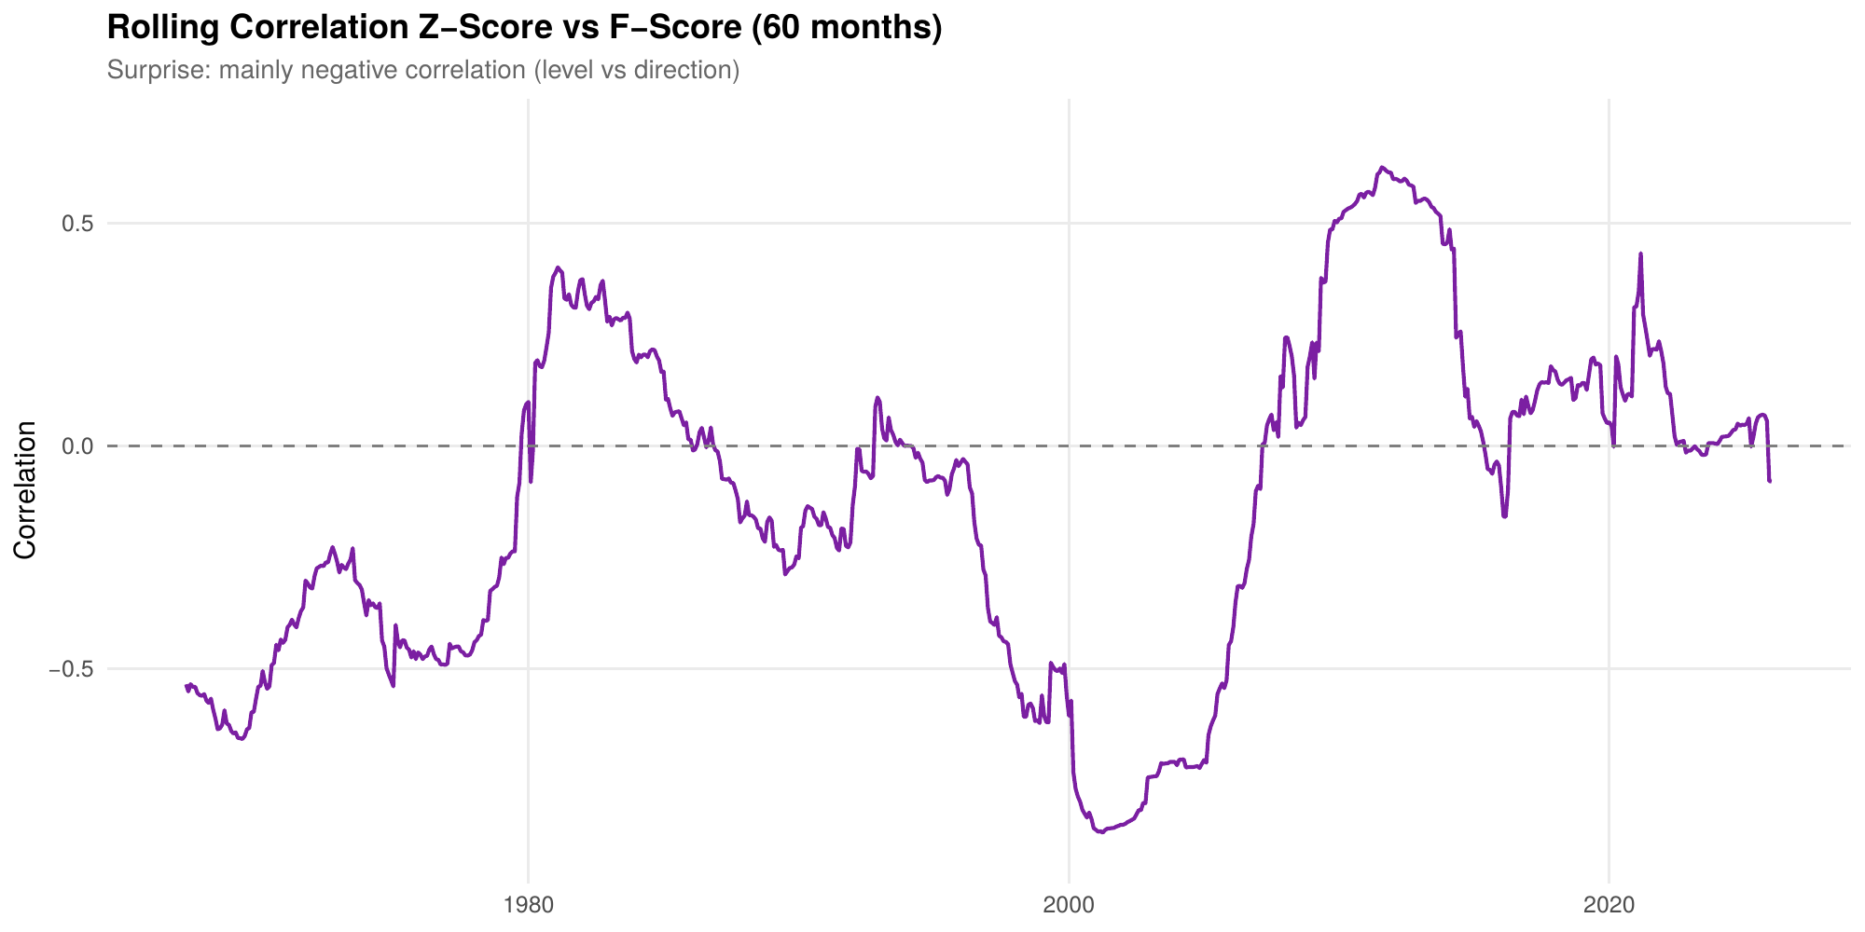
PART B - INTERPRETATION & RELATIONSHIP
Level vs. Direction, and the Distress Anomaly
Both factors are long-short: long high-score (safe / improving) firms, short low-score (distressed / weak).
Contrarian theory: distressed firms are riskier, so they ought to earn a premium.
The distress anomaly says the opposite: distressed stocks systematically underperform (Campbell-Hilscher-Szilagyi 2008; Dichev 1998).
So, the real edge is not 'cheap' but 'improving’, exactly what Piotroski (2000) sorts on.
Rolling 60-month correlation: mostly negative over time
Key correlations (full sample)
Z-Score vs F-Score: -0.36
Z-Score vs Quality: +0.56
F-Score vs Market: -0.37
F is defensive; Z aligns with the Quality theme
Asset / Risk Management I · WU Vienna
3

Slide 4
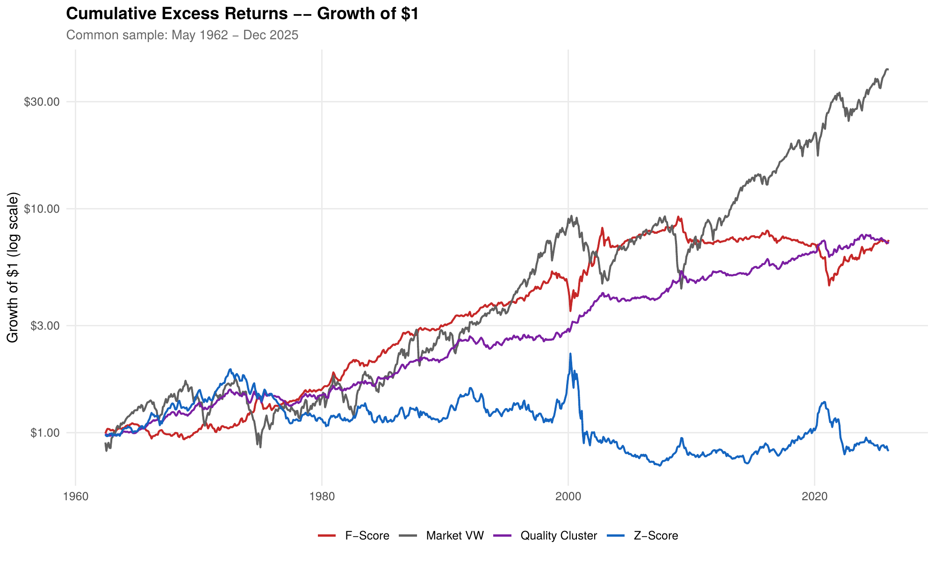
PART C - FULL-SAMPLE PERFORMANCE & RISK
Risk, Return and Significance
Factor | Ret | Vol | SR | t
Z-Score | 0.32% | 10.99% | 0.03 | 0.21
F-Score | 3.23% | 7.52% | 0.43 | 3.28
Quality Cluster | 2.55% | 12.28% | 0.21 | 2.88
Market VW | 8.22% | 18.38% | 0.45 | 4.32
Market EW | 11.26% | 25.12% | 0.45 | 4.05
Annualised, full sample. t = Newey-West. Quality skewed by a 1932 outlier; post-1962 Sharpe 0.60 (as charted).
Only F-Score clears the Harvey-Liu-Zhu hurdle of t > 3 (t = 3.28). Z-Score is indistinguishable from zero.
Growth of $1, excess returns (log scale), common sample from 1962
Asset / Risk Management I · WU Vienna
4

Slide 5
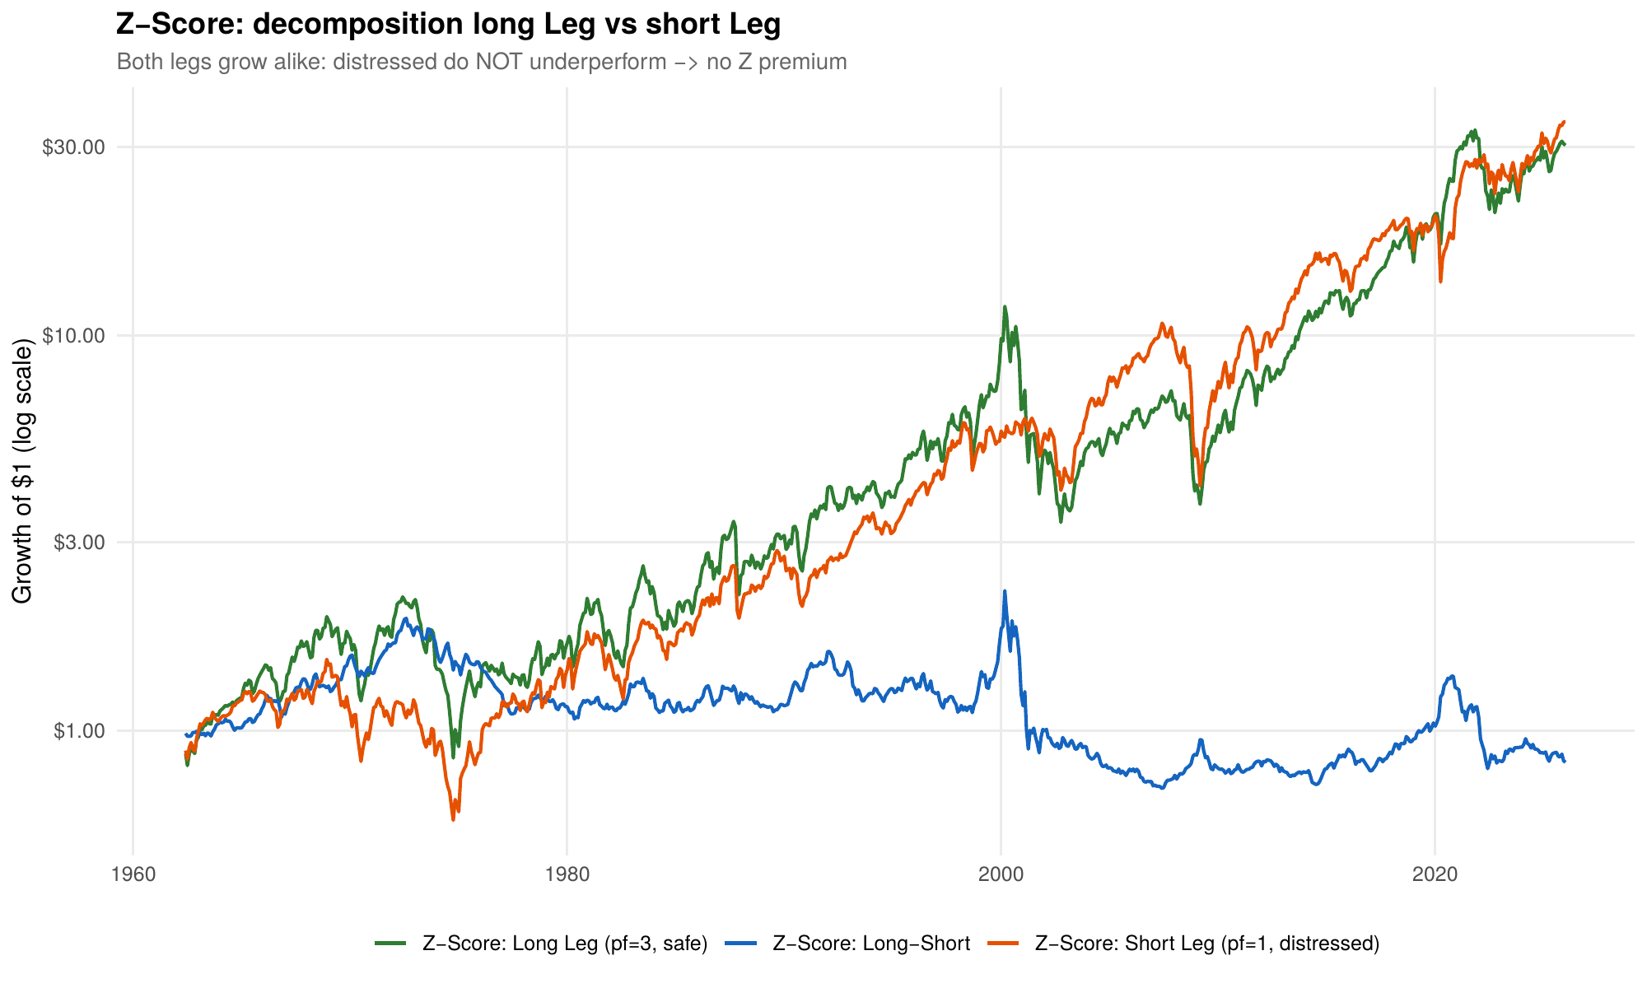
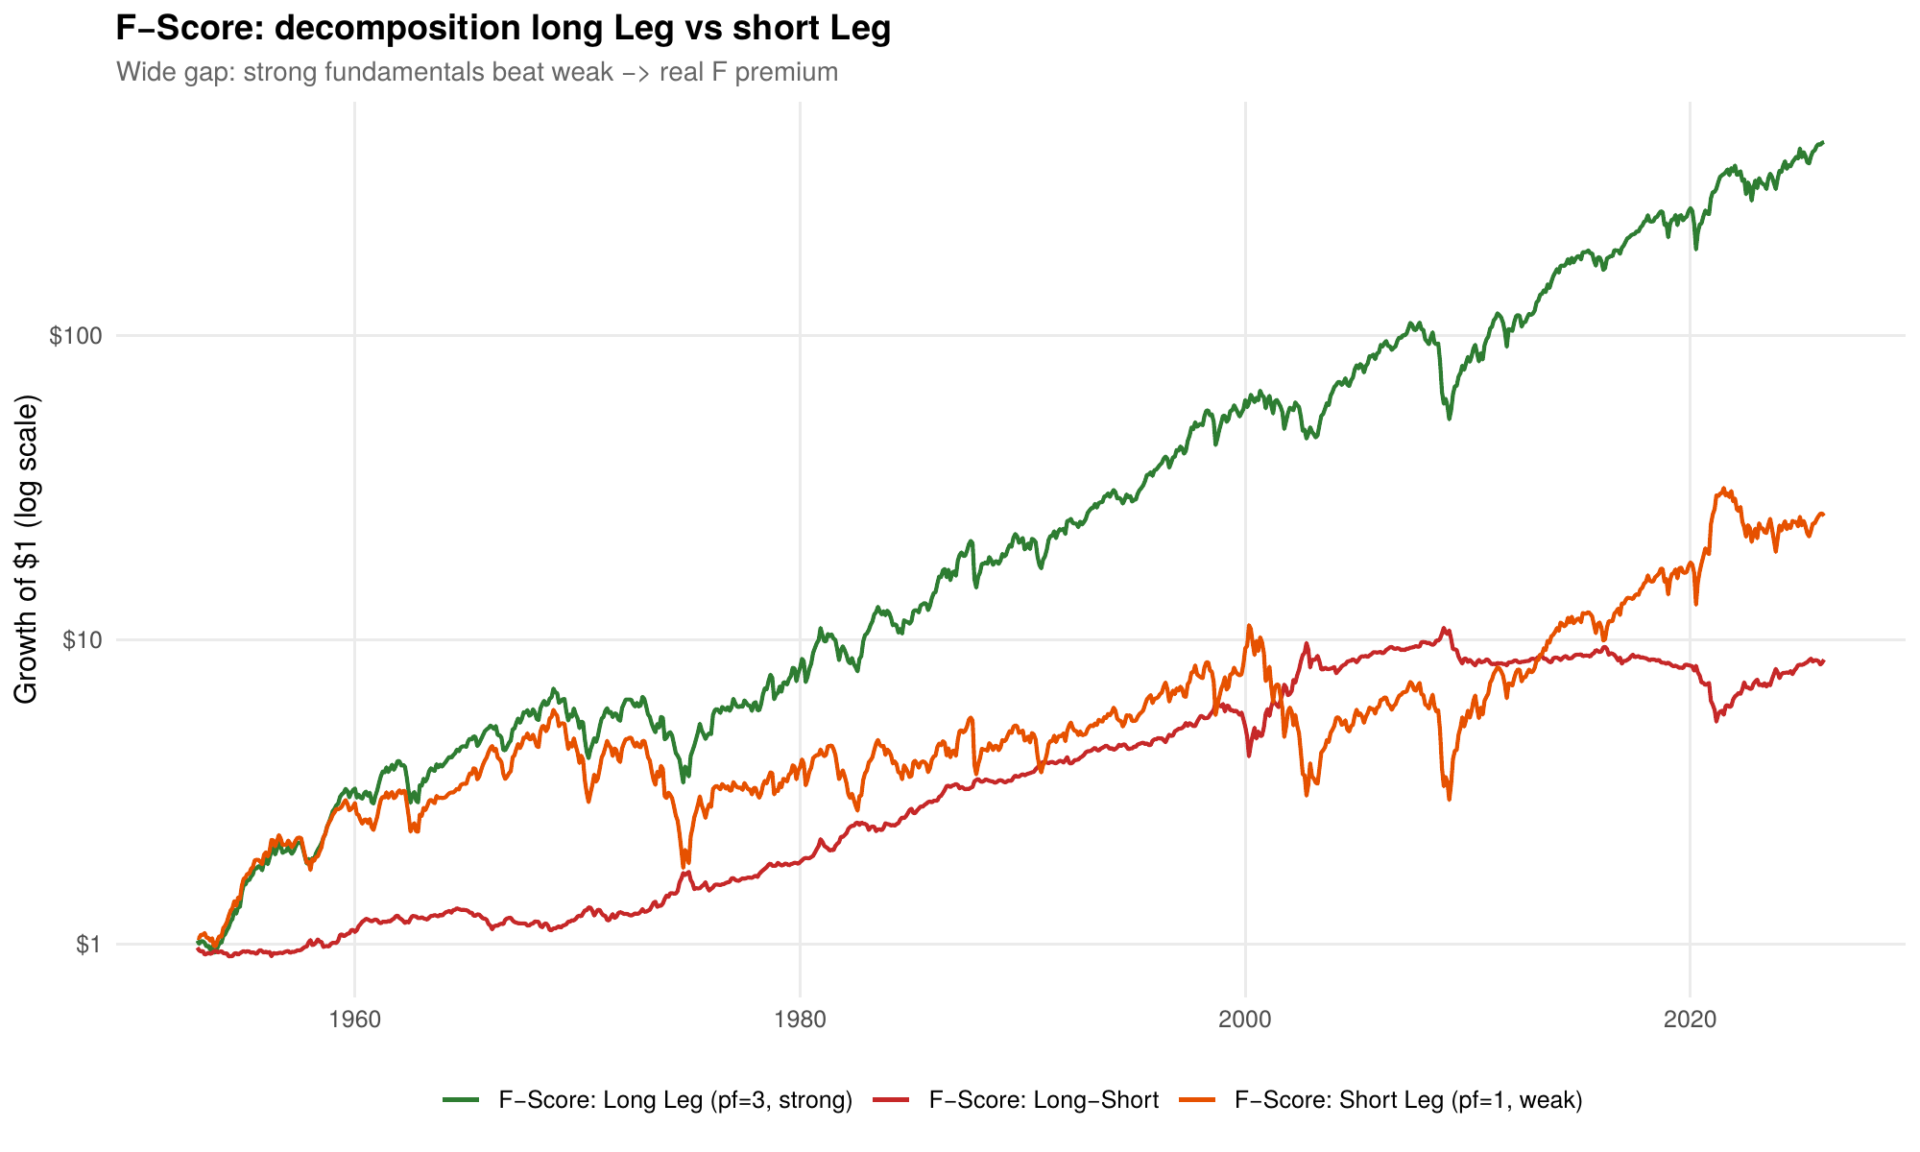
PART C - WHERE THE PREMIUM COMES FROM
Long Leg vs. Short Leg
Each factor is split into its safe/strong leg (top tercile) and distressed/weak leg (bottom tercile) to see where returns originate.
Z-Score: both legs grow alike -> no premium
F-Score: strong clearly beats weak -> real premium
Asset / Risk Management I · WU Vienna
5

Slide 6
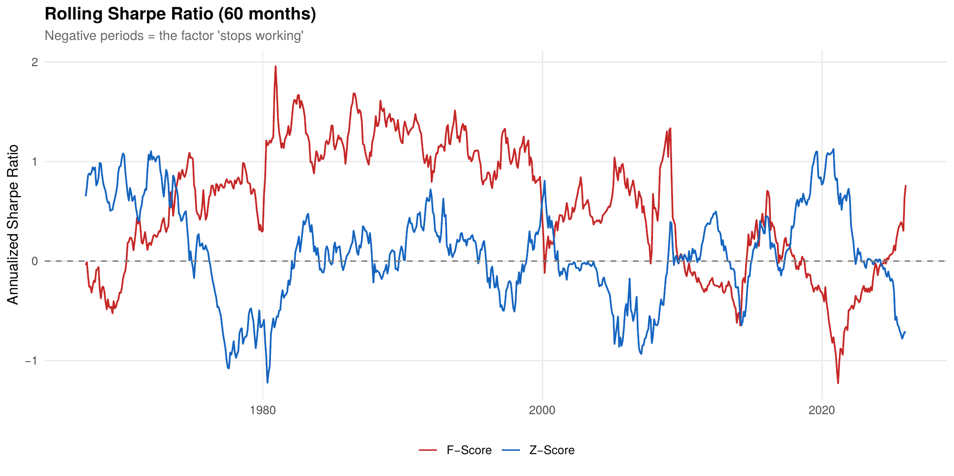
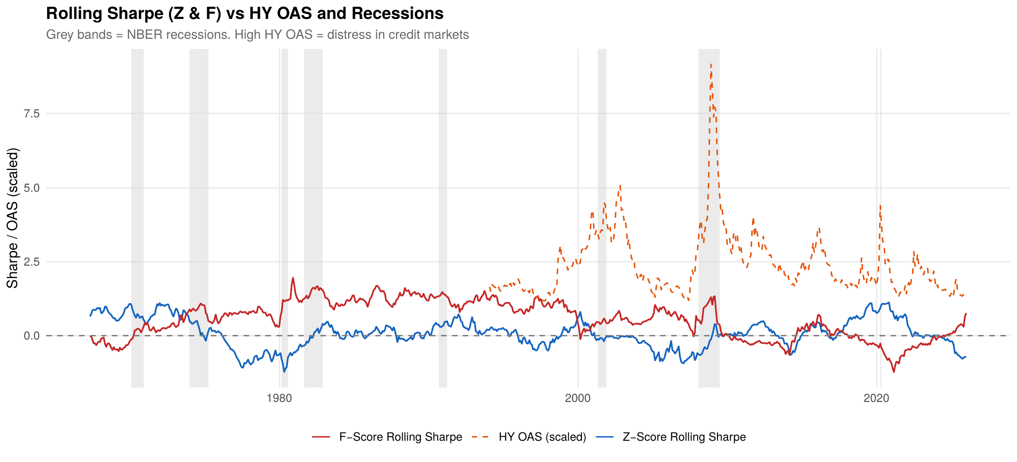
PART C - STABILITY & REGIMES
Rolling Performance Through Regimes
60-month rolling Sharpe: long flat / negative stretches
Rolling Sharpe vs HY credit spread & NBER recessions
Factor premia are time-varying, not constant: both factors weaken for years at a time, a key risk-management caveat for the strategy.
Asset / Risk Management I · WU Vienna
6

Slide 7
PART C - OUT-OF-SAMPLE & PUBLICATION DECAY
Performance Before & After Publication
Factor | Period | Ret | SR | t
Z-Score | In-sample <=1965 | 4.05% | 0.80 | 1.48
Z-Score | Pre-pub 1966-67 | 7.07% | 0.77 | 1.10
Z-Score | Post-pub >=1968 | -0.15% | -0.01 | -0.09
F-Score | In-sample <=1996 | 3.83% | 0.74 | 4.48
F-Score | Pre-pub 1997-99 | 0.91% | 0.10 | 0.18
F-Score | Post-pub >=2000 | 2.48% | 0.24 | 1.18
F-Score
t-stat falls 4.48 -> 1.18 after publication; the classic McLean-Pontiff (2016) decay.
Z-Score
Never significant out-of-sample; the in-sample strength did not survive.
Annualised. 'Pre-pub' = after the paper's sample, before publication.
Z window is short (data start 1962).
Asset / Risk Management I · WU Vienna
7

Slide 8
PART D - SPANNING REGRESSIONS
Do Standard Models Price Them?
Factor | Model | alpha | t | R2
Z-Score | CAPM | -0.9% | -0.50 | 6%
Z-Score | FF3 | +2.7% | 2.84 | 64%
Z-Score | q5 | +1.8% | 0.95 | 41%
Z-Score | FF6 | +3.1% | 2.99 | 68%
F-Score | CAPM | +4.7% | 4.87 | 14%
F-Score | FF3 | +4.4% | 4.87 | 29%
F-Score | q5 | -0.8% | -1.04 | 61%
F-Score | FF6 | +1.2% | 1.68 | 57%
GRS joint test
H0: both factors' alphas = 0;
run per model on { Z-Score , F-Score }:
CAPM, FF3, FF5, FF6 rejected (p < 0.01)
q5 p = 0.32 -> NOT rejected
Only q5 prices both factors jointly.
F-Score's premium is absorbed by q5 profitability (ROE beta = 0.52, t = 9.5).
FF5 omitted: FF6 dominates and tells the same story
Alpha annualised, t = Newey-West. q5 = Hou, Mo, Xue & Zhang (2021).
Z-Score loads strongly negative on value (HML beta = -0.78): a growth / safety bet.
Asset / Risk Management I · WU Vienna
8

Slide 9

CONCLUSIONS
Verdict: Is Financial Strength Priced?
Sharpe ratio: excess returns, annualized, from 1989
1 F-Score is a genuine premium (t = 3.3); Z-Score is not (t = 0.2); the distress anomaly in action.
2 Level vs direction: the two factors are negatively correlated (-0.36).
3 F-Score's edge is profitability; only the q5 model spans both factors (GRS p = 0.32).
4 Combining adds diversification, not return: as long-short factors they sit below long-only equity benchmarks.
Note: benchmarks are long-only total-return indices (excess of RF); Z / F / Combined are long-short, zero-cost. MSCI Quality > S&P reflects this, so Sharpe ratios are not directly comparable.
Asset / Risk Management I · WU Vienna
9

Slide 10
REFERENCES
Selected Bibliography
Altman, E. I. (1968). Financial ratios, discriminant analysis and the prediction of corporate bankruptcy. J. of Finance, 23(4).
Piotroski, J. D. (2000). Value investing: using historical financial statement information. J. of Accounting Research, 38.
Fama, E. F. & French, K. R. (1993). Common risk factors in stocks and bonds. JFE, 33.
Fama, E. F. & French, K. R. (2015). A five-factor asset pricing model. JFE, 116.
Hou, K., Mo, H., Xue, C. & Zhang, L. (2021). An augmented q-factor model with expected growth. Review of Finance, 25.
Jensen, T. I., Kelly, B. T. & Pedersen, L. H. (2023). Is there a replication crisis in finance? J. of Finance, 78.
Campbell, J. Y., Hilscher, J. & Szilagyi, J. (2008). In search of distress risk. J. of Finance, 63.
Dichev, I. D. (1998). Is the risk of bankruptcy a systematic risk? J. of Finance, 53.
McLean, R. D. & Pontiff, J. (2016). Does academic research destroy stock return predictability? J. of Finance, 71.
Asness, C., Frazzini, A. & Pedersen, L. H. (2019). Quality minus junk. Review of Accounting Studies, 24.
Gibbons, M., Ross, S. & Shanken, J. (1989). A test of the efficiency of a given portfolio. Econometrica, 57.
Harvey, C. R., Liu, Y. & Zhu, H. (2016). ...and the cross-section of expected returns. RFS, 29.
Newey, W. K. & West, K. D. (1987). A simple, positive semi-definite HAC covariance matrix. Econometrica, 55.
Data: Global Factor Data (jkpfactors.com), global-q.org, Ken French Data Library, Bloomberg, FRED.
Asset / Risk Management I · WU Vienna
10

