Slide 1

K-Means++
Parallelizaton with OpenMP
Mirko Bicchierai
Firenze, 05/07/2024

Slide 2

K-Means++,
Parallelization with OpenMP
Firenze, 05/07/2024
K-Means algorithm, Introduction
Algorithm steps
Initialization :​
  Random, Start by selecting k random point from the dataset.
  ​
  K-Means++:​
    First Centroid, Select the first centroid randomly from the dataset.​
    Subsequent Centroids, For each subsequent centroid, select a point from the dataset with a probability proportional to its squared distance from the nearest already chosen centroid.
Assignment, Assign each data point to the nearest cluster.​
Update centroids, Calculate the new cluster centroids by computing the mean of all data points assigned to each cluster.​
Repeat, until the centroids no longer move compared to the previous iteration.​
​
​
2

Slide 3
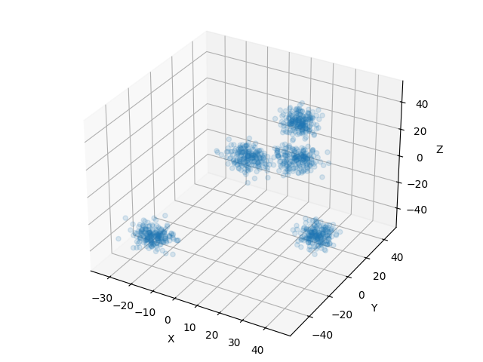
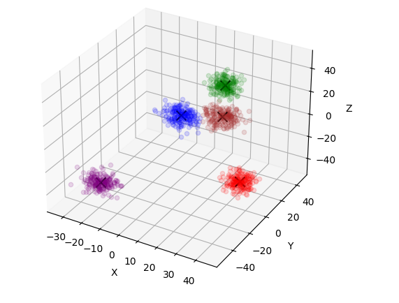
K-Means++,
Parallelization with OpenMP
Firenze, 05/07/2024
K-Means algorithm, Output
An example of K-Means algorithm output
3

Slide 4
K-Means++,
Parallelization with OpenMP
Firenze, 05/07/2024
Data generation process
To generate the various datasets used later to test this algorithm, the 'make_blobs' function from the 'sklearn.datasets' library was utilized.​
For these tests, we utilized datasets generated with varying values of n = (100, 1000, ….., 10000000)​
For each n: k = (3, 5, 10, 15, 20, 25, 30, 40, 50)
​
​
4

Slide 5
K-Means++,
Parallelization with OpenMP
Firenze, 05/07/2024
Hardware used and testing performance method
.​
All the experiments were performed on 11th Gen Intel(R) Core(TM) i7-11800H @ 2.30GHz (Mobile) (8 CPU cores and 16 threads) and NVIDIA GeForce RTX 3050 Ti (Mobile)
All the results reported below regarding the obtained speedup are calculated as the average of 100 executions of the sequential algorithm divided by the average of 100 executions of the parallel algorithm. This approach is used to ensure the most accurate results possible.​
This is except for n=10000000, where 100 executions were unmanageable in terms of time.​
​
​
5

Slide 6
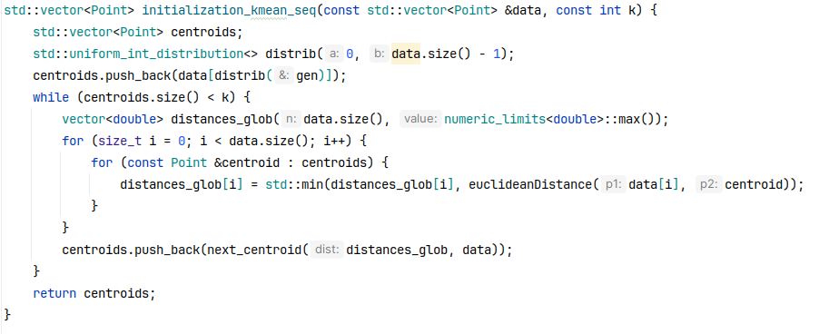
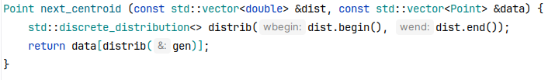
K-Means++,
Parallelization with OpenMP
Firenze, 05/07/2024
K-Means++ inizialization, implementation
Sequential algorithm
This inizialization method have cost of O(knk) vs random inizialization tha have a cost of O(k). ​
6

Slide 7
K-Means++,
Parallelization with OpenMP
Firenze, 05/07/2024
K-Means++ inizialization
Parallelization strategy
The inner for loop, which iterates through the entire dataset, has been parallelized by dividing the data points into equal chunks for analysis.
In this way, each thread computes the minimum distances for a subset of the total points relative to the current centroids.
Chunk #1
Chunk #2
Chunk #3
Chunk #4
Thread 1
Compute the
distance between
centroid and the
data points
Thread 2
Compute the
distance between
centroid and the
data points
Thread 3
Compute the
distance between
centroid and the
data points
Thread 4
Compute the
distance between
centroid and the
data points
Next_centroid()
7

Slide 8
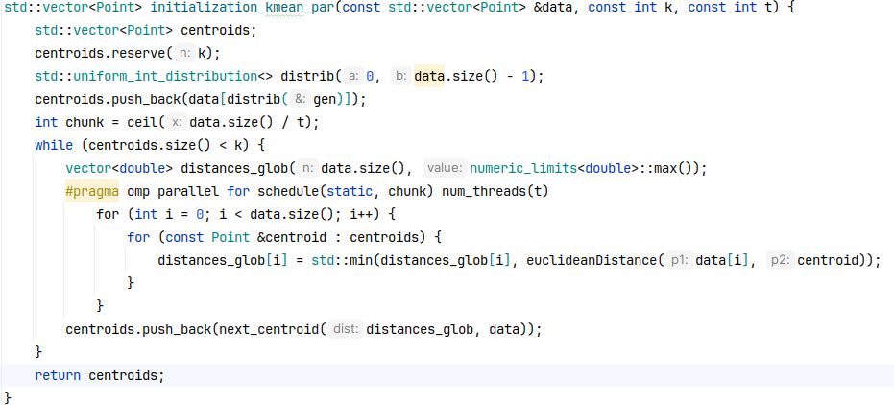
K-Means++,
Parallelization with OpenMP
Firenze, 05/07/2024
K-Means++ inizialization, implementation
Parallel algorithm
This inizialization method have cost of O(k*n/t*k) , where t is the number of threads used.
8

Slide 9
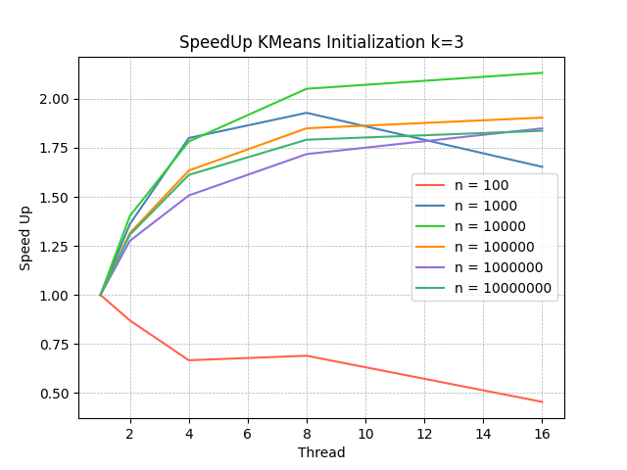
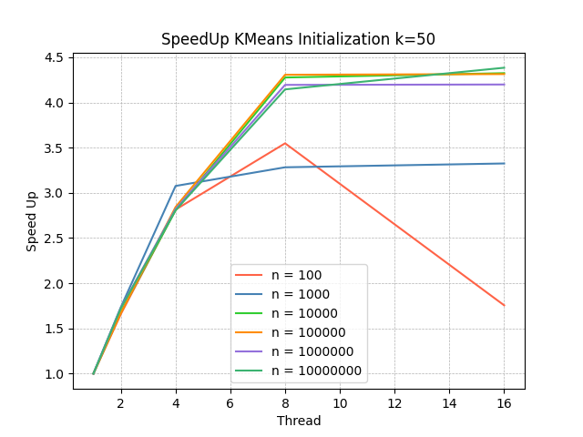
K-Means++,
Parallelization with OpenMP
Firenze, 05/07/2024
K-Means++ inizialization, results
Speed Up obtained: number of data points
For small values of n, this approach is generally not advisable, as the overhead of management outweighs the benefits.
9

Slide 10
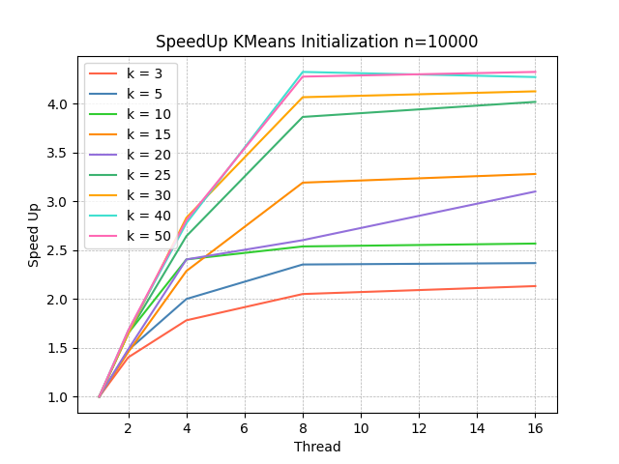
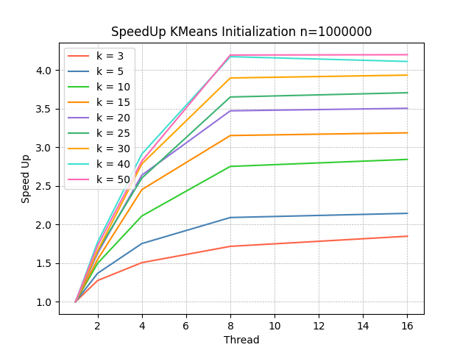
K-Means++,
Parallelization with OpenMP
Firenze, 05/07/2024
K-Means++ inizialization, results
Speed Up obtained: number of clusters
As expected, the speedup achieved increases roughly linearly with the increase in K.
10

Slide 11
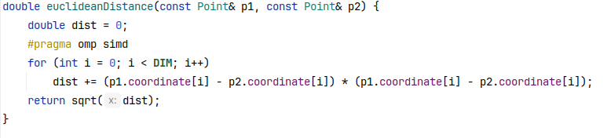
K-Means++,
Parallelization with OpenMP
Firenze, 05/07/2024
Vectorization
Implementation and results
In addition to the parallelization approach discussed, a vectorization approach for distance computation was also tested.
This approach did not yield any advantages in terms of speedup. It was tested with point dimensions of 3 and 5; going beyond these dimensions made visualizing the output too complex.​
This result also applies to the following section, where the parallel implementation of the K-Means algorithm will be discussed.
11

Slide 12
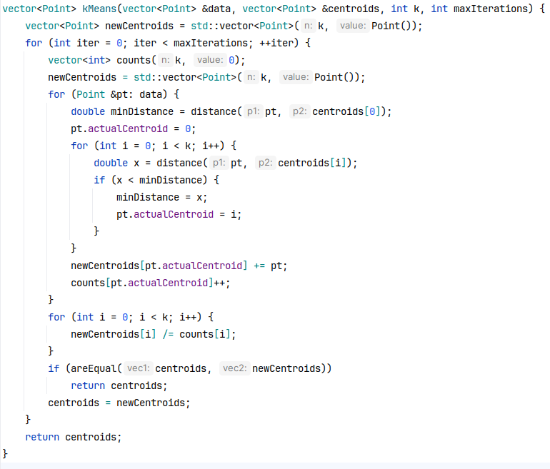
K-Means++,
Parallelization with OpenMP
Firenze, 05/07/2024
K-Means implementation
Sequential algorithm
The assignment has a cost of O(dnk).
The update phase has a cost of O(k).
12

Slide 13
K-Means++,
Parallelization with OpenMP
Firenze, 05/07/2024
K-Means
Parallelization strategy
The inner for loop, which iterates through all the points in the dataset, has been parallelized.
In this way, each thread works on a chunk of data, assigning points to local clusters and then updating these local clusters.
Chunk #1
Chunk #2
Chunk #3
Chunk #4
Thread 1
Assing the
data points of chunk
and update the
private centroids
Thread 2
Assing the
data points of chunk
and update the
private centroids
Thread 3
Assing the
data points of chunk
and update the
private centroids
Thread 4
Assing the
data points of chunk
and update the
private centroids
Critical Region
All contributions from the threads are then
aggregated into the global clusters.​
13

Slide 14
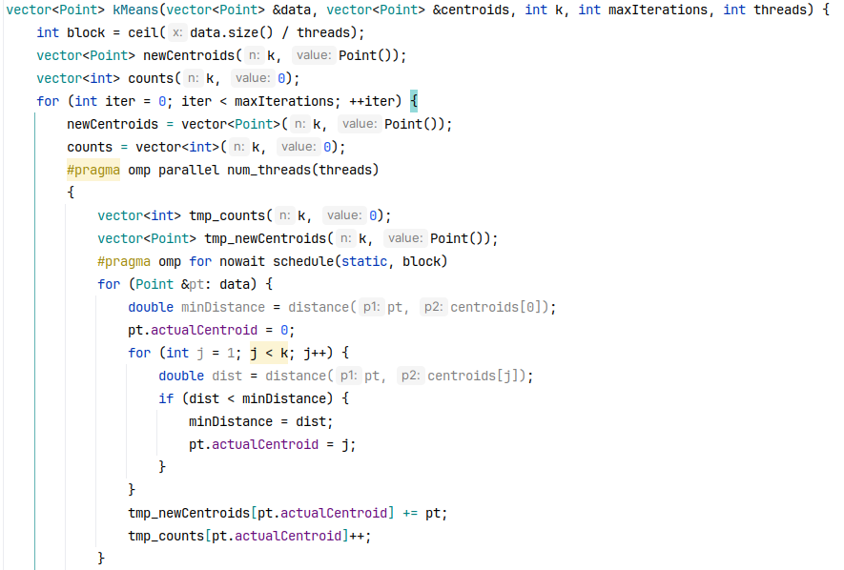
K-Means++,
Parallelization with OpenMP
Firenze, 05/07/2024
K-Means implementation (1/2)
Parallel algorithm
14

Slide 15
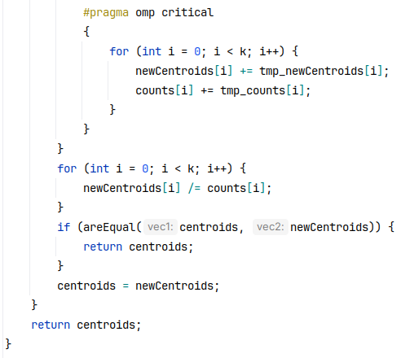
K-Means++,
Parallelization with OpenMP
Firenze, 05/07/2024
K-Means implementation (2/2)
Parallel algorithm
In this mode, the algorithm has a cost of O(d * n/t * k).
The update always has a cost of O(k).
15

Slide 16
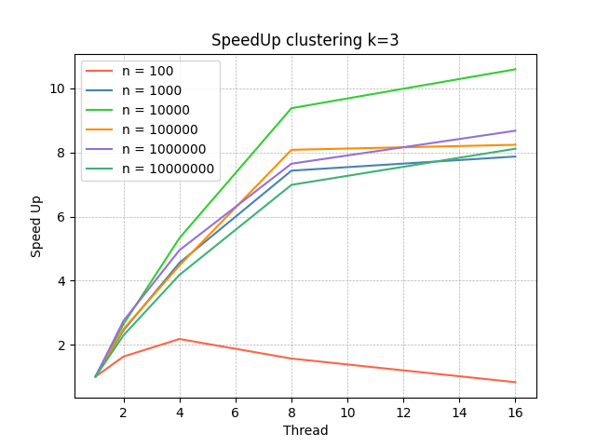
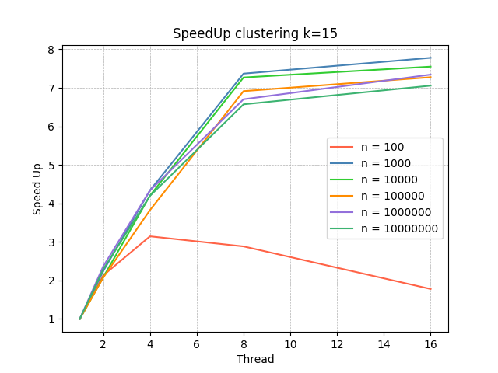
K-Means++,
Parallelization with OpenMP
Firenze, 05/07/2024
K-Means, result
Speed Up obtained: number of data points
Even in this case, for small values of n, this approach is not worthwhile.​.
Except for cases with small k, the results align with expectations: for larger n, we generally achieve greater speedup.
16

Slide 17
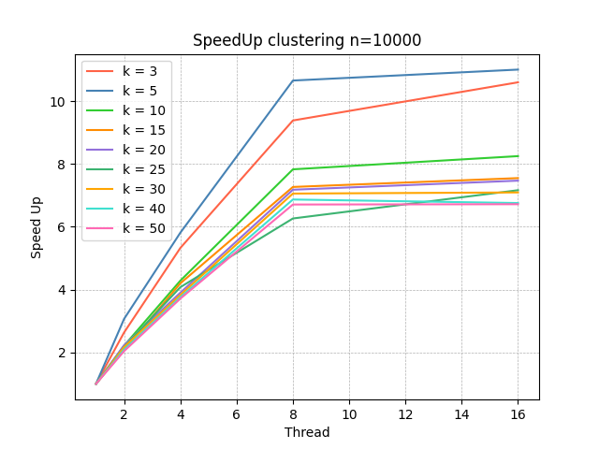
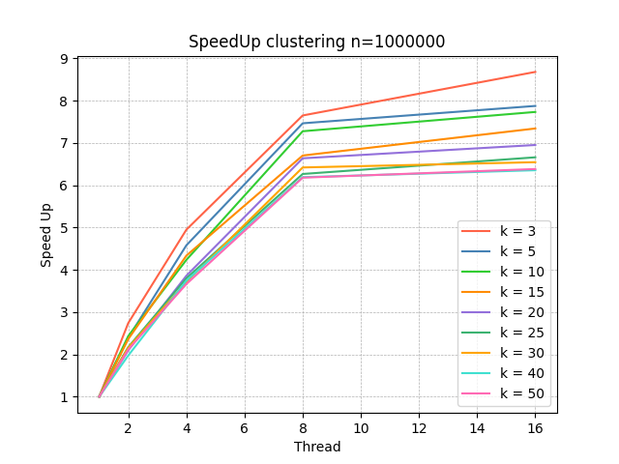
K-Means++,
Parallelization with OpenMP
Firenze, 05/07/2024
K-Means, result
Speed Up obtained: number of clusters
For higher values of k, the speedup tends to stabilize between 7 and 8.​
In general, the highest recorded speedup value is 11, achieved with 16 threads, n=10000 and k=5.​
17

