Slide 1

Kernel Image Processing
Parallelizazion in Python
Mirko Bicchierai
Firenze 05/07/2024

Slide 2

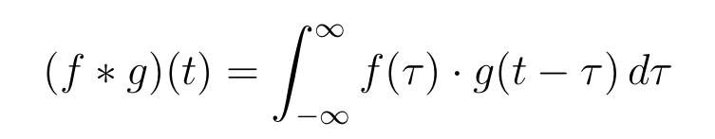
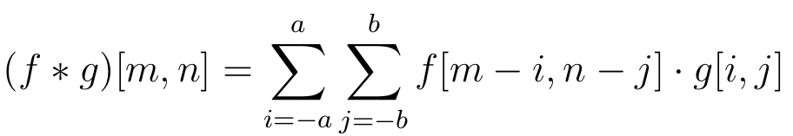
Kernel Image Processing,
Parallelization with python
Firenze, 05/07/2024
Convolutions
Introdutction
The convolution of f () and g() is written f*g, it is defined as the integral of the product of the
two functions after one is reflected about the y-axis and shifted. As such, it is a particular kind of integral transform
We are however focusing on 2-dimensional discrete convolution operation in which both function has finite support, in this case the convolution has the following form:
In the context of image processing, the function f represents the input image, while the function g denotes the kernel matrix
2

Slide 3
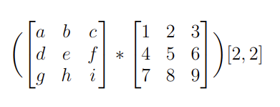

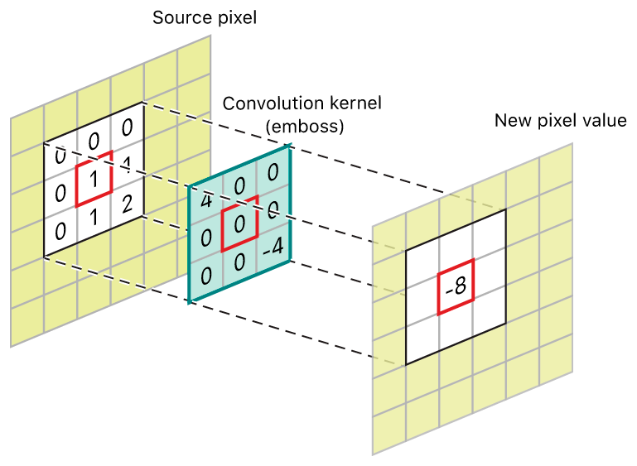
Kernel Image Processing,
Parallelization with python
Firenze, 05/07/2024
Example of Convolutions
Compute a convolution
For example, if we have two three-by-three matrices, the first a kernel, and the second an image piece, convolution is the process of flipping both the rows and columns of the kernel and multiplying locally similar entries and summing.
3

Slide 4

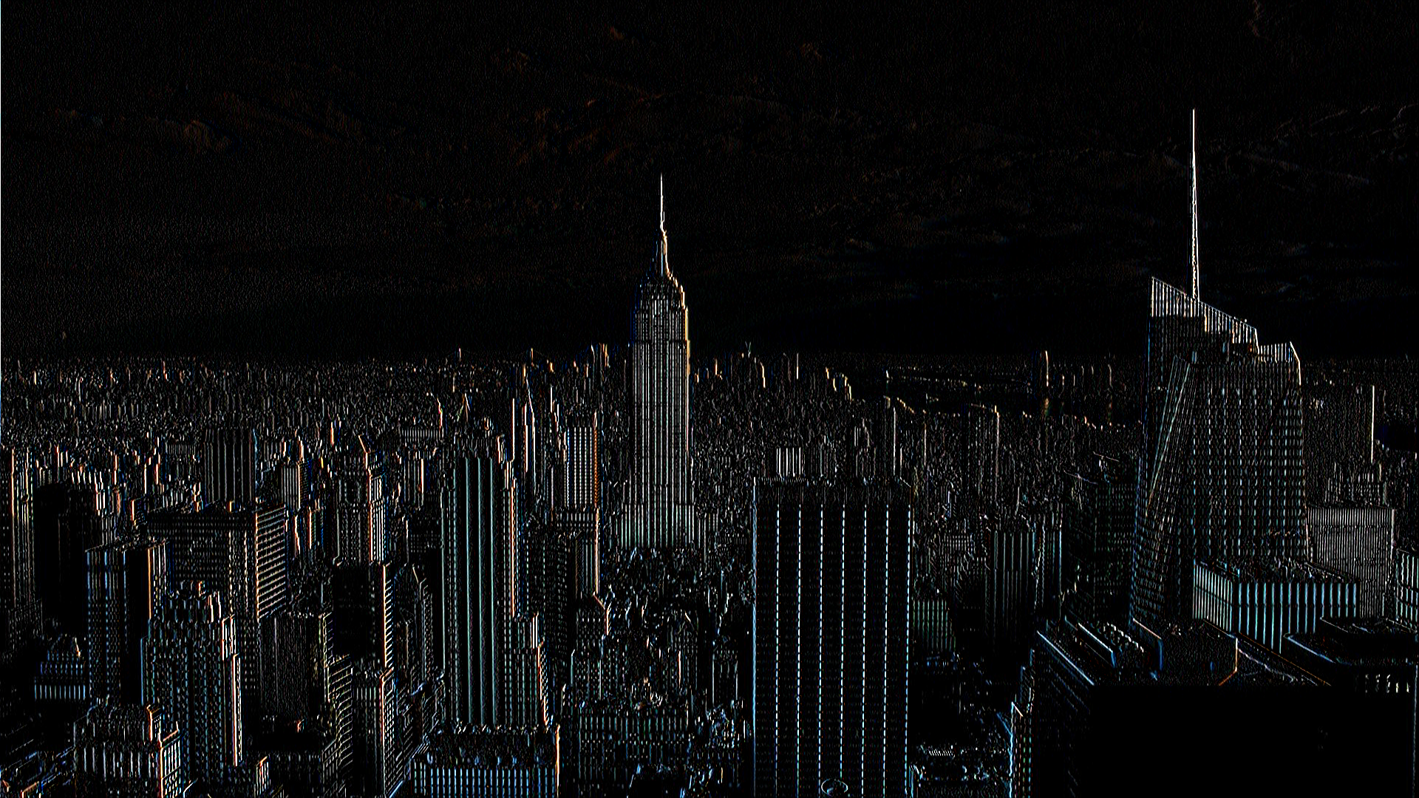
Kernel Image Processing,
Parallelization with python
Firenze, 05/07/2024
Image processing
Convolution Example
It can be used both as preprocessing tool or a image manipulation.
The effect of the convolution on the input image depend on the kernel used.
4

Slide 5
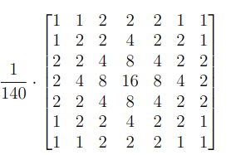
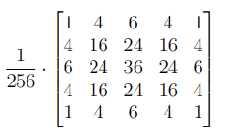
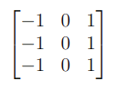
Kernel Image Processing,
Parallelization with python
Firenze, 05/07/2024
Image and Kernels used for testing
Quality of the images and dimension of kernels
For the tests conducted regarding the obtained performance, images of different quality were used:
  SD (720x480)
  HD (1280x720)
  Full-HD (1920x1080)
  2K (2560x1440)
  4K (3840x2160)
All these image qualities were tested for convolutions with various kernels; however, in the end, three were chosen.
Prewitt horizontal kernel (3x3)
Gaussina Blur kernel (5x5)
Gaussian Blur kernel (7x7)
5

Slide 6
Kernel Image Processing,
Parallelization with python
Firenze, 05/07/2024
Hardware used and testing performance method
All the experiments were performed on 11th Gen Intel(R) Core(TM) i7-11800H @ 2.30GHz (Mobile) (8 CPU cores and 16 threads) and NVIDIA GeForce RTX 3050 Ti (Mobile)​.
All the results reported below regarding the obtained speedup are calculated as the average of 100 executions of the sequential algorithm divided by the average of 100 executions of the parallel algorithm. This approach is used to ensure the most accurate results possible.
For each image quality tested, 5 different images were used, and the results were averaged. This approach was taken to further improve the accuracy and reliability of the final results.
6

Slide 7
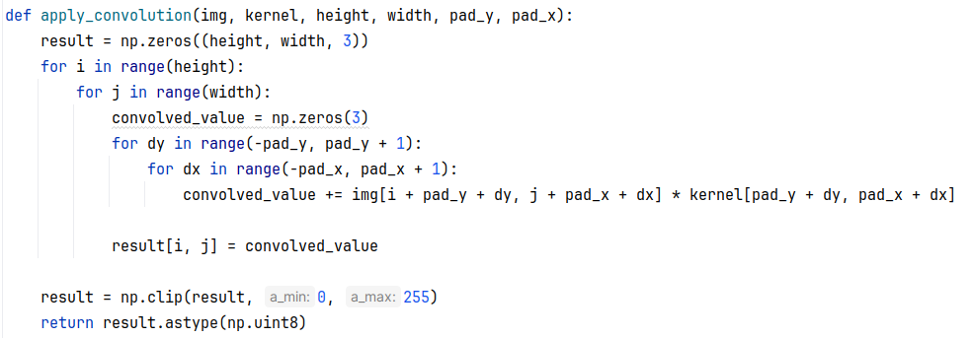
Kernel Image Processing,
Parallelization with python
Firenze, 05/07/2024
Implementation
Sequential algorithm (naive)
The input image is represented as a matrix across the three RGB channels. Additionally, zero padding was applied to the edges of the image beforehand; otherwise, the convolution would not be defined at the borders.
7

Slide 8
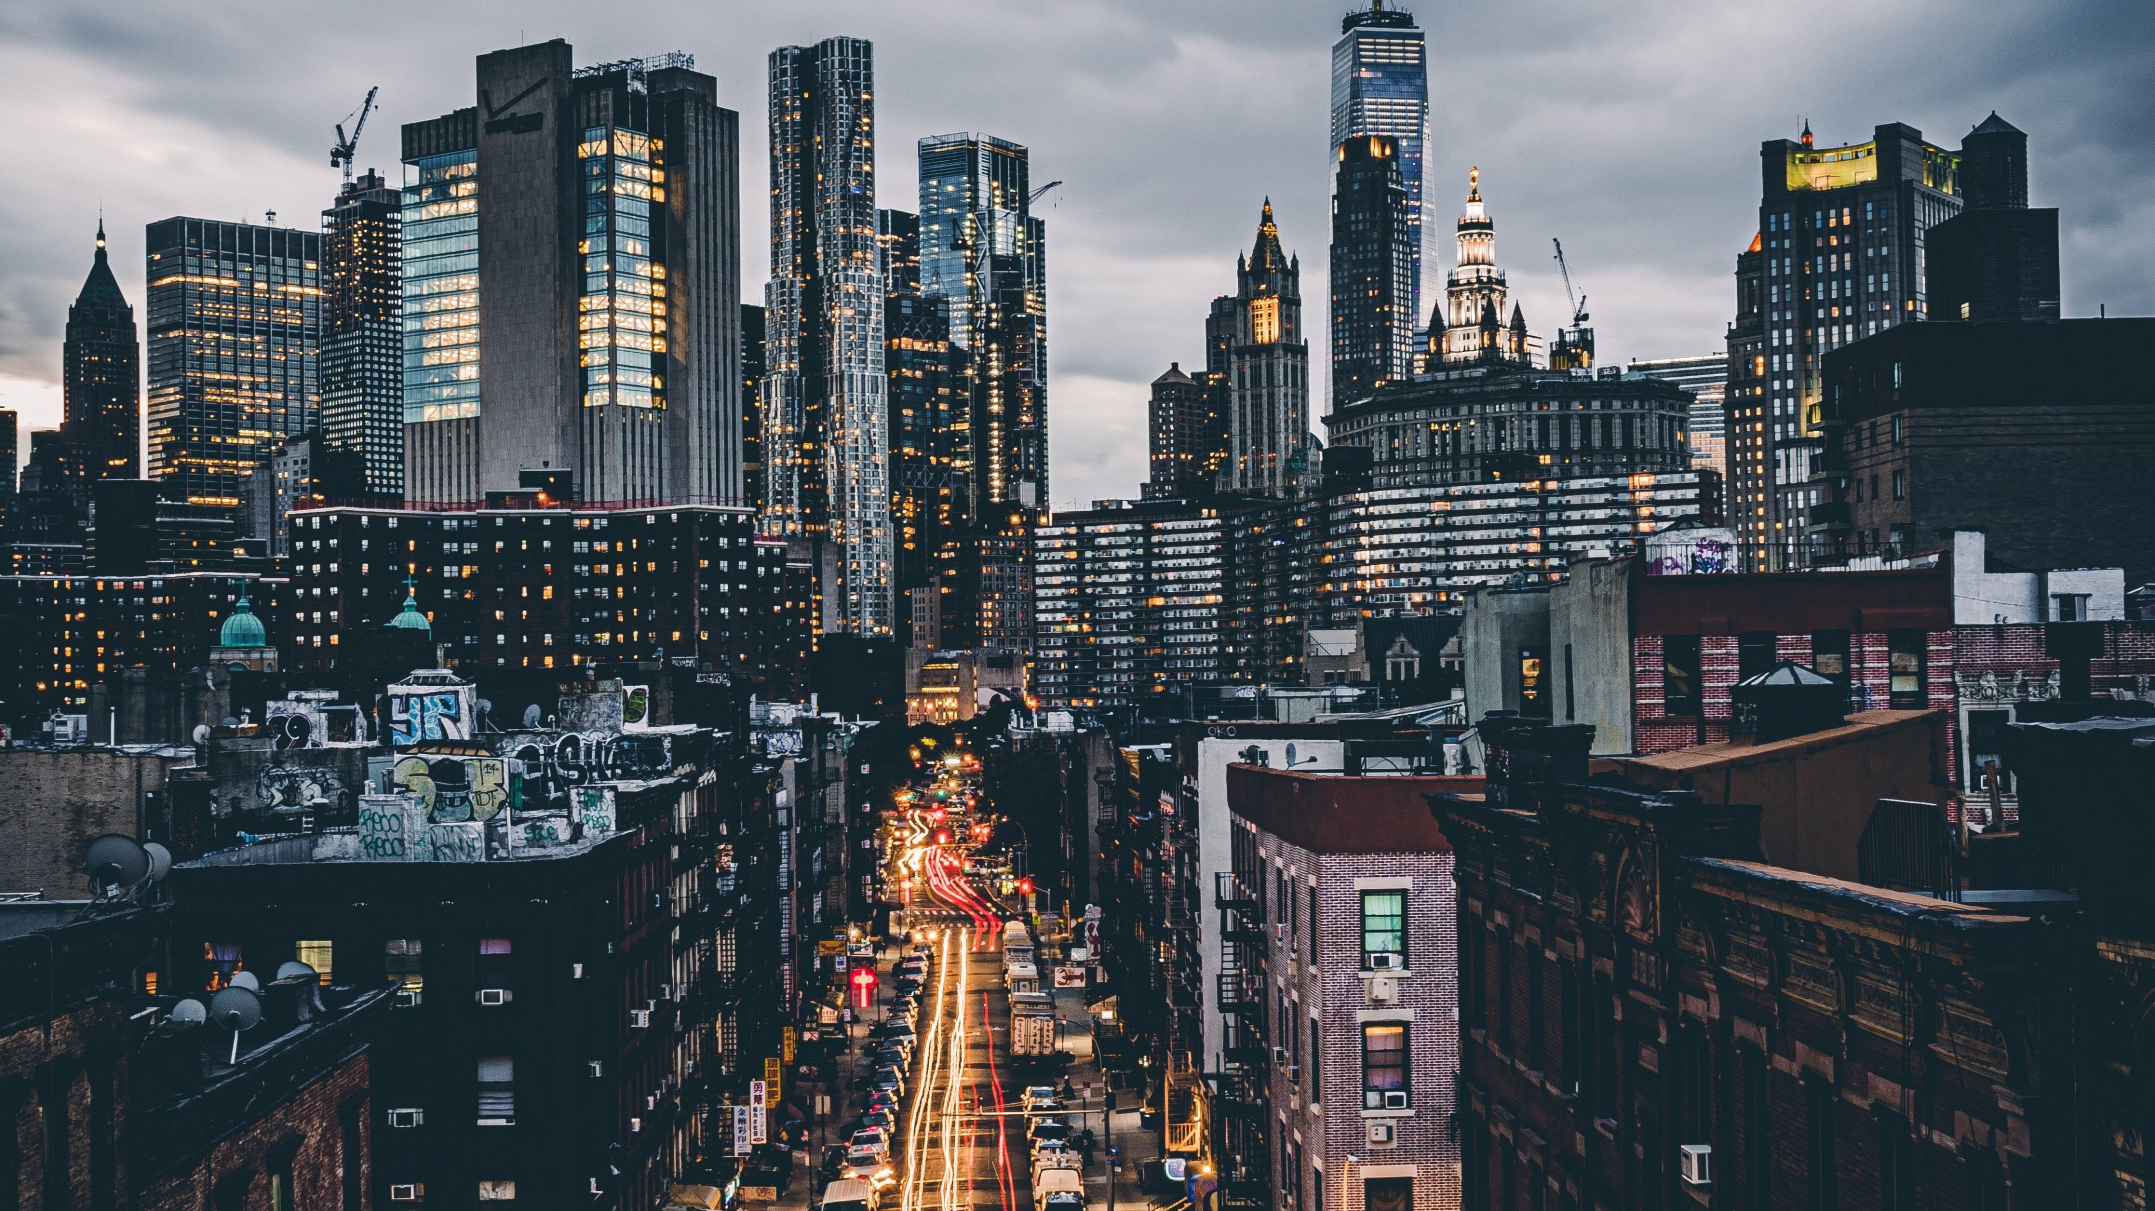
Kernel Image Processing,
Parallelization with python
Firenze, 05/07/2024
Convolutions
Parallelization strategy
Process #1
Process #2
Process #3
+
Process #4
Process #5
In this way, each process handles and computes the convolution for a single row of the image. Subsequently, the output from each process needs to be reassembled.
8

Slide 9
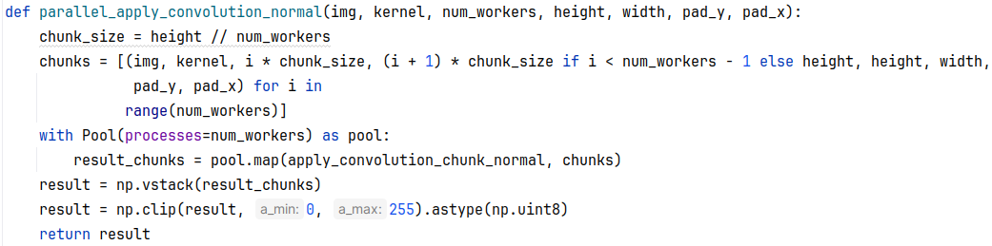
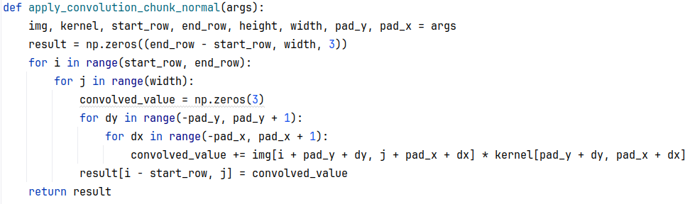
Kernel Image Processing,
Parallelization with python
Firenze, 05/07/2024
Implementation
Parallel algorithm
This implementation reduces the cost from O(h*w*hK*wK) to O(h/np * w * hK * wK), where “np” represents the number of parallel processes. Padding is not taken into account because its size is minimal.
9

Slide 10
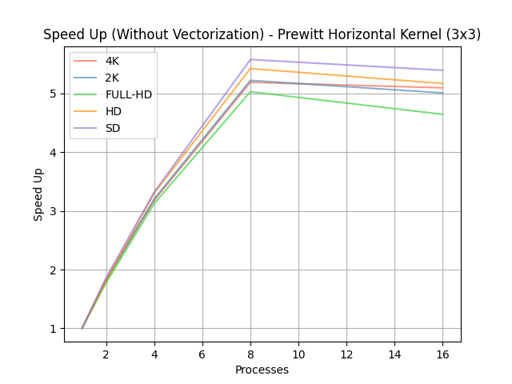
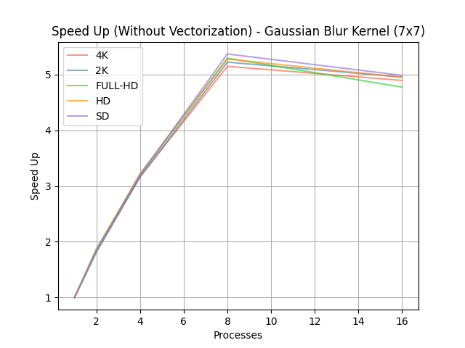
Kernel Image Processing,
Parallelization with python
Firenze, 05/07/2024
Convolutions Results
SpeedUp Obtained
The speedup achieved is stable with respect to the kernel size (though results for the 5x5 kernel are not shown). This outcome was expected since the parallelization does not involve the kernel loops.
However, as the kernel size increases, the speedup tends to stabilize across all tested image dimensions.
10

Slide 11
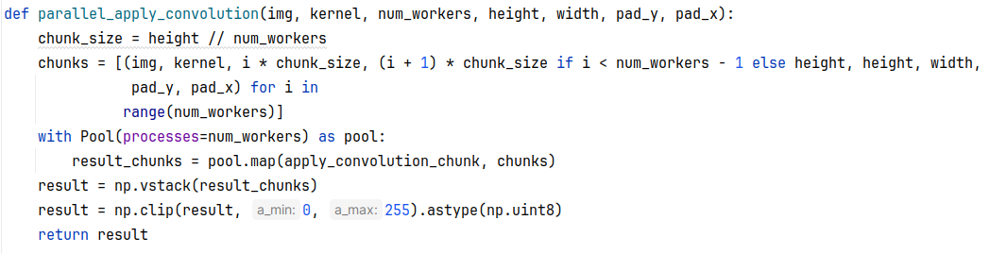
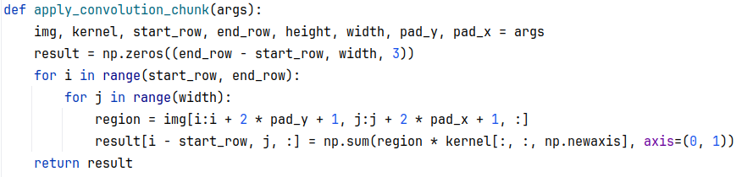
Kernel Image Processing,
Parallelization with python
Firenze, 05/07/2024
Vectorization
Parallel algorithm with vectorization for computing the convolution
This implementation leverages the NumPy library, which operates under the hood with optimized C code. As we will see, this results in significant performance advantages.
11

Slide 12
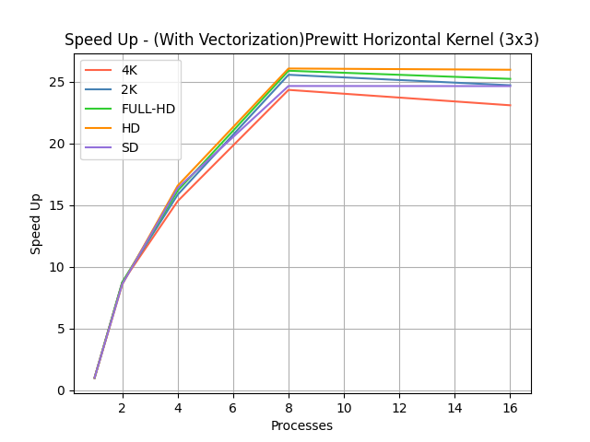
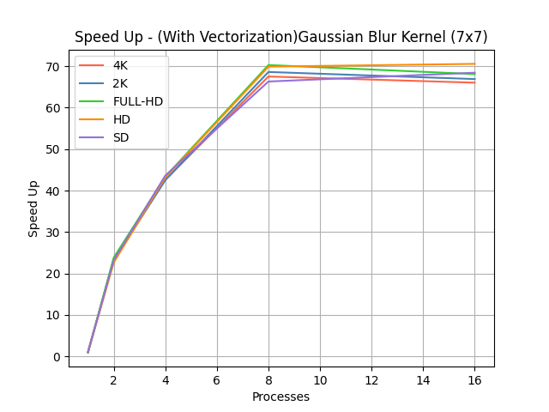
Kernel Image Processing,
Parallelization with python
Firenze, 05/07/2024
Vectorization Results
SpeedUp Obtained
With this type of implementation, we achieved a significant speedup compared to the previous version.
As the kernel size increases, a significant improvement in terms of speedup is observed this time.
The highest recorded speedup value, 70.56, is achieved with HD images using 16 processes for the computation.
12

Slide 13
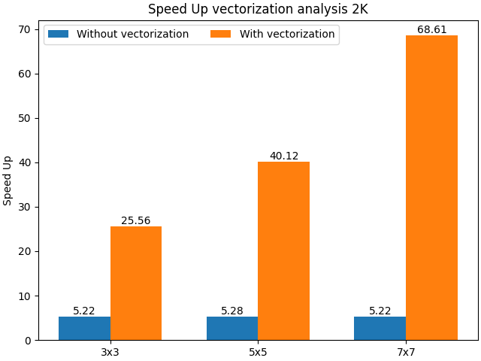
Kernel Image Processing,
Parallelization with python
Firenze, 05/07/2024
Comparison between the two implementations
SpeedUp comparison
With a 3x3 kernel, an improvement of nearly 5 times is recorded. With a 5x5 kernel, the improvement is about 8 times, and finally, with a 7x7 kernel, the speedup is approximately 13 to 14 times greater.
In conclusion, it can be said that, despite Python not being the optimal choice for this type of task, excellent results can still be achieved using vectorization techniques.
13

