Slide 1
Quantum Key Hunt VR
Mirko Bicchierai, Niccolò Marini
Course: Computer Graphics

Slide 2
Introduction

Slide 3


Game Overview
Quantum Key Hunt VR – Mirko Bicchierai, Niccolò Marini
Quantum Key Hunt is an immersive VR game developed in Unity, where players are challenged to shoot moving targets to unlock a door and complete each level.
Tools and Technologies
Unity: The game is built on Unity, leveraging its powerful engine for immersive VR experiences and robust gameplay mechanics.
XR Interaction Toolkit: Utilizing Unity's XR Interaction Toolkit to translate VR user input into game input

Slide 4

Showcase Video
Quantum Key Hunt VR – Mirko Bicchierai, Niccolò Marini

Slide 5
Game Design
Assets pack and Level System

Slide 6
Assets
Quantum Key Hunt VR – Mirko Bicchierai, Niccolò Marini
The main assets packs used during the project are:
Sci-Fi assets Pack (Materials/Stairs/Doors)
Sci-Fi Guns (Low Poly)
Attachment (C4/Torch/Laser/Scope , Low Poly)
Conversion to URP: To achieve optimal performance and visual fidelity in our game, we converted these asset packs to the Universal Render Pipeline (URP). URP provides several advantages:
Enhanced Performance:
Improved Graphics Quality:
Consistency

Slide 7
Universal Render Pipeline (URP)
Quantum Key Hunt VR – Mirko Bicchierai, Niccolò Marini
The Universal Render Pipeline (URP) is a rendering solution provided by Unity designed to offer high performance and graphical fidelity across a wide range of platforms.
URP optimizes rendering processes to improve performance on both high-end and low-end devices.
It features advanced rendering techniques, such as better lighting and shading effects, and ensures consistent visual quality across various hardware.
URP is ideal for projects that need to balance performance with visual quality, making it a popular choice for both 2D and 3D games.

Slide 8
Game Physics
Layer Collision and Collision detection

Slide 9
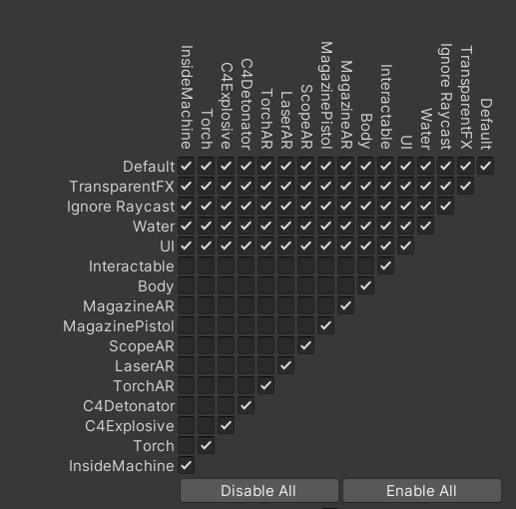
Layer Collision
Quantum Key Hunt VR – Mirko Bicchierai, Niccolò Marini
To prevent issues, we disabled collisions between the various layers, particularly between the body and the layers.
This is because, when collisions were enabled, objects would sometimes apply forces to others, causing issues, particularly with various sockets, as we will see later.
To make everything more VR-friendly, collisions with the body must obviously be disabled.

Slide 10
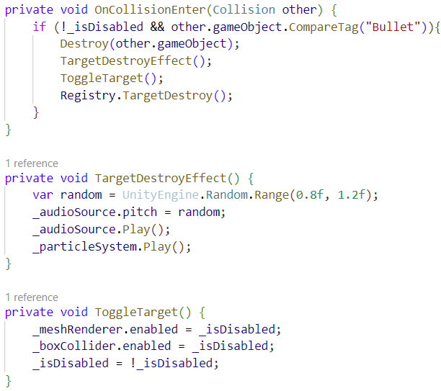
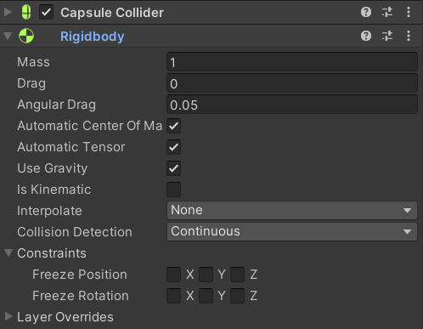
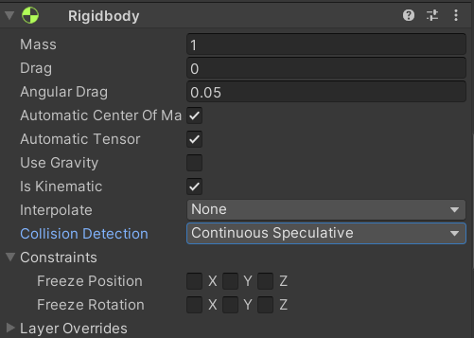
Collision Target Detection
Quantum Key Hunt VR – Mirko Bicchierai, Niccolò Marini
The collisions registered for the fired bullets rigidbody are set to "continuous" to improve accuracy in detecting collisions.

Slide 11
Player Movement
Different Type

Slide 12
Different types of player movement
We chose the second option because, based on our testing, it proved to be the best for our type of game and caused less nausea when using the headset.
Quantum Key Hunt VR – Mirko Bicchierai, Niccolò Marini
There are mainly three ways to implement player movement in VR:
  Snap Turn: Rotate the view by n degrees with each input.
  Continuos Turn: Continuously rotate the view smoothly according to the player's input.
  Teleport: Allow the player to choose the point to teleport to and the direction to face.

Slide 13
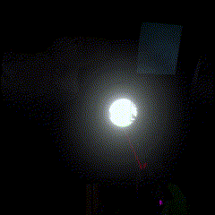
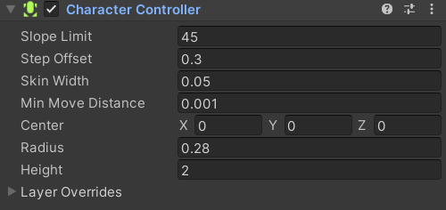
Stairs climb system
Quantum Key Hunt VR – Mirko Bicchierai, Niccolò Marini
In the CharacterController, we set a slope limit of 45 degrees and a maximum step offset. This allows our player to climb over objects in the scene that are up to 0.3 units high.

Slide 14
Grab Interactor
Torch and the Guns

Slide 15
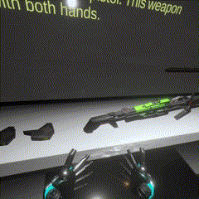
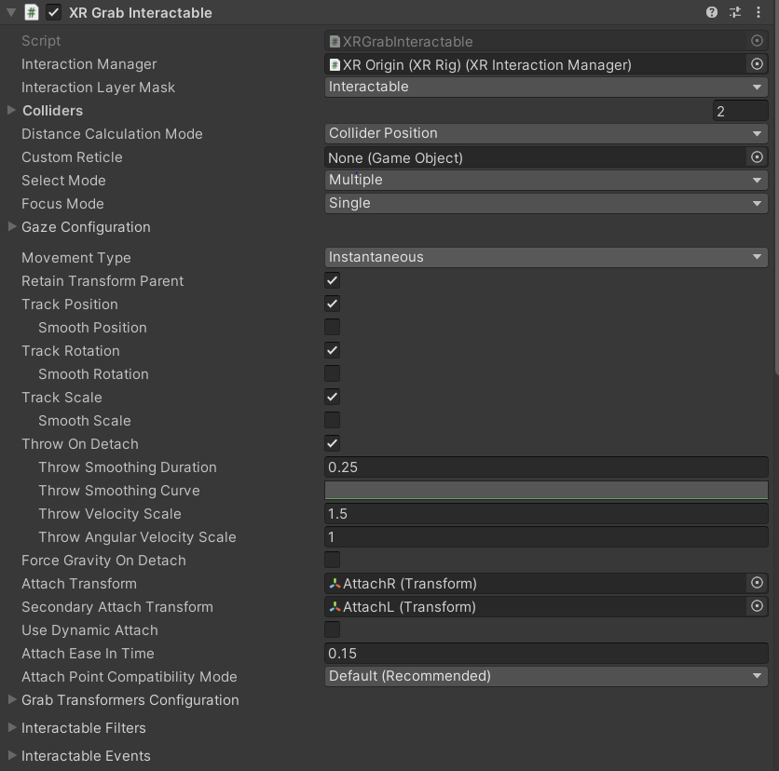
Grab Interactor
Quantum Key Hunt VR – Mirko Bicchierai, Niccolò Marini
The Grab Interactor This is used for interacting with objects at close range by directly grabbing them with hand controllers.

Slide 16
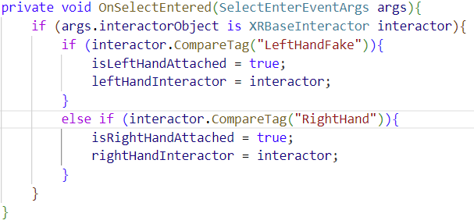
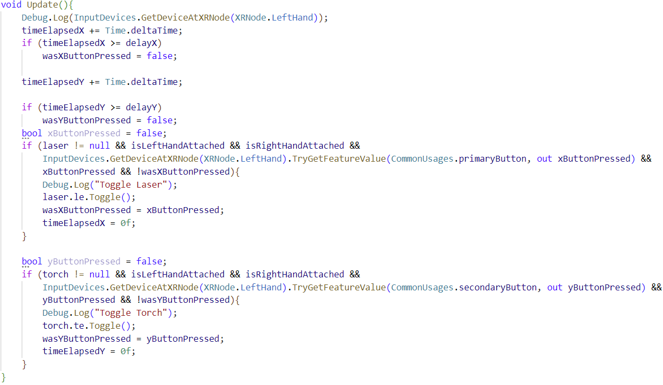
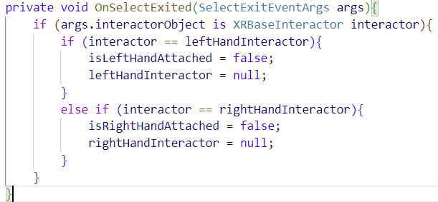
Grab Interactor
Quantum Key Hunt VR – Mirko Bicchierai, Niccolò Marini
This weapon, in particular, features a different grab interactor from the standard ones, configured for a two-handed grip, with two Attach Transformers, one for each hand.

Slide 17
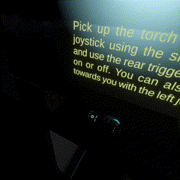
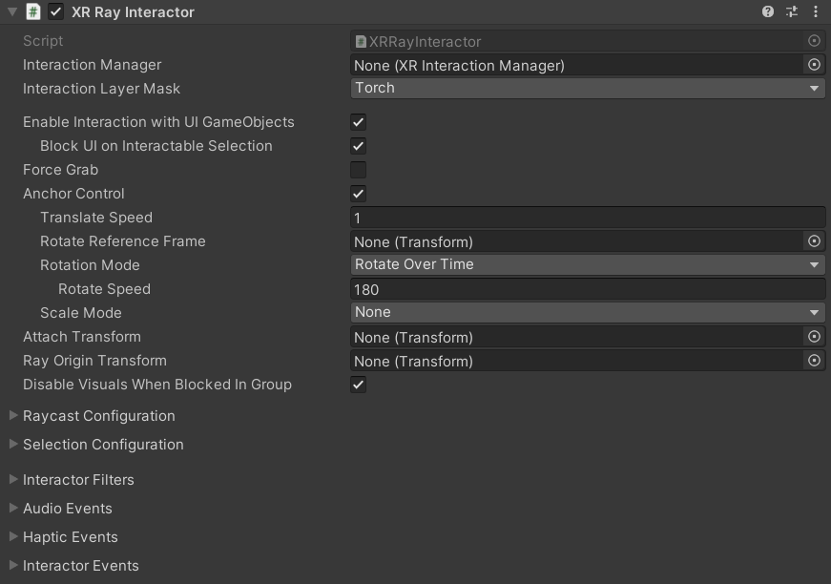
Ray interactor
Quantum Key Hunt VR – Mirko Bicchierai, Niccolò Marini
The XR Ray interactor allows for interactions at a distance by projecting a ray from the controller. It’s ideal for selecting or interacting with objects without needing to be physically close.

Slide 18
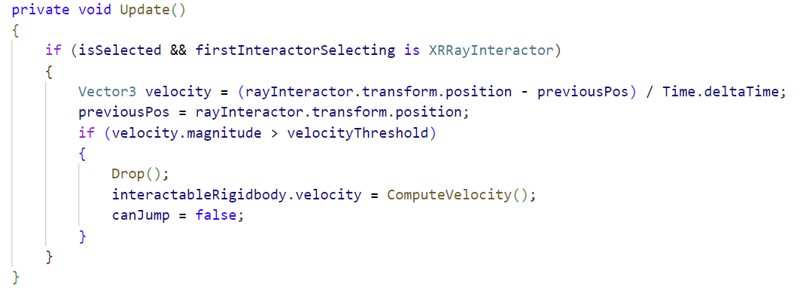
Using Direct and Ray interactor together
In Quantum Key Hunt, we implemented a grab system similar to Half-Life: Alyx on the left hand, allowing players to grab objects both directly and from a distance. Using Unity’s XRRayInteractor, players can pull distant objects toward them with a physics-based throw interaction.
Quantum Key Hunt VR – Mirko Bicchierai, Niccolò Marini

Slide 19
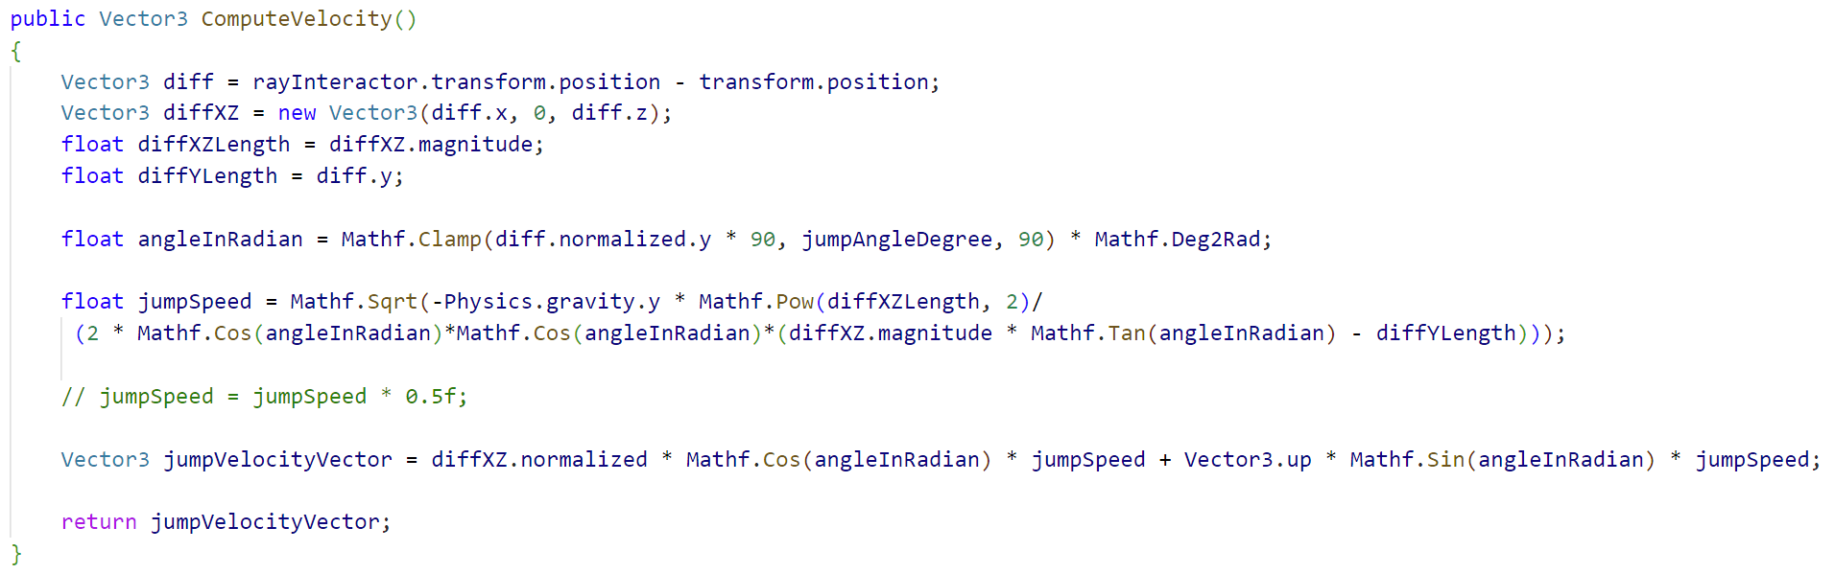
Using Direct and Ray interactor together
The system calculates the velocity of the grabbed object, determining when to "drop" and send the object flying based on the player’s hand movement. The interaction combines Direct Interactor for close objects and Ray Interactor for distant grabs.
Quantum Key Hunt VR – Mirko Bicchierai, Niccolò Marini

Slide 20
Scoket Interactor
Magazine and attachments

Slide 21
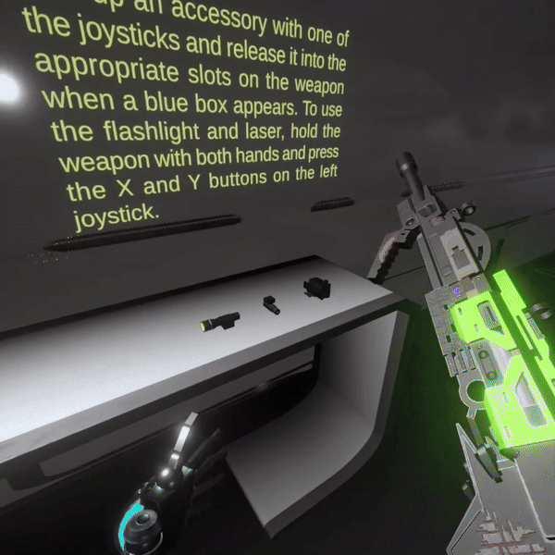
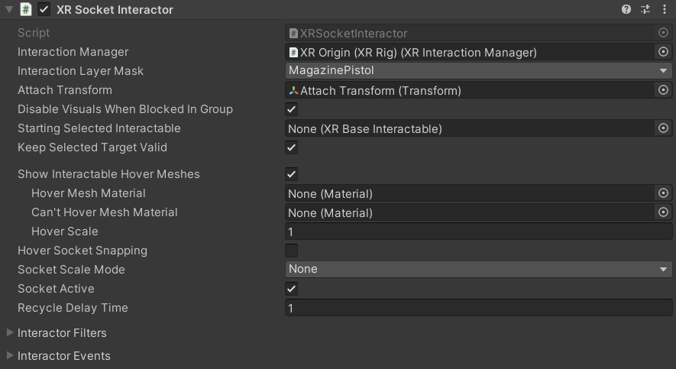
Socket Interactor
Quantum Key Hunt VR – Mirko Bicchierai, Niccolò Marini
The XR Socket Interactor enables snapping objects into predefined slots, allowing for object placement or assembly mechanics in a 3D space.

Slide 22
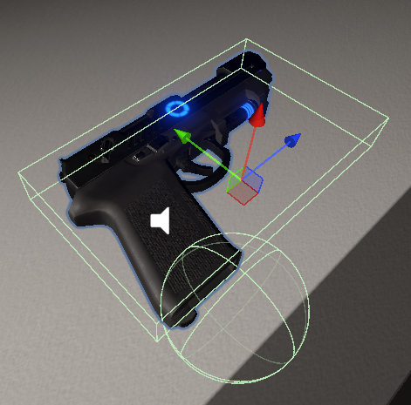
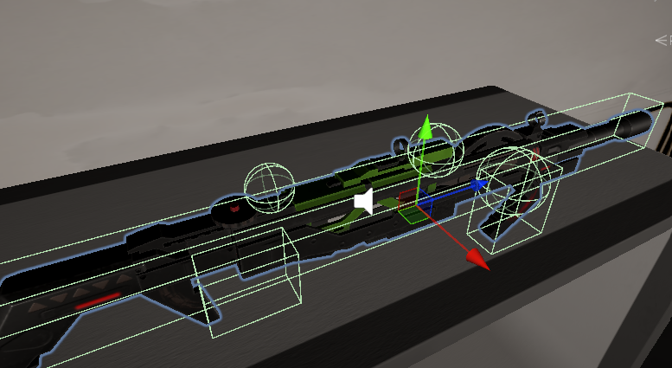
Socket Colliders model
Quantum Key Hunt VR – Mirko Bicchierai, Niccolò Marini

Slide 23
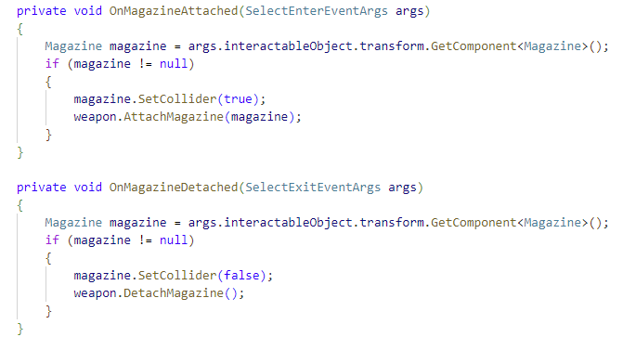
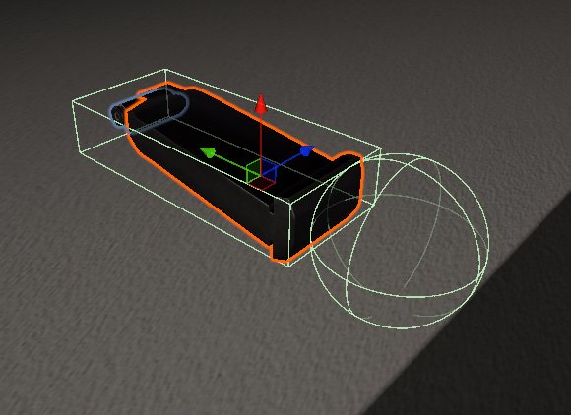
Socket Interactor
Quantum Key Hunt VR – Mirko Bicchierai, Niccolò Marini
We implemented XRSocketInteractors to allow players to seamlessly attach and detach magazines and attachments to guns. The socket mechanism ensures that objects like magazines are snapped into place, enabling smooth interactions during reloading or modifying the weapon.
The MagazineSocket script listens for objects entering or exiting the socket, attaching the magazine to the weapon and enabling it for use once it's placed in the correct slot.

Slide 24
Poke Interactor
Key-Pad

Slide 25
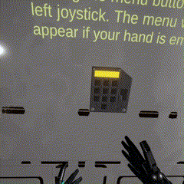
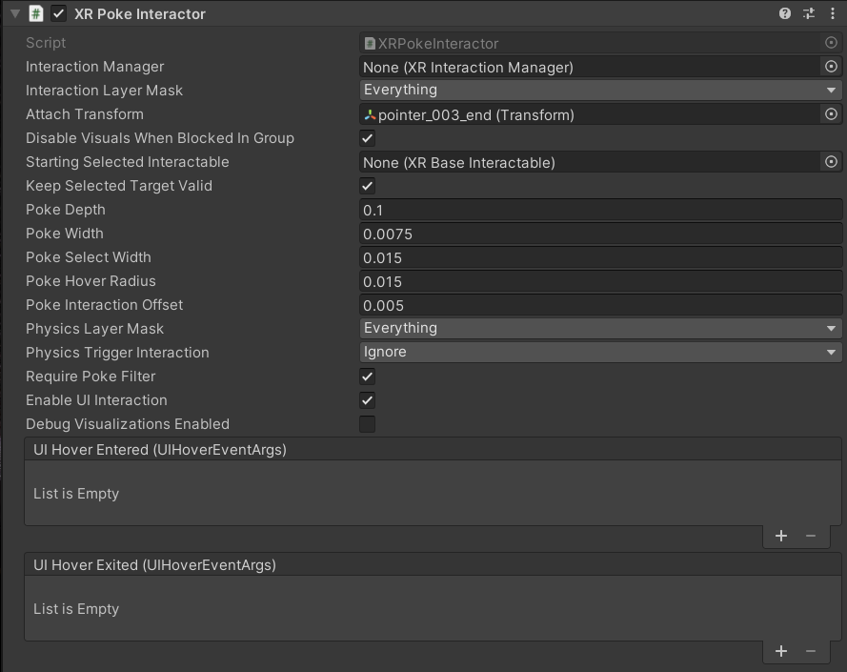
Poke Interactor
Quantum Key Hunt VR – Mirko Bicchierai, Niccolò Marini
The XR Poke Interactor is designed for touch-based interactions, it lets players "poke" objects, simulating real-world tapping or button-press actions.

Slide 26
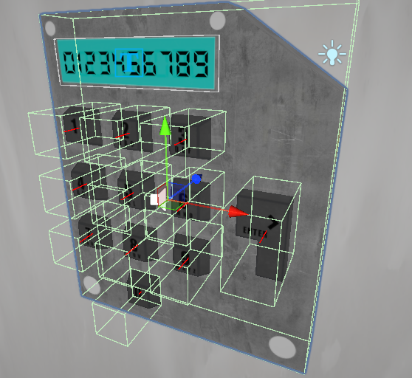
PinPad Model
Quantum Key Hunt VR – Mirko Bicchierai, Niccolò Marini
For the pinpad, we modeled each key with its own BoxCollider to allow it to be pressed by the player's right index finger.
This can sometimes lead to missed collisions between the finger and the key. However, adjusting the poke interactor settings can improve the situation.

Slide 27
Destroyable Wall
C4 system

Slide 28
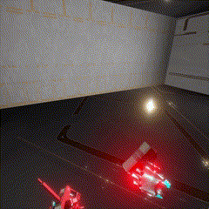
Destroyable Wall: Introduction
Quantum Key Hunt VR – Mirko Bicchierai, Niccolò Marini
In our game, there is an explosion mechanic involving C4 and a detonator.
Only certain walls within the scene are destructible.

Slide 29
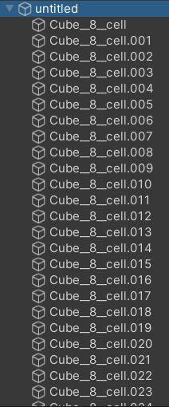
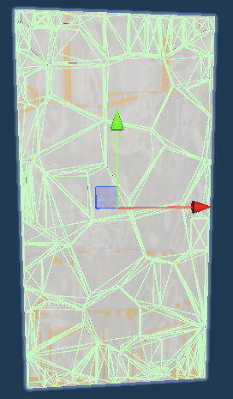
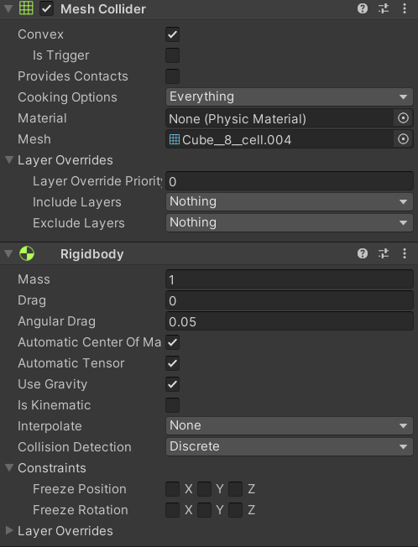
Destroyable Wall: Brick System
Quantum Key Hunt VR – Mirko Bicchierai, Niccolò Marini

Slide 30
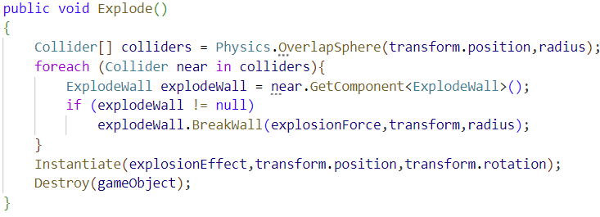
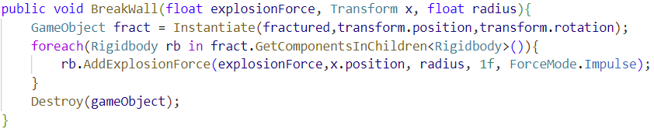
Destroyable Wall: Explosion System
Quantum Key Hunt VR – Mirko Bicchierai, Niccolò Marini
The first function pertains to the C4 and is called by the detonator when activated.
The second function is specific to the destructible wall.

Slide 31
Light System

Slide 32
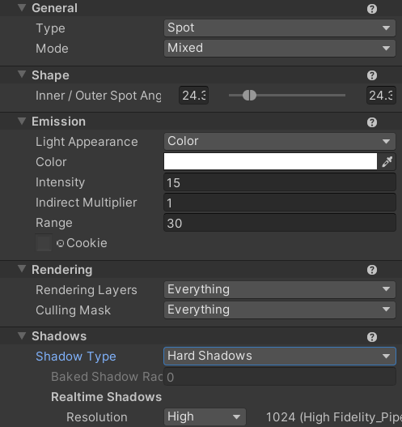
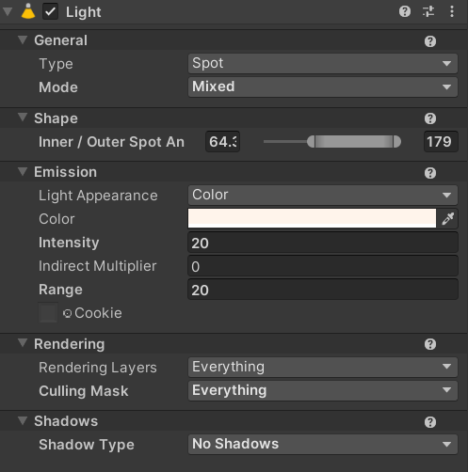
Light System
Quantum Key Hunt VR – Mirko Bicchierai, Niccolò Marini
In the game, we have two types of lighting: static lights within the scene and real-time lights, such as torches, which can move.
Torch lights are the only ones casting shadows, due to performance considerations.

Slide 33
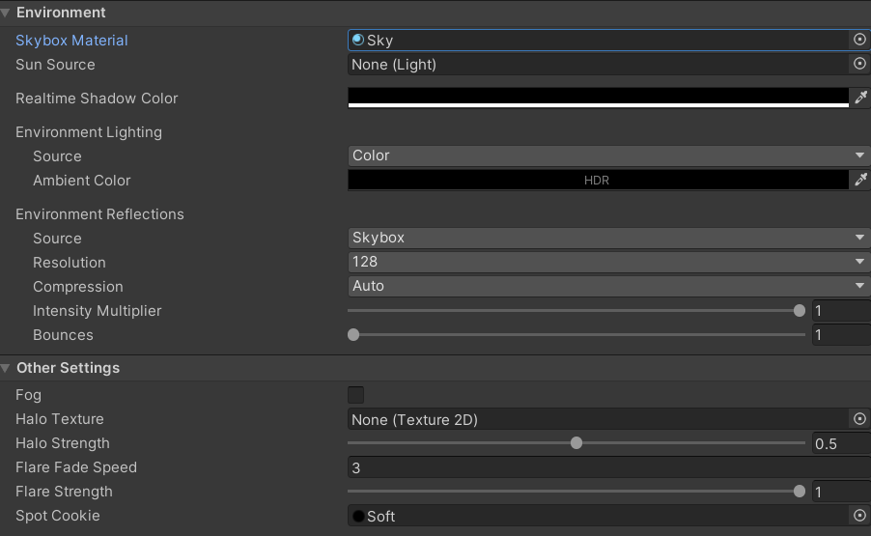
Environment Settings
Quantum Key Hunt VR – Mirko Bicchierai, Niccolò Marini
For our project, since we are always rendering indoor rooms, we set the shadow color to black and the ambient color to black as well, making it effectively inconsequential.
Additionally, we disabled all external lights, such as the sun.

Slide 34
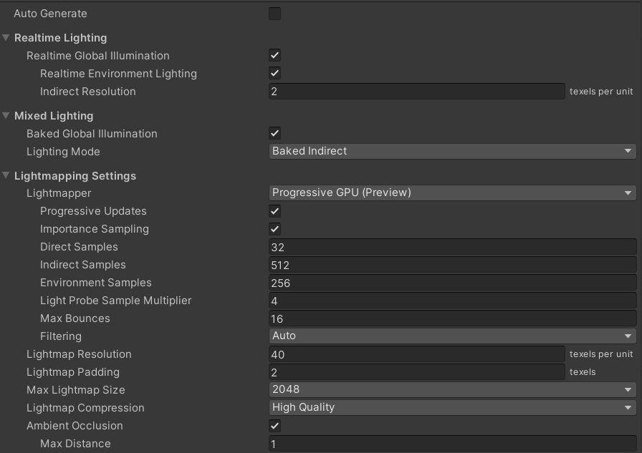
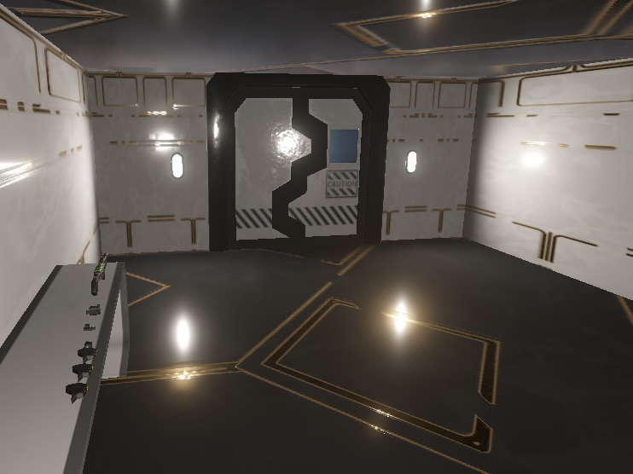
Light, global settings
Quantum Key Hunt VR – Mirko Bicchierai, Niccolò Marini
We used these settings for all the scenes.
We set the maximum number of light bounces to 16 because, experimentally, this resulted in more aesthetically pleasing shadows and colors.
We also increased the samples for indirect lighting.

Slide 35
Conclusions

Slide 36
Conclusions
Quantum Key Hunt VR – Mirko Bicchierai, Niccolò Marini
In conclusion, we aimed to create a game that is as comprehensive as possible, covering all aspects and incorporating the standard features expected in modern VR games.
Unlike a traditional 3D game, VR introduces unique challenges when dealing with elements that aren't VR-friendly. For instance, an HUD with text (like a canvas that follows you) can be problematic, or even the placement of objects in the scene, which may sometimes be physically out of reach.
Additionally, in VR, every small graphical detail, such as lighting and shadows, becomes much more noticeable. Any imperfections in these elements will be amplified by the immersive nature of VR, making flaws more apparent to the player.
Another crucial aspect we've focused on is performance. In VR, dropping below 60 FPS can lead to motion sickness, so maintaining a high frame rate is essential to ensure a comfortable experience for the player.

Slide 37
Thank you for your attention!
Quantum Key Hunt VR
Course: Computer Graphics.
Mirko Bicchierai and Niccolò Marini
Quantum Key Hunt VR – Mirko Bicchierai, Niccolò Marini

