Slide 1

Team 9, Emanuele, Marina, Mirko

Slide 2
1. Project Overview
👀 Goal (what it does, for whom)
Interactive Computer Vision - Detects object movement and user gestures on a 3D space
The goal is a more user friendly/gamified way for the user interacting with their space
🎯Use case in brief: why it matters
More enriching and interactive way of interacting
with museum exhibits

Slide 3
1. Project Overview
🖼️ Visual: simple mockup
Small demo: the user moves an item around the space, avoiding the “trapped” space and landing on the correct block
Bigger demo: The user interacts with a game exhibit menu, where they use 3 gestures to navigate. One to select, one to confirm and one to return back. On the menu there are the following options: Information about the exhibit, game instructions and the option to play the game, which starts the

Slide 4
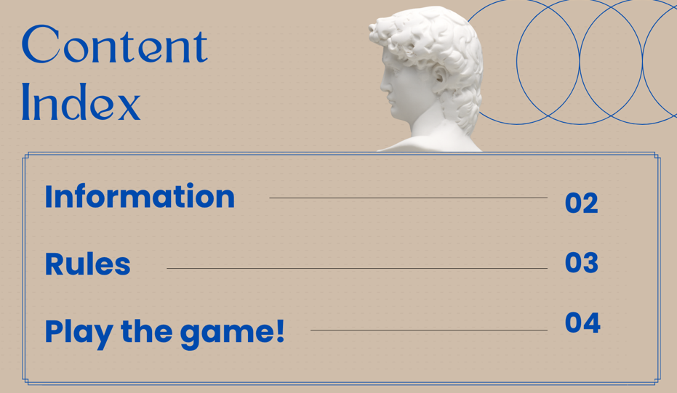
1. Project Overview
🖼️ Visual: simple mockup

Slide 5
2. Dataset & Model
📊 Dataset: 2 Datasets:
1st Dataset for Object Detection:
5 classes
Training 5348 items
Validation 1505 items
Focoos pre-trained detector (COCO)
2nd Dataset for Gesture Classification:
3 classes ~150 pictures
Captured with Nicla at 96×96, balanced;

Slide 6
2. Dataset & Model
🧠 Model architecture:
1st Model for Object Detection:
fai-detr-m-coco Focoos detection (cloud/SDK) → outputs label, x, y.
2nd Model for Gesture Classification:
fai-cls-n-coco compact CNN 96×96 RGB, with this parameters: resolution: 96, crop_size: 96, scale_ratio: 0.3, square: 1

Slide 7
2. Dataset & Model
⚖️ Trade-offs: low accuracy on nicla, memory restrictions
💡 Reasoning: why this setup is suitable for edge deployment:
tiny 96×96 classifier, INT8, weights in QSPI/XIP; fits memory and runs real-time on Nicla.

Slide 8
3. Deployment Pipeline
🔧 Pipeline steps
Cloud Model training,local build and quantization,build of the arduino library, uploading firmware into arduino
⚡ Performance: frame rate: 0.8 fps , latency: 1 second

Slide 9
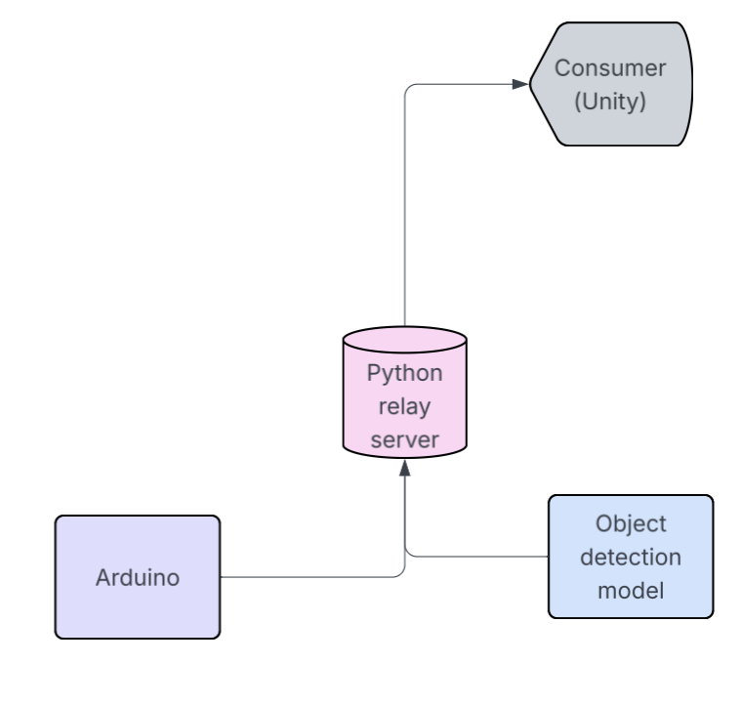
4. Demo & User Experience
🌐 Integration:
👤 UX: The goal is a more gamified/user friendly interface

Slide 10
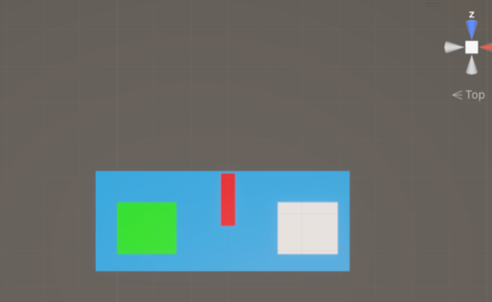
4. Demo & User Experience
📷 Screenshot or mockup of the demo

Slide 11
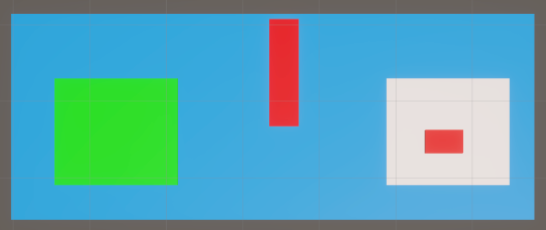
4. Demo & User Experience
📷 Screenshot or mockup of the demo

Slide 12
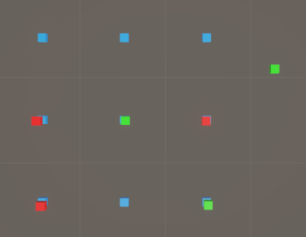
4. Demo & User Experience
📷 Screenshot or mockup of the demo

Slide 13
5. Impact & Next Steps
🌟 Innovation & originality:
🚀 Future potential: multiple & more practical gesture classification for real world user use, bigger/better datasets,use of 2 niclas for true 3D space imaging, broader application for multiple industries, like education, medicine etc.

Slide 14
That’s a wrap!🌮 Thanks

