Slide 1

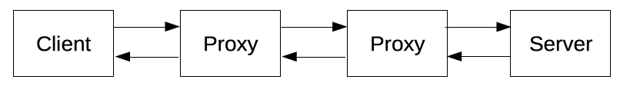



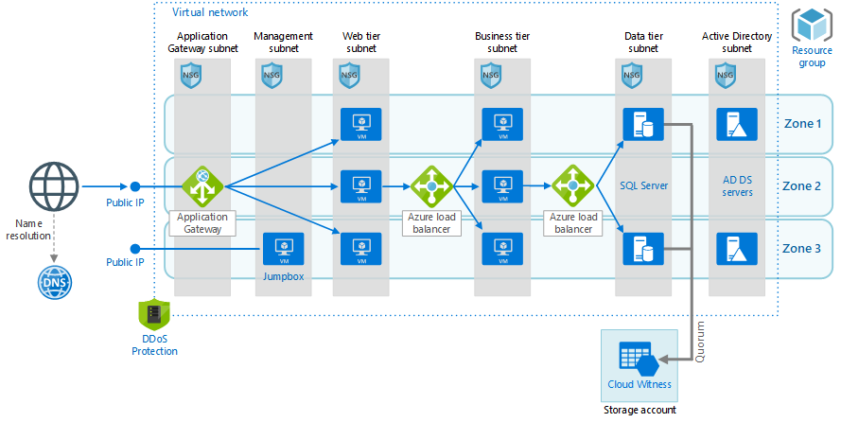
Caching
Relaxing the origin constraint
Authentication
Proxy & Tunneling
Sessions
Web Application / Content Provider
(Middleware & Application Servers)
Caching
Filtering
Load balancing
Authentication
Logging
HTTP Control on Communication
(Mostly Client Side)
- Web Browser
- Scrawler Robot
- Etc.
DNS Servers
CDN Servers
Etc.
Request
Request
Request
Application Layer
(HTTP)
Response
Response
Response
Transport Layer
HTTP1 | HTTP2 | HTTP3
TCP + [SSL] | TCP + SSL/TLS | QUIC (UDP Based)
Network Layer
...

Slide 2
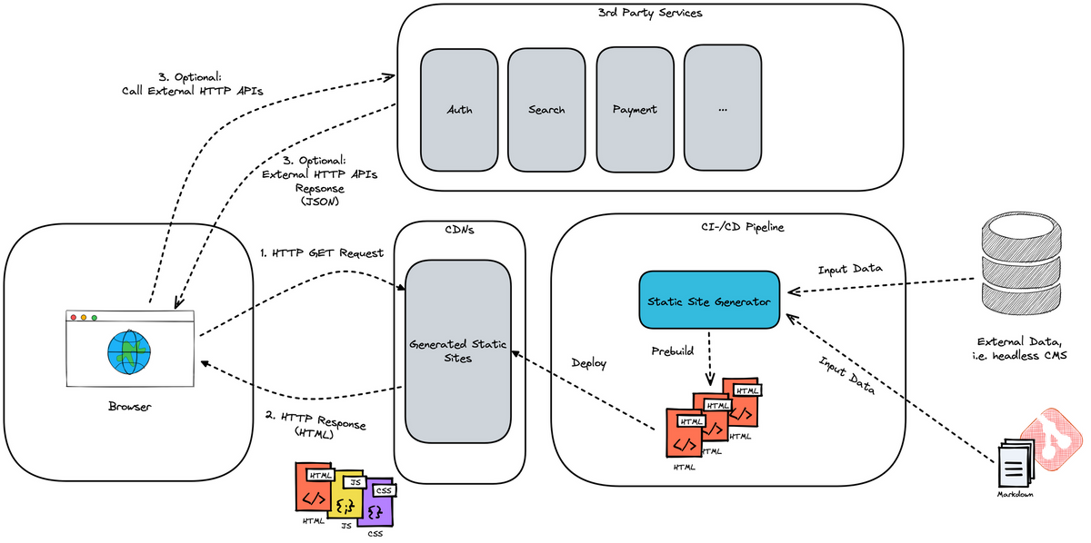
Frontend /User Agent /Browsers
Backend /Web Application / Content Provider
(Middleware & Application Servers)
DNS Servers
CDN Servers
Etc.
Request
Request
Request
Application Layer
(HTTP)
Response
Response
Response

