Slide 1
Input/Output Modeling of Simple Artificial Cell Using Modularized Approach
Miroslav Gasparek, Imperial College London
Mentor: Richard Murray, Caltech
Co-mentor: Vipul Singhal
26 September 2017

Slide 2
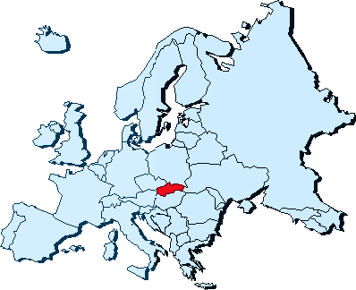
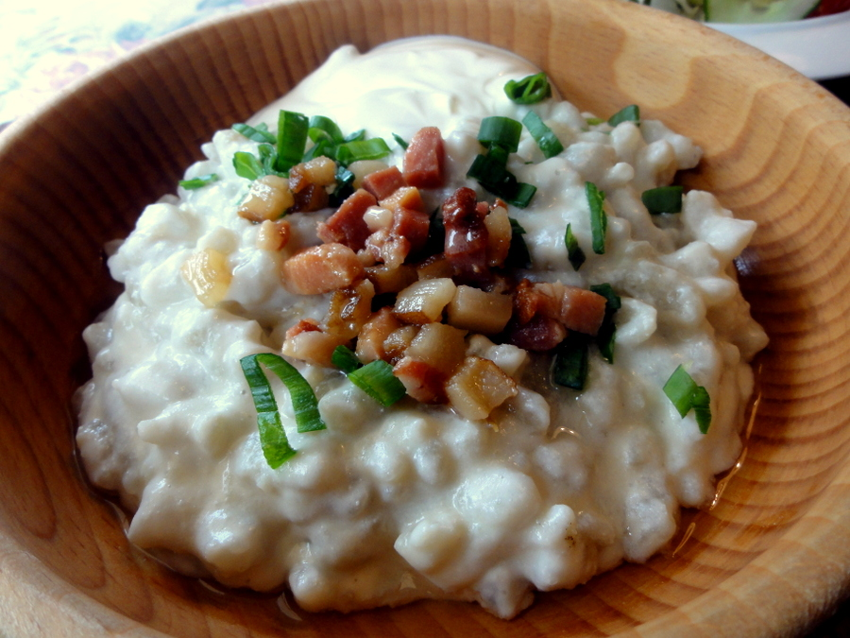
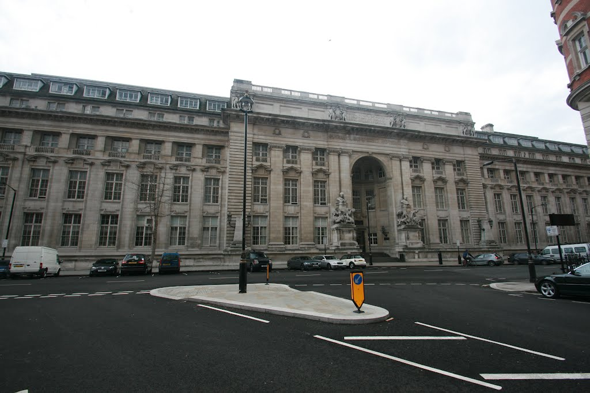


Introduction & Background
Miroslav Gasparek
Coming from Puchov, Slovakia
Year Two Undergraduate, Department of Bioengineering, Imperial College London
Interested in dynamical and control systems
I play accordion for more than 13 years

Slide 3
Contents
Motivation & Background
Modeling of interconnection of simple cellular subsystems in BioSIMI
Interconnection of TX-TL reactions using BioSIMI
Input/output characteristics of genetic toggle switch encapsulated in the liposome
Summary of experimental work
Conclusion and the future plans

Slide 4
Contents
Motivation & Background
Modeling of interconnection of simple cellular subsystems in BioSIMI
Interconnection of TX-TL reactions using BioSIMI
Input/output characteristics of genetic toggle switch encapsulated in the liposome
Summary of experimental work
Conclusion and the future plans

Slide 5
Properties of living cells
Output signal
Membrane Export
Self-organization
Homeostasis
Reproduction
Growth
Metabolism
Adaptation to surrounding environment
Response to environmental stimuli
Reproduction
Input signal
Sensing/
Membrane Import
Intracellular
Signaling
Regulation/Computation
Alberts, B. (2014). Essential cell biology. New York: Garland Science.

Slide 6
Properties of artificial cells
Output signal
Membrane Export
Self-organization
Homeostasis
Reproduction
Growth
Metabolism
Adaptation to surrounding environment
Response to environmental stimuli
Reproduction
Input signal
Sensing/
Membrane Import
Intracellular
Signaling
Regulation/Computation
Alberts, B. (2014). Essential cell biology. New York: Garland Science.

Slide 7
Modular “bottom-up” approach
Output signal
Biomolecular circuits as subsystems
Various subsystems
- Sensing
- Transport
- Signaling
- Regulatory
- Metabolic
“Building blocks” of artificial cell
Membrane Export
Input signal
Sensing/
Membrane Import
Intracellular
Signaling
Regulation/Computation
Alberts, B. (2014). Essential cell biology. New York: Garland Science.

Slide 8
Input/Output analysis
Current tools:
- in vitro cell-free approach (TX-TL)
- in silico MATLAB SimBiology TX-TL modeling toolbox
Issues:
Inability to model modular behavior in TX-TL
No way to connect subsystems
Need for simple modeling tool
for I/O modeling
Output signal
RNAP, Enzymes…
Membrane Export
Input signal
Sensing/
Membrane Import
Intracellular
Signaling
Regulation/Computation
Del Vecchio, D. and Murray, R. (2015). Biomolecular feedback systems. Princeton, NJ [u.a.]: Princeton Univ. Press.

Slide 9
Contents
Motivation & Background
Modeling of interconnection of simple cellular subsystems in BioSIMI
Interconnection of TX-TL reactions using BioSIMI
Input/output characteristics of genetic toggle switch encapsulated in the liposome
Summary of experimental work
Conclusion and the future plans

Slide 10
Modeling of interconnection of simple cellular subsystems
Output signal
Diffusion out of the cell
Input signal
Diffusion into the cell
Double Phosphorylation Pathway
Incoherent
Feed-Forward Loop

Slide 11
BioSIMI
BioSIMI (“Biomolecular Subsystems Interconnection Modeling Instrument”)
Tool for simple I/O modeling of interconnected biomolecular subsystems
Multiple Input/Single Output modeling
User-defined (mainly transport) and TX-TL-defined (standard assembly)
Accounts for retroactivity and resource competition

Slide 12
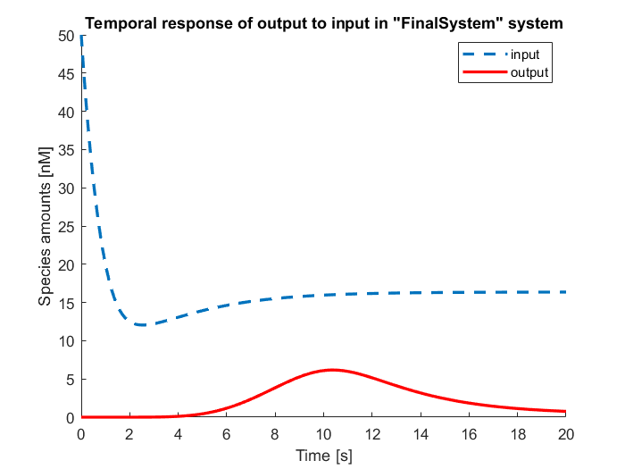
BioSIMI (I/O Model of Vesicle)
% Create SimBiology model object vesicle vesicle = BioSIMI_make_vesicle('vesicle') % Create subsystem with reactions and species in DiffusionIn subsystem DiffIn = BioSIMI_make_subsystem('DiffusionIn','input','output','DiffIn') % Add reactions and species in DiffusionIn subystem to the appropriate % compartments of vesicle object BioSIMI_add_subsystem(vesicle,{'int','ext'},DiffIn) % Create subsystem with reactions and species in Double-Phosphorylation subsystem DP_Subsystem = BioSIMI_make_subsystem('DP','in','out','DP_Subsystem') % Add reactions and species in Double-Phosphorylation subystem to the appropriate % compartments of vesicle object BioSIMI_add_subsystem(vesicle,'int',DP_Subsystem) % Connect DiffusionIn subsystem with Double-Phosphorylation subsystem and % create object of class subsystem that contains connection of both % subsystems DiffDP = BioSIMI_connect(vesicle,'int',DiffIn,DP_Subsystem,'DiffDP') % Create subsystem with reactions and species in IFFL subsystem IFFL_Subsystem = BioSIMI_make_subsystem('IFFL','in','out','IFFL_Subsystem') % Add reactions and species in IFFL subystem to the appropriate % compartments of vesicle object BioSIMI_add_subsystem(vesicle,'int',IFFL_Subsystem) % Connect the combination of DiffusionIn and Double-Phoshporylation subsystem with IFFL % subsystem and create object of class subsystem that contains connection % of all three subsystems Diff_DP_IFFL = BioSIMI_connect(vesicle,'int',DiffDP,IFFL_Subsystem,'Diff_DP_IFFL') % Create subsystem with reactions and species in DiffusionOut subsystem DiffOut = BioSIMI_make_subsystem('DiffusionOut','input','output','DiffOut') % Add reactions and species in DiffusionOut subystem to the appropriate % compartments of vesicle object BioSIMI_add_subsystem(vesicle,{'int','ext'},DiffOut) % Connect the combination of DiffusionIn, Double-Phoshporylation, and IFFL % subsystem with Diffusion Out subsystem and create object of class subsystem % that contains connection of all four subsystems subsystems FinalSystem = BioSIMI_connect(vesicle,'int',Diff_DP_IFFL,DiffOut,'FinalSystem') % Run the simulation of the Final System SimData = BioSIMI_runsim(FinalSystem,20) % Plot the Input/Output relationship in the Final System BioSIMI_plot(FinalSystem,SimData)

Slide 13
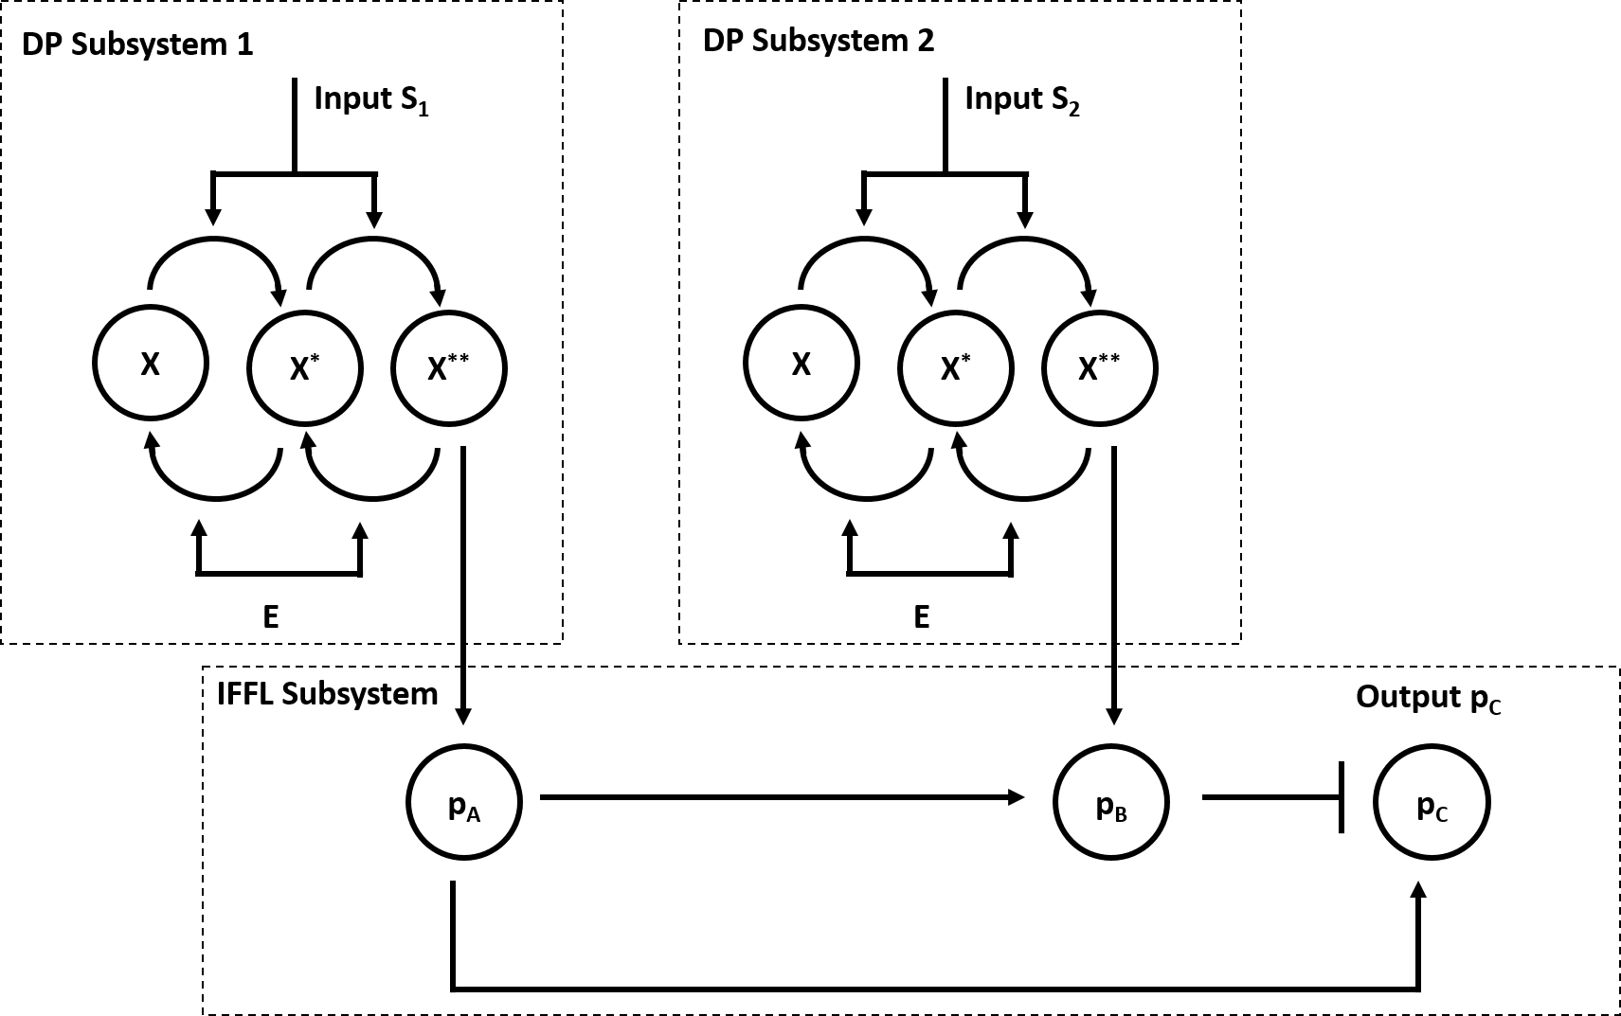
BioSIMI (Multiple input/Single Output)

Slide 14
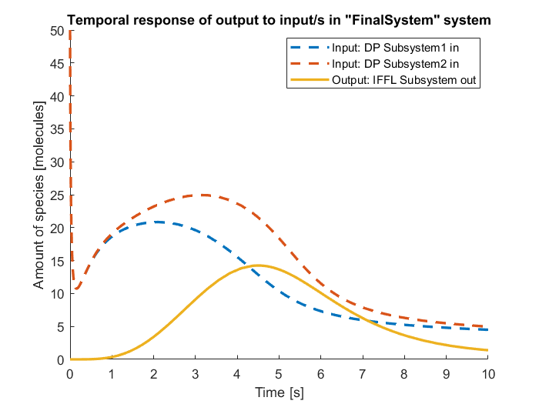
BioSIMI (Multiple input/Single Output)
% Create SimBiology model object vesicle vesicle = BioSIMI_make_vesicle('vesicle'); % Create subsystem with reactions, parameters and species in the first Double-Phosphorylation subsystem DP_Subsystem1 = BioSIMI_make_subsystem('DP','in','out','DP_Subsystem1'); % Create subsystem with reactions, parameters and species in the second Double-Phosphorylation subsystem DP_Subsystem2 = BioSIMI_make_subsystem('DP','in','out','DP_Subsystem2'); % Create subsystem with reactions, parameters and species in Incoherent Feed-Forward Loop subsystem % Choose species activator protein A ('pA') and repressor protein B ('pB') % as inputs of IFFL subsystem IFFL_Subsystem = BioSIMI_make_subsystem('IFFL',{'pA','pB'},'out','IFFL_Subsystem'); % Add all subsystems into vesicle's internal compartment BioSIMI_add_subsystem(vesicle,'int',DP_Subsystem1); BioSIMI_add_subsystem(vesicle,'int',DP_Subsystem2); BioSIMI_add_subsystem(vesicle,'int',IFFL_Subsystem); % Create final system that consists of input subsystems and output % subsystem FinalSystem = BioSIMI_connect(vesicle,'int',{DP_Subsystem1,DP_Subsystem2},IFFL_Subsystem,'FinalSystem'); % Run the simulation of the Final System SimData = BioSIMI_runsim(FinalSystem); % Plot the Input/Output relationship in the Final System BioSIMI_plot(FinalSystem,SimData);

Slide 15
Contents
Motivation & Background
Modeling of interconnection of simple cellular subsystems in BioSIMI
Interconnection of TX-TL reactions using BioSIMI
Input/output characteristics of genetic toggle switch encapsulated in the liposome
Summary of experimental work
Conclusion and the future plans

Slide 16
Connecting TX-TL systems
Incoherent Feed-Forward Loop + Gene Expression TX-TL reaction
Amino acids, AGTP…
Arabinose
Incoherent
Feed-Forward Loop
Gene Expression Reaction
Protein deGFP*
Protein deGFP-lva*
RNAP

Slide 17
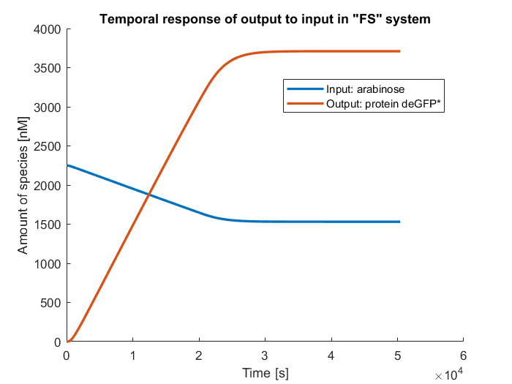
BioSIMI (I/O modeling of multiple TX-TL subsystems)
%% Create Incoherent Feed-Forward Loop (IFFL) circuit in TX-TL modeling toolbox % Set up the standard TXTL tubes tube1 = txtl_extract('E30VNPRL'); tube2 = txtl_buffer('E30VNPRL'); tube3 = txtl_newtube('circuit_closed_loop_withClpX'); % Define the DNA strands (defines TX-TL species + reactions) txtl_add_dna(tube3, 'p70(50)', 'utr1(20)', 'AraC(600)',0.5*4.5, 'plasmid'); txtl_add_dna(tube3, 'pBAD(50)', 'utr1(20)', 'tetR(600)', 2*4.5, 'plasmid'); txtl_add_dna(tube3,'pBAD_ptet(150)', 'utr1(20)', 'deGFP(1000)-lva(20)',4*4.5, 'plasmid'); txtl_add_dna(tube3,'p70(50)', 'utr1(20)', 'ClpX(600)',0.1*4.5, 'plasmid'); % Add species to the tube 3 txtl_addspecies(tube3, 'arabinose', 10000); txtl_addspecies(tube3, 'aTc', 1000); ClpXToAdd = 80; % ClpX are added % Mix the contents of the individual tubes % Create Model Object 'IFFL' that can serve as model object for 'IFFL subsystem' IFFL = txtl_combine([tube1, tube2, tube3]); %% Create subsystem for 'IFFL' circuit assembled in TX-TL above IFFL_Subsystem = BioSIMI_make_subsystem(IFFL,'arabinose','protein deGFP-lva*','IFFL_Subsystem'); | %% Create simple Gene Expression (GenExp) circuit in TX-TL modeling toolbox % Set up the standard TXTL tubes tube1 = txtl_extract('E30VNPRL'); tube2 = txtl_buffer('E30VNPRL'); tube3 = txtl_newtube('gene_expression'); % Define the DNA strands (defines TX-TL species + reactions) dna_deGFP = txtl_add_dna(tube3, ... 'p70(50)', 'utr1(20)', 'deGFP(1000)', ... % promoter, rbs, gene 30, ... % concentration (nM) 'plasmid'); % type % Mix the contents of the individual tubes % Create Model Object 'GenExp' that can serve as model object for 'GenExp subsystem' GenExp = txtl_combine([tube1, tube2, tube3]); %% Create subsystem for 'GenExp' circuit assembled in TX-TL above GenExp_Subsystem = BioSIMI_make_subsystem(GenExp,'RNAP','protein deGFP*','GenExp_Subsystem'); %% Create new subsystem 'FinalSystem' that contains species from connected 'IFFL' and 'GenExp' subsystems FinalSystem = BioSIMI_connect_txtl('FinalSystem','int',IFFL_Subsystem,GenExp_Subsystem,'FinalSystem'); % Create new subsystem 'FS' that removes repeated species and the unused output of 'input subsystem' % Set up events, parameters, and reactions in the final subsystem 'FS' FS = BioSIMI_assemble(FinalSystem,'FS'); % Simulate final subsystem 'FS' with assembled reactions for (14*60*60) seconds SimData = BioSIMI_runsim(FS,14*60*60); % Plot time dependences of input (arabinose) and output (protein deGFP*) of interconnection of IFFL and GenExp subsystems BioSIMI_plot(FS,SimData);

Slide 18
Contents
Motivation & Background
Modeling of interconnection of simple cellular subsystems in BioSIMI
Interconnection of TX-TL reactions using BioSIMI
Input/output characteristics of genetic toggle switch encapsulated in the liposome
Summary of experimental work
Conclusion and the future plans

Slide 19
Input/output characteristics of liposome-encapsulated toggle switch
Input 1: IPTG
Interconnection of user-defined
and TX-TL-created subsystems:
IPTG initially present (“OFF”)
Import of aTc through diffusion
Sequestration of TetR
Increased yield of GFP (“ON”)
GFP export by channel-mediated diffusion
pTet
TetR
LacI
GFP
pLac
Input 2: aTc

Slide 20
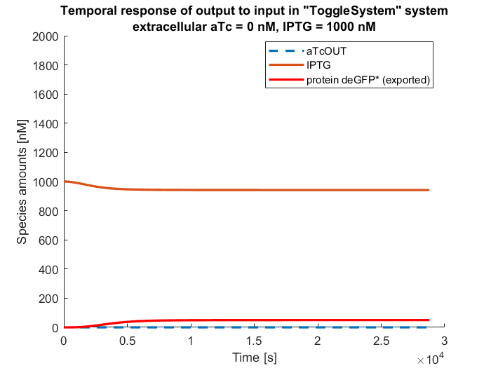
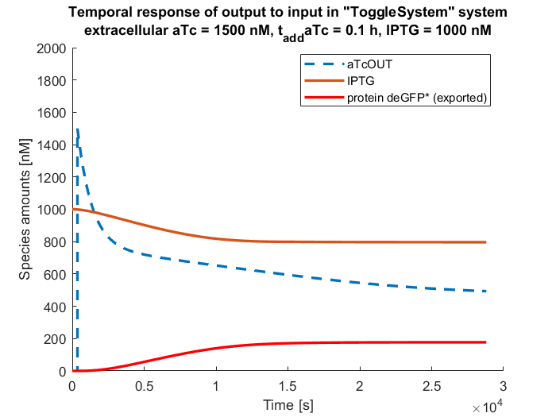
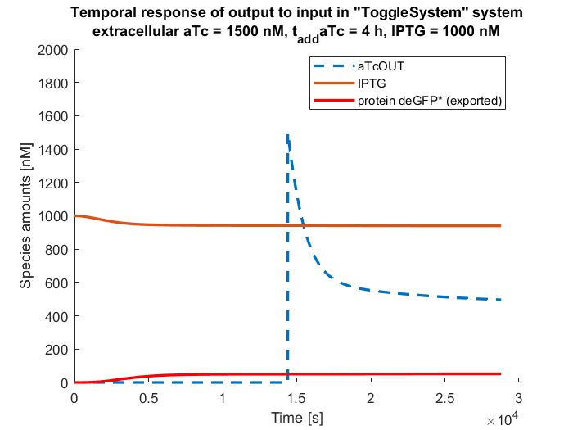
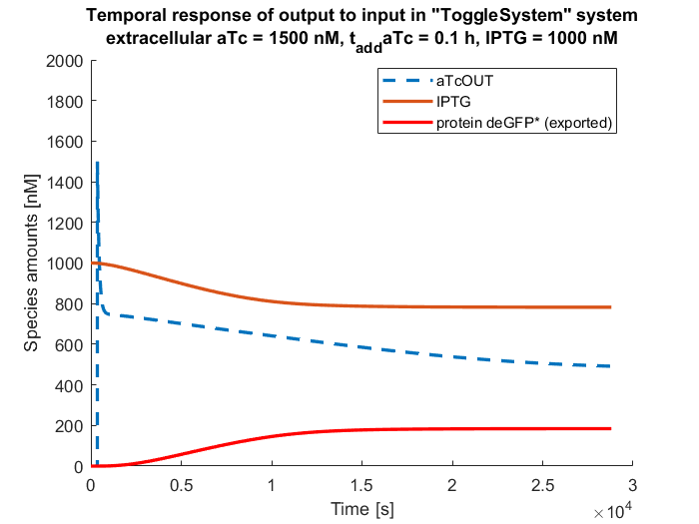

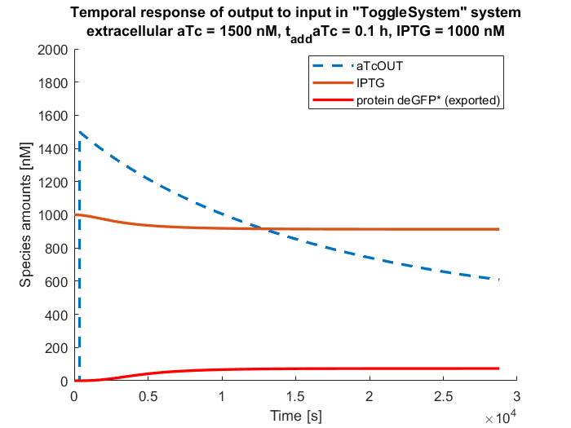
Input/output characteristics of the liposome-encapsulated toggle switch
Variation in time of addition of the aTc
Variation in diffusion rate of the aTc

Slide 21
Contents
Motivation & Background
Modeling of interconnection of simple cellular subsystems in BioSIMI
Interconnection of TX-TL reactions using BioSIMI
Input/output characteristics of genetic toggle switch encapsulated in the liposome
Summary of experimental work
Conclusion and the future plans

Slide 22
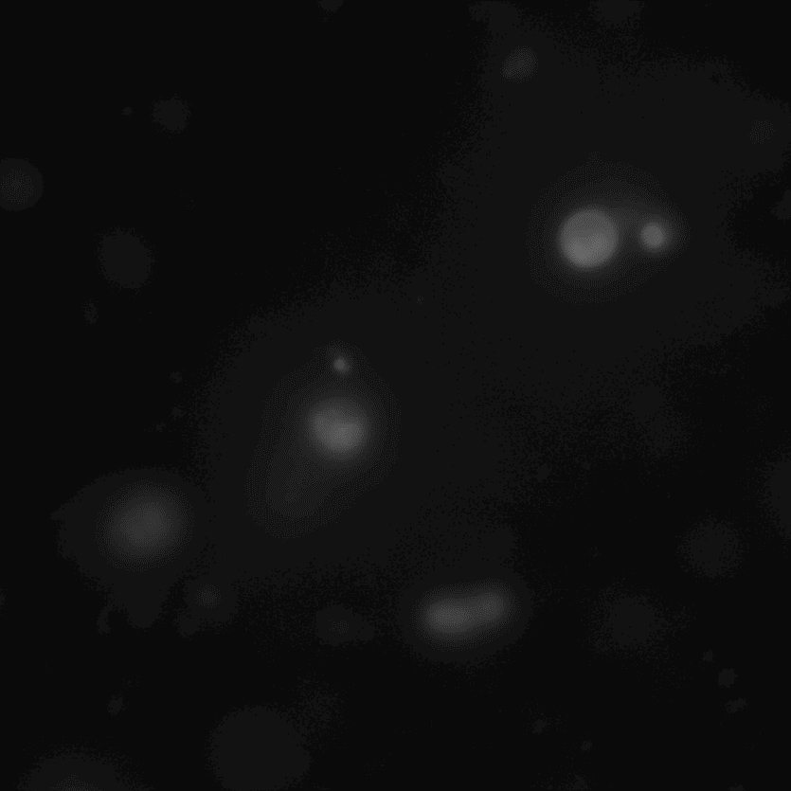
Encapsulation of TX-TL in lipid vesicles
Liposome vesicles prepared using protocol by Jonsson, Noireaux, Adamala and all
Attempt to encapsulate protein GFP and Luciferase
Luciferase Failed, GFP successfully encapsulated
Vesicle with encapsulated GFP

Slide 23
Optimization of protocol for liposome preparation
Variations in experimental protocol were applied:
- Decrease in centrifuging speed (20 000g to 5000g)
- Change in method of the lipid vesicle extraction (bottom vs. top)
- Number of washes by buffer (1 wash vs. 3 washes)
Extraction from the bottom + multiple washing = no vesicles observed
For extraction from the bottom, single wash is optimal

Slide 24
Contents
Motivation & Background
Modeling of interconnection of simple cellular subsystems in BioSIMI
Interconnection of TX-TL reactions using BioSIMI
Input/output characteristics of genetic toggle switch encapsulated in the liposome
Summary of experimental work
Conclusion and the future plans

Slide 25
Conclusion
Development of BioSIMI framework for modeling I/O behavior of subsystems interconnection:
- Creation of several user-defined subsystems (transport, signaling, regulatory)
- Compatibility with TX-TL modeling toolbox
- Multiple input/Single Output
- Rapid, user-friendly modeling
- Demonstration of several use-cases (multiple subsystems, TX-TL, toggle switch)
Experimental investigation of liposome formation
- Contribution to optimization of the experimental protocol
- Further work required for robust process

Slide 26
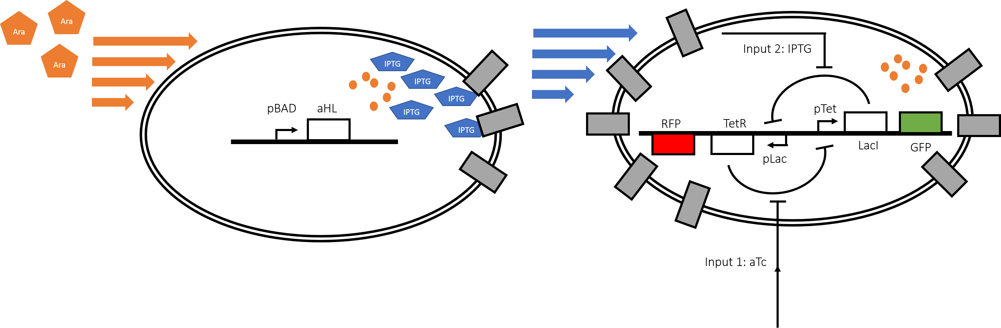
Further plans
Use of parameter identification to optimize I/O characteristics
Modeling of the sensor-reporter system with genetic toggle switch (orthogonal communication, concentration sensor)
Experimental investigation of the sensor-reporter system
Finalization of BioSIMI development (Multiple Inputs-Multiple Outputs)
Simulation of large population of vesicles
Response to stochasticity in the input

Slide 27
Acknowledgements
Professor Richard Murray – big picture insights and challenging suggestions!
Vipul Singhal – great hands-on and hands-off mentoring and keeping me up!
Shaobin Guo – patience in the lab and answers to all my questions!
Miki Yun – teaching me PCR, TX-TL, proper pipetting and other crucial life skills!
… And thanks to all the members of the Murray Lab

