Slide 1
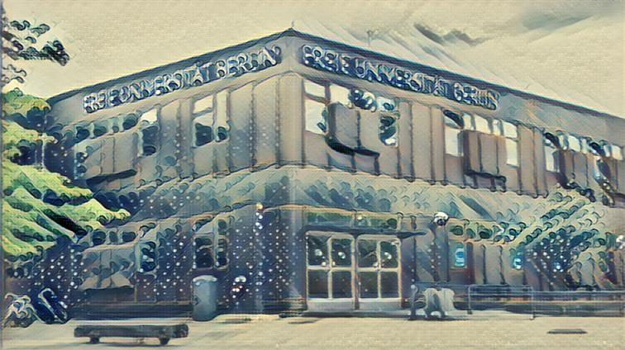

EEG (pre)processing
SCAN Masters Program 2019

Slide 2
What to Expect
Today: - Recap experiment - Preprocessing - ERP’s Tomorrow: - GLM for ERP’s - Fitting models to EEG data

Slide 3

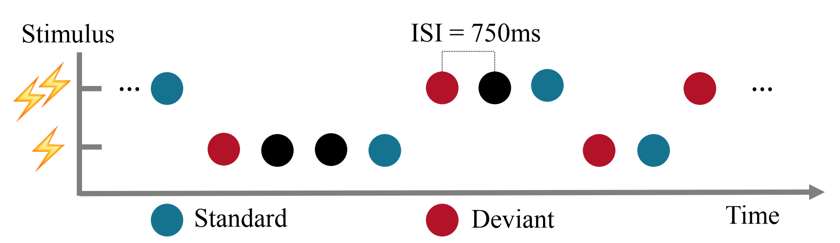
Experimental Design

Slide 4
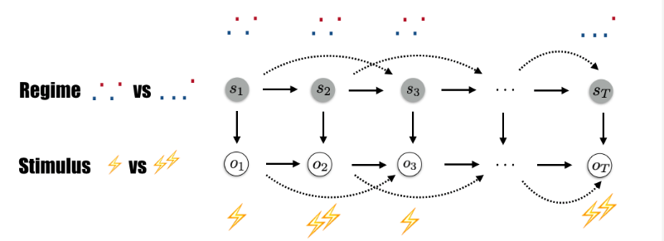
Regimes

Slide 5
Events and trigger coding
11 = Regime 1, low intensity 12 = Regime 1, high intensity
21 = Regime 2, low intensity 22 = Regime 2, high intensity
33 = Catch trials
128 = Stimulation 126 = Start Recording / Block 127 = Stop Recording

Slide 6
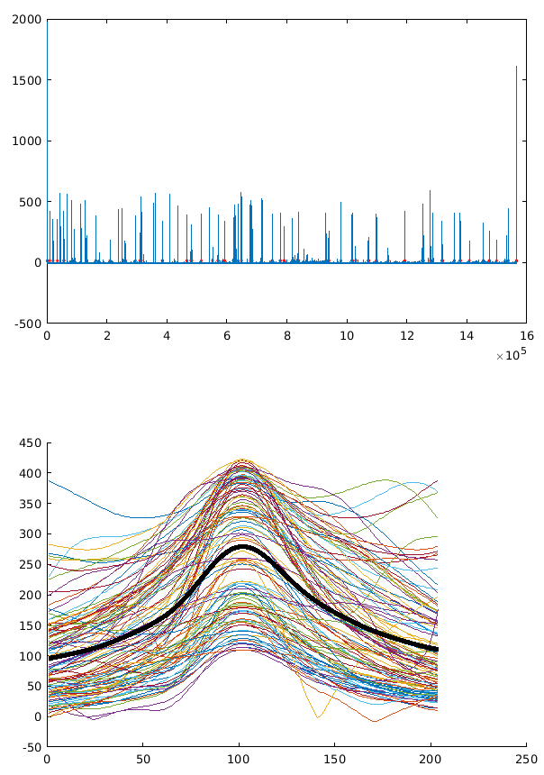
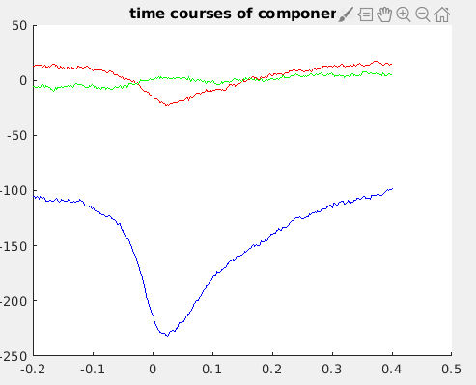
Threshold = 10, 109 eyeblinks

Slide 7
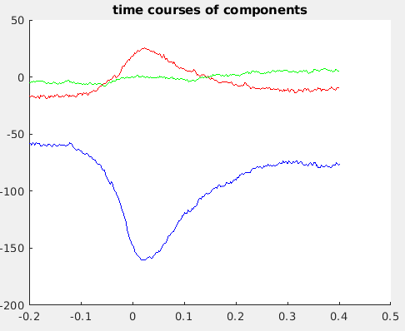
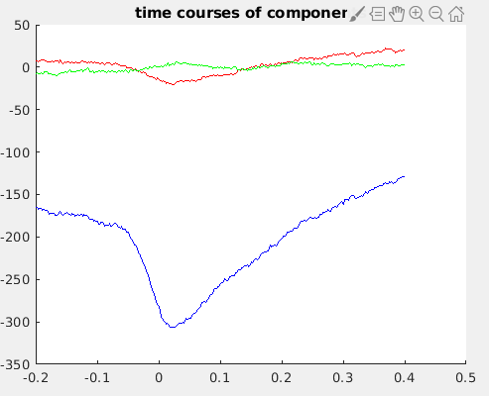
Threshold = 5 / Threshold = 50

Slide 8
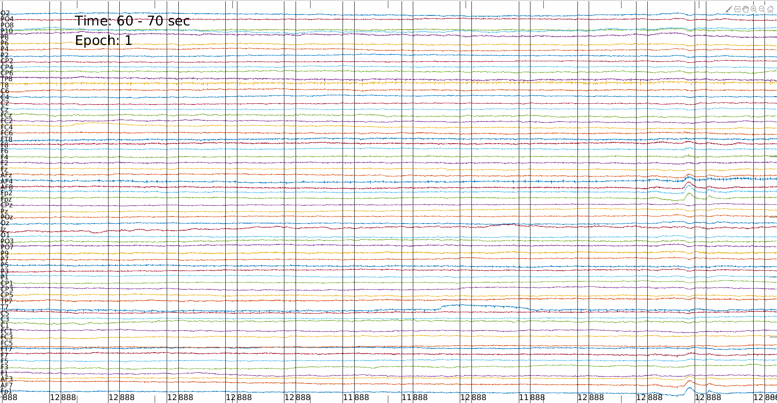
Bad channel detection

Slide 9
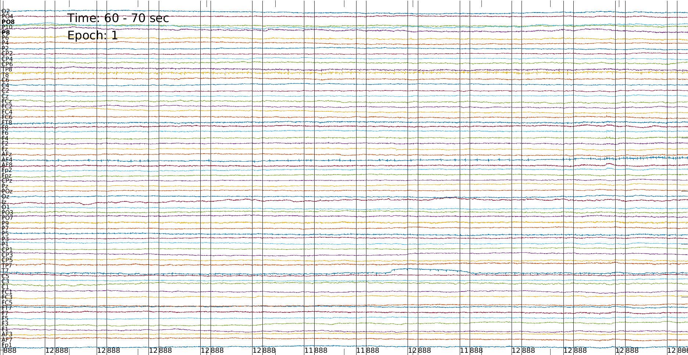
Post eye-blink correction

Slide 10
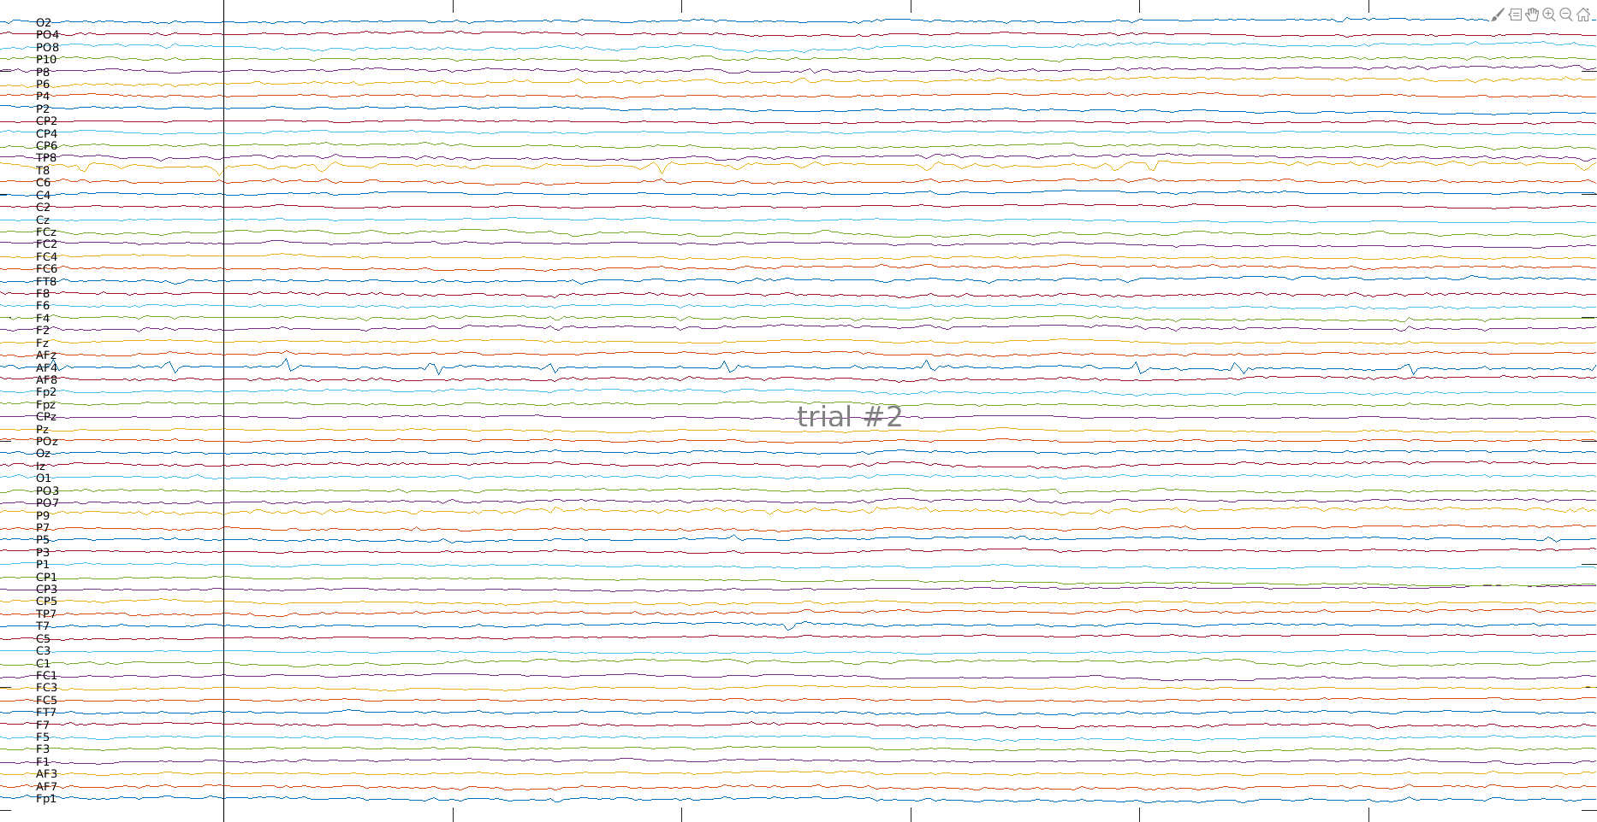
Single trial inspection

Slide 11
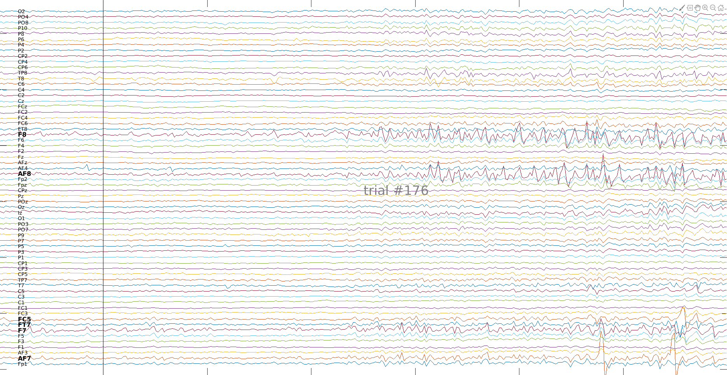
Single trial inspection

Slide 12
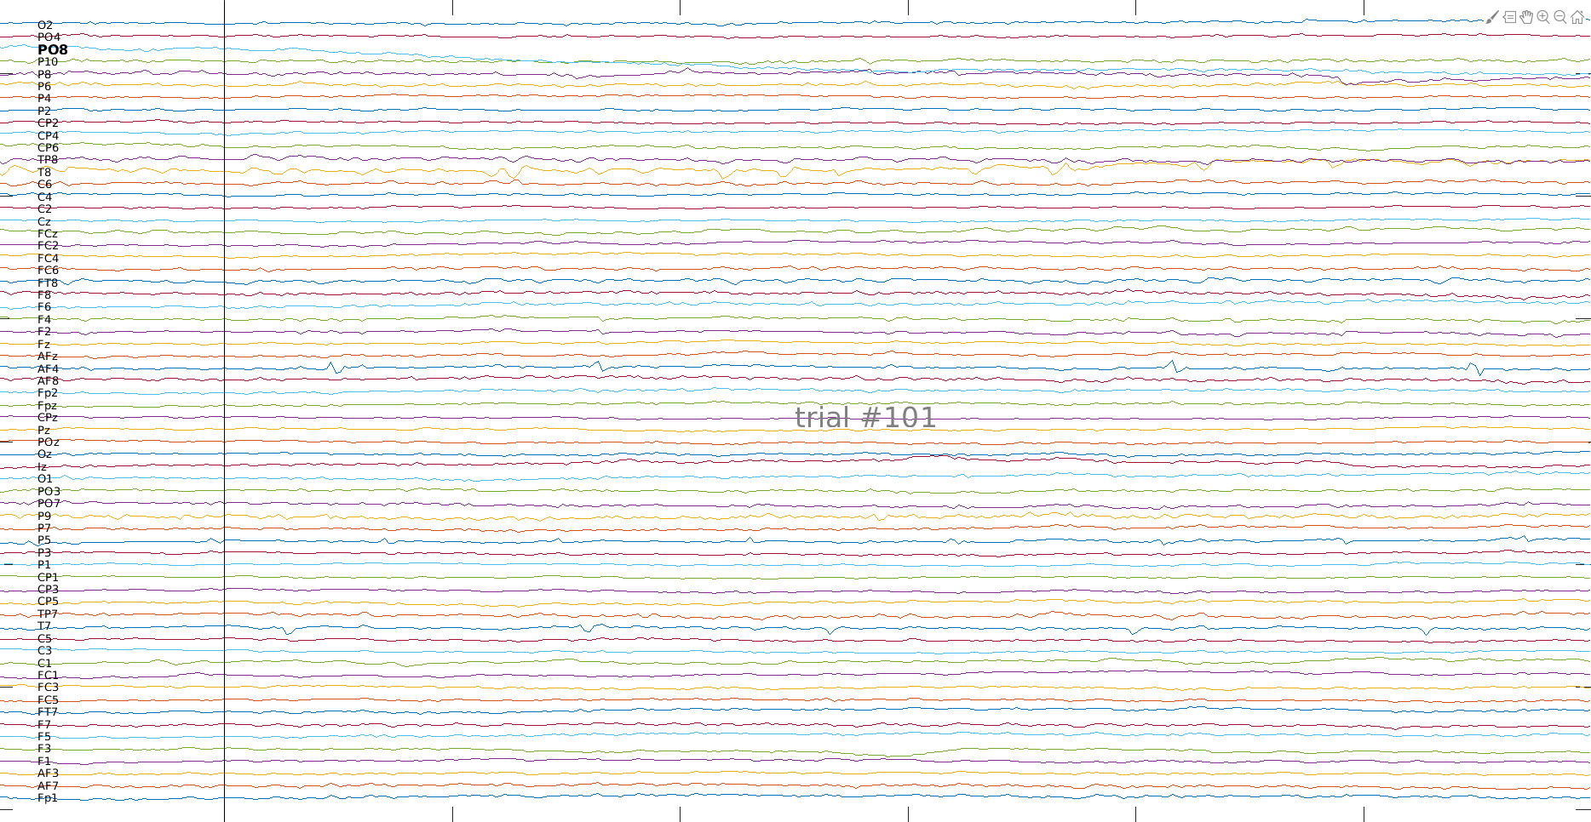
Automatic Artefact Detection? “bad”

Slide 13
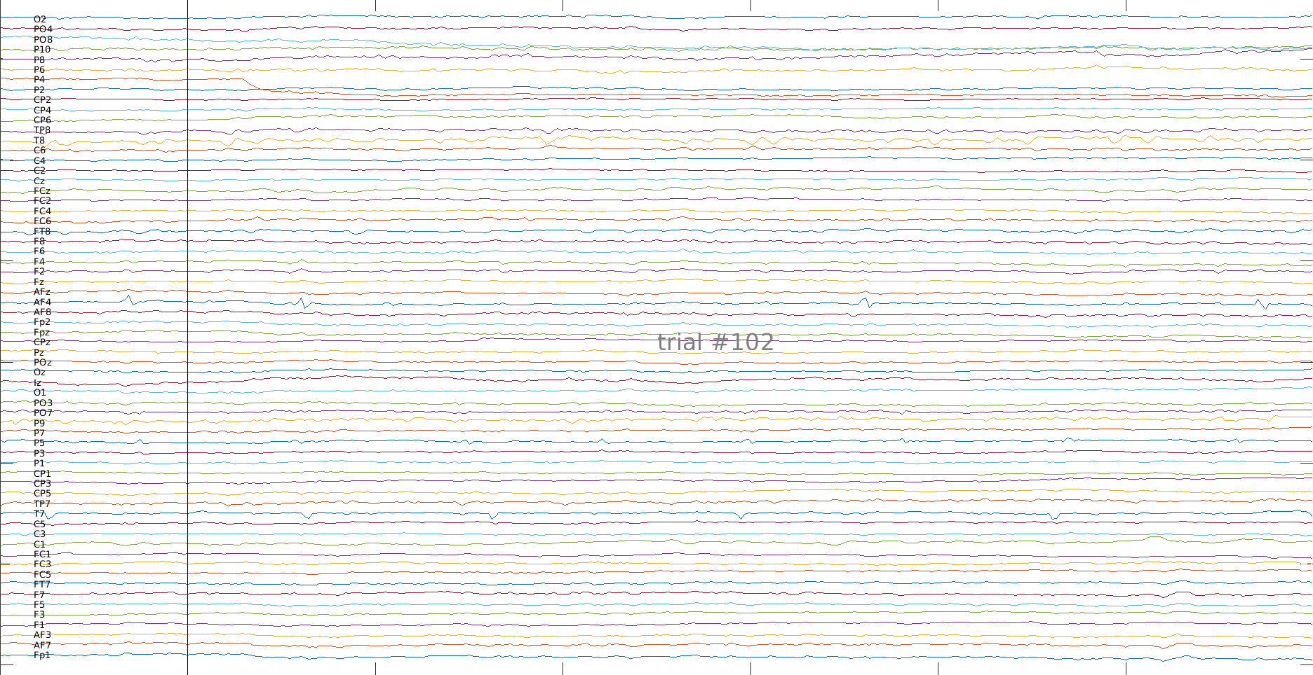
Automatic Artefact Detection? “good”

Slide 14
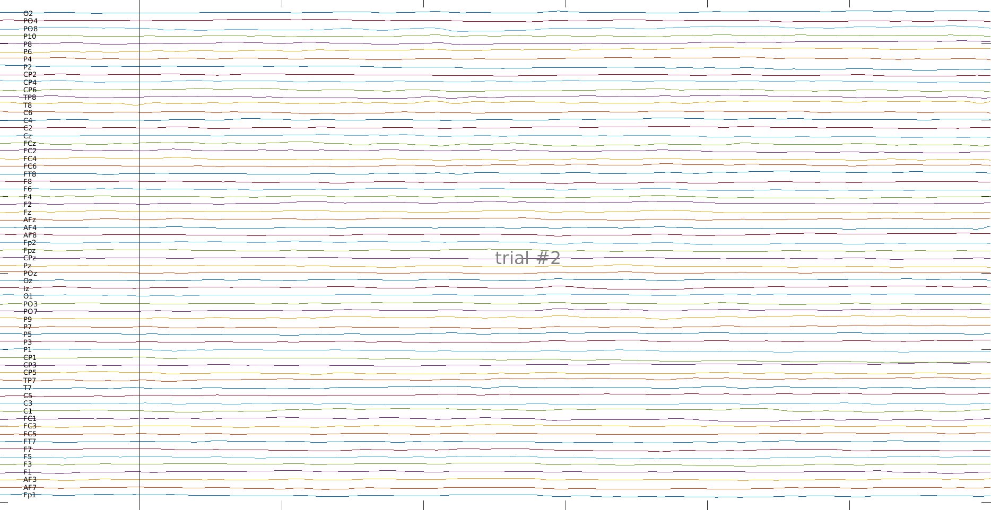
Post low-pass filter

Slide 15
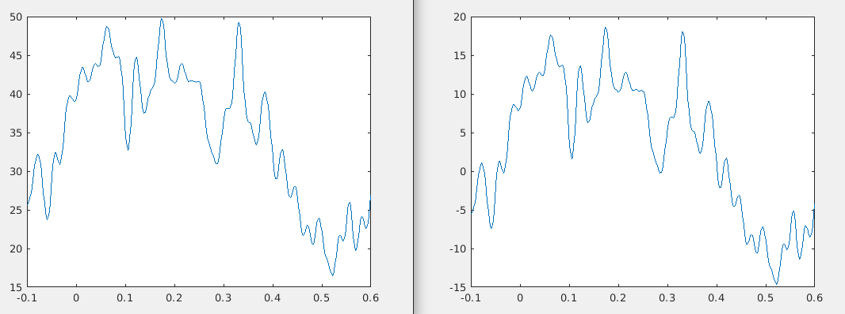
Post baseline correction
Note y-axis!

Slide 16
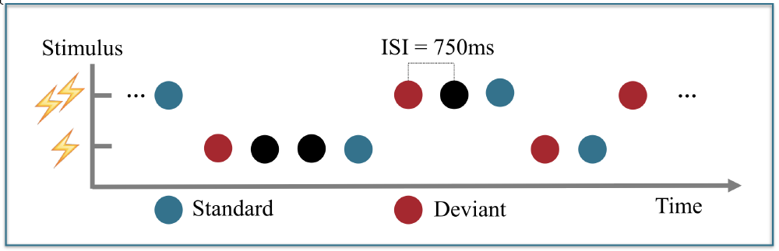

Slide 17
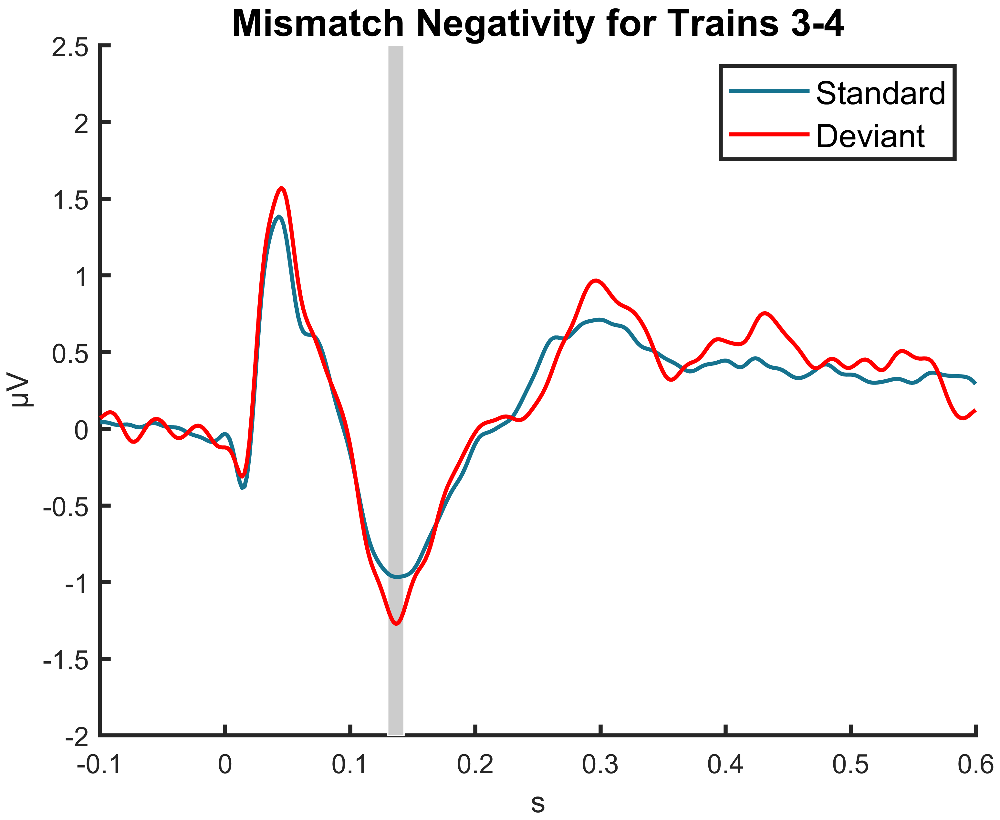
P50
P300
N20
N140
P<0.01

Slide 18
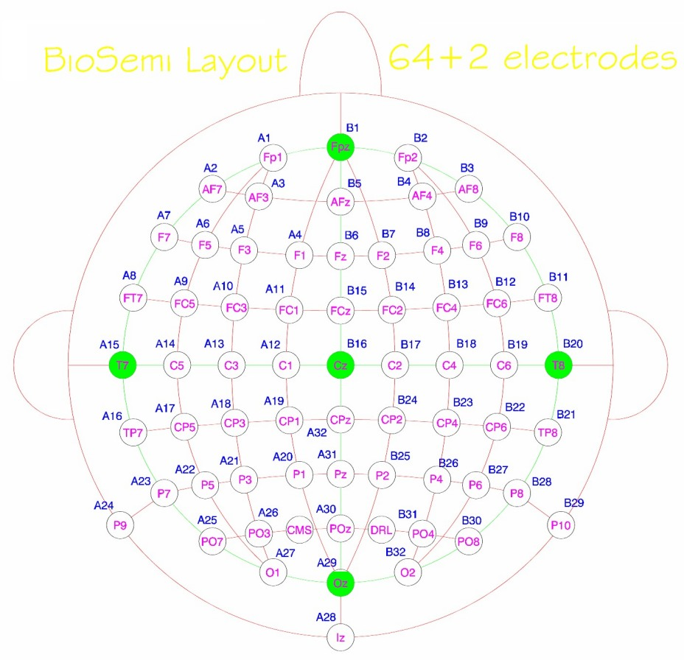

Slide 19
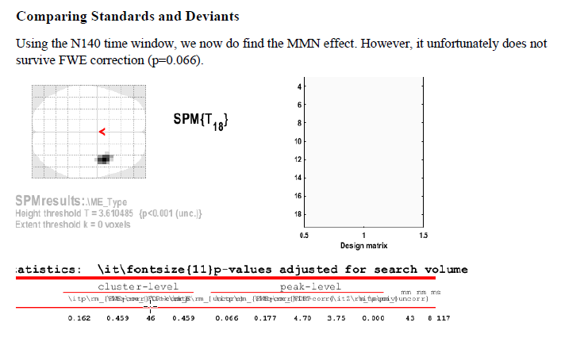

Slide 20
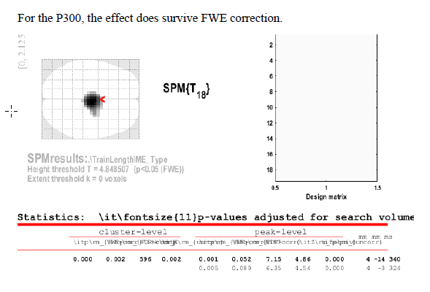

Slide 21
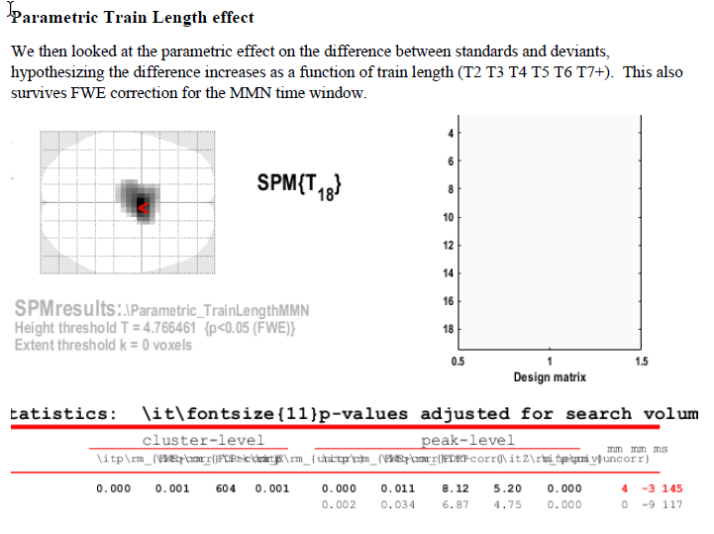

Slide 22
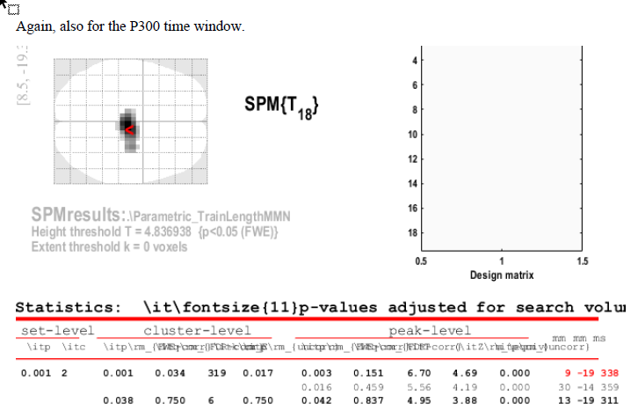

Slide 23
Computational modelling pipeline
Correlation
GLM (VI)
Create Model
Generate Regressors
Fit Regressor to EEG data
Yield Criterion
Model Selection
Stimulus Sequences
Record EEG Data
FFX
RFX
BIC
AIC
F

Slide 24
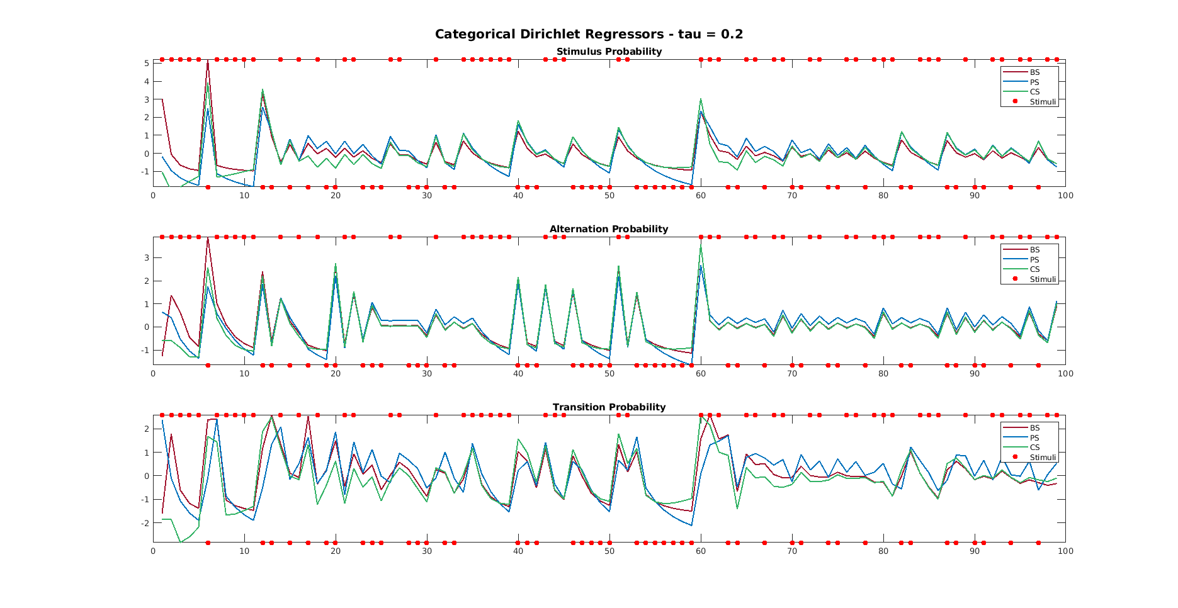

Slide 25
Fitting a Regressor to Data (to allow for model comparison)
EEG DATA:
4000 Trials
359
Data Points
…
REGRESSOR:
4000 Surprise Estimates
…

Slide 26
