Slide 1
Phase 1 - Prerequisites
Infrastructure
Kubernetes
three nodes, Centos 7.9.2009 provisioned on VMWARE (2 x Dell R720)
data disks mapped from TrueNAS
opensource kubernetes version 1.21.3
https://packages.cloud.google.com/yum/repos/kubernetes-el7-x86_64
AWS S3 cloud storage & compute arrangement (to do)
Software
Docker images
„mvblog-webui“ - simple web blog application storing data in a mysql db
„mvblog-mysql“ – mysql db with articles and comments tables
Kubernetes pods
mvblog-webui – implemented as Deployment with external service
mvblog-mysql – implemented as Statefullset with internal service

Slide 2
Phase 2 – High Available Application
Robin volume provisioning, moving
database pod works on one node only, it is reattached in case of failure
Kubernetes
mvblog service
mvblog-webui
knode1
knode2
knode3
mysql service
mvblog-mysql
knode1
knode2
knode3
Robin disk/volume reattachment
TrueNAS 1

Slide 3
Phase 3 – High Available System
Robin volume replication – Local Disaster Recovery plan
data is replicated to secondary volumes, stored in two zones and ready to takeover
Kubernetes
zone1
mvblog service
zone2
mvblog-webui
knode1
knode2
knode3
mysql service
mvblog-mysql
knode1
knode2
knode3
Robin disk/volume replication
TrueNAS 1
TrueNAS 2

Slide 4
Phase 4 – Data Scalable System
Robin volume snapshoting and cloning – database scaling & testing
the data is snapshoted and cloned, used for db (read only) scaling and test system making
Kubernetes
mvblog service
mvblog-test
service
mvblog-webui
mvblog-test-webui
knode1
knode2
knode3
mysql service
mysql RO
service
mysql-test
service
mvblog-mysql
mvblog-test-mysql
knode1
knode2
knode3
Robin volume snapshoting & cloning
TrueNAS 1
TrueNAS 2

Slide 5
Phase 5 – Consistent Application Ecosystem
Robin application – set of kubernetes resources - snapshot, clone & restore
define application, store it on robin volumes and repository - snapshot, clone & PIT recovery
Kubernetes
mvblog service
mvblog service
mvblog-webui
mvblog-webui
Robin Application
Pods, Services, StatefulSets, Secrets, Volumes
Robin Application
clone
in other
namespace
knode1
knode2
knode3
mysql service
mysql
service
mvblog-mysql
mvblog-mysql
knode1
knode2
knode3
TrueNAS 1
TrueNAS 2

Slide 6
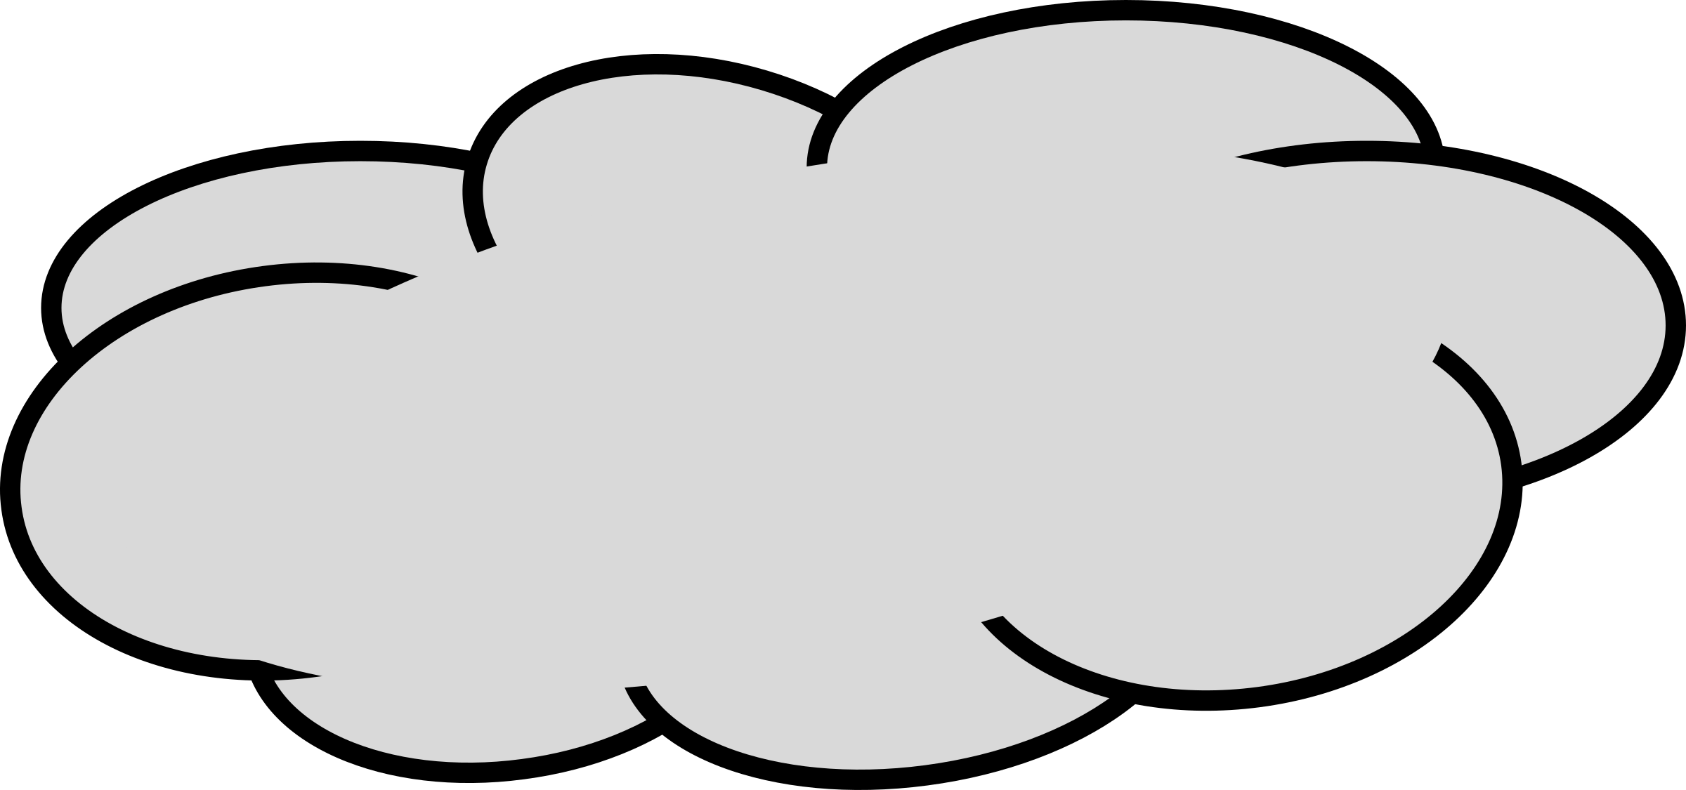
Phase 6 – Global Disaster Recovery Plan
Robin application backup – scheduled consistent backup, ready for DRP
backup application to external cloud, ready for restore or operation takeover
Kubernetes
mvblog service
mvblog-webui
Robin Application
Pods, Services, StatefulSets, Secrets, Volumes
Robin Application
backup
in
EXTERNAL CLOUD
knode1
knode2
knode3
mysql service
mvblog-mysql
knode1
knode2
knode3
TrueNAS 1

