Slide 1
CodeIgniter
Group: Index
Members: Wu Zeling
He Lijun
Zhou Zikai
Internet Programming Presentation

Slide 2
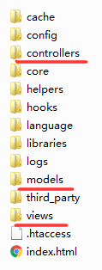

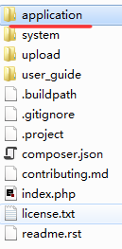
Hello CodeIgniter
Download https://www.codeigniter.com/download
CodeIgniter
17.01.2017 – Internet Programming Presentation
#<number>

Slide 3
Welcome.php
myform
Content.php
Form.php
formsuccess
CodeIgniter
17.01.2017 – Internet Programming Presentation
#<number>

Slide 4
Features in Our Project
contact_view
Database
Index
content_view
ModifiedData
Change
index_view
ModifyDataTools
Form
Form
write_view
ModifyImage
CodeIgniter
17.01.2017 – Internet Programming Presentation
#<number>

Slide 5

Features in Our Project
Object Oriented
CodeIgniter
17.01.2017 – Internet Programming Presentation
#<number>

Slide 6
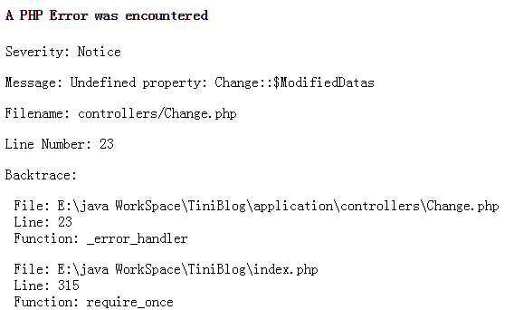
Features in Our Project
URL rooting
Error Logging
CodeIgniter
17.01.2017 – Internet Programming Presentation
#<number>

Slide 7
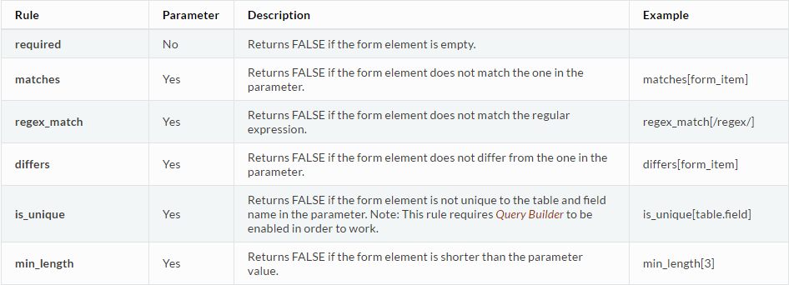
Features in Our Project
Validation
CodeIgniter
17.01.2017 – Internet Programming Presentation
#<number>
Notes:
Common and unusual

Slide 8
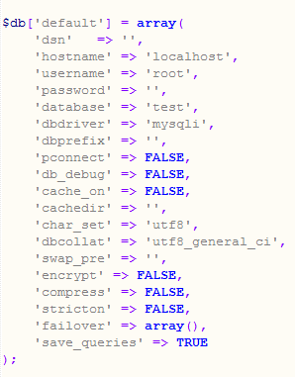
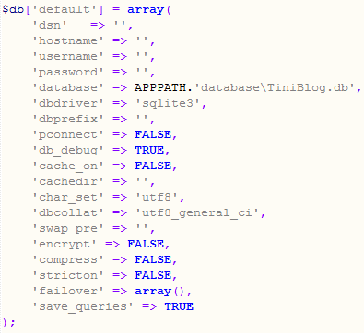
Features in Our Project
Database Configuration
CodeIgniter
17.01.2017 – Internet Programming Presentation
#<number>

Slide 9
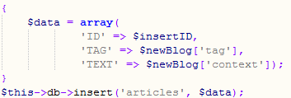
Features in Our Project
Query Builder
CodeIgniter
17.01.2017 – Internet Programming Presentation
#<number>

Slide 10
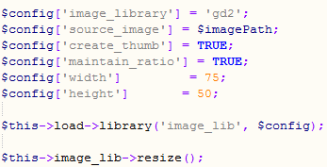
Features in Our Project
Image Manipulation Class
Image Resizing
Image Rotating
Image Watermarking
CodeIgniter
17.01.2017 – Internet Programming Presentation
#<number>

Slide 11

Features in Our Project
File Uploading Class
CodeIgniter
17.01.2017 – Internet Programming Presentation
#<number>
Notes:
Use image upload
restricting the type and size of the files.

Slide 12

Features in Our Project
Unit Test
CodeIgniter
17.01.2017 – Internet Programming Presentation
#<number>

Slide 13
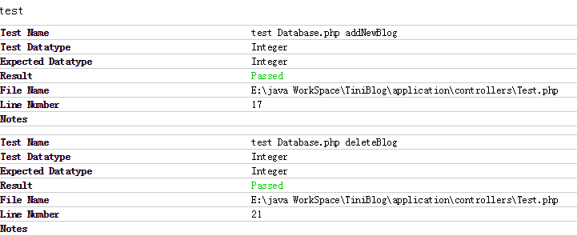
Features in Our Project
Unit Test
CodeIgniter
17.01.2017 – Internet Programming Presentation
#<number>

Slide 14
Other features
Security
  URL security
  XSS Filter
  CSRF
CodeIgniter
17.01.2017 – Internet Programming Presentation
#<number>

Slide 15
Comments
Highly recommended!
  Start up Friendly
  Programmer Friendly
  A Completed Framework
CodeIgniter
17.01.2017 – Internet Programming Presentation
#<number>

Slide 16


Features in Our Project
Smiley Helper
  THANK YOU FOR WATCHING
CodeIgniter
17.01.2017 – Internet Programming Presentation
#<number>

