Slide 1

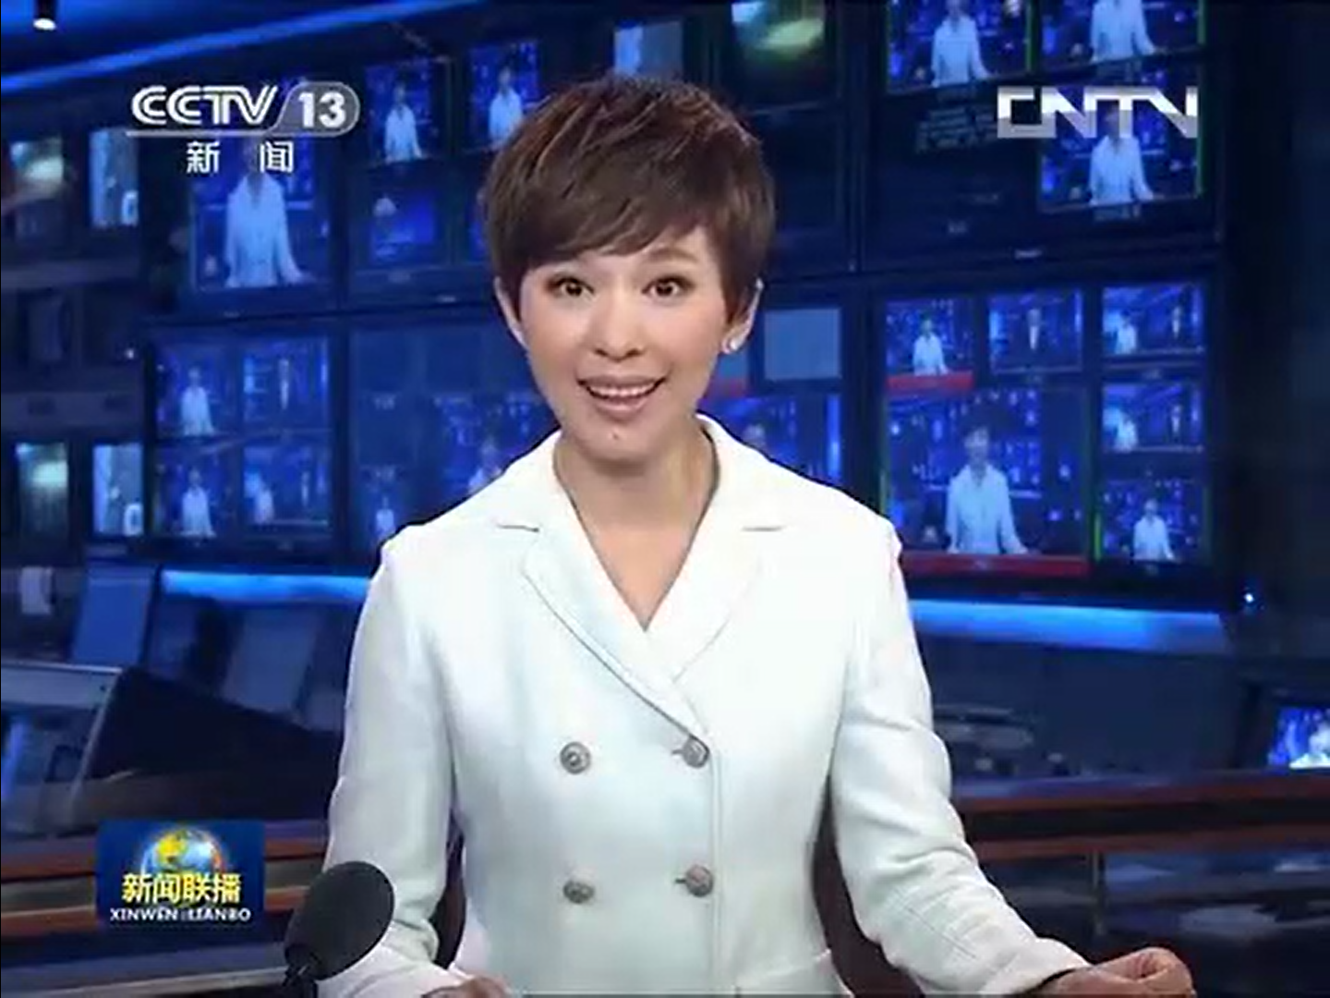
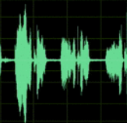
CE loss
CTC loss
Linear (FC)
Decoder
Transformer Decoder
Linear (FC)
Prefixes
Fusion Module
MLP
Back-end
Conformer Encoder
Back-end
Conformer Encoder
Visual Front-end
Conv3D+MobileNet025
Acoustic Front-end
Conv1D+MobileNet025
Image Sequence
Audio Waveform
Input Video

Slide 2
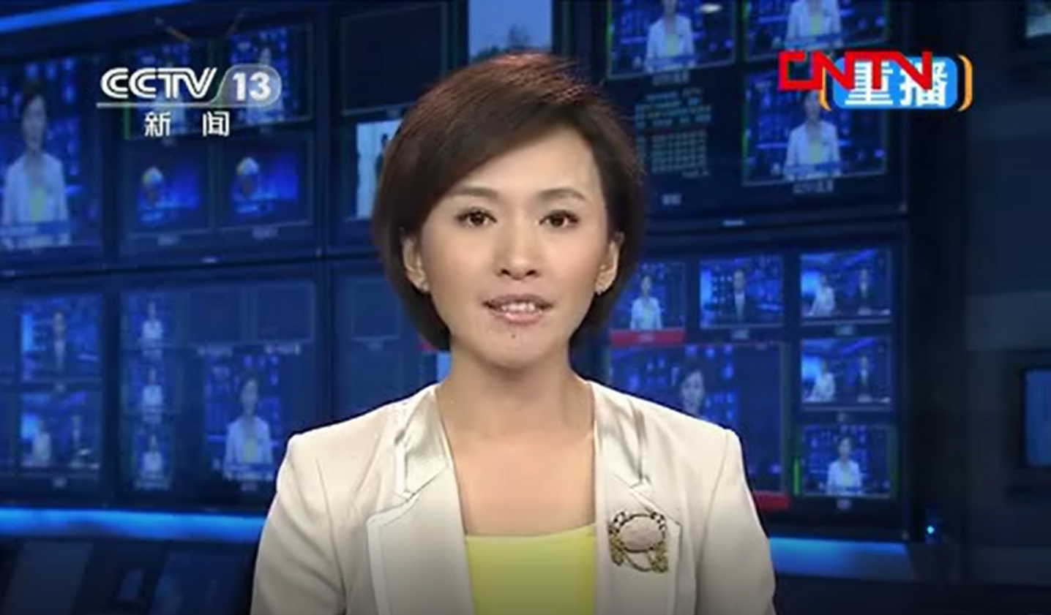
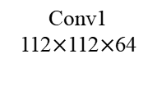
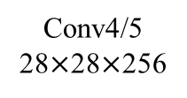
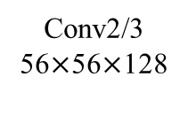
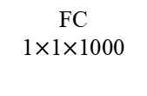
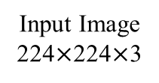
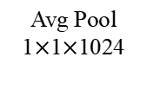

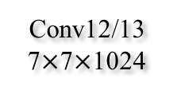
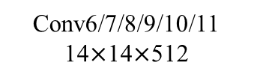
Conv1
112$×$112$×$64
Input Image
224$×$224$×$3
Conv4/5
28$×$28$×$256
Avg Pool
1$×$1$×$1024
Conv12/13
7$×$7$×$1024
Softmax
Conv6/7/8/9/10/11
14$×$14$×$512
FC
1$×$1$×$1000
Conv2/3
56$×$56$×$128
Conv0
112$×$112$×$32
Depthwise separable convolution layer
Standard convolution layer

Slide 3



Layer Normalization
Conformer
Blocks
+
$$×e$$
1/2$×$
Feed Forward
Module
Dropout
+
Convolution
Module
Linear
+
Convolution
Subsampling
Multi-Head Self
Attention Module
SpecAug
+
1/2$×$
Feed Forward
Module
(a) Encoder architecture
(b) Conformer Blocks architecture

Slide 4
Decoder Outputs
Add & Norm
Feed Forward
Add & Norm
MLP-Fusion
Module Outputs
Multi-Head Attention
Add & Norm
Masked Multi-Head Attention
+
Positional Encoding
Output
Embedding
Outputs (shifted right)

