Slide 1
CPLEX For Java and Python Users
Speaker: GengHong Wang

Slide 2
Table of Contents
01
Meet CPLEX
02
03
CPLEX for Python Users
04
CPLEX for Java Users
Introduces CPLEX
Explores the features CPLEX offers to Java users
Case Study
Explores the features CPLEX offers to users of Python
CPLEX is applied to solve the problems

Slide 3
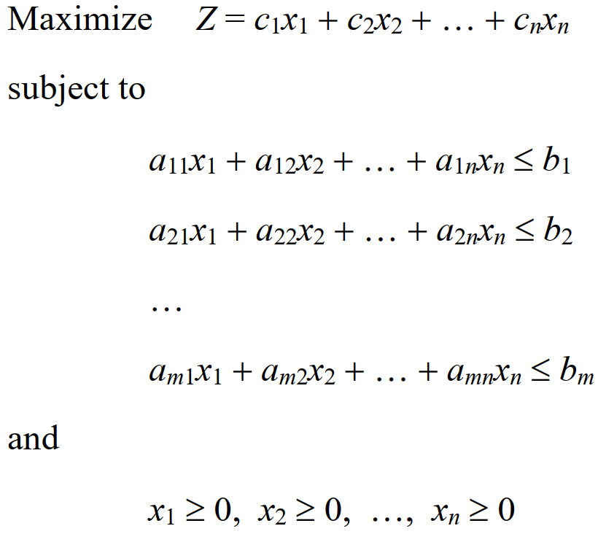
A Standard Form of the Model

Slide 4
01
Meet CPLEX
Introduces CPLEX, explains what it does

Slide 5
What is CPLEX?
IBM ILOG CPLEX offers C, C++, Java, .NET, and Python libraries that solve linear programming (LP) and related problems
Specifically, it solves linearly or quadratically constrained optimization problems where the objective to be optimized can be expressed as a linear function or a convex quadratic function.
The variables in the model may be declared as continuous or further constrained to take only integer values.
Notes:
Concert Technology is a set of libraries offering an API that includes modeling facilities to allow a programmer to embed CPLEX optimizers in C++, Java, or .NET applications.
The CPLEX Callable Library is a C library that allows the programmer to embed CPLEX optimizers in applications written in C, Visual Basic, Fortran or any other language that can call C functions.
The Concert Technology libraries make use of the Callable Library.
The Python API for CPLEX a full-featured Python application programming interface supporting all aspects of CPLEX optimization.
The .NET platform (pronounced as “dot net”) is a free and open-source, managed computer software framework for Windows, Linux and macOS operating system.

Slide 6
What does CPLEX do?
CPLEX is a tool for solving linear optimization problems.
CPLEX can also handle certain problems in which the objective function is not linear but quadratic. Such problems are known as quadratic programs or QPs.
CPLEX also solves kinds of quadratically constrained problems. Such problems are known as quadratically constrained programs or QCPs.
CPLEX is also a tool for solving mixed integer programs or MIPs.
Notes:
CPLEX also offers a network optimizer aimed at a special class of linear problem with network structures.
A QP model has a quadratic objective function and linear constraints; a QCP includes quadratic constraints, and it may have a linear or quadratic objective function.

Slide 7
02
CPLEX for Java Users
Explores the features CPLEX offers to Java users to solve mathematical programming problems

Slide 8
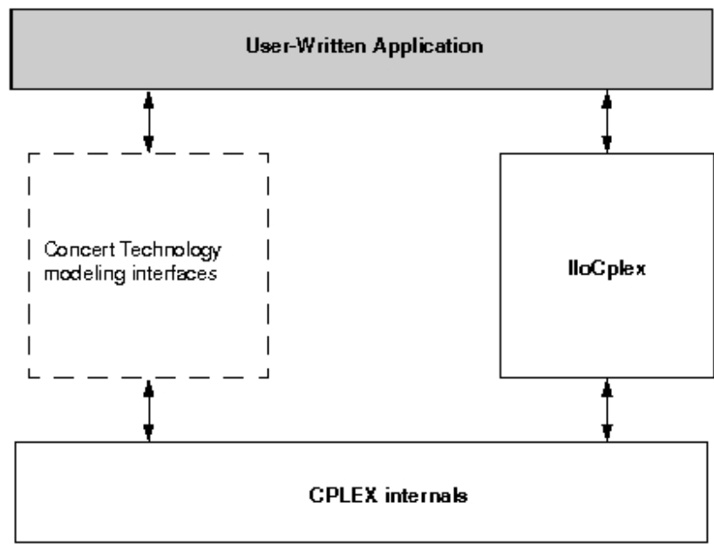
Architecture of a CPLEX Java application
Concer Technology modeling interaces
Java Interface.
IloCplex
It uses the Concert Technology moding interface implemented by IloCplex to create the variables, the constraints, and the objective function of the model to be solved.
CPLEX internals
It include the computing environment, its communication channels, and your problem objects.
Notes:
A user-written Java application and CPLEX internals use separate memory heaps.

Slide 9
Modeling Classes
To Model This | Use an Object of This Class or Interface
variable | IloNumVar and its extensions IloIntVar and IloSemiContVar
range constraint | IloRange with (piecewise) linear or quadratic expressions
other relational constraint | IloConstraint of the form expr1 relation expr2, where both expressions are linear or quadratic and may optionally contain piecewise linear terms
linear or quadratic objective | IloObjective with (piecewise) linear or quadratic expressions
logical constraints | IloOr, IloAnd, and methods such as not
Notes:
A semi-continuous variable is a variable that by default can take the value 0 (zero) or any value between its semi-continuous lower bound (sclb) and its upper bound (ub).

Slide 10
Using IloModeler
Variables in a Model
IloNumVar x = cplex.numVar(lb, ub, IloNumVarType.Float, “name”);
IloIntVar x = cplex.intVar(lb, ub, “name”);
IloIntVar x = cplex.boolVar(“name”);
IloNumVar[] x = cplex.numVarArray(num, min, max, “name”);
IloIntVar[] x = cplex.intVarArray(num, min, max, “name”);
IloIntVar[] x = cplex.boolVarArray(num, “name”);

Slide 11
Using IloModeler
Variables in a Model
IloNumVar[] x = new IloNumVar[num];
IloIntVar[] x = new IloNumVar[num];
IloNumVar[][] y = new IloNumVar[rnum][cnum];
IloIntVar[][] y = new IloIntVar[rnum][cnum];

Slide 12
Using IloModeler
Variables in a Model
IloNumVar[] x = new IloNumVar[num];
for (int i = 0; i < num; i++)
x[i] = cplex.numVar(lb, ub, “name”);
IloNumVar[][] y = new IloNumVar[rnum][cnum];
for (int i = 0; i < rnum; i++)
for (int j = 0; j < cnum; j++)
y[i][j] = cplex.numVar(lb, ub, “name”);

Slide 13
Using IloModeler
Expressions
Expressions are represented by objects of type IloNumExpr. They are built using method such as sum, prod, diff, negative, and square.
x1 + 2*x2
IloNumExpr expr = cplex.sum(x1, cplex.prod(2.0, x2));
IloLinearNumExpr lin = cplex.linearNumExpr();
for (int i = 0; i < num; i++)
lin.addTerm(value[i], variable[i]);
IloLinearNumExpr lin = cplex.scalProd(value, variable);
It is recommended that you build expressions in terms of data that is either integer or double-precision floating-point.

Slide 14
Using IloModeler
Ranged Constraints
Ranged constraints are constraints of the form: lb ≤ expression ≤ ub
IloRange rng = cplex.range(lb, expr, ub, “name”);
IloRange rng = cplex.le(expr, ub);
IloRange rng = cplex.eq(expr, value);
IloRange rng = cplex.ge(lb, expr);

Slide 15
Using IloModeler
The Objective Function
The objective function is represented by an object of type IloObjective.
IloObjective obj = cplex. objective(IloObjectiveSense.Maximize, expr, “name”);

Slide 16
The Active Model
Modeling objects, constraints and objective functions are created to explained in “Using IloModeler”, then these components must be added to the active model.
The active model is the model implemented by the IloCplex object itself. A model is just a set of modeling objects of type IloAddable such as IloObjective and IloRange.
IloObjective obj = cplex. addMaximize(expr);
IloObjective obj = cplex.add(cplex.maximize(expr));

Slide 17
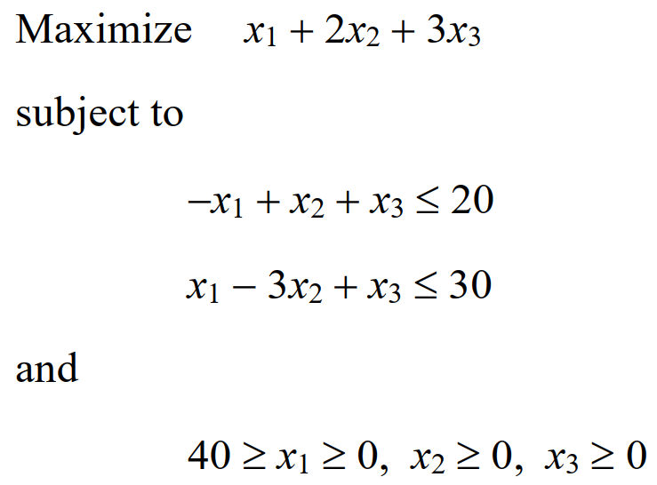
Building the Model

Slide 18
Solving the Model
Return Status | Active Model
Error | It has not been possible to process the active model, or an error occurred during the optimization
Unknown | It reports that the optimizer has not gathered any information about the active model. This is usually the status before a solve method has been called, or after the model has been manipulated.
Feasible | A feasible solution for the model has been proven to exist. Neither the optimality nor the nonoptimality of this solution has been proven.
Bounded | It has been proven that the active model has a finite bound in the direction of optimization. However, this does not imply the existence of a feasible solution.

Slide 19
Solving the Model
Return Status | Active Model
Optimal | The active model has been solved to optimality. The optimal solution can be queried.
Infeasible | The active model has been proven to process no feasible solution.
Unbounded | The active model has been proven to be unbounded. The notion of unboundedness adopted by IloCplex is technically that of dual feasibility; this does not include the notion that the model has been proven to feasible. Instead, what has been proven is that if there is a feasible solution with objective value z*, there exists a feasible solution with objective value z*−1 for a minimization problem, or z*+1 for a maximization problem.
InfeasibleOrUnbounded | The active model has been proven to be infeasible or unbounded

Slide 20
Accessing solution information
If a solution has been found with the solve method, you access it and then query it using a variety of methods.
double objval = cplex.getObjValue();
double x1 = cplex.getValue(var1);
double[] x1 = cplex.getValues(vars);

Slide 21
03
CPLEX for Python Users
Explores the features that CPLEX offers to users of Python to solve mathematical programming problems

Slide 22
CPLEX Library
cplex
The cplex is a lightweight wrapper around the C API (CPLEX Callable Library). As such, it provides access to nearly all of the functionality CPLEX has to offer. Variables and constraints are identified by their indices in the matrix.
docplex
The docplex is an object-oriented modeling Python API that is numpy/pandas friendly. The model can be solved locally (using the CPLEX Python API under the hood), or on the cloud. In addition to providing access to CPLEX for mathematical programming, it can also be used to access the CP Optimizer constraint programming engine.

Slide 23
Cplex

Slide 24
Modifying and querying problem data
Variables in a Model
x = cp.variables.add(lb=[0], ub=[cplex.infinity],
names=[″x″], types=[cp.variables.type.integer])
cp.variables.get_upper_bounds(″x″)
cp.variables.get_upper_bounds(0)
cp.variables.set_upper_bounds(0, 3.0)
cp.variables.set_upper_bounds(″x″, 5.0)

Slide 25
Modifying and querying problem data
The Objective Function
cp.objective.set_linear([[″x″, ″y″], [1.0, 1.0]])
cp.objective.set_sense(cp.objective.sense.maximize)

Slide 26
Modifying and querying problem data
Ranged Constraints
cp.linear_constraints. add(lin_expr=[[″x″, ″y″], [1.0, 2.0]], senses=[″L″], rhs=[30], names=[″c1″])
cp.linear_constraints. add(lin_expr=[[″x″, ″y″], [1.0, 2.0]], senses=[″E″], rhs=[30], names=[″c1″])
cp.linear_constraints. add(lin_expr=[[″x″, ″y″], [1.0, 2.0]], senses=[″G″], rhs=[30], names=[″c1″])

Slide 27
Building the Model

Slide 28
Accessing solution information
If a solution has been found with the solve method, you access it and then query it using a variety of methods.
cp.solution.status[cp.solution.get_status()]
cp.solution.get_objective_value()
cp.variables.get_num()
cp.solution.get_values()

Slide 29
DOcplex

Slide 30
DOcplex
Variables in a Model
x = cp.continuous_var(lb=0.0, ub=model.infinity, name=″x″)
x = cp.continuous_var_list(3, ub=model.infinity, name= ″x″)
x = cp.integer_var(lb=0, ub=10, name= ″x″)
x = cp.integer_var_list(3, ub=model.infinity, name= ″x″)
x = cp.binary_var(name= ″x″)
x = cp.binary_var_list(3, name= ″x″)

Slide 31
DOcplex
The Objective Function
cp.maximize(3*x + 4*y)
cp.minimize(3*x + 4*y)

Slide 32
DOcplex
Constraints
x = cp.add_constraint(ct=4*x + y <= 20, ctname= ″c1″)
x = cp.add_constraint(ct=x + 3*y <= 15, ctname= ″c2″)

Slide 33
DOcplex
Building the Model

Slide 34
DOcplex
Accessing solution information
solution.get_objective_value()
solution.get_value(x)
solution.get_values(y)
print(solution)

Slide 35
04
Case Study
CPLEX is applied to solve mathematical programming problems

Slide 36
The Multiple-Choice Knapsack Problem
Given N = 4 mutually disjoint classes of items to be packed into a knapsack of capacity V = 5. There are s_{i} items in the ith class. Each item has a weight w_{i} and a profit v_{i}. The problem is to choose the items from each class into the knapsack such that the profit sum is maximized without exceeding the capacity V in the corresponding weight sum.
 | s_{i} | w_{i} | v_{i}
1 | 1 | 2 | 3
2 | 2 | 4 | 1
3 | 3 | 4 | 3
4 | 4 | 5 | 2

Slide 37
The Multiple-Choice Knapsack Problem
Assume that there are x_{i} items to be picked in the ith class.
Maximize Z = 2x₁ + 4x₂ + 4x₃ + 5x₄
subject to
1x₁ + 2x₂ + 3x₃ + 4x₄ ≤ 5
and
3 ≥ x₁ ≥ 0, 1 ≥ x₂ ≥ 0, 3 ≥ x₃ ≥ 0, 2 ≥ x₄ ≥ 0
 | v_{i} | w_{i} | s_{i}
1 | 1 | 2 | 3
2 | 2 | 4 | 1
3 | 3 | 4 | 3
4 | 4 | 5 | 2

Slide 38
The Travelling Salesman Problem
Given a set of cities and distances between every pair of cities, the problem is to find the shortest possible route that visits every city once and returns to the starting point.
1
12
24
15
10
5
20
2
25
34
22
30
4
3
18

Slide 39
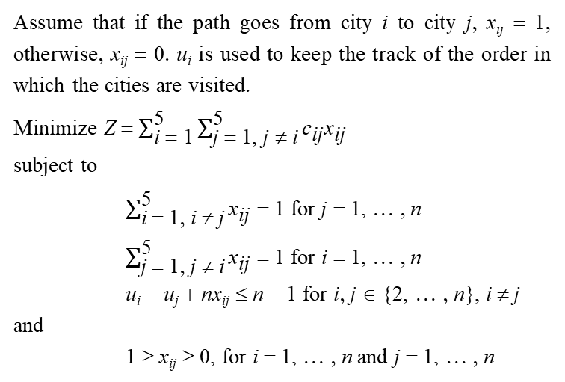
The Travelling Salesman Problem
1
Assume that if the path goes from city i to city j, x_{ij} = 1, otherwise, x_{ij} = 0. u_{i} is used to keep the track of the order in which the cities are visited.
Minimize Z = $\sum_{\text{i} \text{=}\text{ 1}}^{\text{5}}{\sum_{\text{j} \text{=}\text{ 1, }\text{j} \text{≠} \text{i}}^{\text{5}}{{\text{c}}_{\text{ij}}{\text{x}}_{\text{ij}}}}$
subject to
$\sum_{\text{i} \text{=} \text{1}\text{,} \text{i} \text{≠} \text{j}}^{\text{5}}{{\text{x}}_{\text{ij}}}$ = 1 for j = 1, … , n
$\sum_{\text{j} \text{=} \text{1}\text{,} \text{j} \text{≠} \text{i}}^{\text{5}}{{\text{x}}_{\text{ij}}}$ = 1 for i = 1, … , n
u_{i} − u_{j} + nx_{ij} ≤ n − 1 for i, j ∈ {2, … , n}, i ≠ j
and
1 ≥ x_{ij} ≥ 0, for i = 1, … , n and j = 1, … , n
12
24
15
10
5
20
2
25
34
22
30
4
3
18

Slide 40
—Chiyun Jung and Tae-Eog Lee
An Efficient Mixed Integer Programming Model Based on Timed Petri Nets for Diverse Complex Cluster Tool Scheduling Problems

Slide 41
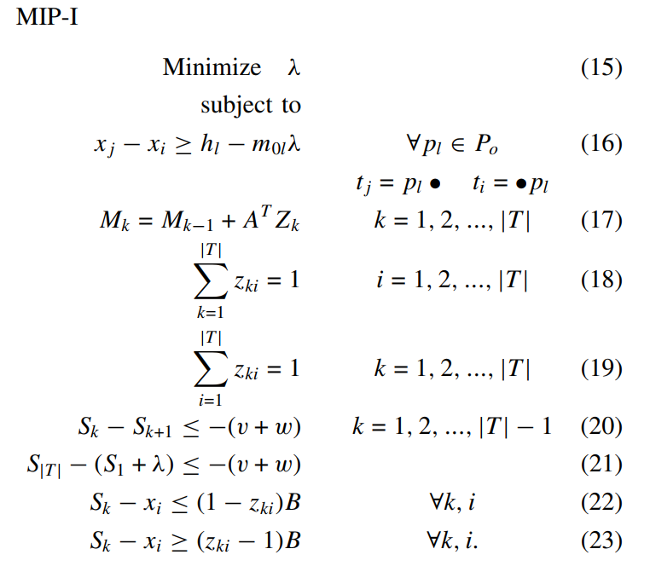
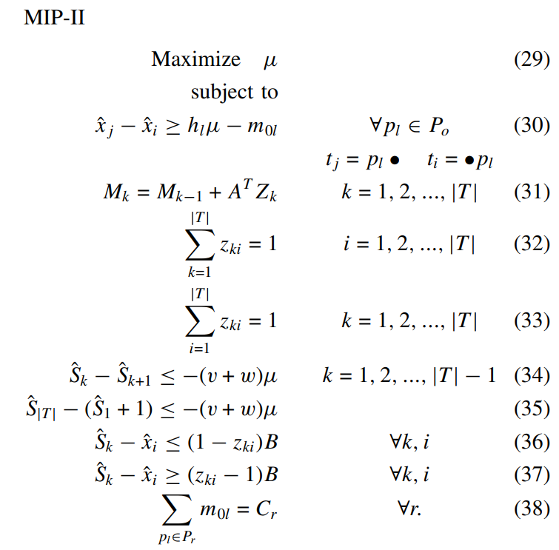

Slide 42
Exercise
Given 3 classes of tasks T₁, T₂, T₃ and 2 classes of machines M₁, M₂. Now 5 T₁, 3 T₂, and 2 T₃ are scheduled on 1 M₁ and 2 M₂. A machine only tackles a task at a time. The time taken by different machines for different tasks is showed as follows. The problem is to minimize the makespan such that 10 tasks are completed.
 | T₁ | T₂ | T₃
M₁ | 10 | 12 | 18
M₂ | 15 | 8 | 20

Slide 43
Thanks

