Slide 1


Output Probabilities
Softmax
FC
Add & Norm
Feed Forward
Add & Norm
Add & Norm
Feed Forward
Multi-Head Attention
V
K
Q
Add & Norm
Add & Norm
Multi-Head Self Attention
Multi-Head Self Attention
N$×$
$×$N
Positional Encoding
+
+
Positional Encoding
Input Embedding
Output Embedding
Inputs
Outputs
(shifted right)

Slide 2


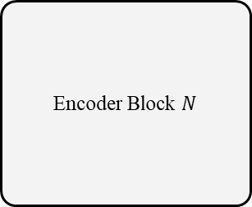
Encoder Block 1
Encoder Block 2
Encoder Block $N$
$$⋯$$
Positional Encoding
+
Input Embedding
Inputs
$$N$$

Slide 3


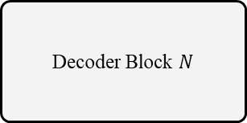
Decoder Block 1
Decoder Block 2
Decoder Block $N$
Encoder Outputs
$$⋯$$
Positional Encoding
+
Outputs Embedding
Outputs
(shifted right)
$$N$$

Slide 4
FC
Concat
矩阵乘法
MatMul
矩阵乘法
MatMul
MatMul
软最小化
Softmax
软最小化
Softmax
Softmax
掩码处理
Masking
掩码处理
Masking
h
Masking
比例缩小
Scale
比例缩小
Scale
Scale
矩阵乘法
MatMul
矩阵乘法
MatMul
MatMul
V
V
K
K
Q
Q
V
K
Q
线性层
Linear
线性层
Linear
FC
FC
FC

Slide 5
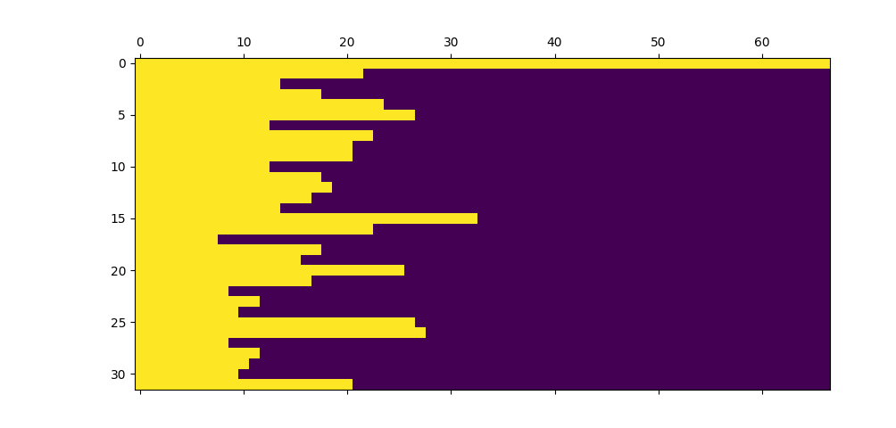
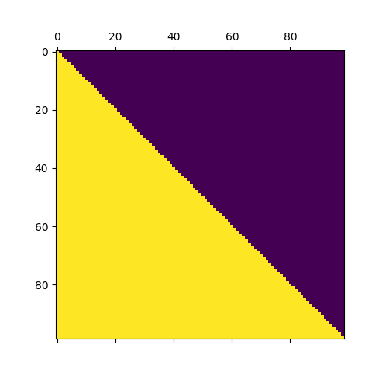
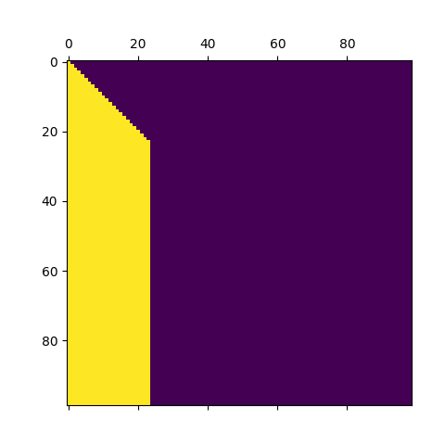
Source Padding Mask
0
1
1st Source Mask
2nd Source Mask

Slide 6
Batch
Batch
Mean STD
1
3
6
3
3
1
3
6
2
2
2
2
0
2
2
2
0
1
5
3
3
0
1
5
Length
4
6
1
4
3
4
6
1
5
2
3
3
2
5
2
3
1
0
1
1
1
1
0
1
Mean
STD
2
3
3
2
2
2
Batch Normalization
Layer Normalization

Slide 7
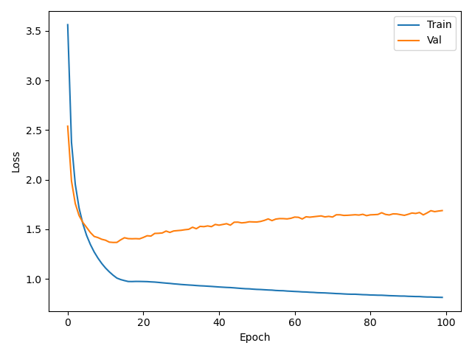
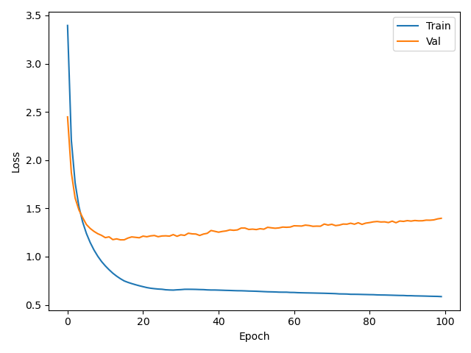
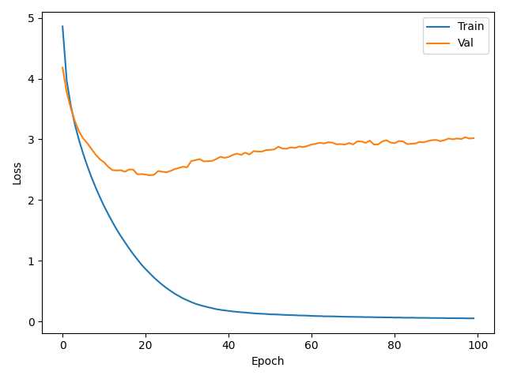
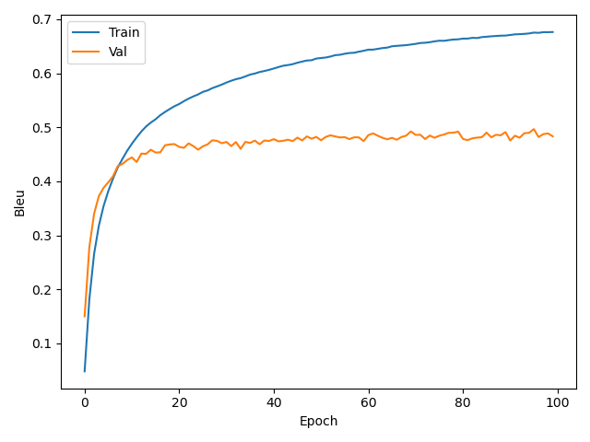
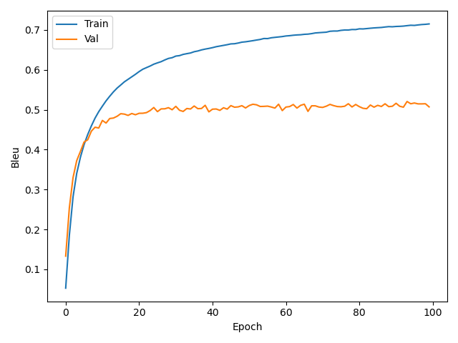
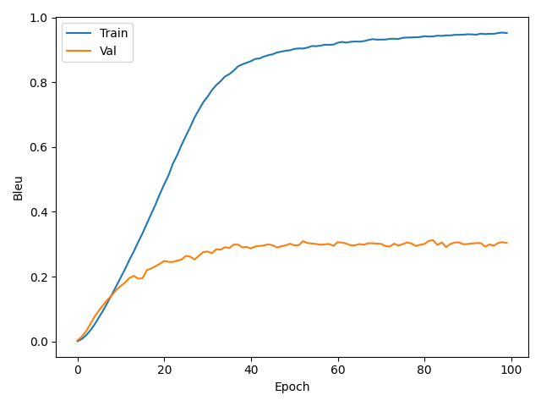
English-to-Deutsch
English-to-French
English-to-Chinese

