Slide 1
WI Task
Backbone
FPN Fusion
Holistic Encoder
Conv-Module
Contrast based Part Decoder
Forged or
Genuine
Reference
Distance
Query
OSVTF
WD Task
Classifier
Forged or
Genuine
Query
OSVTF
Notes:
Overview

Slide 2




Reference Signature
$$(1×128×512)$$
*
Conv2D $7×7@64$
Conv2D $1×1@64$
Conv2D $3×3@64$
Conv2D $1×1@256$
Conv2D $1×1@128$
Conv2D $3×3@128$
Conv2D $1×1@512$
Conv2D $1×1@256$
Conv2D $3×3@256$
Conv2D $1×1@1024$
Conv2D $1×1@512$
Conv2D $3×3@512$
Conv2D $1×1@2048$
0
1
Weighted-sum
Cross-Attention
Multi-Head Self Attention
Swinging Projection
Transformer Encoder Layer
Transformer Encoder Layer
2
3
$$⋯$$
$$⋯$$
$$⋯$$
N
Forged or
Genuine
Layer 1 $×3$
Layer 2 $×4$
Layer 3 $×6$
Layer 4 $×3$
Conv-Module
Distance
$$L$$
Feed Forward Network (FFN)
Feature Pyramid Network Fusion
Input Projection
*
Conv2D $7×7@64$
Conv2D $1×1@64$
Conv2D $3×3@64$
Conv2D $1×1@256$
Conv2D $1×1@128$
Conv2D $3×3@128$
Conv2D $1×1@512$
Conv2D $1×1@256$
Conv2D $3×3@256$
Conv2D $1×1@1024$
Conv2D $1×1@512$
Conv2D $3×3@512$
Conv2D $1×1@2048$
0
1
Swinging Projection
Transformer Encoder Layer
Transformer Encoder Layer
2
Weighted-sum
Multi-Head Self Attention
Cross-Attention
Query Signature $$(1×128×512)$$
3
$$⋯$$
$$⋯$$
$$⋯$$
N
Backbone (ex. ResNet-50)
Holistic Encoder
Contrast based Part Decoder
Notes:
OSVTF

Slide 3


















Reference $(I_{r})$
$$x_{r}^{ℋ}=\left[x_{r}^{ℋ_{1}}, ⋯, x_{r}^{ℋ_{N}}\right]$$
$$F_{r}^{ℋ}$$
Conv-Module
$$F_{r}^{𝒞}$$
GAP
GAP
Rearrange
$$F_{r}^{𝒞}$$
Backbone
FPN Fusion
Holistic Encoder
Decoder
$$f_{r}^{𝒞}$$
$$f_{r}^{ℋ},$$
Sparsity
Loss
$$α_{r}$$
$$f_{r}^{𝒫}$$
Focal Contrast Loss (FC)
$$f_{r}^{ℱ}$$
Backbone
FPN Fusion
Holistic Encoder
$$f_{q}^{ℱ}$$
$$α_{q}$$
$$f_{q}^{𝒫}$$
$$f_{q}^{𝒞}$$
$$f_{q}^{ℋ},$$
$$F_{q}^{𝒞}$$
Rearrange
Conv-Module
$$F_{q}^{𝒞}$$
GAP
GAP
$$x_{q}^{ℋ}=\left[x_{q}^{ℋ_{1}}, ⋯, x_{q}^{ℋ_{N}}\right]$$
$$F_{q}^{ℋ}$$
Query $(I_{q})$
Notes:
Train Flowing

Slide 4



























Input Image
$$1×128×512$$
Conv1
$$64×64×256$$
Layer 1
$$256×32×128$$
Layer 2
$$512×16×64$$
Layer 3
$$1024×8×32$$
Layer 4
$$2048×4×16$$
aaaaaaaaaa$×102$
aaaaaaaaaa$×102$
aaaaaaaaaa$×102$
aaaaaaaaaa$×102$
Conv $7×7@64$
Max Pooling 2D
Conv $1×1@64$
Conv $3×3@64$
Conv $1×1@256$
Max Pooling 2D
Conv $1×1@128$
Conv $3×3@128$
Conv $1×1@512$
Max Pooling 2D
Conv $1×1@256$
Conv $3×3@256$
Conv $1×1@1024$
Max Pooling 2D
Conv $1×1@512$
Conv $3×3@512$
Conv $1×1@2048$
+
+
+
+
$$×3$$
$$×4$$
$$×6$$
$$×3$$
Notes:
Backbone ex. ResNet-50

Slide 5



ReLU
Conv2D $1×1$
Batch Normalization
Conv2D $3×3$
Batch Normalization
Conv2D $1×1$
Bottleneck Block
Notes:
bottleneck

Slide 6












Conv2D $1×1$
$$×16$$
$$F^{ℬ\left(4\right)}$$
Layer 4
Conv2D $1×1$
$$F^{ℬ\left(3\right)}$$
Fusion
$$×8$$
Layer 3
Conv2D $1×1$
$$F^{ℬ\left(2\right)}$$
$$×4$$
$$F^{ℱ}$$
Layer 2
Conv2D $1×1$
$$F^{ℬ\left(1\right)}$$
Layer 1
Notes:
Fpn fusion

Slide 7



















$$f^{ℋ_{cls}}$$
$$x^{ℋ_{1}}$$
$$x^{ℋ_{2}}$$
$$x^{ℋ_{3}}$$
$$x^{ℋ_{4}}$$
$$x^{ℋ_{5}}$$
$$x^{ℋ_{N}}$$
$$⋯$$
$$⋯$$
Transformer Encoder Layer
$$⋯$$
$$⋯$$
$$L$$
Transformer Encoder Layer
$${\overline{f}}^{ℋ_{cls}}$$
$${\overline{x}}^{ℋ_{1}}$$
$${\overline{x}}^{ℋ_{2}}$$
$${\overline{x}}^{ℋ_{3}}$$
$${\overline{x}}^{ℋ_{4}}$$
$${\overline{x}}^{ℋ_{5}}$$
$${\overline{x}}^{ℋ_{N}}$$
*
0
1
2
3
4
5
$$⋯$$
N
Swinging Projection of Flattened Patches
FPN Fusion Feature Map $\left(F^{ℱ}\right)$
Notes:
Holistic Encoder

Slide 8




Add & LN
Linear
Matmul
Feed Forward Network
Concat
Softmax
Mask (opt.)
Add & LN
标准化点乘注意力
标准化点乘注意力
Scaled
Scaled Dot Product Attention
$$M$$
Multi-Head Self Attention
Matmul
Linear
Linear
Linear
$$X_{v}$$
$$X_{k}$$
$$X_{q}$$
Transformer Encoder Layer
Multi-Head Attention
Scaled Dot Product Attention
Notes:
Multi Head Attention

Slide 9










Max Pooling 2D
ReLU
$$\frac{h}{4}×\frac{w}{4}×\frac{d_{𝒞}}{2}$$
Conv2D $3×3$
ReLU
$$\frac{h}{2}×\frac{w}{2}×\frac{d_{𝒞}}{2}$$
Conv2D $3×3$
$$\frac{h}{2}×\frac{w}{2}×\frac{d_{𝒞}}{2}$$
Max Pooling 2D
ReLU
$$\frac{h}{2}×\frac{w}{2}×d_{𝒞}$$
Conv2D $3×3$
ReLU
$$h×w×d_{𝒞}$$
Conv2D $3×3$
$$h×w×d_{𝒞}$$
Notes:
Conv-module

Slide 10



















Max Pooling 2D
Max Pooling 2D
ReLU
$$\frac{h}{2}×\frac{w}{2}×D$$
ReLU
$$\frac{h}{4}×\frac{w}{4}×\frac{d_{𝒞}}{2}$$
Conv2D $3×3$
Conv2D $3×3$
ReLU
$$h×w×D$$
ReLU
$$\frac{h}{2}×\frac{w}{2}×\frac{d_{𝒞}}{2}$$
Conv2D $3×3$
Conv2D $3×3$
$$h×w×d_{𝒞}$$
$$\frac{h}{2}×\frac{w}{2}×\frac{d_{𝒞}}{2}$$
Optimized
ReLU
Max Pooling 2D
ReLU
$$\frac{h}{2}×\frac{w}{2}×d_{𝒞}$$
Conv2D $3×3$
Conv2D $3×3$
ReLU
$$h×w×d_{𝒞}$$
ReLU
$$h×w×d_{𝒞}$$
Conv2D $3×3$
Conv2D $3×3$
$$h×w×d_{𝒞}$$
$$h×w×d_{𝒞}$$
Notes:
Conv-module

Slide 11


















$$F_{r}^{𝒞}$$
Linear Projection & Flatten
$$f_{r}^{𝒫_{cls}}$$
$$[x_{r}^{𝒫_{1}},x_{r}^{𝒫_{2}}, ⋯,x_{r}^{𝒫_{h^{′}w^{′}}}]$$
$$x_{r}^{𝒫}$$
$$f_{r}^{𝒫}$$
Linear
$${\overline{f}}_{q}^{𝒫_{cls}}$$
$${\overline{x}}_{r}^{𝒫}$$
$${\overline{f}}_{r}^{𝒫}$$
Cross Multi-Head Attention
$$α_{r}$$
Multi-Head Self Attention
Weighted-sum
Feed Forward Network (FFN)
Class Token
Multi-Head Self Attention
Cross Multi-Head Attention
Weighted-sum
Feed Forward Network (FFN)
$$α_{q}$$
$${\overline{f}}_{q}^{𝒫}$$
$${\overline{f}}_{r}^{𝒫_{cls}}$$
$${\overline{x}}_{q}^{𝒫}$$
Linear
$$f_{q}^{𝒫}$$
$$f_{q}^{𝒫_{cls}}$$
$$[x_{q}^{𝒫_{1}},x_{q}^{𝒫_{2}}, ⋯,x_{q}^{𝒫_{h^{′}w^{′}}}]$$
$$x_{q}^{𝒫}$$
Linear Projection & Flatten
$$F_{q}^{𝒞}$$
Notes:
Decoder

Slide 12


Weight-Mean
Softmax
Softmax
Softmax
Mask (opt.)
Mask (opt.)
Mask (opt.)
Scaled
Scaled
Scaled
Matmul
Matmul
Matmul
Linear
Linear
Linear
Linear
Linear
Linear
$$f_{r}^{𝒫}$$
$$F_{q}^{𝒞}$$
Notes:
Cross attention

Slide 13
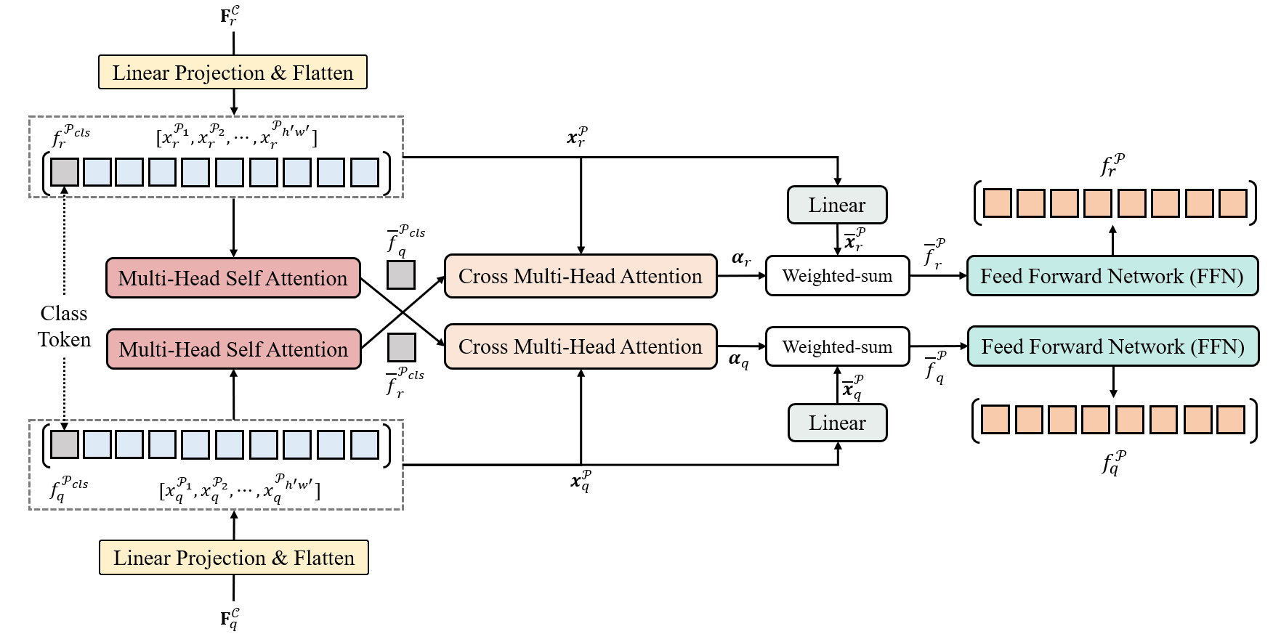
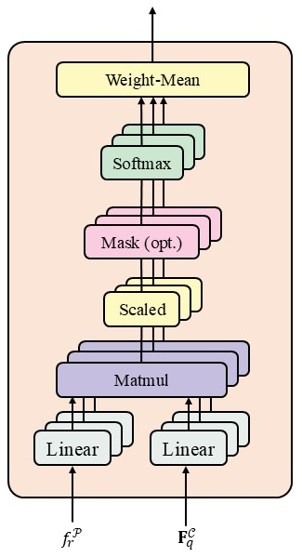
Contrast based Part Decoder
Cross Multi-Head Attention

