Slide 1
QuizAI
AI-Powered Quiz Generator from PDF & PowerPoint
Artificial Intelligence Project · Topic: Generative AI
Group Members: 1. Mohamed Gasem · 2. Maulid Yuswan Hidayat · 3. Mohamed Ahmed
github.com/Mirror71/Quiz-Ai-
Notes:
Introduce yourselves and the project: QuizAI, an AI project under the Generative AI topic. One sentence: 'QuizAI turns any PDF or PowerPoint into an interactive multiple-choice quiz using Google Gemini.' Group of 3, code on GitHub.

Slide 2
The Problem & Our Solution
❗ The Problem
✅ Our Solution: QuizAI
• Creating quiz questions from study material is slow and tedious.
• Students need fast self-assessment to test understanding.
• Good options + explanations need effort and expertise.
• Upload any PDF or PowerPoint document.
• Gemini AI reads it and writes a 10-question quiz.
• Take it interactively: feedback, explanations & a score.
📄 Upload Document → 🤖 Gemini AI Reads It → ❓ 10-Question Quiz
Notes:
Motivation: making quiz questions by hand is slow; students need quick self-assessment. Solution: upload a document, the AI writes a 10-question quiz with answers and explanations, taken interactively. Point at the bottom banner showing the transformation.

Slide 3
How It Works
1
2
3
4
5
Upload
Extract
Generate
Validate
Play
User drops a PDF / PPTX (max 10 MB)
Server extracts text (pdf-parse / slide XML)
Gemini returns a 10-question quiz as JSON
JSON parsed, repaired & schema-checked
Interactive quiz → feedback → score
Browser (React) → Express API (Node.js) → Google Gemini API
Notes:
Walk through the five steps left to right. Emphasize step 3 (Gemini returns strict JSON) and step 4 (we validate/repair it). Bottom line shows the architecture: React, Express, Gemini.

Slide 4
Technology & Features
🛠️ Tech Stack
✨ Key Features
• Frontend: React + Vite + Tailwind CSS
• Backend: Node.js + Express
• AI Model: Google Gemini (gemini-2.5-flash)
• Parsing: pdf-parse + JSZip (PPTX)
• Drag-and-drop upload with validation.
• Instant green / red answer feedback.
• Score screen with per-question review.
• Robust: auto-retry + model fallback.
System Architecture
React Frontend (browser)
→
Express API (Node.js)
→
Google Gemini API (AI model)
Notes:
Highlight React, Node/Express, and Gemini. Point to features that show polish: instant feedback, score/review, robustness. Use the mini diagram to show the three-tier architecture.

Slide 5
Dataset & Evaluation Method
📚 Dataset
🔬 How We Evaluated
• 10 fact-verified educational documents.
• 6 domains (Biology, Physics, History…).
• Avg ~1,750 characters each; sources cited.
• Generated quizzes across 3 Gemini models.
• Measured success, latency, JSON validity.
• Checked answer-position balance (bias).
Dataset Summary
Documents | Domains | Avg length | Models tested | Total quiz runs
10 | 6 | ~1,750 chars | 3 | 30
Notes:
Explain we tested scientifically: 10 fact-checked docs across 6 subjects, quizzes generated across 3 models, objective metrics measured. Walk the audience through the summary table.

Slide 6
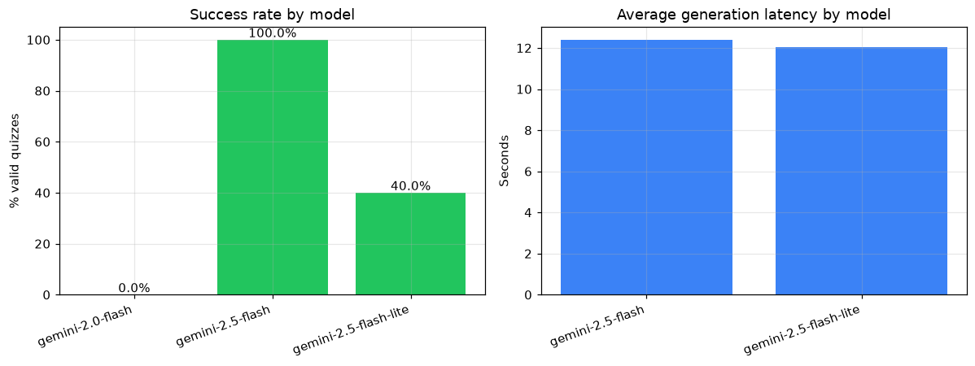
Results
• gemini-2.5-flash: 100% success.
• Exactly 10 questions each.
• 100% valid JSON (first try).
• ~12 s average per quiz.
• Reliable for real-time use.
Notes:
Headline numbers for gemini-2.5-flash: 100% success, exactly 10 questions, 100% valid JSON first try, ~12 seconds. Point at the chart comparing success and latency.

Slide 7
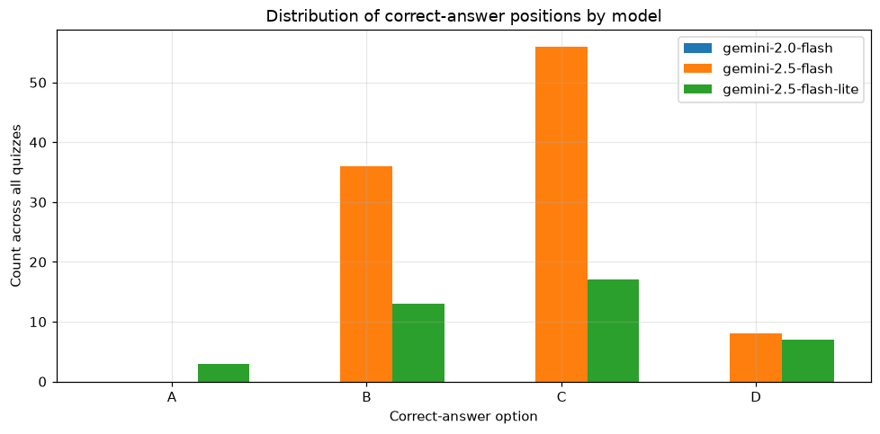
Key Finding: Answer-Position Bias
• Model favored some answer slots.
• Chose 'C' 56% of the time…
• …and never 'A' (0%).
• Known LLM bias (Zhao 2021).
• Fix: shuffle options per question.
Notes:
Our most interesting result: position bias — chose C 56% and never A. Matches a known research finding (Zhao et al., 2021). Real quality issue; simple fix is shuffling options.

Slide 8
Application Demo
Upload Screen
Quiz Screen
Score Screen
Drag & drop a
PDF / PPTX file
→ Generate Quiz
Question 3 of 10
[A] [B] [C] [D]
instant feedback
You scored 8/10
80% 🎉
review answers
Live demo at http://localhost:5000 · (replace these boxes with real screenshots)
Notes:
Show the app flow: upload screen, quiz screen with feedback, score screen. If possible, do a LIVE demo here at localhost:5000, or replace the boxes with real screenshots beforehand.

Slide 9
Conclusion
• Built a complete Generative AI app: documents → interactive quizzes.
• gemini-2.5-flash generates reliable, well-structured quizzes (100% success).
• Evaluation revealed a measurable, fixable answer-position bias.
• Deployed and running locally; full code on GitHub.
🚀 Future Work
Shuffle answer options (fix bias)
→
OCR for scanned documents
→
Configurable difficulty & length
→
Public cloud deployment
github.com/Mirror71/Quiz-Ai- · Thank you!
Notes:
Wrap up: we built, evaluated, and deployed a complete Generative AI app. Mention future work (shuffle options, OCR, difficulty, cloud). Thank the audience and invite questions.

Slide 10
References (Daftar Pustaka)
1. Brown, T. B., et al. (2020). Language models are few-shot learners. NeurIPS, 33.
2. Gemini Team, Google. (2023). Gemini: A family of highly capable multimodal models. arXiv:2312.11805.
3. Kasneci, E., et al. (2023). ChatGPT for good? On opportunities and challenges of large language models for education. Learning and Individual Differences, 103.
4. Kurdi, G., et al. (2020). A systematic review of automatic question generation for educational purposes. IJAIED, 30(1).
5. Zhao, Z., et al. (2021). Calibrate before use: Improving few-shot performance of language models. ICML, 139.
Notes:
Briefly note the key academic sources that informed the project, especially Zhao et al. (2021) for the bias finding and the Gemini technical report.

