Slide 1


Department Of Information Technology
Madras Institute of Technology,
Anna University - Chennai
AZ 5811 Project - II
GenAI Music Rendition: A Deep Learning Framework for Controllable Indian Art Music Melody and Singer-Style Generation
Team No: 4,
Mirsha A K - 2022510044
Piruthviraj V S- 2022510012
Divyabharathi S- 2022510063
Dipakumar M - 2022510061
B. Tech Artificial Intelligence and Data Science
Guided by,
Dr. R. Geetha Ramani, Dept. of IT

Slide 2
Objectives
3. Musical Theme & Emotion Conversion
Develop a framework to transform the emotional character of a rendition.
Analyze and manipulate acoustic features such as pitch dynamics, tempo, timbre, and energy distribution
4. Singer Voice Conversion (Raga-Preserving)
Develop a GAN/Diffusion-based voice conversion module for singer-style adaptation.
Preserve lyrics, pitch contour, and raga identity while transforming vocal timbre.
Raga Recognition & Validation
Develop a multi-channel CNN using Mel and MODGD spectrograms for accurate raga classification.
Support recognition across Carnatic, Hindustani, and Tamil film music.
Raga Generation
Design a Transformer-based model to generate melodies conditioned on theme and raga.
Ensure strict adherence to raga grammar, scale, and characteristic phrases.

Slide 3
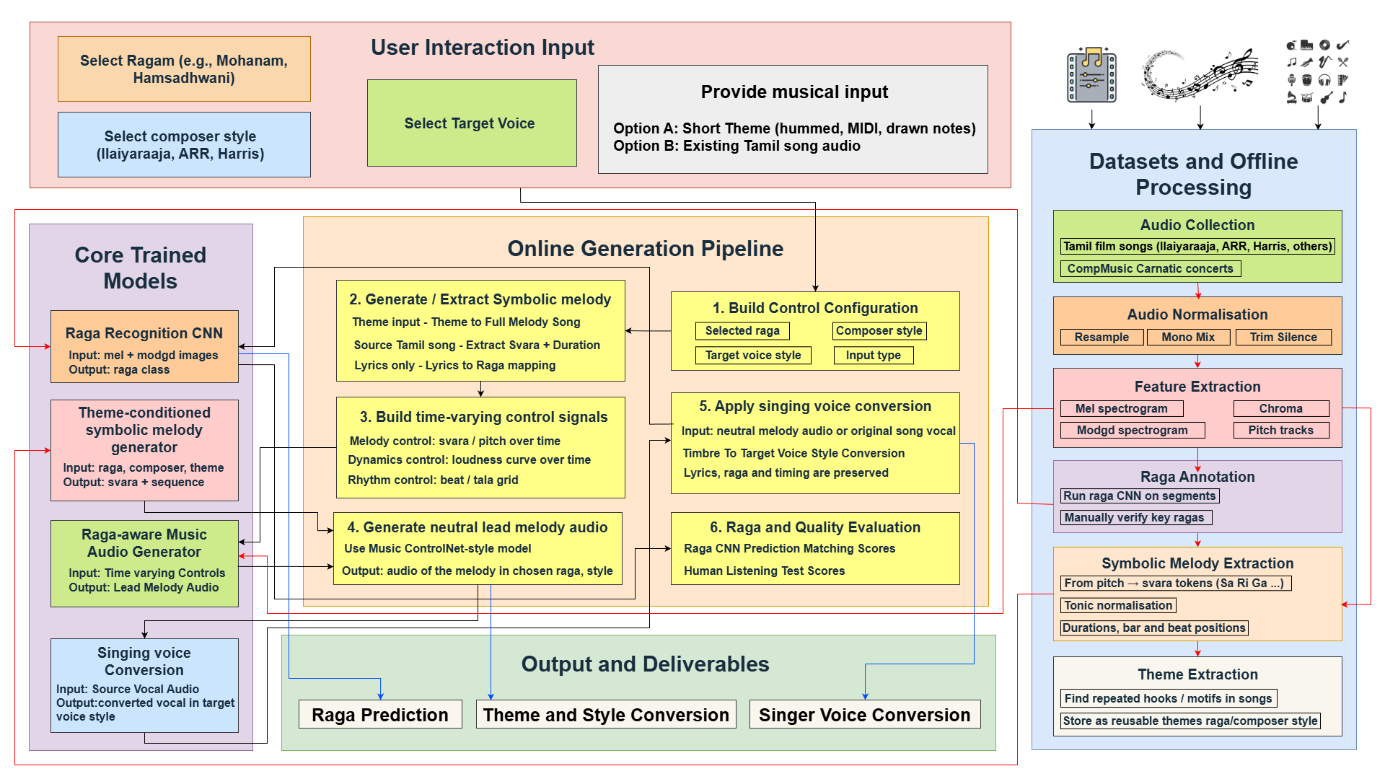
Architecture Diagram

Slide 4
Existing Singer Voice Conversion Approaches
A. Spectral Mapping (Classical + Early DL)
Source singer → spectral features → mapping → target singer
Limitations
Pitch leakage
No explicit control over gamakas
Poor audio quality
Assumes speech-like structure
B. GAN-based Singing Voice Conversion
Convert mel-spectrogram, GAN learns timbre distribution
Limitations
Pitch is entangled with timbre
No explicit pitch supervision
C. Autoencoder-based (Content–Style Disentanglement)
Split representation into: Content (lyrics, pitch), Style (timbre)
Limitations
Pitch often treated as part of content but not explicitly constrained
Reconstruction loss blurs gamakas
D. F0-Explicit Neural SVC
Vocal → Content Encoder → F0 extractor → Speaker Embedding → Decoder
Limitations
Pitch smoothers destroy gamakas
Raga structure NOT enforced
No tonic (Sa) awareness

Slide 5
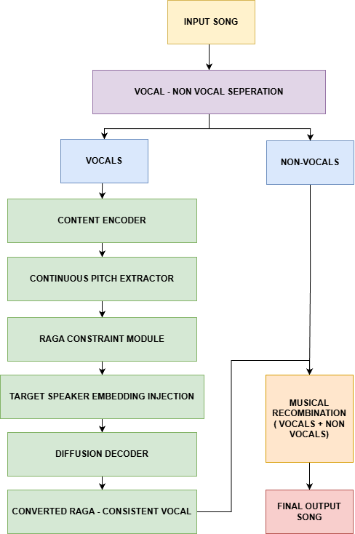
Proposed Approach
Existing Model | Problem
GAN-SVC | Pitch floats freely
Autoencoder VC | No tonal center
F0-conditioned VC | Over-smooths
Speech VC | Ignores raga grammar
Higher F0 correlation → better raga retention
Lower MFCC drift → less musical distortion
Same WER → lyrics preserved
Higher speaker similarity → VC still works

Slide 6

Evaluation Metrics
Singer Voice Conversion Results
Accuracy, Precision, Recall, F1-score – raga recognition
Confusion Matrix – per-raga performance
Raga Adherence Score – fraction of notes within target raga scale / phrases
MOS (Mean Opinion Score) – perceived audio quality and naturalness
Speaker Similarity (embedding cosine distance) – SVC voice similarity
Pitch RMSE / Gross Pitch Error – pitch preservation after conversion
ABX / Preference Tests – user preference for style and timbre
Original Song
AR Rahman
Ilayaraaja
Mano
SPB

Slide 7
Swara Generation
Convert audio into time-domain signal for processing.
Extract fundamental frequency (F0) using the pYIN algorithm.
Normalize MIDI values into pitch classes using modulo 12 operation.
Define allowed swaras for the selected raga (Kalyani, Shankarabharanam, Mohanam).
Apply circular snapping algorithm to map detected pitch classes to nearest valid raga swara.
Generate raga-constrained pitch contours for all candidate ragas.
Compute deviation/error between original pitch contour and each raga-constrained contour.

Slide 8
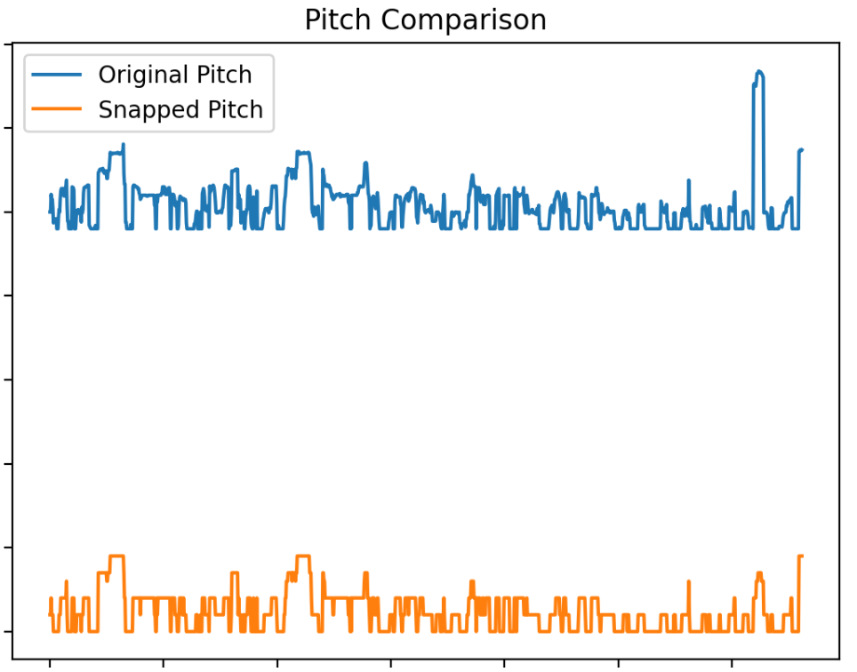
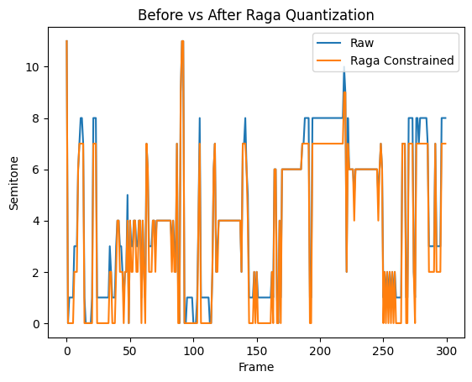
Works done so far
Original and Normalized Pitch Comparison
Swara Generation
Song : Ennavale Adi Ennavale
['Ni3', 'Pa', 'Pa', 'Ri2', 'Ri2', 'Ri2', 'Ri2', 'Ma1', 'Sa', 'Ga3', 'Ga3', 'Ga3', 'Ga3', 'Ga3', 'Ri2', 'Ga3', 'Ri2', 'Pa', 'Sa', 'Da2', 'Ni3', 'Ni3', 'Ri2', 'Pa', 'Ri2', 'Ri2', 'Pa', 'Pa', 'Ri2', 'Ri2']

Slide 9
Raga Recognition
Custom Tamil song dataset from Ilaiyaraaja
1,100+ audio samples, 90+ ragas after filtering
Audio → Mel-spectrograms + MFCC, chroma, spectral, tempo features
Train–test split for raga recognition model evaluation
Model Used – Key Points
CNN-based deep learning model built using TensorFlow
Input: Mel-spectrogram images from audio songs
Output: Predicted raga + confidence score

Slide 10
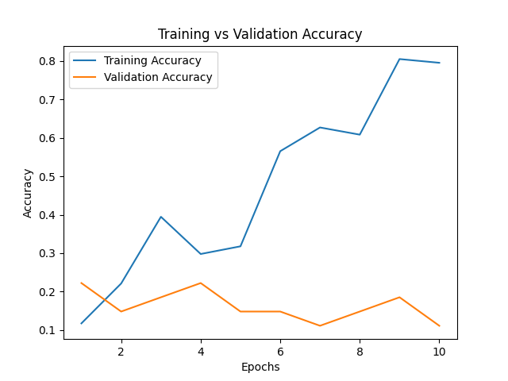
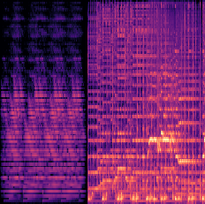

Mel-spectrograms
OUTPUT

Slide 11
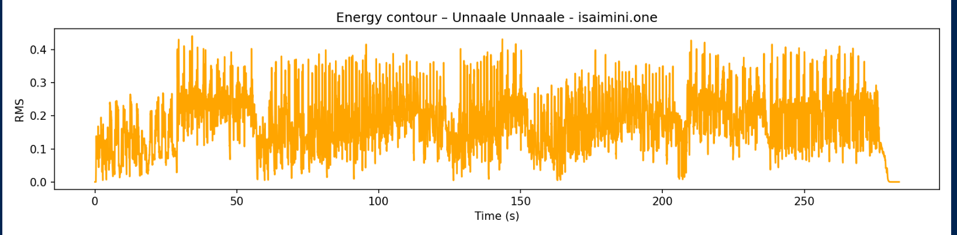
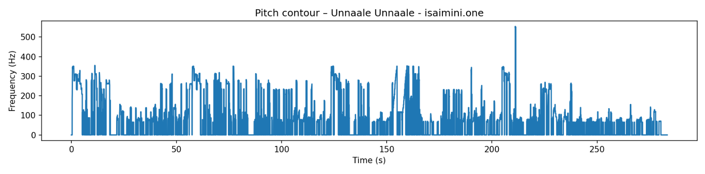
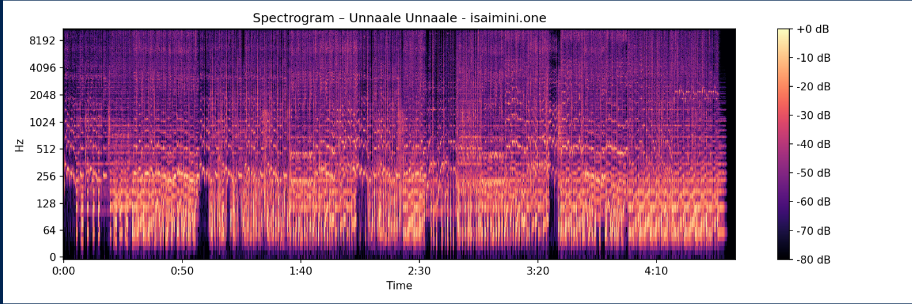
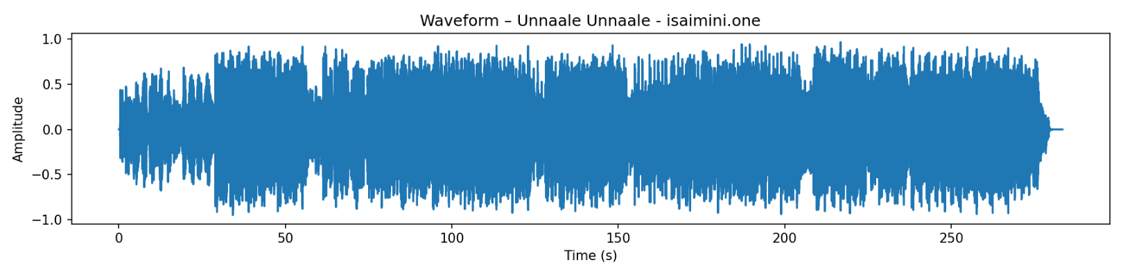
Acoustic Features
INPUT: Tamil Songs (.mp3)
↓ HPSS Vocal Separation ↓
PROCESSED: 6+ songs
FEATURES CSV (time-stamped):
• F0 Pitch (Hz) → Raga
• RMS Energy → Dynamics
• Spectral Centroid → Timbre
• 13 MFCCs → Style
PLOTS GENERATED:
Waveform Pitch Energy Spectrogram

Slide 12
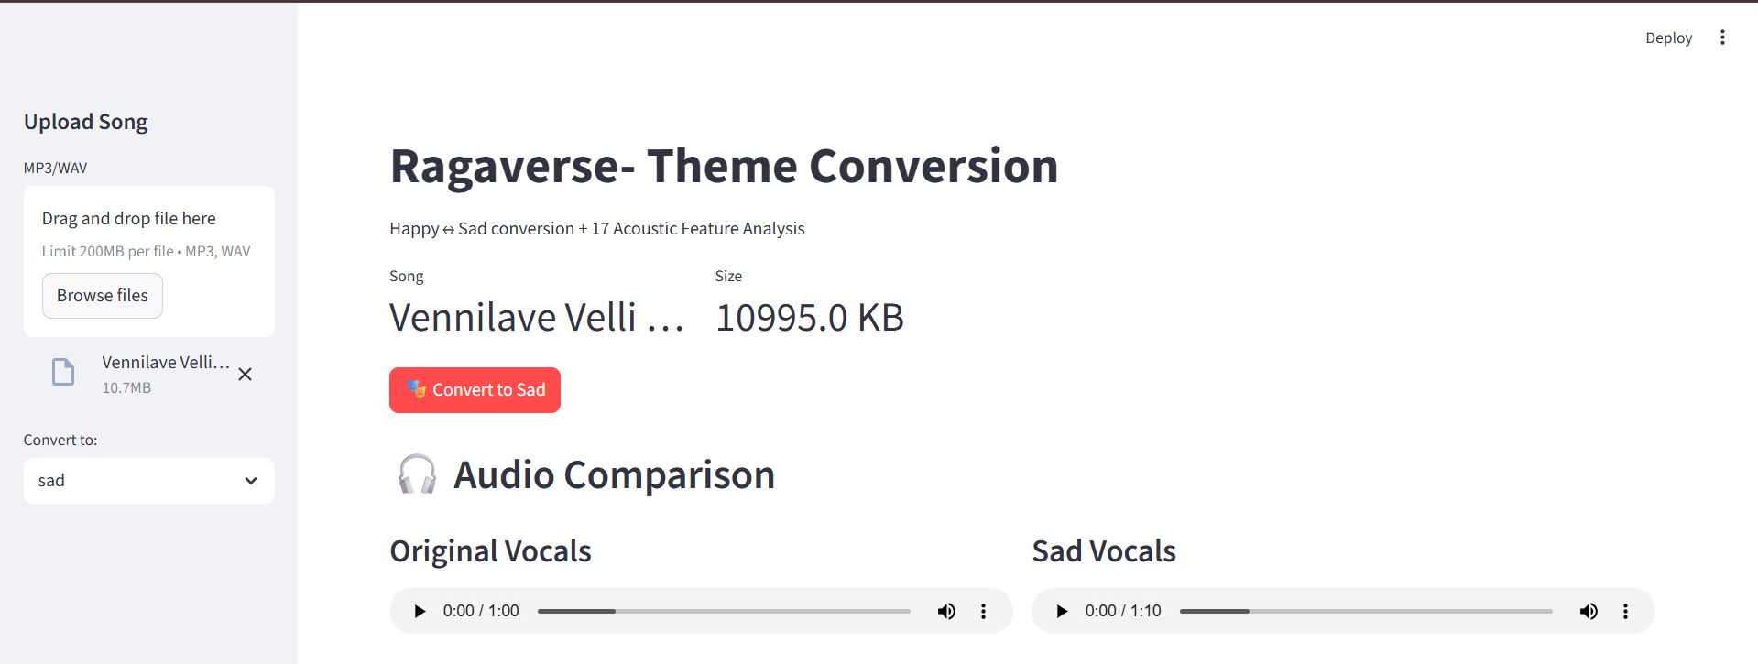
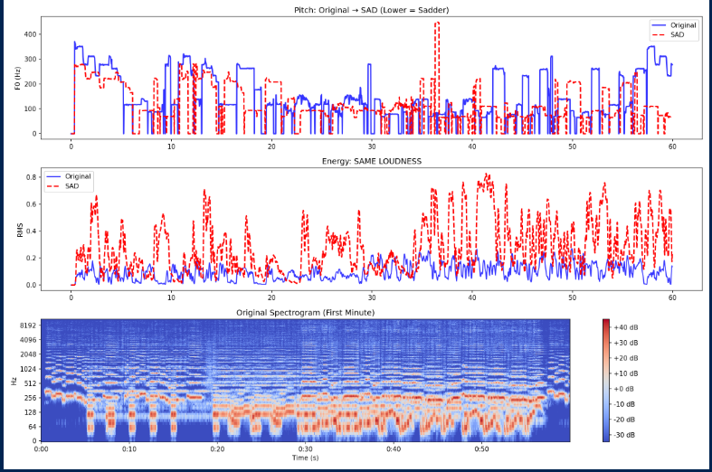
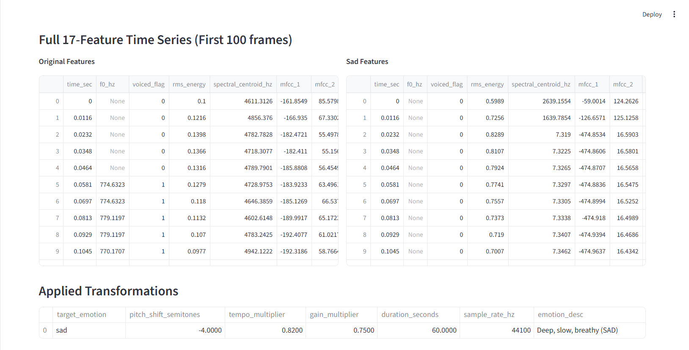

Slide 13
Base Paper
Music ControlNet: Multiple Time-Varying Controls for Music Generation
Problems Addressed:
Text-to-music models struggle with precise, time-varying control over melody, dynamics, and rhythm
Existing systems cannot incorporate multiple synchronized musical controls simultaneously
Method Overview:
Adapts ControlNet (image-domain pixel-wise controls) to audio spectrograms with time-varying melody, dynamics, and rhythm controls
Uses per-control MLPs to map control signals to spectrogram frequency bins
Employs masking strategy to allow any subset of controls, fully or partially specified in time
Key Contributions
First framework for precise, time-varying music controls on diffusion models
Novel masking strategy enabling partial control specification for improvisation
Demonstrates 49% better melody adherence than MusicGen with 35x fewer parameters
Why this paper?
Directly applicable to raga-constrained melody control (svara-based pitch, dynamics, rhythm)
Provides architecture template for integrating multiple musical controls
Proven approach for time-varying control integration into diffusion models.

Slide 14
References
[1] Rajan, S., and Sivan, R., "Multi-channel CNN-Based Rāga Recognition in Carnatic Music Using Sequential Aggregation Strategy", Circuits, Systems, and Signal Processing, Vol. 42, 2023
[2] Sharma, A., Kumar, P., Reddy, V., and Pandey, K., "Towards Building a Deep Learning Based Automated Indian Classical Music Tutor for the Masses", Heliyon, Vol. 8, No. 5, 2022
[3] Singh, R., Kumar, A., Verma, S., and Saxena, P., "Raga Recognition of Indian Classical Music Using Meerkat Optimization Based MFCC and Fine Tuned BILSTM-XGBOOST", Circuits, Systems, and Signal Processing, 2025
[4] Kumar, V., Mishra, A., Gupta, R., and Sharma, N., "Explainable Deep Learning Analysis for Raga Identification in Indian Art Music", IEEE Transactions on Audio, Speech, and Language Processing, Vol. 32, 2024
[5] Zhang, L., Chen, W., Liu, Y., and Wang, X., "Music Generation Using Deep Learning and Generative AI: A Systematic Review", IEEE Access, Vol. 12, 2024
[6] Benetos, E., Coutinho, G., Holzapfel, A., and Klapuri, A., "Music Deep Learning: Deep Learning Methods for Music Signal Processing—A Review of the State-of-the-Art", IEEE/ACM Transactions on Audio, Speech, and Language Processing, Vol. 31, 2023
[7] Wu, H., Tan, J., Liu, Y., and Zhou, S., "Music ControlNet: Multiple Time-Varying Controls for Music Generation", IEEE/ACM Transactions on Audio, Speech, and Language Processing, Vol. 32, 2024
[8] Sisman, B., Yamagishi, J., King, S., and Li, H., "SINGAN: Singing Voice Conversion with Generative Adversarial Networks", APSIPA Annual Summit and Conference, 2019
[9] Shih, Y., Wu, S., Zalkow, F., and Yang, Y., "Theme Transformer: Symbolic Music Generation With Theme-Conditioned Transformer", IEEE Transactions on Multimedia, Vol. 25, 2023
[10] Deng, X., Tong, X., Liu, R., and Zhang, Z., "Singing Voice Conversion Based on Non-Parallel Corpus", IEEE/ACM Transactions on Audio, Speech, and Language Processing, Vol. 28, 2020

Slide 15
Thank You

