Slide 1
PCL (Personal Character Learner)
Multimedia Computing
Mirtolip Saitov U1610145

Slide 2
Abstract
In this days artificial intelligence and neural networking systems are becomes more interested spheres in the world. To determine people and gathering their information plays very important role I the business. So here I decided to make face recognition system and gathering customers data. The platform about to learn people’s character and recognize them. After configuring the program, the program automatically will find the person or people which were configured and show them by their names. Using the OpenCV we can analysis the face.

Slide 3
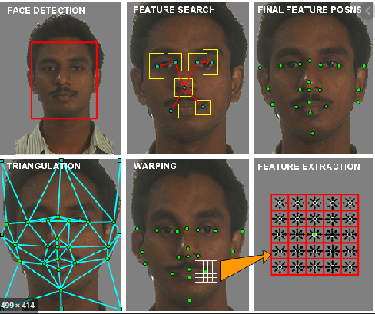

Slide 4
Methods
The function detects the actual face and is the key part of our code:
The detectMultiScale function is the general function that detects object.
Since we are calling on the face cascade, that’s what it detects.
The first option is the grayscale image.
The second is the scaleFactor. Since some faces may be closer to the camera,
they would appear bigger than the faces in the back.
The scale factor compensates for this.
The detection algorithm uses a moving window to detect objects.
minNeighbors defines how many objects are detected near the current
one before it declares the face found. minSize, meanwhile, gives the size
of each window.

Slide 5

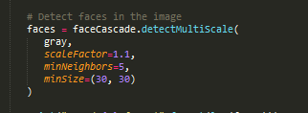

Slide 6
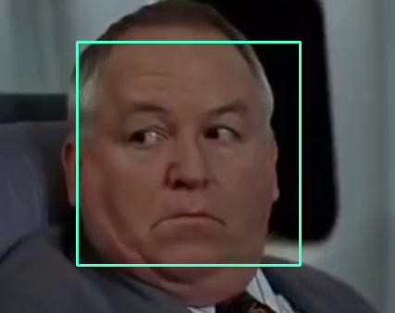
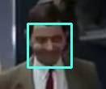
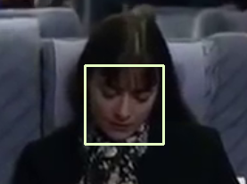
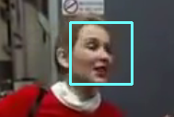

Slide 7
Thank you for attention

