Slide 1


Heart Disease Prediction
By Sajeewa
Mini Project 03

Slide 2
INDEX
introduction
Analysis and interpretation
summary

Slide 3

INTRODUCTION
Heart Disease is number 1 cause of death globally
More than 17.9 million people died each year (31% of global deaths)
85% of due to Heart attacks and storks
Most of heart diseases can be prevented
Notes:
This is quite scary fact that heart diseases is main cause death in the world.
By improving your lifestyle, including your diet and level of fitness, you can minimise your risk of getting heart diseases.

Slide 4
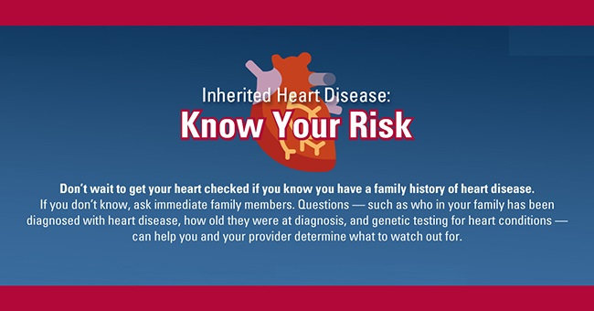
INTRODUCTION
Cholesterol < 180 mg/dL
Blood Sugar < 126 mg/dL
Blood Pressure 120/80 mmHg
Notes:
These are the threshold levels you must be

Slide 5
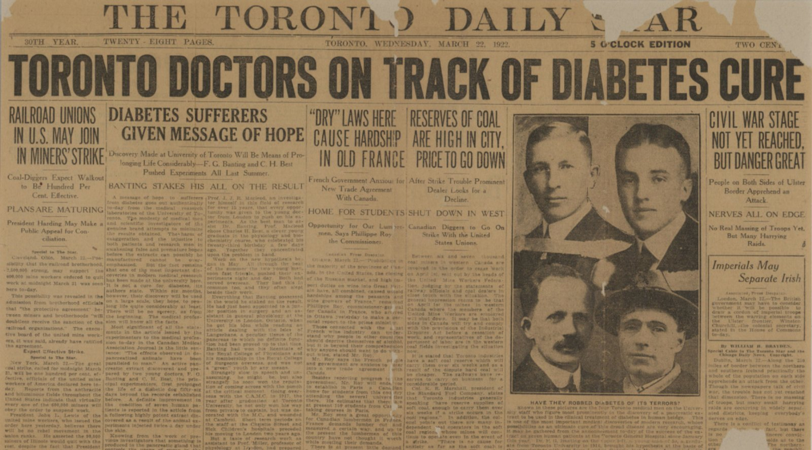
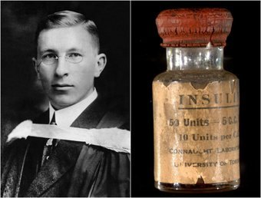
INTRODUCTION
Insulin, discovered in 1921.
Before the discovery of insulin, a diagnosis of diabetes meant certain death
One Greatest discoveries…
Notes:
Insulin discovery was one of great discoveries in medical history in this century.

Slide 6
INTRODUCTION
140
In 1997, the American Diabetes Association (ADA) and the federal government lowered the per se standard for diagnosing diabetes from a fasting blood glucose level of 140 mg/dL to 126 mg/dL
Changing the threshold for diabetes from a fasting glucose level of >140 mg/dL to >126 mg/dL would result in millions of new cases
Blood Sugar Level (mg/dL)
126
0
Notes:
In 1990’s some very strange happened. ADA reduce the standard level of glucose level.

Slide 7

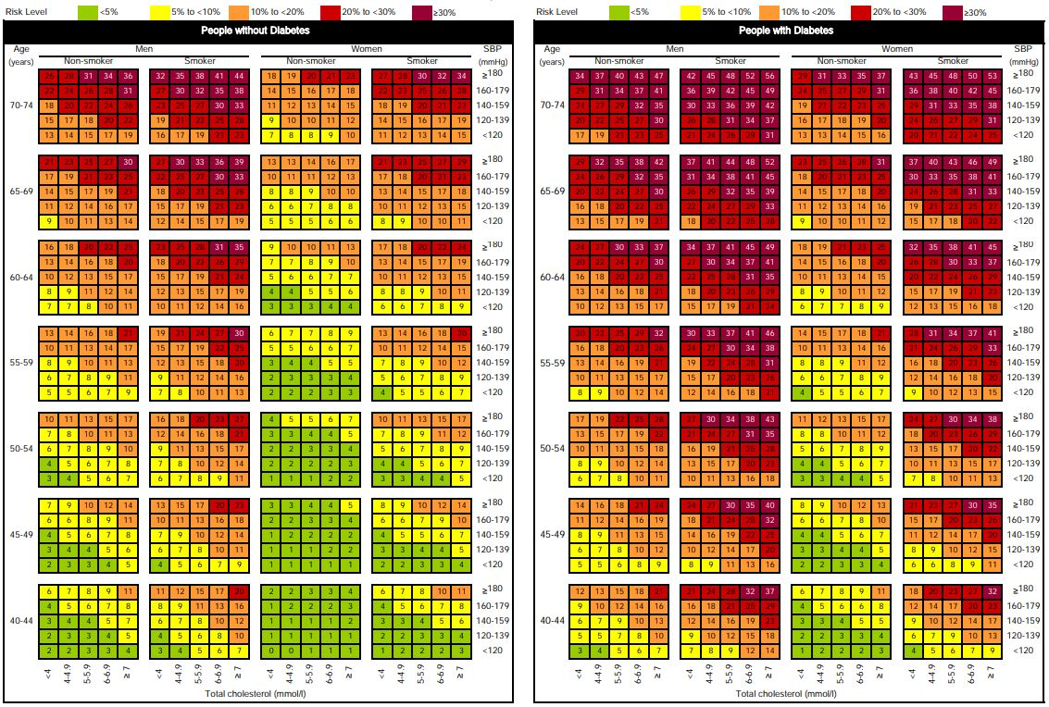
Risk Factor Chart
Notes:
This is the rick factors that has been released from WHO. It shows how your life is in danger.

Slide 8
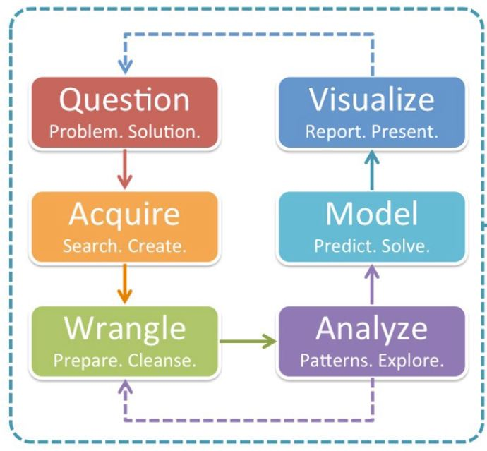
ANALYSIS AND INTERPRETATION
Data Science solution workflow

Slide 9
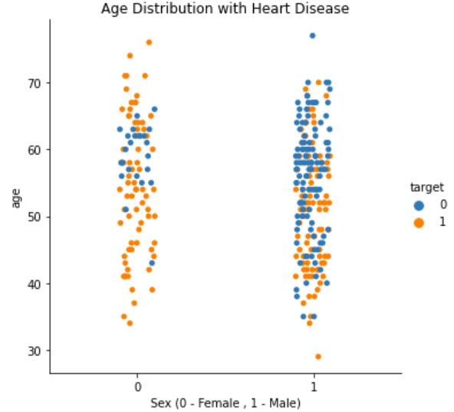
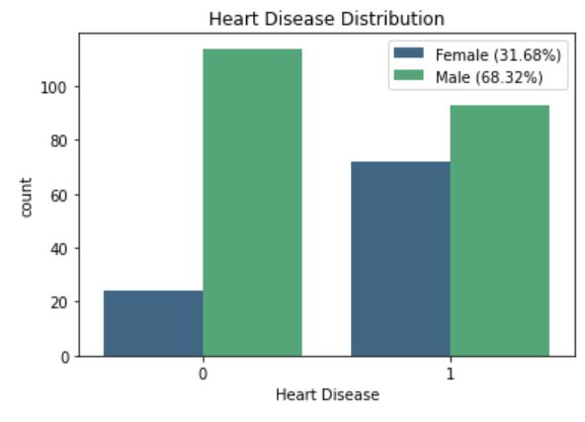
ANALYSIS AND INTERPRETATION
DATA
Notes:
This is how my data looks like.. Distribution among male and female

Slide 10
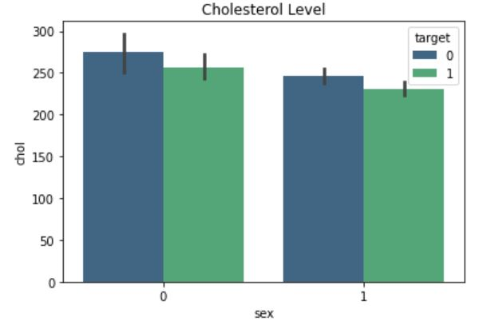
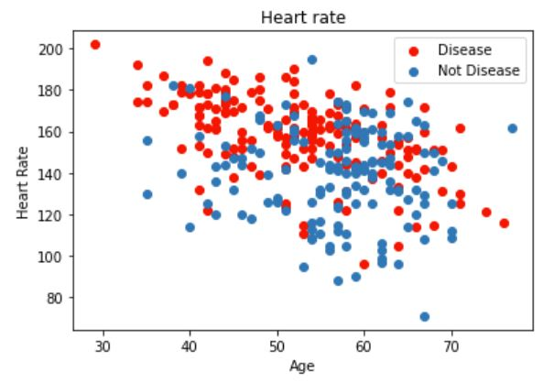
ANALYSIS AND INTERPRETATION
DATA

Slide 11
ANALYSIS AND INTERPRETATION
Model Name | AUC Score | f1 Score | Recall | Precision
Random Forest | 0.89 | 0.89 | 0.84 | 0.93
Logistic Regression | 0.88 | 0.89 | 0.91 | 0.88
Naive Bayes | 0.87 | 0.87 | 0.84 | 0.90
SVM | 0.87 | 0.88 | 0.88 | 0.88
Decision Tree | 0.82 | 0.83 | 0.84 | 0.82
Neural Network | 0.82 | 0.84 | 0.91 | 0.78
AdaBoost | 0.81 | 0.80 | 0.75 | 0.86
K Nearest Neighbors | 0.66 | 0.66 | 0.63 | 0.69
MODEL PERFORMANCE
Notes:
I used 8 different models including K Nearest Neighbors , Scalar Vector machine.
Except KNN all other models performed well. Accuracy well above 80%. And Random forest was performed great nearly 90%.
Also Precision and Recall is 93% and 84% for the model. It is quite good model.

Slide 12
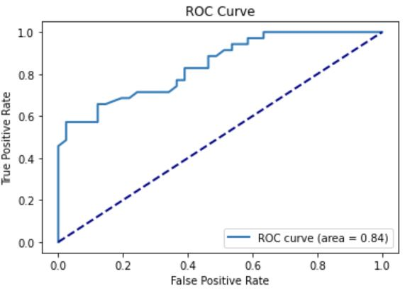
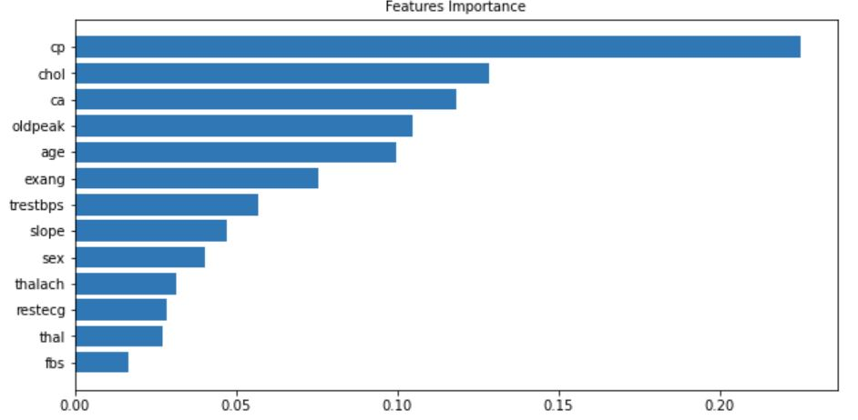
ANALYSIS AND INTERPRETATION
CP (Chest pain type)
Chol – Cholesterol Level
CA - Major vessels
Based on RandomForestClassifier
FEATURE IMPORTANCE
Notes:
Most influence feature is the Chest Pain.
ROC curve shows how good is Random Forest.

Slide 13
SUMMARY
DATA
EDA APPROACH
OUTCOME
Data : UCI (Machine Learning Repository)
Male - 68.2% Female – 31.6%
(Among Patients - 56.3% are Male)
Target Variable:
Heart Disease
14 features
Age/Sex
Blood Sugar
Cholesterol
Blood Pressure
Apply different Machine Learning methods
and identify the best performances models
RandomForest scored the highest accuracy 89%, Precision 93%,
Recall 84%, f1 Score 89 %
and Chest Pain is most
influence feature
SUMMARY

Slide 14
NEXT STEP
NEXT STEP
Identify how obesity influence
Heart diseases
SUMMARY

Slide 15


THANK YOU

