Slide 1

Predicting Compressive Strength of Ready Mixed Concrete
Mini Project 1
08/08/2020
Dr Nariman Saeed

Slide 2


Lay out
Concept
Definition
Design
Delivery
2
Summary
https://au.phaidon.com/

Slide 3
Lay out
Concept
Definition
Design
Delivery
3
Summary
https://au.phaidon.com/

Slide 4
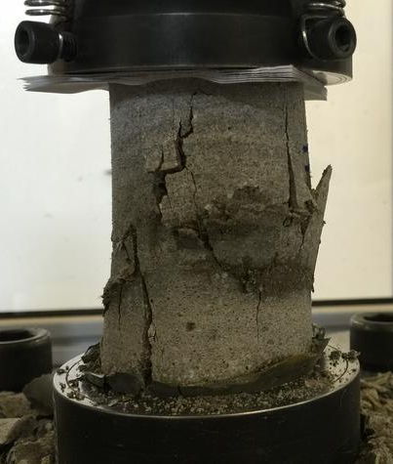

Compressive strength of concrete
Cement
Water
Additives and Admixtures
Aggregates
28 days

Slide 5
Lay out
Concept
Definition
Design
Delivery
5
Summary
https://au.phaidon.com/

Slide 6
Business Question Data Question
Do additives improve compressive strength?
How to predict Compressive strength of Concrete?
Based on?
6

Slide 7
Lay out
Concept
Definition
Design
Delivery
7
Summary
https://au.phaidon.com/

Slide 8
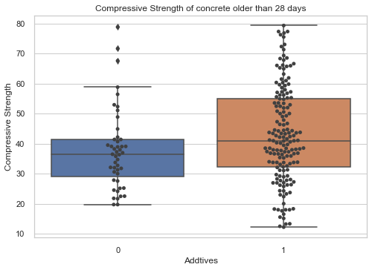
Data exploration analysis
Average:
Concrete w additives: 42.94 KPa
Concrete w/o additives: 37.73 KPa
Improvement : 14%

Slide 9
Project Pipeline
Context and Objective
Stakeholders
Business Question
Business Answer
DATA
Data Analysis
Modeling and Validation
SOLUTION

Slide 10
Lay out
Concept
Definition
Design
Delivery
10
Summary
https://au.phaidon.com/

Slide 11

Linear Regression
Modelling based on the total weight of cement and additives
Modelling based on the total weight of aggregates, cement and additives
Intercept | -10.56
Coeff | 0.124
Intercept | -191.54
Coeff | 0.109

Slide 12
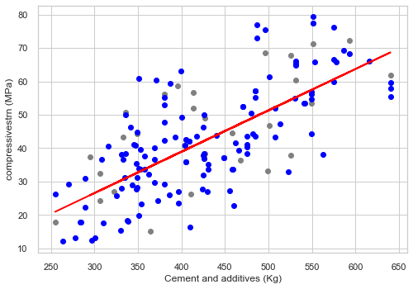
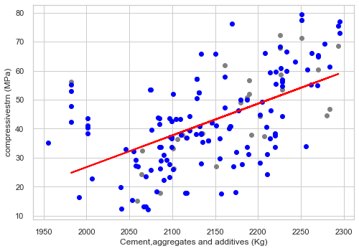
Comparison
MAE | 9.75
MSE | 149.01
RMSE | 12.21
MAE | 10.19
MSE | 143.07
RMSE | 11.96

Slide 13
Lay out
Concept
Definition
Design
Delivery
13
Summary
https://au.phaidon.com/

Slide 14
Summary
Data
Approach
Outcome
Set of data, copied from Kaggle
9 different features
Compressive strength
Coarse aggregate
Fine aggregate
Cement
Fly ash
Slag
Water
Plasticizer
Select the target based on the business question
Select the influencive features
Feature Engineering and choosing the variable
Application of linear regression model
Delivering predictive models
14

