Slide 1
By Sajeewa
CO2 Emission
GOGreen
Mini Project
01

Slide 2
AGENDA
01 : INTRODUCTION
02 : METHOLOGY
03 : ANALYSIS AND INTERPRETATION
04 : SUMMARY
05 : NEXT STEP

Slide 3

01. INTRODUCTION
What factors that
affect
quality of air.
What engine’s specification influence the
CO₂ emission.
STAKEHOLDERS : Scientists, Researchers, Environment Activists

Slide 4

01. INTRODUCTION
CO₂
NO_{x}
CO
Noise dB(A)
Environment is everything that is around us. Pollution is particularly from human activity. Humans have made progress in stopping damage to the environment.
But more remains to be done to protect and restore the atmospheric shield.

Slide 5
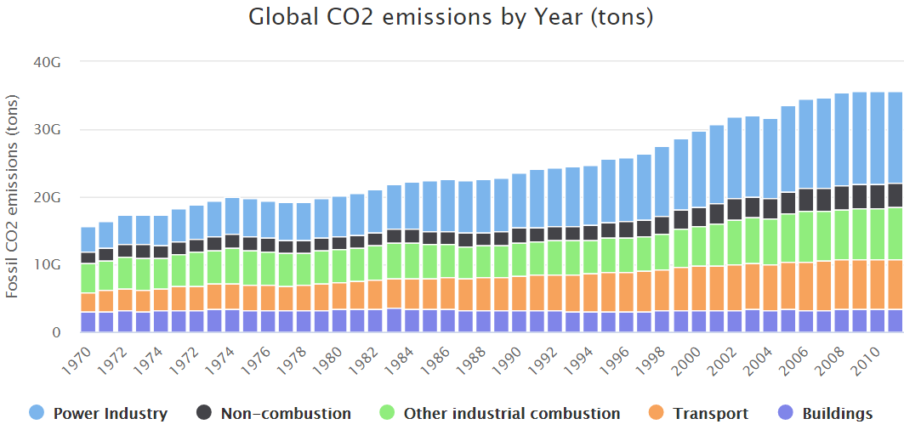
01. INTRODUCTION
Source : https://www.worldometers.info/co2-emissions/
CO2 - 35,753,305,000
Tons (in 2016)
4.79 tons per person (in 2016)
Notes:
CO2 emissions were 35,753,305,000 tons in 2016.
CO2 emissions per capita worldwide are equivalent to 4.79 tons per person (in 2016)

Slide 6
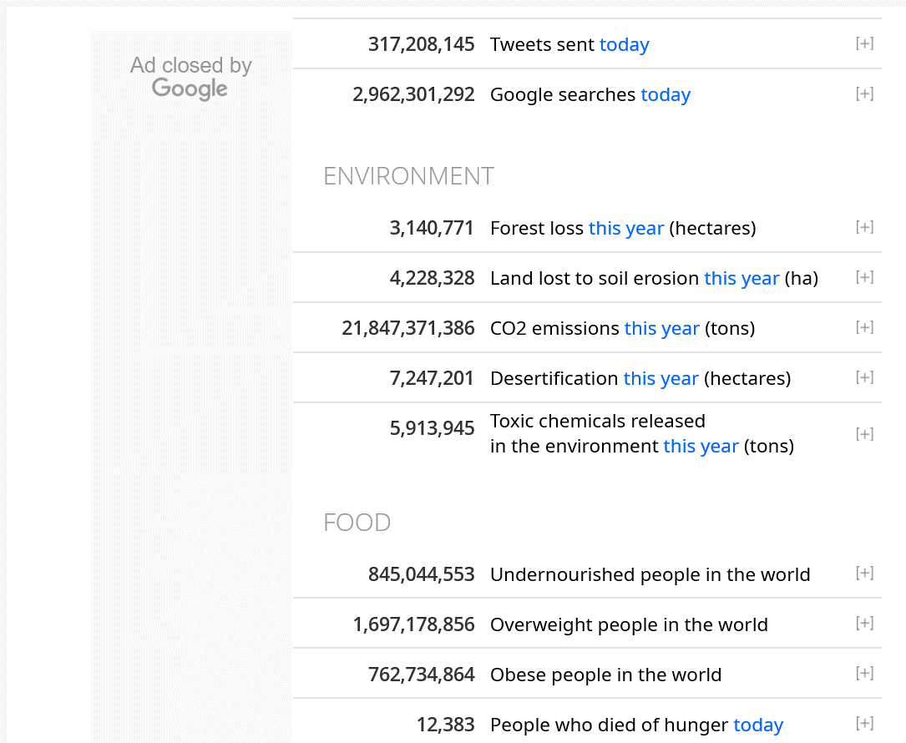
01. INTRODUCTION
Streaming live Data for 2020

Slide 7
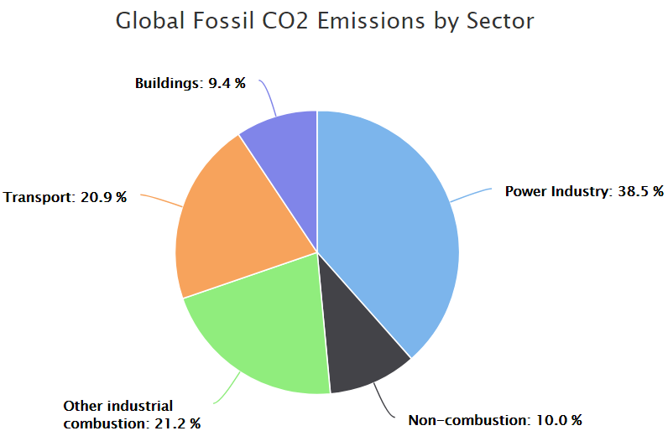
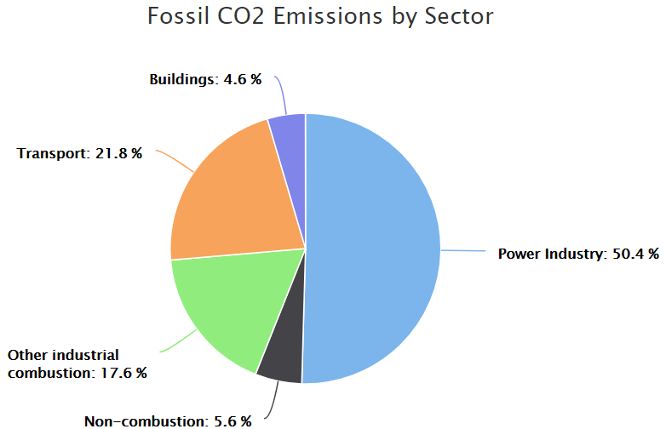
01. INTRODUCTION
(World)
(Australia)
Nearly 21% CO2 emission due to Transport. It is about 7.5 billions tons.
(in 2016)
Notes:
Power Industry - Electricity production. Burning coal and natural gas.
Transportation - From burning fuel for cars, trucks, ships, trains, and planes.
Non-combustion – Due to certain chemical reactions (such as cement production etc..)
Buildings - Commercial and residential. Mostly fuels burned for heat.

Slide 8


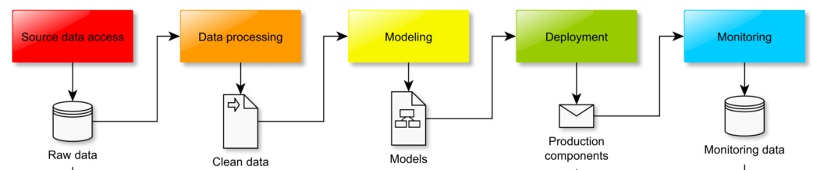
02. METHOLOGY
Stakeholders
Business /
Data
Solutions/
Suggestions
Questions
Answers
Notes:
This is the simple pipeline does my job and input and output share information and is connected together.
It is very important to follow each steps and consider every single component seriously.

Slide 9
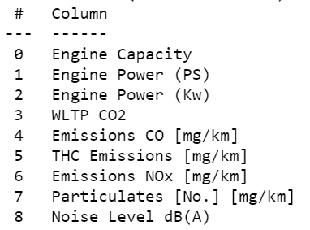
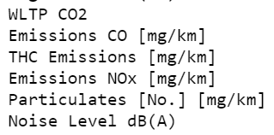

03. ANALYSIS AND INTERPRETATION
Feature Selections
Predictor Variables
Target Variables

Slide 10
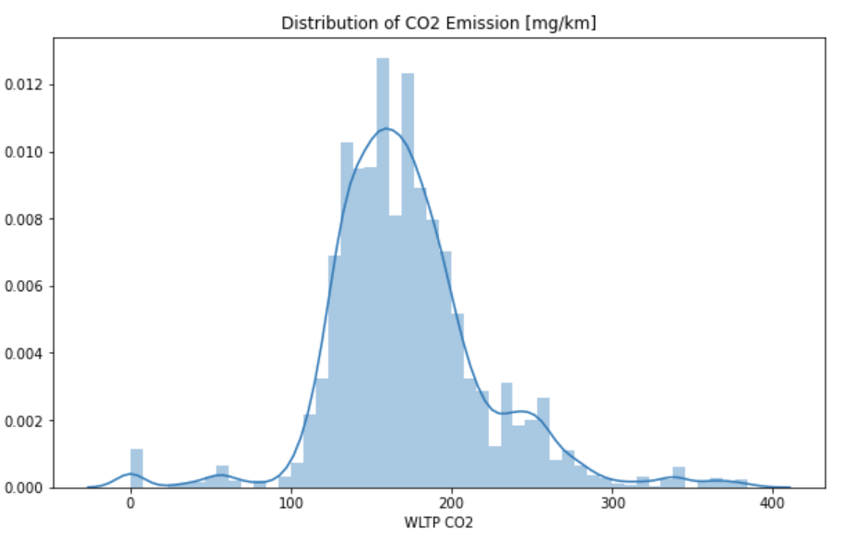
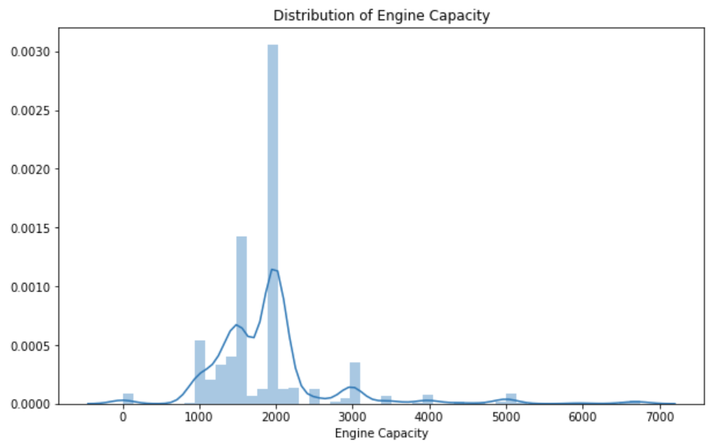
03. ANALYSIS AND INTERPRETATION

Slide 11
04. SUMMARY
Data
EDA Approach
Outcomes
Data : Transport authority
(5078 records)
Target Variable:
Engine Capacity
46 features
CO2 Emissions
Noise Level
NO_{x} Emissions
Select most influence
feature for CO2 emissions
Linear Regression
model used for prediction
and selected
Engine Capacity as most
influence feature

Slide 12
05. NEXT STEP
STEP1
STEP2
STEP3
Identify environment
friendly
engine capacity
Identify environment
Friendly fossil
fuel type
Identify environment
friendly vehicle
model

Slide 13
THANK YOU.

