Slide 1

Household Income & Expenditure
BY SAJEEWA
Capstone project

Slide 2
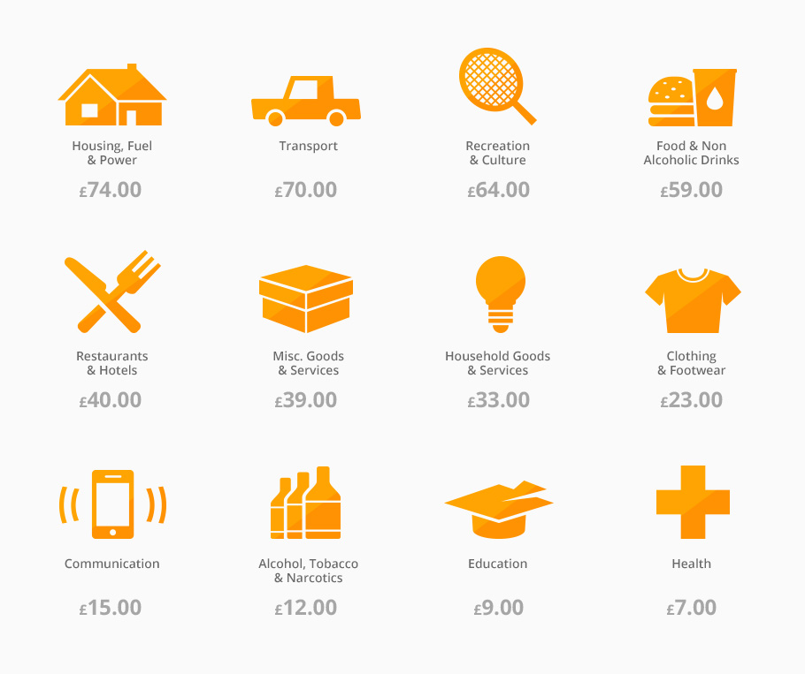
Data Question?
Business Question?
Household income relate on the way we spend?
How expenditure impact the Household income?

Slide 3

AGENDA
introduction
methodology
Analysis and interpretation
Summary and conclusion
next step
Notes:
This is the agenda for today’s presentation. It would go.. Intro. to Next Steps

Slide 4

01. INTRODUCTION
How household income is spread around the word?
Notes:
Firstly we will see.. HOW>>> WORLD.

Slide 5
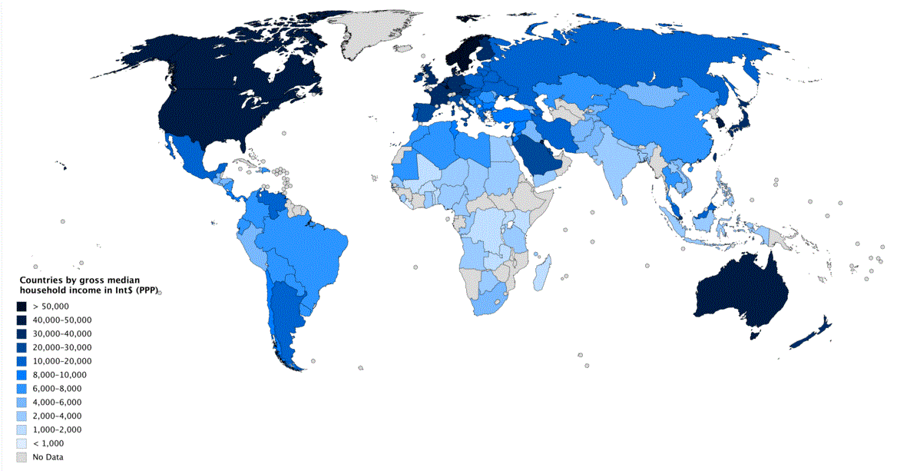
HOW WEALTH THE COUNTRIES AROUND THE WORLD
Notes:
This map shows the median household income around the world. Darker the color.. Increases Income level. America, European countries, Japan and Australia and New Zealand has darker colors. Even mid-east countries, the same.

Slide 6

01. INTRODUCTION
What are the main income sources for countries around the world?
Notes:
WHAT>>> WORLD.

Slide 7
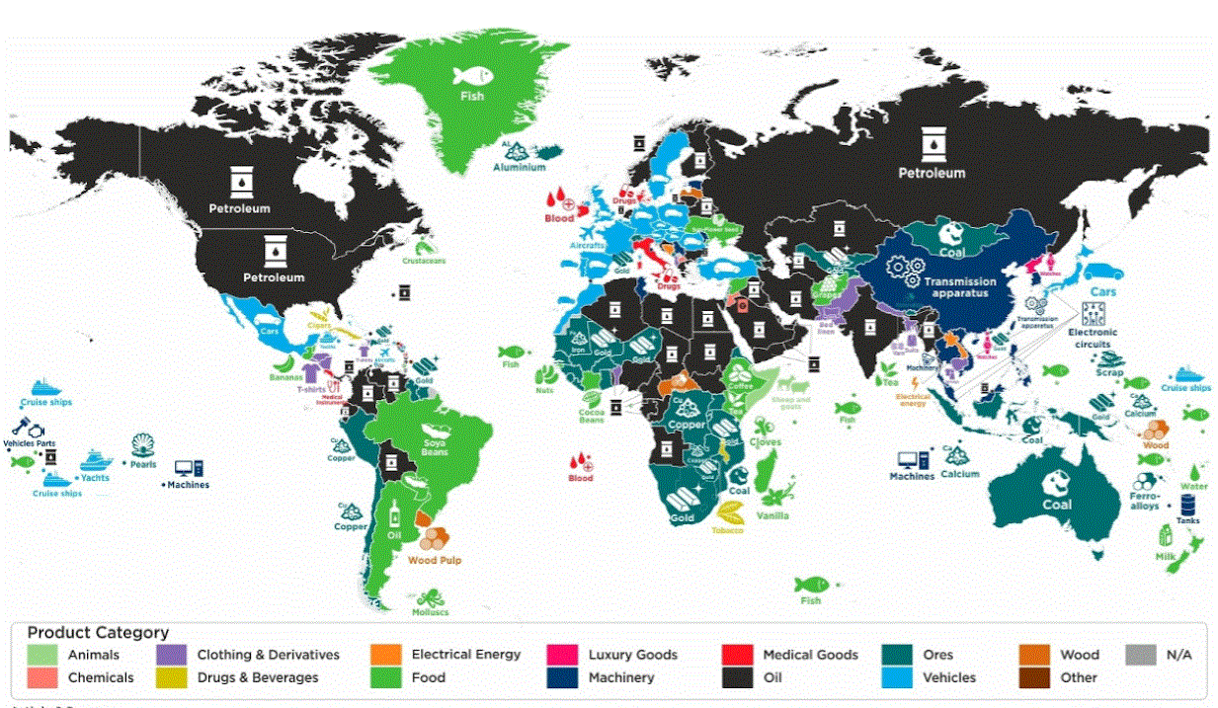
MAIN INCOME SOURCES
Notes:
This maps shows the main income source for the country. Graphs has several categories. For a example South Africa’s main income from GOLD. Japan due to export of motor vehicles. New Zealand Dairy Products. Yes.. Australia Because of Coal.

Slide 8

01. INTRODUCTION
How we spend?
What do we buy?
Notes:
How we spend? What do we buy?

Slide 9
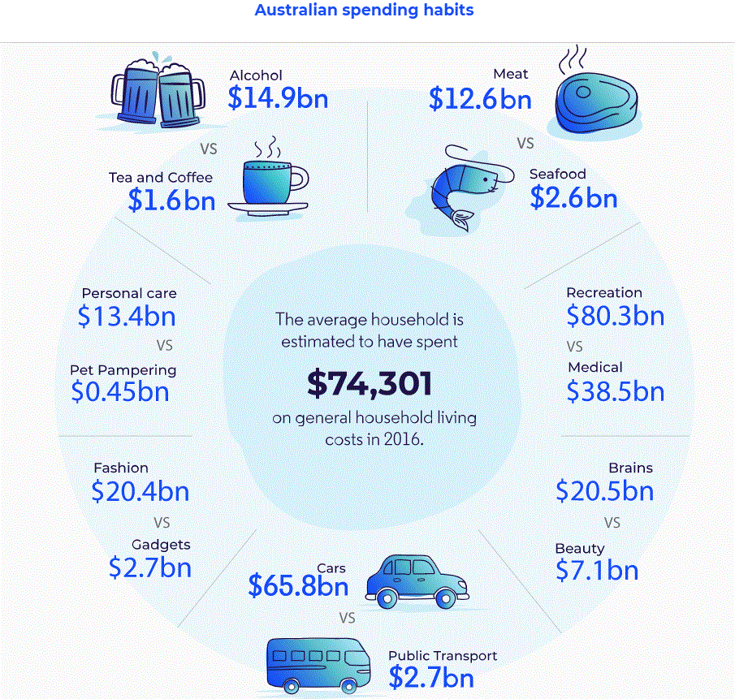
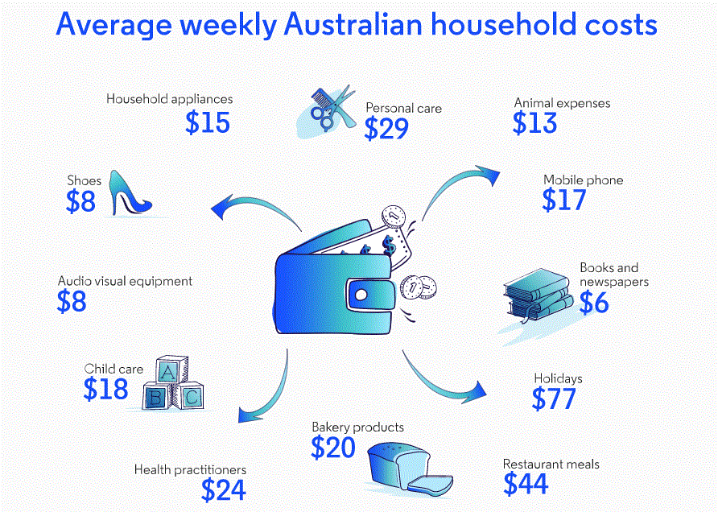
HOW WE SPEND AUSTRALIA - 2016
Source : https://moneysmart.gov.au/australian-spending-habits
Notes:
This is how we spent our money. This data is from 2016. Surprisingly we spent over $1.6 billion of dollars for just Tea and coffee. With alcohol its 16.5 billion. That amount is great than what we spent on food.
By weekly household cost we spend more on holidays. $77 followed by Restaurant $44.

Slide 10
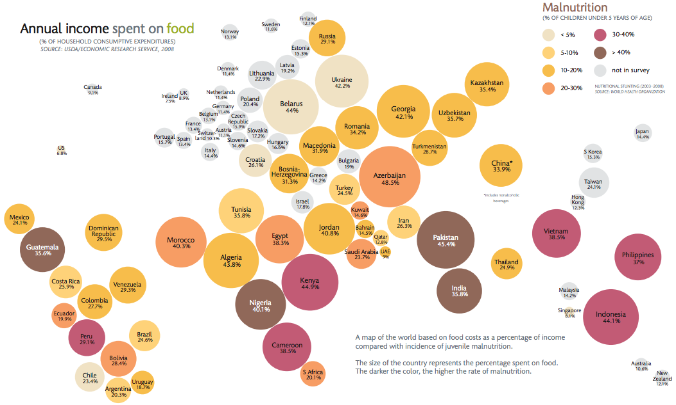
SPEND ON FOOD
Notes:
This graph shows annual income spent on food around the countries.

Slide 11
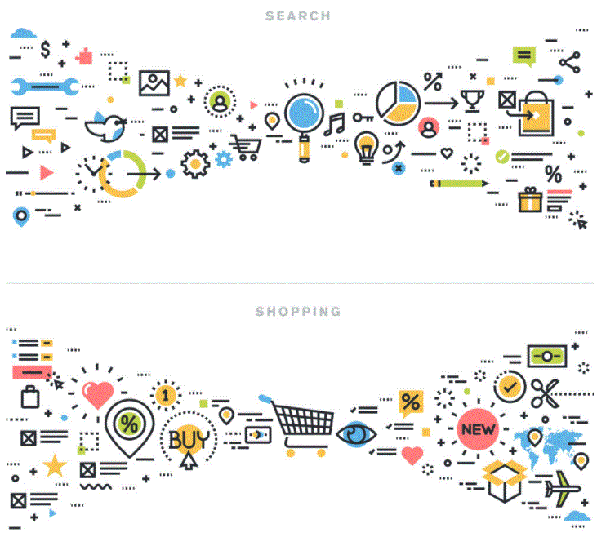
01. INTRODUCTION
Has our spending style (consumer) changed over the years?
Notes:
This is quite interesting.. Has our spending style (Consumer) changed over the years? Will see

Slide 12
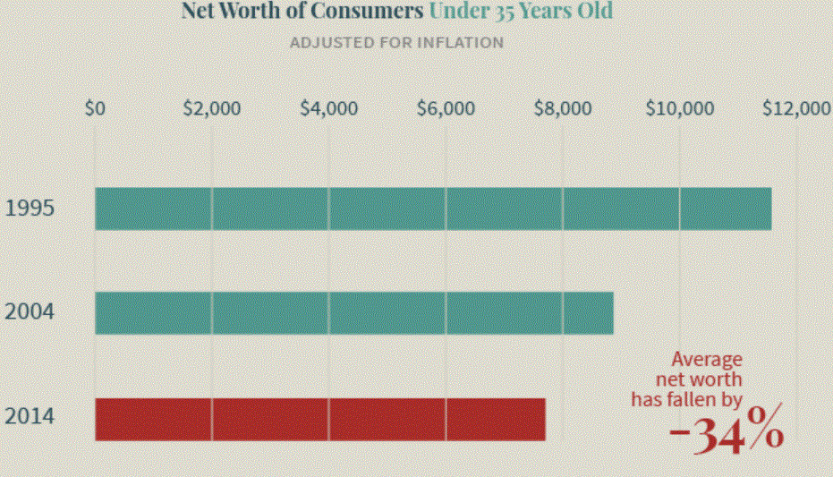
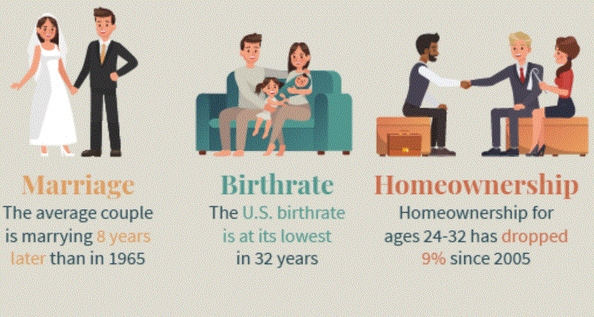
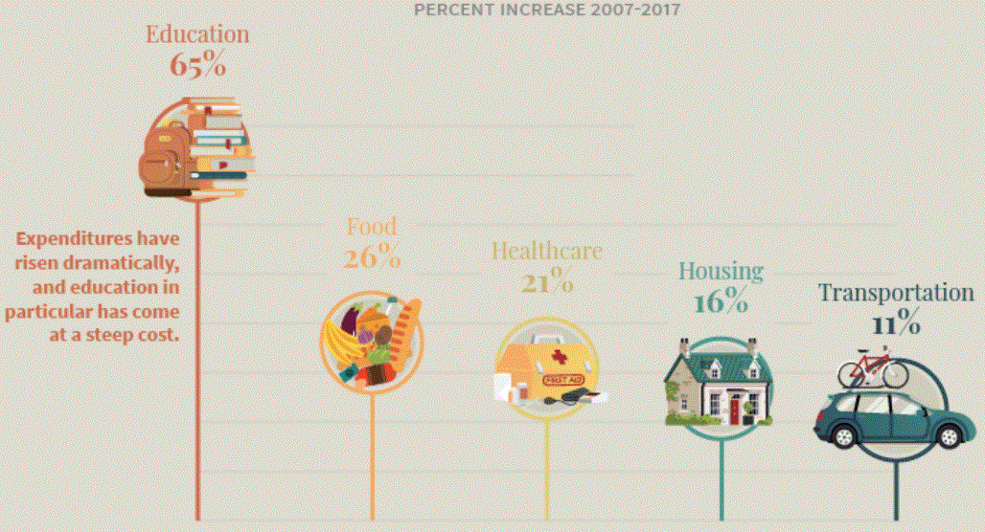
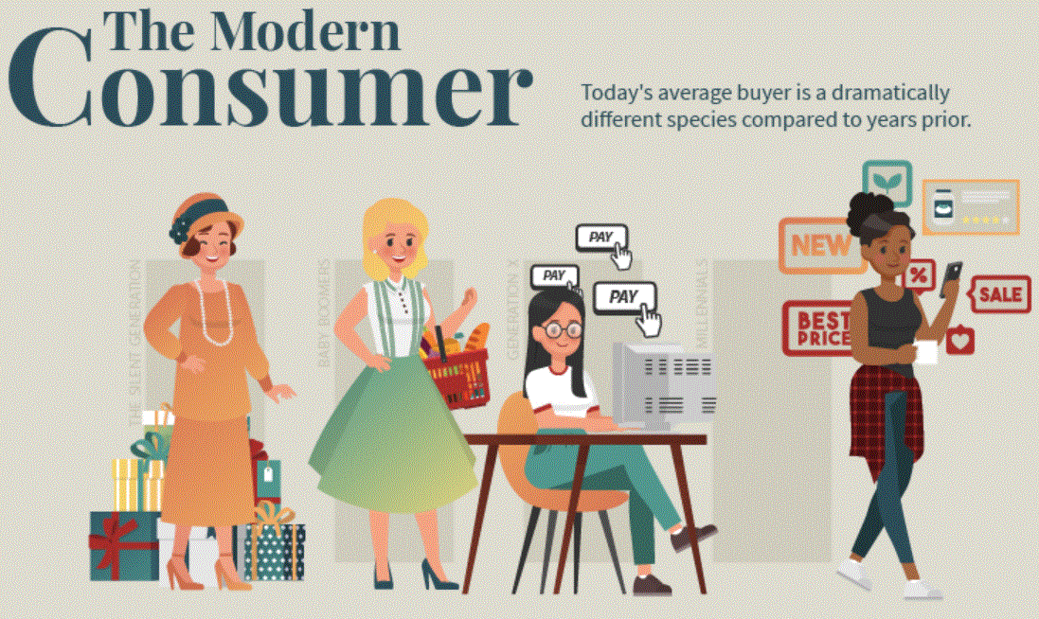
MODERN CONSUMER…
Today’s Consumer is unrecognizable
Today’s Consumer is educated
Today’s Consumer is delaying life milestone.
Today’s Consumer is poor.
https://www.visualcapitalist.com/how-the-modern-consumer-is-different/
Notes:
Consumer today is almost unrecognizable to those decades ago. So both businesses and investors will need to fully adapt to this new reality.
Today’s Consumer is most educated in history and most in debts.
Young generations are also delaying key life milestones

Slide 13


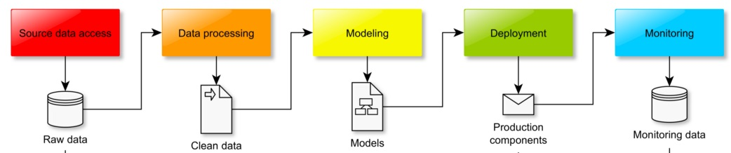
02. METHODOLOGY
Stakeholders
Questions
Solutions/
Suggestions
Data Science Workflow
Notes:
This is the my data science workflow.
Get the question/queries from Stakeholders.
Collect the data… ..data processing…… testing and validating …. and implementation and monitoring..
Finally.. Present the solutions and suggestions

Slide 14
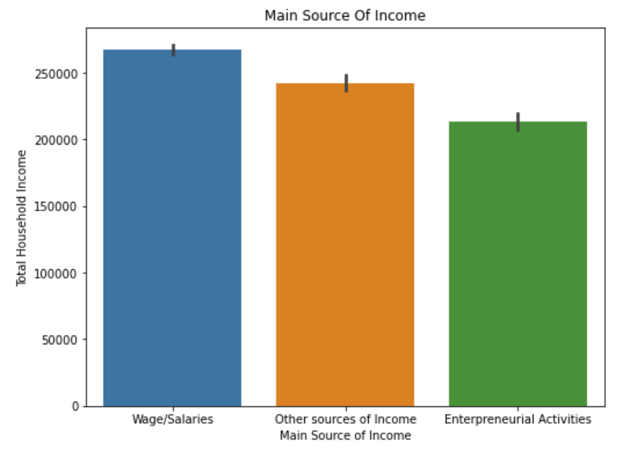
03. ANALYSIS AND INTERPRETATION
Data has
41k observations
60 features
Average Household income is $247,555
Main income sources
Wages/Salaries
Entrepreneurial Activities
Other

Slide 15
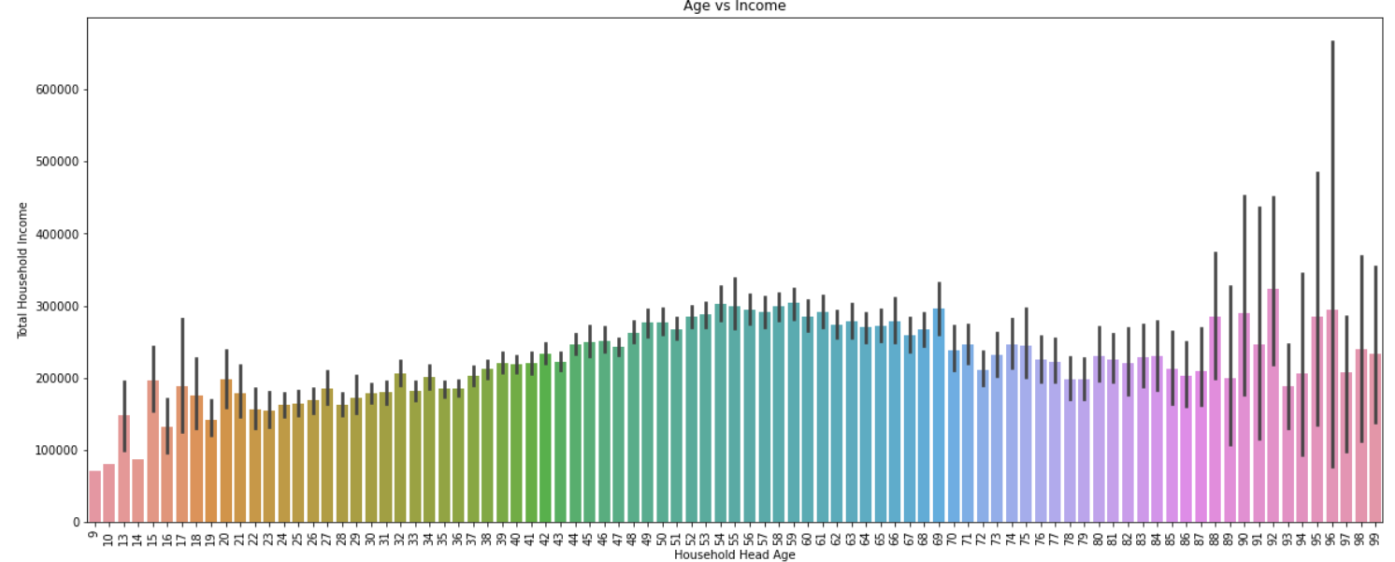
Household Income/Age
75% Household heads – Below 61 years
Age < 15 years – 5 household heads
4 girls/ a boy

Slide 16
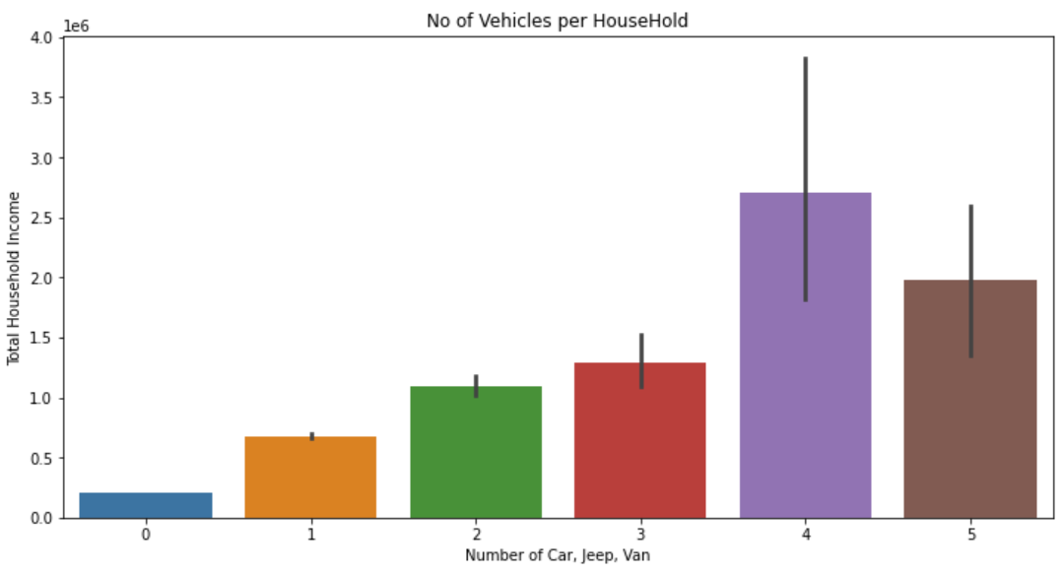
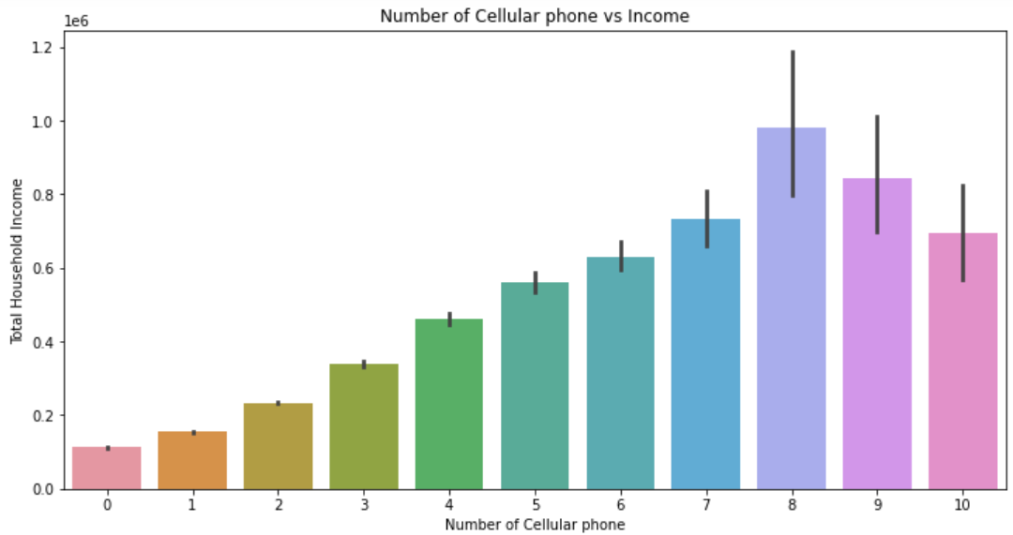
38.8k – Don’t have vehicles. That’s 93.6%
Graphs shows – Incomes increases with no of vehicles owns
268 Household use – 8 or more mobile phones
16.7% Household - no mobiles

Slide 17
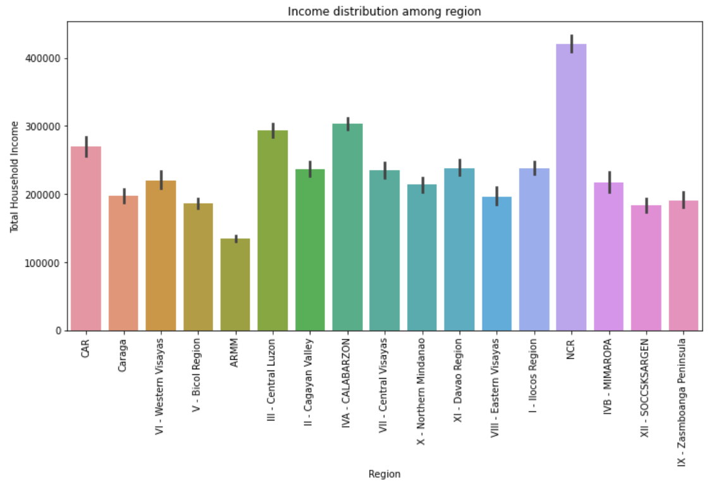
Household Income spreads for 17 suburbs
NCR is the richest area and average income is $420,861
More people :
IVA - CALABARZON

Slide 18
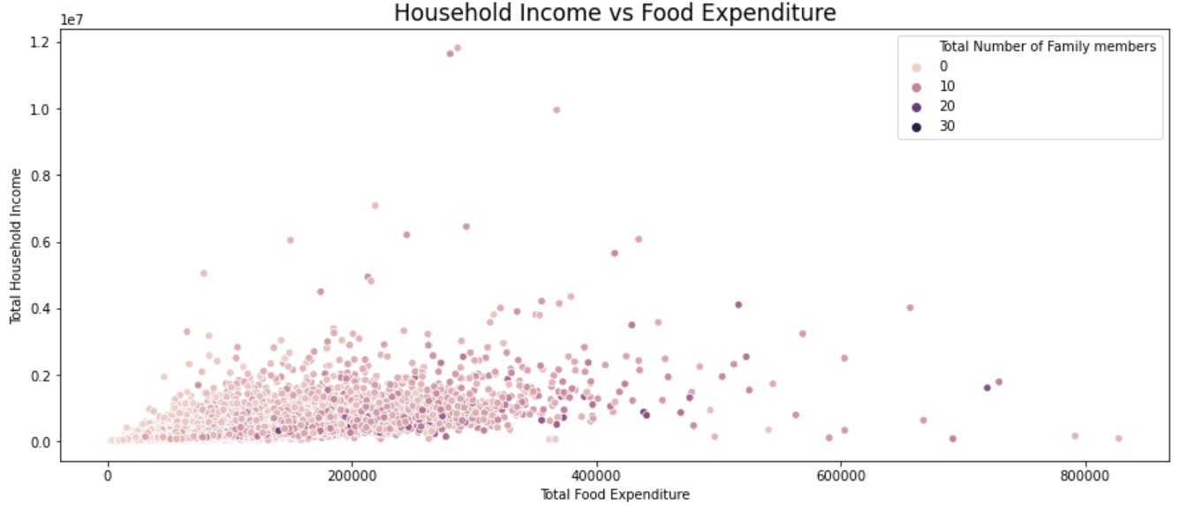
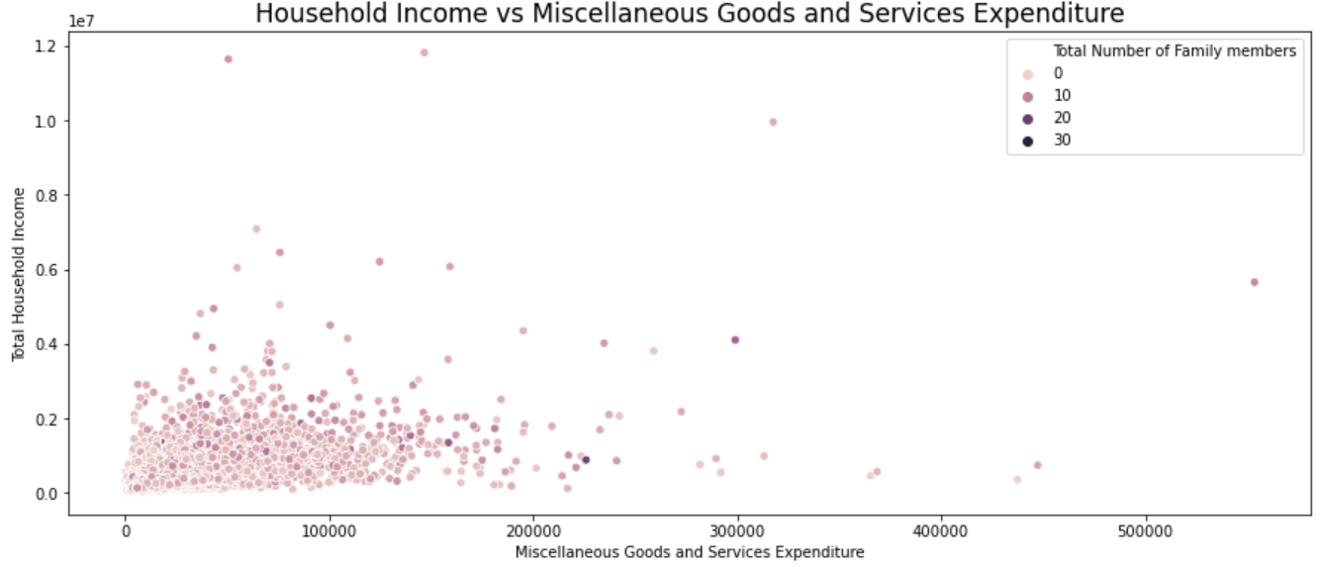
Average - $85k
50% households spend below the average ($73k)
Max - $553k
Household Income > $10 million spends average $283k on Miscellaneous Goods & Services

Slide 19
Models Performances
Predictive Models trained and cross validated.
Accuracy
SVC – 71.40%
LogisticRegression – 70.7%
Model Name | Accuracy | F1 Score | Precision | Recall
SVC | 71.40% | 65.30% | 67.90% | 64.10%
DecisionTreeClassifier | 59.40% | 54.90% | 55.00% | 55.00%
RandomForestClassifier | 70.00% | 63.20% | 65.70% | 62.50%
KNeighborsClassifier | 66.00% | 60.10% | 62.10% | 59.10%
GaussianNB | 62.80% | 58.90% | 60.70% | 59.50%
LogisticRegression | 70.70% | 63.60% | 66.00% | 63.20%

Slide 20
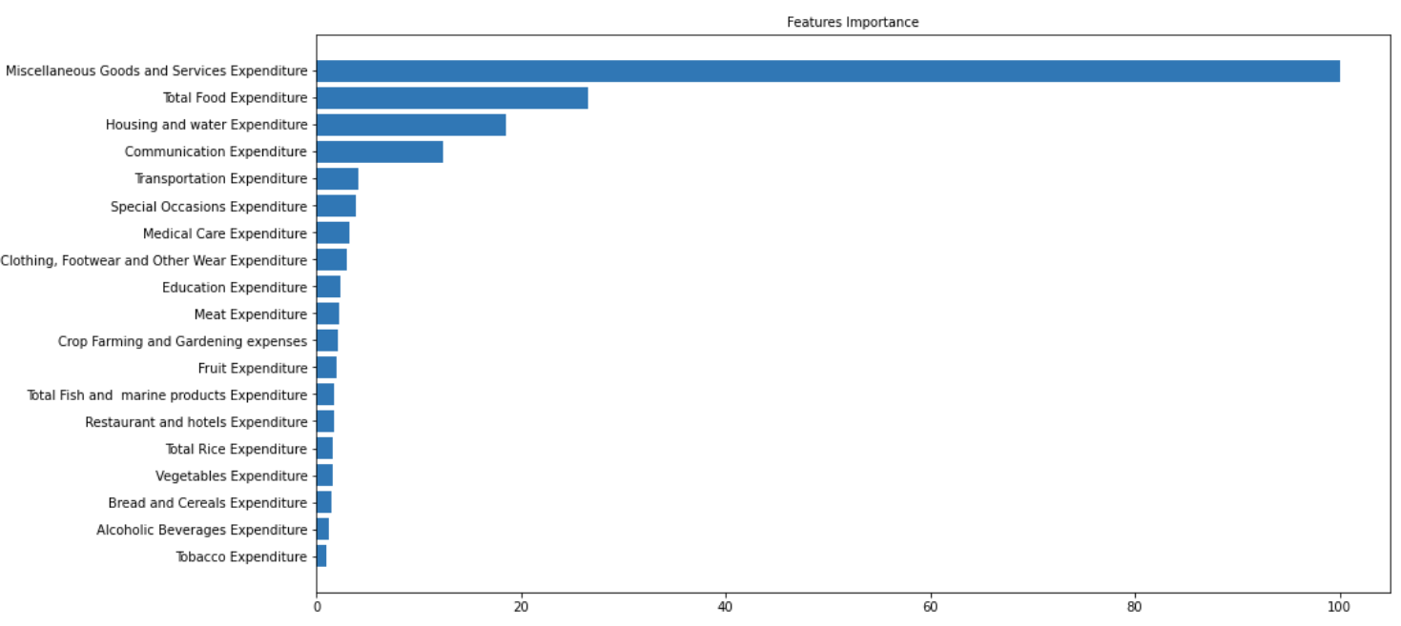
Miscellaneous Goods and Services Expenditure is most influence feature.
Followed by Total Food Expenditure. Housing and Water Exp is also important.

Slide 21
04. SUMMARY AND CONCLUSION
SUMMARY | CONCLUSION
DATA is about Household Income and Expenditure 60 Features (Total Household Income/ Total Food Expenditure..) Target Variable – Household Income | Support Vector Classification provided insightful and valuable information Miscellaneous Goods and Services Expenditure is the most influencing feature

Slide 22
05. NEXT STEPS
STEP 01 | STEP 02
How Does Your Personality Type Affect Your Income? | How Does Social Factors Affect Your Income?
Notes:
while personality does play a role, many other factors contribute to income levels:
Level of education
Years of experience
Local job market
Type of industry
The particular career

Slide 23
Thank you.

