Slide 1
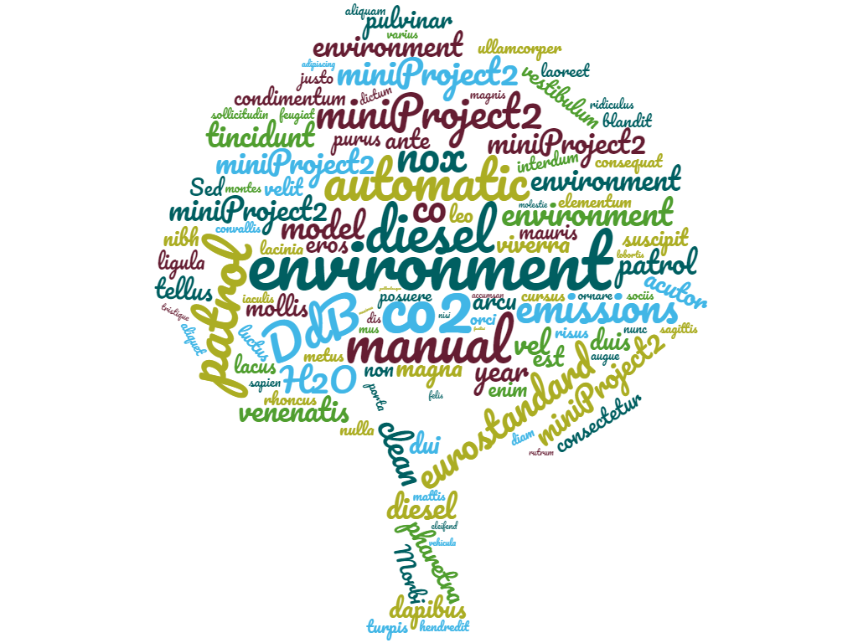
By Sajeewa
Environmental
Pollution
(Mini Project 02)

Slide 2
AGENDA
01 : INTRODUCTION
02 : METHOLOGY
03 : ANALYSIS AND INTERPRETATION
04 : SUMMARY
05 : NEXT STEP

Slide 3
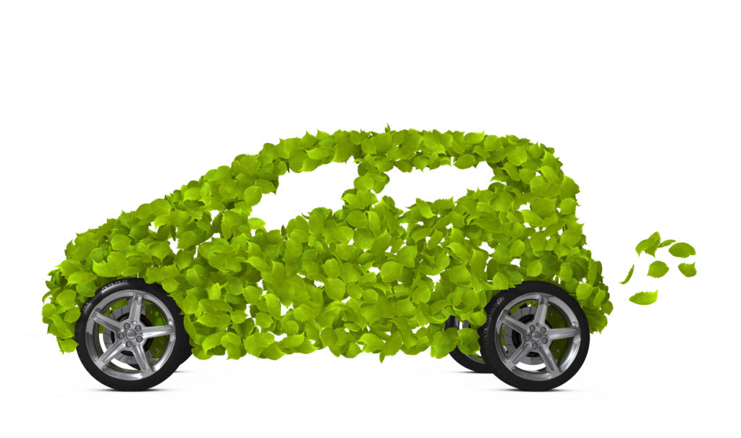
01. INTRODUCTION
CO₂
NO_{x}
CO
Noise dB(A)
Natural resources are the gifts of nature . Either it’s a brand new car or any used car, they both run by consuming fuel and energy. Car pollutants create a bad impact of the natural resources like air, water, and soil.

Slide 4
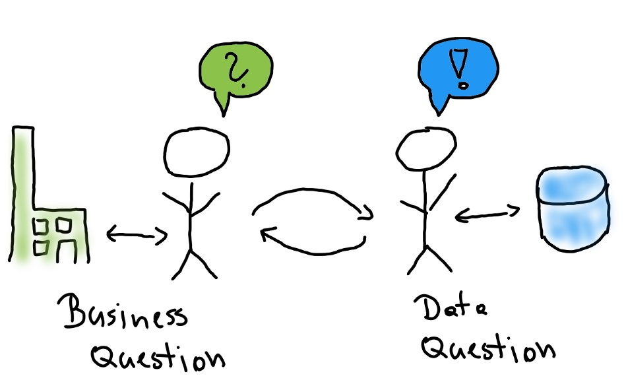
01. INTRODUCTION
How vehicles
influence
environment
How fuel types
impact
environment
STAKEHOLDERS : Scientists, Researchers, Environment Activists

Slide 5
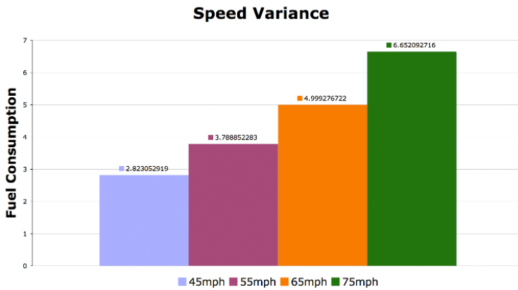
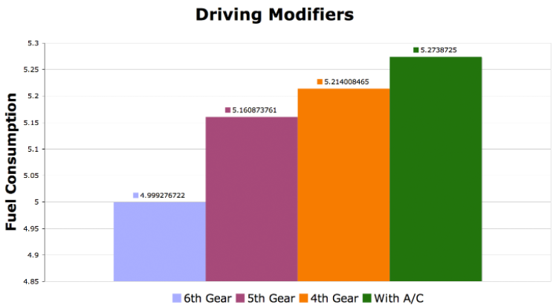
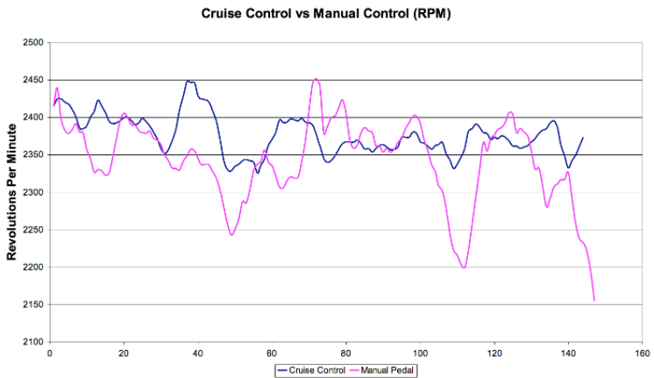
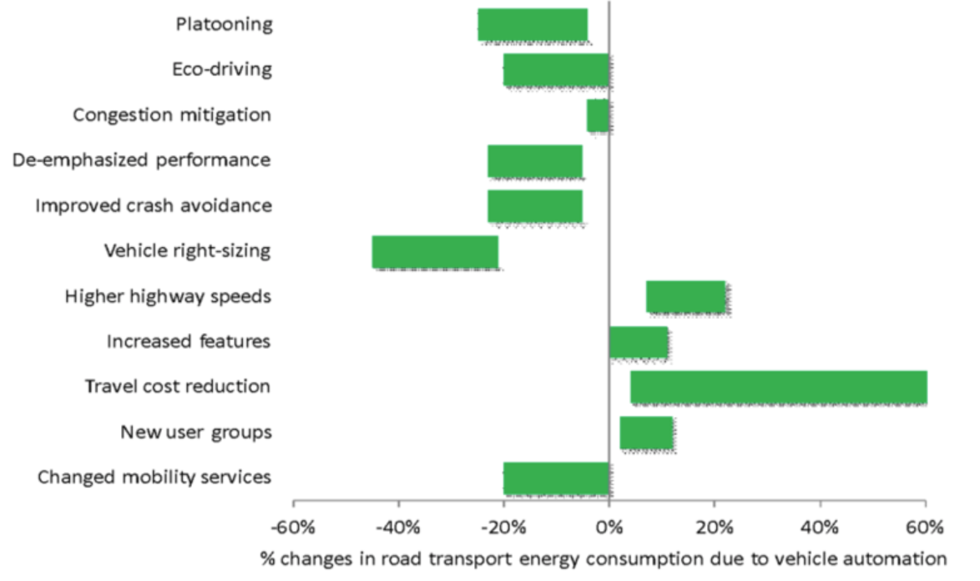
01. INTRODUCTION

Slide 6
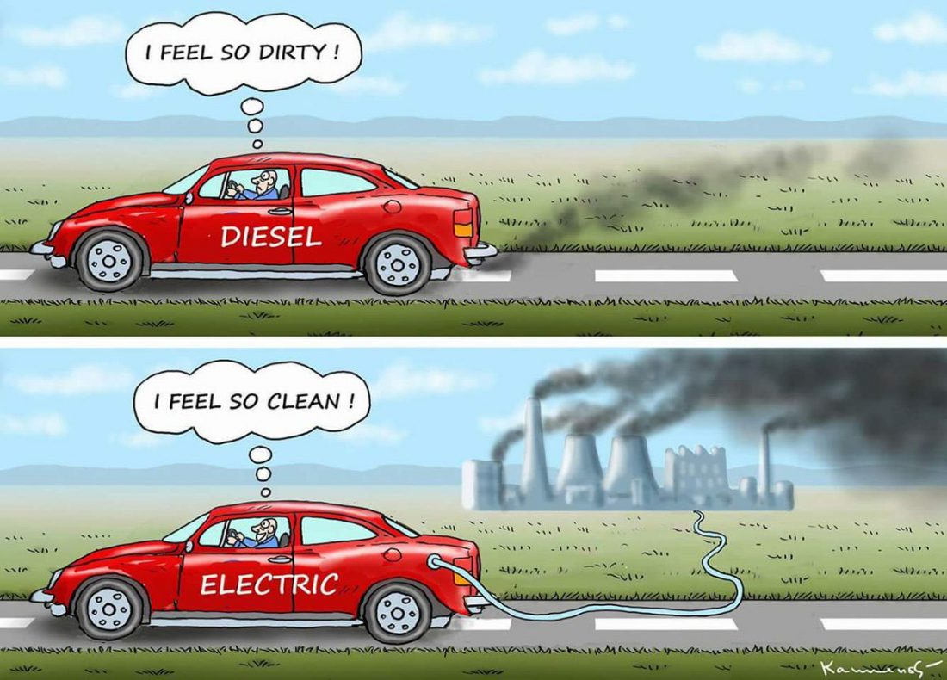
Do you think electric cars
environmentally
friendly?
01. INTRODUCTION
Notes:
Every product produced comes with an expiry date and using it beyond this time can be very harmful in for the user. Similar way, do cars need to have a working age?

Slide 7


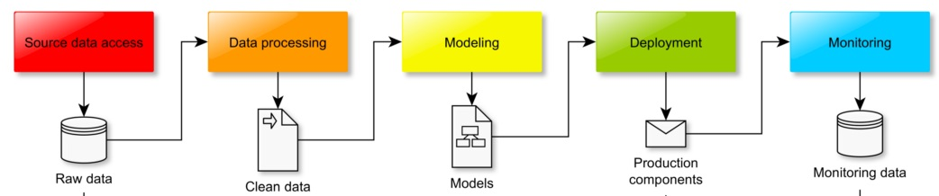
02. METHOLOGY
Stakeholders
Business /
Data
Solutions/
Suggestions
Questions
Answers
Notes:
This is the simple pipeline does my job and input and output share information and is connected together.
It is very important to follow each steps and consider every single component seriously.

Slide 8
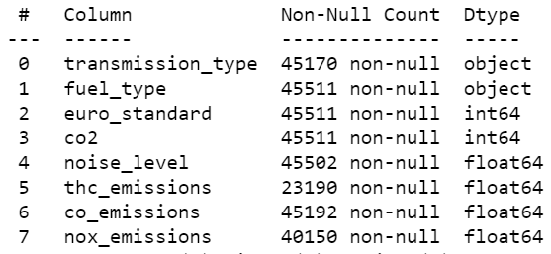
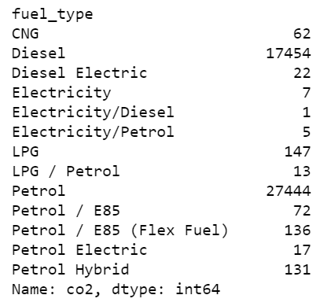
03. ANALYSIS AND INTERPRETATION
Feature Selections :
Target Variables :
Fuel Type: Selected Petrol or Diesel

Slide 9
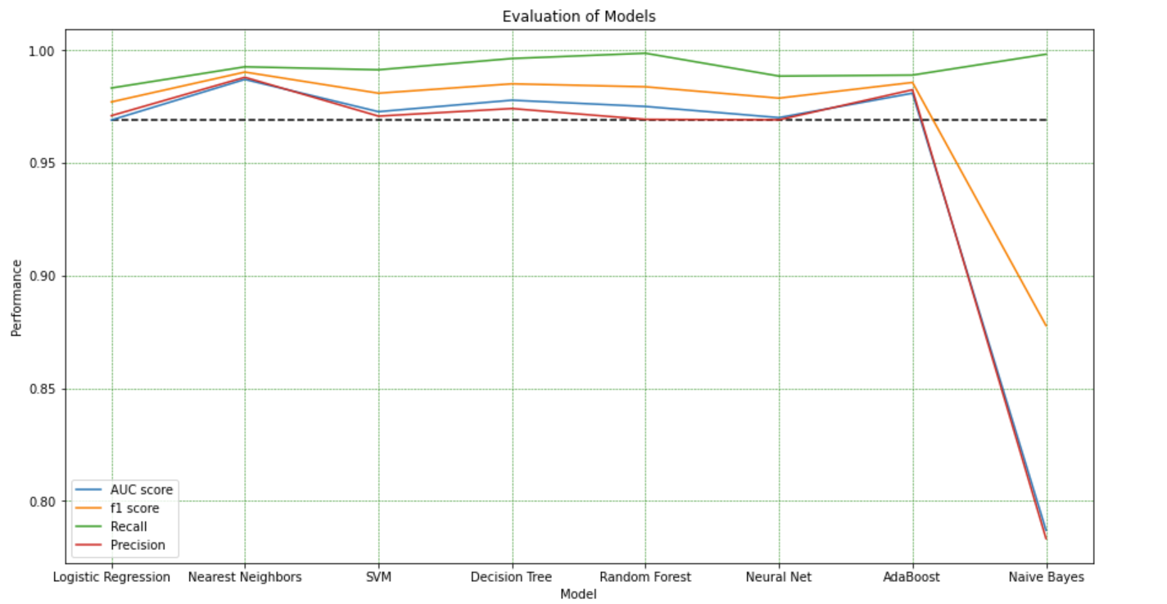
03. ANALYSIS AND INTERPRETATION

Slide 10
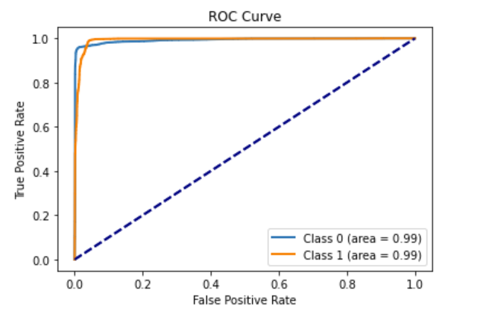
03. ANALYSIS AND INTERPRETATION
Logistic Regression

Slide 11
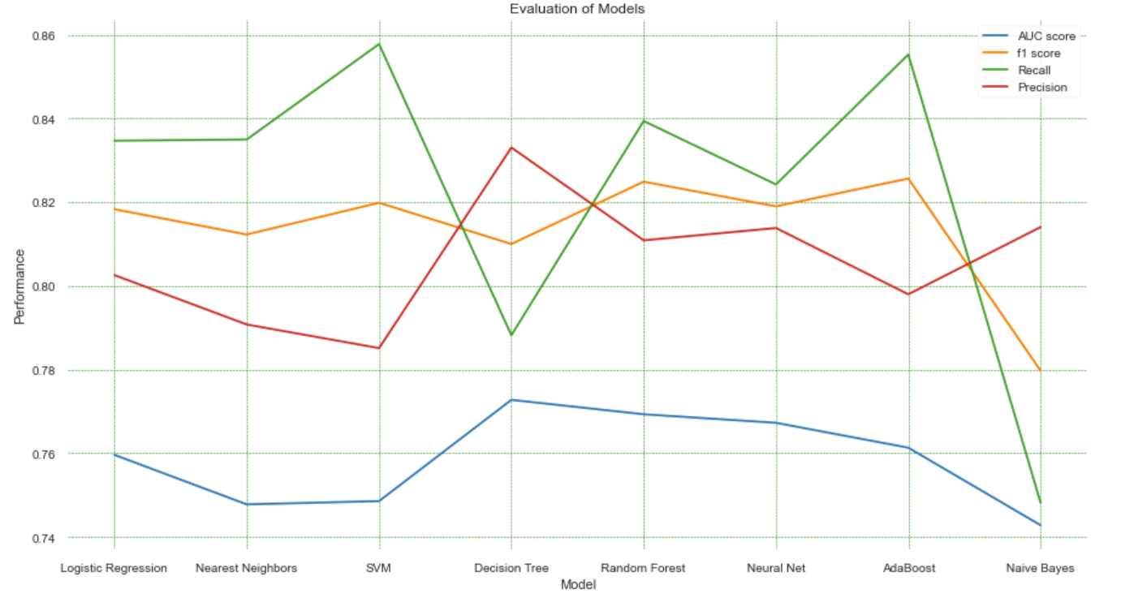
03. ANALYSIS AND INTERPRETATION

Slide 12
04. SUMMARY
DATA
EDA APPROACH
OUTCOME
Data : Transport authority
(45511 records)
Target Variable:
Engine Fuel Type
31 features
Transmission Type
CO2 Emissions
Noise Level
NO_{x} Emissions
Check how
fuel type
influence
the environment
LogisticRegression ,
KNeighbors, SVC RandomForest, MLP,
AdaBoost, GaussianNB
model to check used for prediction
and selected
Engine Capacity as most
influence feature

Slide 13
05. NEXT STEP
STEP1
STEP2
STEP3
Identify how
Hybrid vehicles
Impact
environment
Identify environment
Friendly
transmission
Type
(Automatic/Manual)
Identify environment
friendly vehicle
model

Slide 14
THANK YOU.

