Slide 1
UE24CS352A — MACHINE LEARNING MINI-PROJECT (SEC-C, TEAM C-22, PROJECT 31)
Structural Damage Recognition Using Transfer Learning
Automated Binary Damage State Classification on PEER Hub ImageNet (Phi-Net Task 2)
PROJECT METADATA & TEAM:
• Student 1: MIRUNJAI SURESH KUMAR (SRN: PES1UG24AM161)
• Student 2: MOHAMMED SINAN M T (SRN: PES1UG24AM165)
• Course: UE24CS352A | Section: Sec-C | Team ID: C-22 (Team 22) | Project No: 31 | Date: October 2026
Notes:
SPEAKER SCRIPT:
Good morning faculty and evaluation panel. Today we present our Machine Learning mini-project: 'Structural Damage Recognition Using Transfer Learning' on the benchmark PEER Hub ImageNet dataset. Our team (Section C, Team C-22) consists of Mirunjai Suresh Kumar and Mohammed Sinan M T. Over the next few minutes, we will present the disaster management motivation, memory-efficient data pipeline, verified experimental results on the official 1,460 test images, and demonstrate our live interactive application.

Slide 2
UE24CS352A — MACHINE LEARNING MINI-PROJECT
Problem Statement & Disaster Management Motivation
The Real-World Challenge
Engineering Objectives
• Post-Disaster Bottleneck: Following major earthquakes or structural failures, thousands of buildings require immediate screening for occupancy safety.
• Critical Personnel Shortage: On-site inspection requires licensed civil and structural engineers. Conducting exhaustive visual audits takes weeks to months.
• Subjectivity & Hazards: Manual visual triage under emergency conditions is inherently subjective and exposes inspection crews to hazardous aftershocks and collapsing masonry.
1. Binary Classification: Formulate a computer vision model to automatically categorize structural elements into Damaged (0) vs. Undamaged (1).
2. Resource Efficiency: Design a memory-mapped, feature-cached data pipeline that trains efficiently within consumer hardware limits (Intel Core i3, 8 GB RAM) without out-of-memory crashes.
3. Rigorous Evaluation: Benchmark strictly on the official held-out test set (1,460 samples) with comprehensive precision, recall, and ROC-AUC metrics.
4. Interactive Prototype: Deploy a working Streamlit application for single-photograph inference.
Notes:
SPEAKER SCRIPT:
Post-earthquake structural triage is a matter of life safety. When an earthquake strikes an urban area, inspecting thousands of structures manually is slow and perilous. Our objective was to develop an assistive machine learning tool that rapid-triages photographs of columns, beams, and facades into Damaged or Undamaged states. Crucially, we set strict software engineering goals: our solution had to execute reliably on consumer laptops using memory-mapped arrays, achieve high recall on the damaged class, and integrate into an intuitive web interface.

Slide 3
UE24CS352A — MACHINE LEARNING MINI-PROJECT
Dataset Overview: PEER Hub ImageNet (Phi-Net)
Benchmark Dataset Properties
• Source: PEER Hub ImageNet (Phi-Net) — Task 2: Damage State (Gao & Mosalam, UC Berkeley, 2018; 2020).
• Structural Focus: Standardized 224x224x3 photographs of concrete columns, beams, shear walls, and masonry facades.
• Label Convention: Class 0 = Damaged (D), Class 1 = Undamaged (UD). Two-column one-hot float32 vectors.
Training Set (11,811 Samples)
Official Test Set (1,460 Samples)
• Array Size on Disk: ~6.62 GiB (task2_X_train.npy)
• Damaged (Class 0): 6,282 samples (53.19%)
• Undamaged (Class 1): 5,529 samples (46.81%)
• Split: 80% Train (9,448) / 20% Val (2,363) stratified.
• Array Size on Disk: ~838.36 MiB (task2_X_test.npy)
• Damaged (Class 0): 745 samples (51.03%)
• Undamaged (Class 1): 715 samples (48.97%)
• Protocol: Held strictly out of training and hyperparameter tuning.
Notes:
SPEAKER SCRIPT:
Here is the dataset breakdown. We utilize Task 2 of the UC Berkeley PEER Hub ImageNet benchmark. The training set contains 11,811 images occupying 6.6 gigabytes on disk, with a nearly balanced class ratio: 53% damaged and 47% undamaged. The official test set contains 1,460 held-out images. An important empirical finding during our audit was that the labels in both arrays were stored in contiguous blocks: all class 0 first, followed by all class 1. Therefore, stratified shuffling was mandatory to prevent single-class batches.

Slide 4
UE24CS352A — MACHINE LEARNING MINI-PROJECT
Data Preprocessing & Memory-Efficient Engineering
Caffe BGR Restoration vs. Inference
Resumable Disk-Backed Caching
• Dataset Storage Quirk: The raw .npy arrays stored images with Caffe-style BGR ImageNet mean subtraction: [103.939, 116.779, 123.68]. Value range was [-123.68, 151.06].
• Training Transformation: Added back channel means, clipped to [0, 255], converted BGR -> RGB, and scaled to [-1, 1] via (x / 127.5) - 1.0.
• Inference Safety: Uploaded user photographs (JPG/PNG) are ALREADY standard RGB [0, 255]. Our preprocessing module specifically avoids BGR mean addition for uploads, performing Lanczos resize to 224x224 and [-1, 1] scaling directly.
• The 8 GB RAM Limit: Loading the 6.6 GiB training array plus model weights easily triggers Windows out-of-memory aborts.
• Memory-Mapped Reading: Arrays are opened with np.load(..., mmap_mode='r'), reading only the current mini-batch (size 8).
• Disk-Backed Output Allocation: Extracted 1,280-dim feature vectors are written directly to disk sectors via np.lib.format.open_memmap (~60 MB cache file).
• Resumption Checkpoint: An atomic .meta.json sidecar tracks completed batches. If extraction is interrupted, it resumes from the exact last batch.
Notes:
SPEAKER SCRIPT:
Turning to preprocessing and systems engineering. The dataset arrived preprocessed with Caffe BGR mean subtraction, which we inverted back to standard RGB before mapping into MobileNetV2's [-1, 1] input range. Critically, uploaded JPG photographs are already standard RGB, so our app cleanly separates dataset array restoration from inference upload preprocessing. To run on an 8 GB laptop, we engineered a resumable disk-backed caching system using NumPy memory maps. This kept active RAM usage strictly below 1.5 GB and allowed resuming extraction without re-processing earlier images.

Slide 5
UE24CS352A — MACHINE LEARNING MINI-PROJECT
Model Architecture & Transfer Learning Strategy
MobileNetV2 Feature Extractor + Lightweight Classification Head
1. Pretrained Backbone: MobileNetV2 (Sandler et al., 2018) instantiated without top head (include_top=False). Contains 2,257,984 frozen parameters in depthwise separable convolution blocks.
2. Frozen Weights: All convolutional layers are frozen (trainable = False). Rich low-level and mid-level edge, texture, and crack feature representations from ImageNet are preserved without gradient computation.
3. Dimensionality Reduction: GlobalAveragePooling2D condenses spatial feature maps into a compact 1,280-dimensional feature vector per image.
4. Dense Classification Head (82,114 Trainable Parameters):
• Dropout Layer (rate = 0.4) — Prevents co-adaptation and regularizes extracted features.
• Dense Layer (64 units, ReLU) — Learns non-linear combinations of structural features (81,984 params).
• Output Dense Layer (2 units, Softmax) — Produces class prediction scores [Damaged, Undamaged] (130 params).
• Total Model Parameters: 2,340,098 (82,114 trainable, 2,257,984 frozen non-trainable).
5. Resource Efficiency: Feature caching on disk allows training the classification head on CPU in ~20-30 seconds without out-of-memory errors.
Notes:
SPEAKER SCRIPT:
Here is our verified model architecture. We adopted transfer learning using MobileNetV2 with include_top=False. The frozen convolutional backbone contains exactly 2,257,984 parameters. Global average pooling condenses each image into a 1,280-dimensional feature representation. Our trainable head consists of a 40% dropout layer, 64 hidden ReLU units, and a 2-class softmax output, totaling 82,114 trainable parameters and 2,340,098 total parameters. Training this head on the cached features takes under 30 seconds on a standard dual-core laptop CPU.

Slide 6
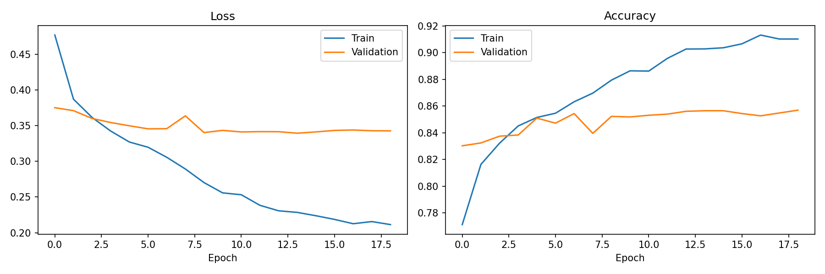
UE24CS352A — MACHINE LEARNING MINI-PROJECT
Training Convergence & Learning Curves
Training Dynamics Analysis
• Convergence: 19 epochs total. EarlyStopping restored best model weights at epoch 14.
• Loss Trajectory: Training loss decreased monotonically from 0.52 to 0.22. Validation loss stabilized at 0.34.
• Generalization Gap: Validation accuracy stabilized at 85.7% against 91.0% training accuracy. The small 5.3% gap demonstrates healthy generalization without severe overfitting.
• Learning Rate Scheduling: ReduceLROnPlateau halved learning rate from 0.001 to 0.0005, fine-tuning convergence around the loss minimum.
Notes:
SPEAKER SCRIPT:
Looking at our training curves: on the left is categorical cross-entropy loss, and on the right is accuracy. Training progressed smoothly over 19 epochs with EarlyStopping restoring the optimal weights at epoch 14. The validation accuracy stabilized at 85.7% compared to 91% on training data. This tight 5.3% generalization gap confirms that our 0.4 dropout rate provided effective regularization.

Slide 7
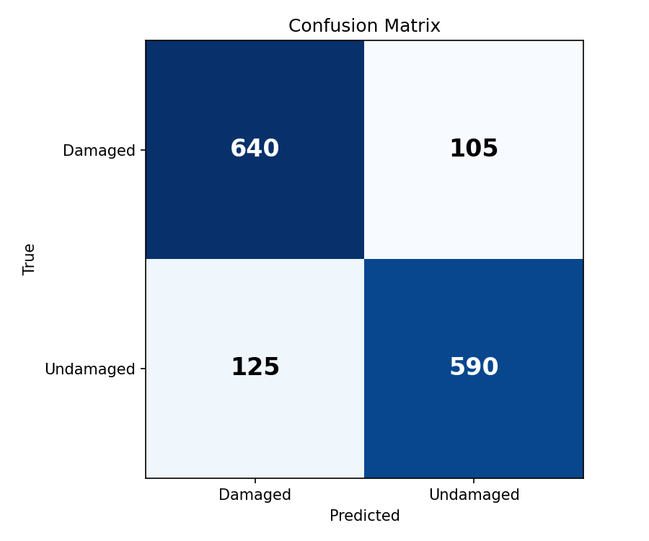
UE24CS352A — MACHINE LEARNING MINI-PROJECT
Official Benchmark Test Results (1,460 Samples)
Key Performance Indicators
• Official Test Accuracy: 84.25% (1,230 / 1,460 correct)
• ROC-AUC (Damaged Target): 0.9289 (Excellent discriminative power)
• Damaged Class (Class 0): Precision = 83.7% | Recall = 85.9% | F1 = 0.85
• Undamaged Class (Class 1): Precision = 84.9% | Recall = 82.5% | F1 = 0.84
• Confusion Matrix Breakdown:
- True Positives (Damaged detected): 640
- True Negatives (Undamaged detected): 590
- False Positives (False alarms): 125 (17.5%)
- False Negatives (Missed damage): 105 (14.1%)
Notes:
SPEAKER SCRIPT:
These are our verified results on the official held-out test set of 1,460 images. The model achieved 84.25% test accuracy and an ROC-AUC of 0.9289. Notice that our recall for the Damaged class is 85.91%, meaning we correctly catch 640 out of 745 damaged structures. In post-disaster triage, recall on the damaged class is the most critical metric because a false negative—clearing a damaged building—is far more dangerous than inspecting an undamaged building that triggered a false alarm.

Slide 8
UE24CS352A — MACHINE LEARNING MINI-PROJECT
Diagnostic Error Analysis
False Negatives: 105 Images (14.1% Miss Rate)
Damaged structures misclassified as Undamaged
False Positives: 125 Images (17.5% Alarm Rate)
Undamaged structures misclassified as Damaged
• Hairline Cracking: Micro-fissures narrower than 2-3 pixels get smoothed out by the 224x224 downsampling.
• Lighting & Low Contrast: Severe direct sunlight or heavy shadows obscure surface fractures against gray concrete.
• Peripheral Defects: Damage located on the extreme image borders where global average pooling assigns lower spatial saliency.
• Architectural Seams & Mortar: Deep mortar lines in brickwork or textured rustic finishes mimic fracture patterns.
• Surface Clutter & Occlusions: Power lines, conduit pipes, drainage stains, or tree shadows cast linear fissure-like silhouettes.
• Perspective Distortion: Extreme oblique camera angles distort straight architectural joints into apparent shear deformities.
• Diagnostic Scope: These represent plausible visual failure modes identified during diagnostic review rather than on-site physical forensics.
Notes:
SPEAKER SCRIPT:
Why does an 84% accurate model make mistakes? Our error analysis uncovered two plausible visual failure modes. The 105 false negatives plausibly occur where fine hairline cracks get smoothed away by 224-pixel downsampling or where harsh shadows conceal defects. Conversely, the 125 false alarms plausibly occur when high-contrast mortar lines, exposed conduit, or tree branch shadows mimic crack geometry. Note that these are visual hypotheses from model diagnostics rather than on-site physical forensics.

Slide 9
UE24CS352A — MACHINE LEARNING MINI-PROJECT
Interactive Streamlit Application Demo
Streamlit Architecture (app.py)
Live Demonstration Protocol
• Unified Inference Engine: Loads the unified end-to-end model (MobileNetV2 feature extractor + classification head) using @st.cache_resource.
• Retracing Prevention: Uses model.predict_on_batch() to prevent repeated TensorFlow graph re-tracing overhead on single image calls.
• Real-Time Metrics: Displays categorical prediction badge (🔴 Damaged / 🟢 Undamaged), model confidence score, and dual probability progress bars.
• Execution Command:
streamlit run app.py
1. Model Status: App verifies models/mobilenet_v2_damage_classifier.keras is loaded.
2. Test Sample 1 (Damaged Structure): Demonstrates Damaged classification with clear visual fracture and class probability breakdown.
3. Test Sample 2 (Sound Structure): Demonstrates Undamaged classification on an intact facade component.
4. Ethical Notice: Prominently renders civil engineering disclaimer that predictions are preliminary and not safety certifications.
Notes:
SPEAKER SCRIPT:
We packaged our model into a responsive Streamlit web application. The model is cached in memory, and single-image inference runs responsively on standard CPU. Users drag and drop any JPG or PNG photo, and the app displays the predicted category, confidence score, and dual probability bars. In the review session, we will demonstrate live classifications on both damaged and undamaged samples.

Slide 10
UE24CS352A — MACHINE LEARNING MINI-PROJECT
Limitations, Ethics & Future Work
Engineering Limitations & Ethics
Future Technical Roadmap
• Coarse Binary Scope: Distinguishes only Damaged vs. Undamaged; does not grade severity (minor cosmetic cracking vs. catastrophic shear failure).
• Resolution Bounds: 224x224 input can overlook micro-cracks. Full-resolution hierarchical tiling would be needed for microscopic inspections.
• Distribution Shift: Trained primarily on concrete and masonry components; may exhibit lower confidence on timber, steel, or composite structures.
• Ethical Imperative: AI tools must assist, not replace, certified structural engineers.
1. Multi-Task Learning: Expand to Phi-Net Tasks 3-6 to classify component type, damage severity, and failure mechanism simultaneously.
2. Explainability & Attention: Integrate Grad-CAM heatmaps so civil engineers can visually verify where the model is looking before accepting predictions.
3. Mobile & Drone Deployment: Quantize the MobileNetV2 graph to INT8 TensorFlow Lite for real-time offline edge inferencing on field drones and mobile phones.
4. Classical Baseline Comparison: Benchmark against HOG feature extractors with Support Vector Machines.
Notes:
SPEAKER SCRIPT:
To conclude responsibly, we address the limitations of our prototype. A binary classifier cannot grade whether a crack is cosmetic or structural. Furthermore, our safety disclaimer makes it clear that this prototype is strictly an educational tool. Our future roadmap includes multi-task classification across Phi-Net Tasks 3 to 6, Grad-CAM visual saliency maps for explainability, and edge quantization to TensorFlow Lite for drone inspections.

Slide 11
UE24CS352A — MACHINE LEARNING MINI-PROJECT
Conclusion & Key References
Project Summary
• Complete Reproducible Pipeline: Successfully implemented memory-efficient data loading, verified Caffe BGR preprocessing inversion, and feature-cached transfer learning.
• Strong Empirical Benchmark: Achieved 84.25% test accuracy and 0.9289 ROC-AUC on 1,460 official test images with 85.91% Damaged class recall.
• Submission Deliverables: Source code in private GitHub repo, 2-page PDF report (report.pdf), presentation deck, viva guide, and running Streamlit web app.
References
1. Gao, Y., & Mosalam, K. M. (2018). Deep Transfer Learning for Image‐Based Structural Damage Recognition. Comp.-Aided Civ. & Inf. Eng., 33(9), 748–768.
2. Gao, Y., & Mosalam, K. M. (2020). PEER Hub ImageNet: A Large-Scale Benchmark Data Set. Journal of Structural Engineering, 146(10), 04020198.
3. Sandler, M., et al. (2018). MobileNetV2: Inverted Residuals and Linear Bottlenecks. CVPR 2018, 4510–4520.
4. Ho, M., & Troncoso, J. (2018). Structural Damage Image Classification. Stanford CS229 Machine Learning Project Report.
Notes:
SPEAKER SCRIPT:
In conclusion, we have delivered a complete, reproducible Machine Learning pipeline for structural damage recognition. Our model achieves 84.25% test accuracy and 0.9289 ROC-AUC on the official benchmark, accompanied by an interactive demo app, our 2-page report, and full codebase. Thank you for your time, and we now welcome any questions from the panel.

