Slide 1

Presentation Video URL
{ https://youtu.be/oD8wVmQEiwc?si=VXV8aIHfjTxc6WTS }

Slide 2

GNUstep Conceptual Architecture
PRESENTED BY
🟩 Daniel Architecture Impact
• Risks & structural changes
🟦Mohamed (Group Leader ) SAAM Alternatives
🟨 David – Feature Interactions
🟪 Mirwais – SAAM Evaluation
🟥 Musdaf – System Qualities
🟥 Mohanad - Use cases and sequence diagrams
(presenter 2)

Slide 3

.
overview
Introduction: Introduce the motivation behind the enhancement..
Examine GNUstep's current state regarding event logging.
Detail our proposed unified logging system.
Discuss the architectural impact of the enhancement.
Provide an evaluation using SAAM analysis.
Present use cases and supporting sequence diagrams.
Limitations and lessons learned :Challenges faced and their impact on findings. And lessons we have learned
Conclusion: Summary of key points and closing thoughts.

Slide 4
Introduction
Our analysis of GNUstep's concrete architecture revealed complexities arising from indirect communication, especially the extensive use of NSNotification. This complexity makes debugging and performance profiling challenging. To address these issues, we propose a unified logging system aimed at centralizing and standardizing logging across the framework.

Slide 5
Proposed Feature - Unified Event Logging System Functionality
Overview: A centralized logging component capturing system events, errors, and user interactions across GNUstep, improving consistency and simplifying debugging.
Interactions with existing features:
Depends on foundational classes in libs-base (NSString, NSError, basic logging capabilities).
Components utilizing the logger include:
libs-gui: logs GUI interactions and rendering issues (e.g., NSWindow.m, NSApplication.m).
libs-back: logs backend-specific issues such as rendering or hardware errors (XGServerWindow.m).
GORM: captures UI configuration errors (GormDocument.m).
Troubleshooting Panel: Provides users an interface to view recent logs, filter them by event type (error, warning, info), and export logs for support teams.

Slide 6

.
Maintainability: Centralized logging makes debugging and tracing easier by providing structured and consistent log outputs, reducing downtime and maintenance overhead
Evolvability: Modular logging interfaces allow each subsystem to independently adapt and evolve, making it simpler to introduce new components or modify existing ones
Performance: Minimal performance impact; logging activities are designed to be lightweight. However, excessive or mismanaged logging could introduce latency or overhead.
Testability: Improved testability as logs enable precise tracing of events and easier debugging of interactions among subsystems. Modular design simplifies individual component testing.

Slide 7

Comparing Logging Implementation Approaches
Approach #1 (Centralized)
Simple integration; single point of update.
Uniform log format.
Potential bottlenecks due to centralized logging.
Difficult to test independently due to shared state.
Approach #2 (Modular Interface-based)
High modularity; subsystems evolve independently.
Enhanced testability through isolation.
Initial complexity in setup.
Potential inconsistencies if not centrally managed.

Slide 8

Team Issues / Risks
Team Issues
Developers should have familiarity with GNUstep’s layered architecture and the event-driven communication patterns we found in our concrete architecture.
Knowledge of libs-base, libs-gui, and libs-back components is essential since the logging system interacts closely with these subsystems.
Collaboration with maintainers or experts familiar with existing GNUstep logging practices (such as NSLog) would ensure smoother integration.
Potential Risks
Introducing unified logging might slightly impact performance, especially if logs become overly detailed or frequent.
Tight coupling or poorly designed logging interfaces could make the system harder to maintain or evolve.
Risk of inconsistent logging formats if the modular interface-based approach isn't clearly standardized across subsystems.

Slide 9
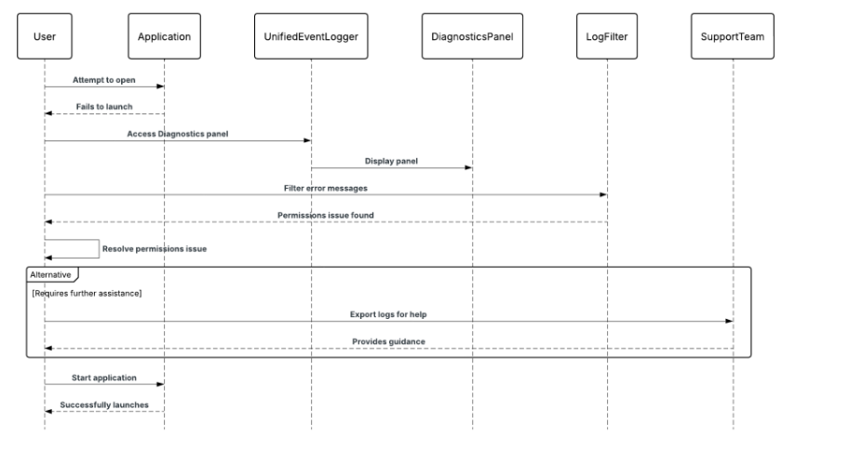
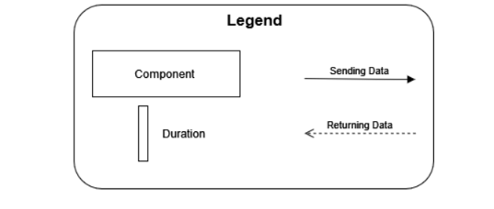
Use Case 1: Diagnosing Launch Failure via Diagnostics Panel
A user tries to open a GNUstep-based app, but it fails
to launch..
hey access the Diagnostics Panel provided by
the Unified Event Logger.
By filtering logs, they find a permissions
error related to a config file.
Using the user-friendly message, they fix the issue or export logs for support.
Once resolved, the app launches successfully.

Slide 10
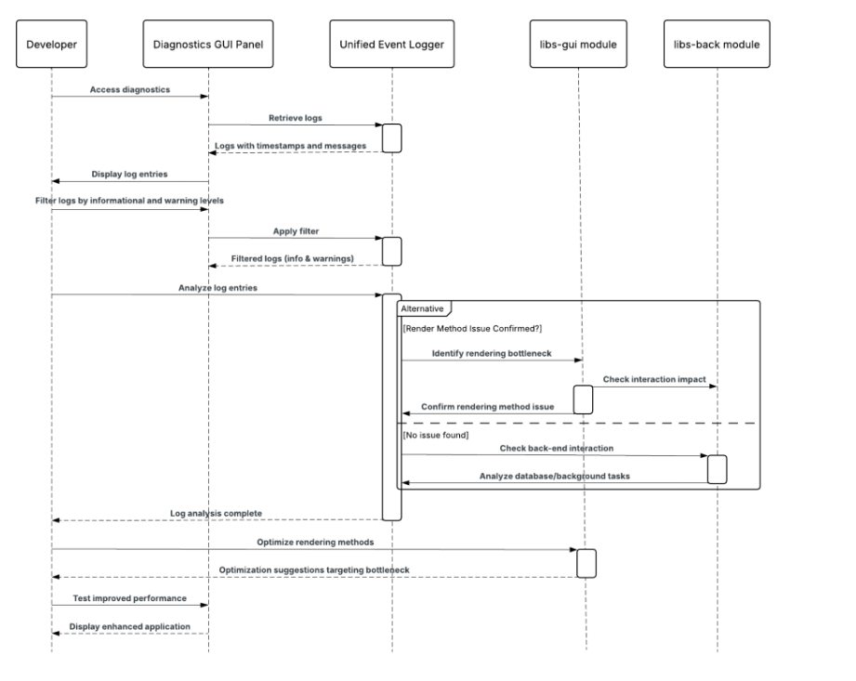
Use Case 2: Backend Crash Logged for Developer Review
During application use, the rendering engine (lib-back) crashes due to a driver fault
The unified event logger automatically captures the crash event, error type timestamp, and affected subsystem
This log is sent to the Diagnostics Panel and stored for developer access.
Developers later review the log through the panel or exported file to trace the root cause..
The issue is patched in the next release, improving system stability.

Slide 11

SAAM Analysis - Part 1
Scenario:
Create a unified logging component that centrally captures user interactions, system events, and errors throughout GNUstep.
Enable enhanced debugging, performance profiling, and easier maintenance through structured and accessible logs.
Stakeholders:
Developers: Need efficient debugging tools and clear logs.
End Users: Require responsive and reliable applications.
Testers: Require clear and traceable logs to easily identify and reproduce issues.
.

Slide 12
SAAM Analysis - Part 2
From a maintainability perspective, the Centralized Logger (Alternative 1) is simpler initially, as it provides a single, consistent point of logging across all subsystems. However, this creates tighter coupling, making maintenance potentially challenging in the long term.
The Modular Logger Interfaces (Alternative 2) approach offers better modularity and evolvability, as subsystems remain independent and easier to maintain and evolve separately, despite the initial complexity in implementation.
Regarding performance, Alternative 1 might face bottlenecks under heavy logging loads, whereas Alternative 2 can optimize performance individually per subsystem, providing better scalability and responsiveness overall.

Slide 13
SAAM Analysis – Conclusion
Alternative 1 (Centralized Logging) is simpler to implement initially, cost-effective, and provides consistent log management.
However, Alternative 2 (Modular Logging Interfaces) significantly enhances maintainability, evolvability, and testability, aligning better with GNUstep’s long-term architectural goals.
Ultimately, Alternative 2 is recommended due to its modularity, adaptability, and long-term benefits, despite its higher initial complexity.

Slide 14

Affected Directories (For Unified Event Logging)
Gorm
Logs design-time configuration errors or resource loading failures.
Files like GormDocument.m will invoke logger for missing files, layout issues, etc.
libs-gui
Needs to be updated to log GUI events like button clicks and input actions.
Files like NSWindow.m, NSApplication.m will interact with the logging API.
libs-base
Hosts the EventLogger core module.
Provides shared utility classes (e.g., NSString, NSError) to support message formatting, filtering, and output handling.
libs-back
Logs platform-level rendering or device-specific errors (e.g., X11, graphics issues).
Files like XGServerWindow.m will need to call logging hooks.

Slide 15
Lessons Learned and Limitations
Lessons Learned
Limitations of Our Findings
Tool Support Matters – Using SciTools Understand revealed dependencies we didn’t expect.
Logging Complexity – Integrating logging in all subsystems added setup overhead
Architecture Evolves – Our initial assumptions changed as we explored the concrete system..
Performance Trade-offs – Heavy logging could impact performance if not managed.
Modularity Helps – Designing a loosely coupled logger improved flexibility and testability..

Slide 16

Conclusion
Our proposed enhancement introduces a centralized event logging system that improves traceability, debugging, and system observability across GNUstep.
The enhancement builds directly on insights from our concrete architecture, addressing the need for visibility in an event-driven, layered system.
We presented and evaluated two architectural options. The modular interface-based approach was identified as the preferred solution due to its flexibility, maintainability, and alignment with GNUstep’s design.
This proposal not only enhances developer experience but also opens the door for end-user troubleshooting tools, increasing system transparency.
Moving forward, this feature strengthens GNUstep's ability to scale, adapt, and remain reliable as complexity grows..

Slide 17
References
GNUstep. libs-base: The GNUstep Base Library. GitHub. https://github.com/gnustep/libs-base Accessed 3 Apr. 2025.
GNUstep. libs-gui: The GNUstep GUI Library. GitHub. https://github.com/gnustep/libs-gui Accessed 3 Apr. 2025.
GNUstep. apps-gorm: GNUstep Interface Builder. GitHub. https://github.com/gnustep/apps-gorm Accessed 3 Apr. 2025.
GNUstep. libs-back: Backend Rendering Library. GitHub. https://github.com/gnustep/libs-back Accessed 3 Apr. 2025.
Kazman, R. et al. SAAM: A Method for Analyzing the Properties of Software Architectures. ICSE 1994. https://www.researchgate.net/publication/3560794_SAAM

