Slide 1
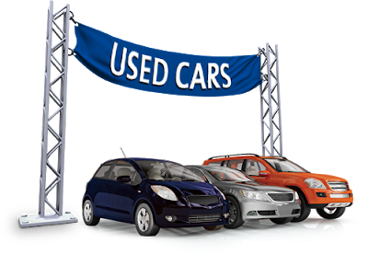
Mirwan
Used car prediction Using random forest regression
Purwadhika Startup and Coding School
Data Science Trainee

Slide 2
introduction

Slide 3
Used cars have their own market in automotive sales, because the prices are more affordable than new cars. Unfortunately, buying a used car carries a high level of risk, when compared to a new car.
This is because the price does not fluctuate unstably every year, besides that the condition of each car that is not always the same will have an impact on different prices.
With the development of digital sales data, used car buying and selling players can refer to the price stated in the data to determine the appropriate price, but without using mathematical calculations and statistics, the used car buying and selling actors still have difficulty determining the price.
By using a machine learning-based application, this project aims to help players buying and selling used cars determine the appropriate price based on data collected during 2020.

Slide 4
Dataset
Dataset is downloaded from atapdata.ai, atapdata.ai is an ecosystem of datasets used for artificial intelligence, descriptice predicting, and data mining purposes. This dataset contains 86,000 used car sale and purchase records throughout Indonesia. This dataset was uploaded by Remko Weingarten on 20-07-2020. The features in this dataset include model, price, band, kms, place, color, bodytype, variant, transmission, and fuel type.
Before running the data cleaning process, the features in this dataset are 15 columns, after removing the image, id, variant, and name columns, there are only 10 columns left.

Slide 5
Model training and performance

Slide 6
Algorithm
The algorithm used in data analysis is 8 regression models with supervised methods including
Linear Regression
Ridge Regression
Lasso Regression
Random Forest Regressor
Bagging Regressor
AdaBoost Regressor
XG Boost Regressor

Slide 7
Models performa
 | Linear Regression | Ridge Regression | Lasso Regression | Random Forest Regressor | Bagging Regressor | AdaBoost Regressor | XGBoost Regressor
Accuracy(%) | 37.920200 | 37.920200 | 37.920900 | 93.784800 | 90.263600 | 91.772600 | 93.048800
RMSE | 0.263647 | 0.263647 | 0.263645 | 0.083421 | 0.104411 | 0.095979 | 0.088222
Root MSLE | 0.013358 | 0.013358 | 0.013358 | 0.004250 | 0.005325 | 0.004876 | 0.004489
R2 Score | 0.379202 | 0.379202 | 0.379209 | 0.937848 | 0.902636 | 0.917726 | 0.930488

Slide 8
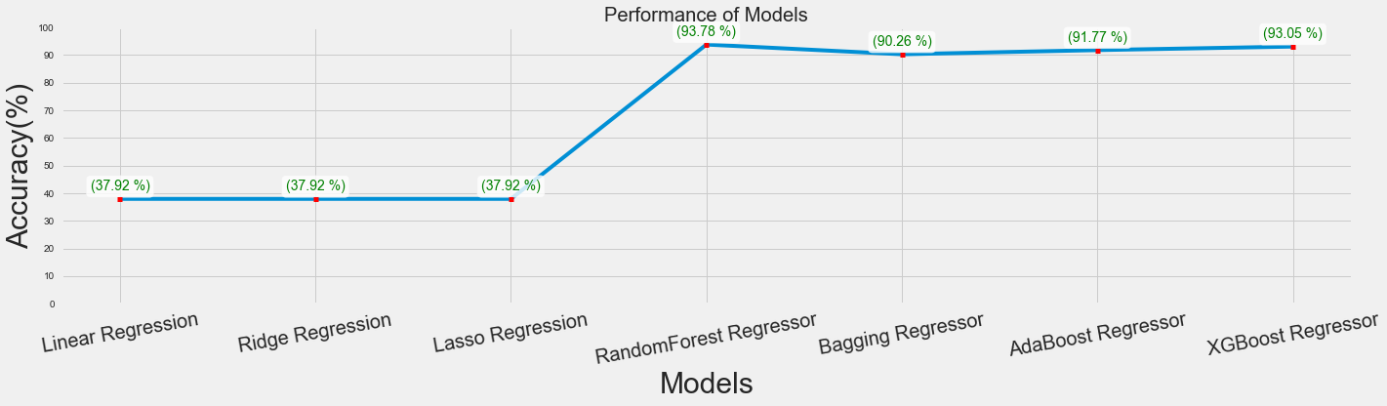
Models performa

Slide 9
flask application

Slide 10
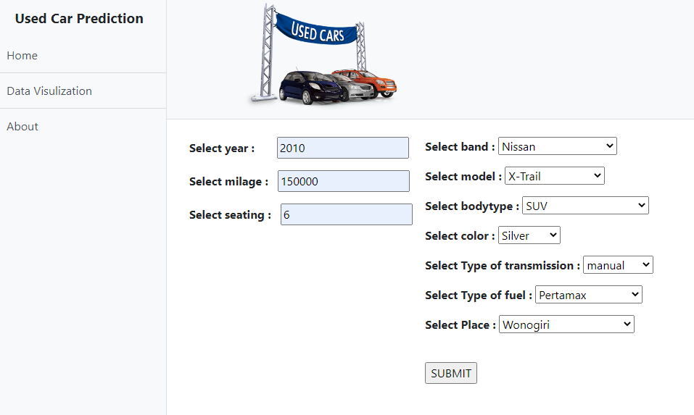

Slide 11
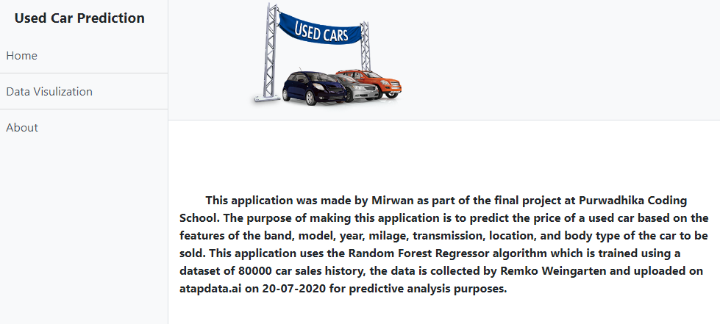

Slide 12
Conclussion
Random Forest Regression can be used to predict the price of used cars with fairly high accuracy, besides that the RMSE value, which is a variation in the cost function, also shows the lowest score.
Conclussion
For further development, it can be used using a dataset with a wider number of columns, rows, and data variations. In addition, the use of dimensional reduction can be used to speed up the computational process.

Slide 13
Thank you

