Slide 1
MINI PROJECT-1
- COP’s FIR RECORD
MANAGEMENT SYSTEM
-TEAM
N.CHARVEE KRISHNA-1602-19-737-078
M.ROHITH-1602-19-737-089

Slide 2
ABSTRACT
As FIRST INFORMATION REPORT(FIR) is the first step which sets for the criminal justice. It is only on the basis of FIR, the police starts investigation .So, our project is based on the idea to maintain all the Fir records of a police station. From this system, the user can easily add each and every convicts details ,with login system which makes data more secure. In order to make it different from the current records in police stations we added a feature of 2-step verification for deleting records.

Slide 3
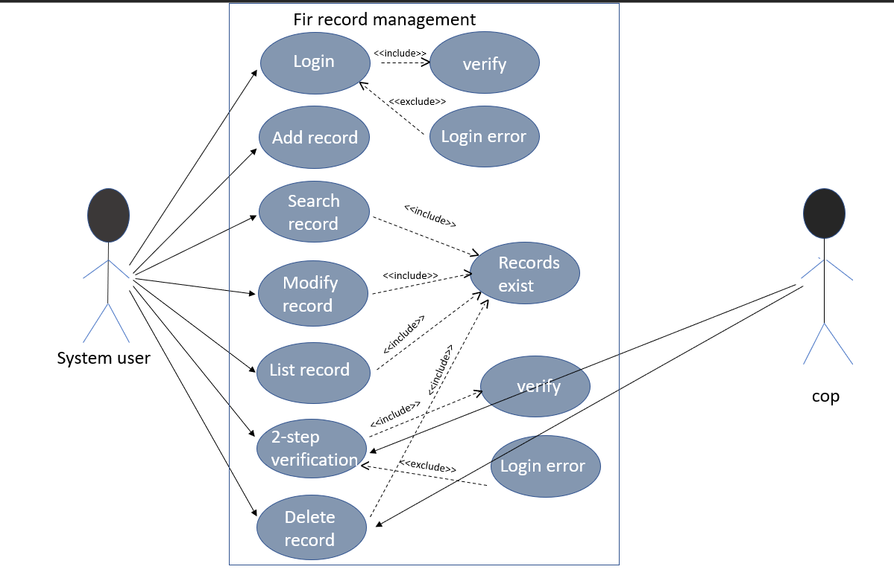
Use Case Diagram

Slide 4
TECHNOLOGY USED
All computer software needs certain hardware components or other
software resources to be present, in order for computers to be used
efficiently. These prerequisites are known as System Requirements.
Within this, we have two types – Software Requirements and Hardware Requirements.
SOFTWARE REQUIREMENTS
Software Requirements deal with defining the software resource requirements and prerequisites
that need to be installed on a computer to provide optimal functioning of an application.
These preconditions are generally not included in the software installation package
and need to be installed separately.
In order to use CODIAC, one should have the following:
Operating System: Windows 7 and above
C Compiler: GNU Compiler Collection (GCC)
Editor: Vim editor .
HARDWARE REQUIREMENTS
Hardware requirements refer to the common set requirements defined by any operating
system or software application and are usually the physical computer resources. In this,
we look into the architecture, processing power, memory, secondary memory,
display adapter and peripherals.
In order to use this project, one should have the following:
Processor: Intel Pentium processor and above
Memory: 4 GB RAM and above

Slide 5
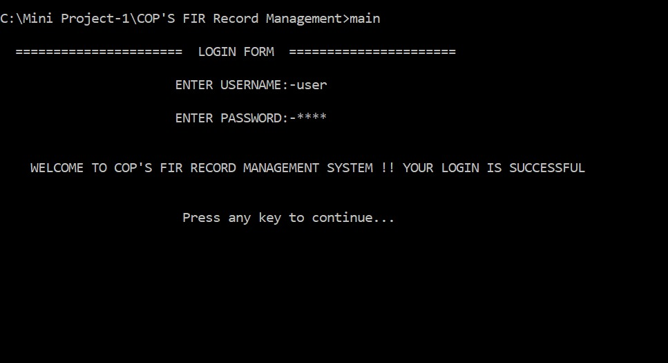
RESULT

Slide 6
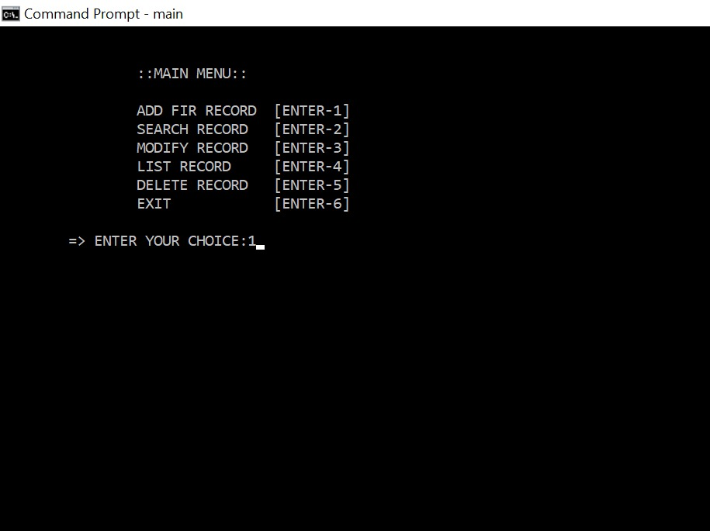

Slide 7
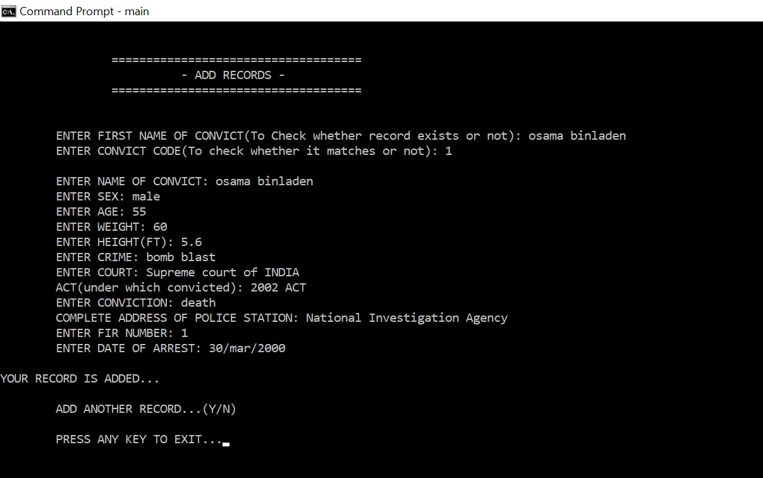

Slide 8
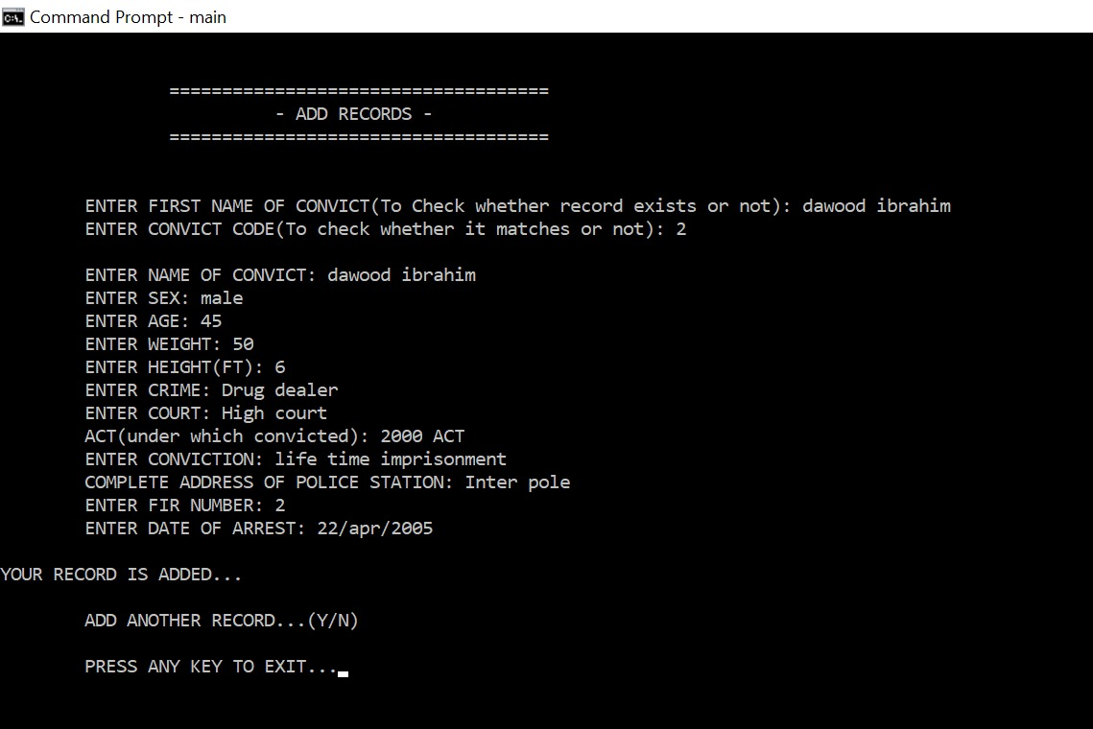

Slide 9
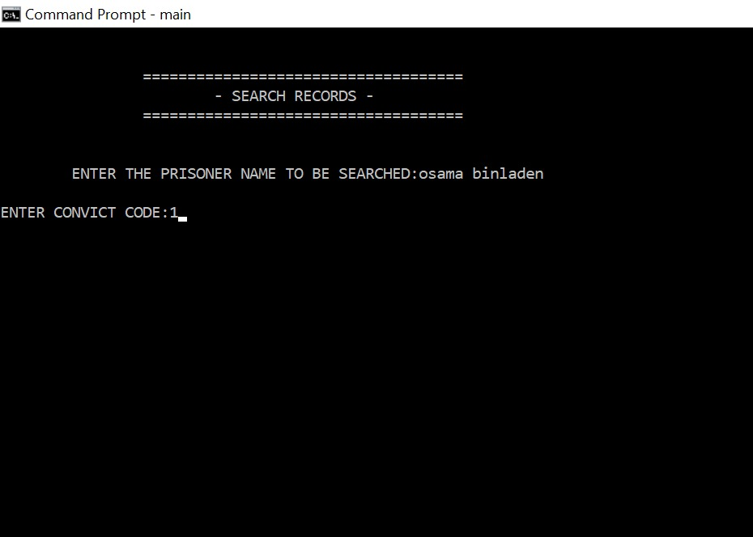

Slide 10
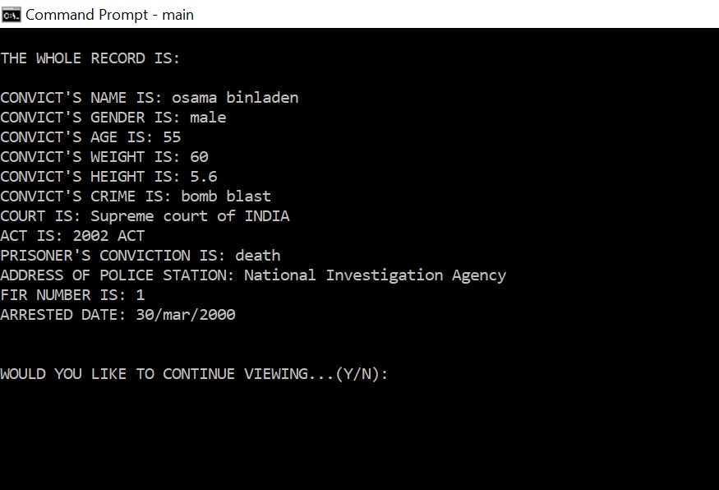

Slide 11
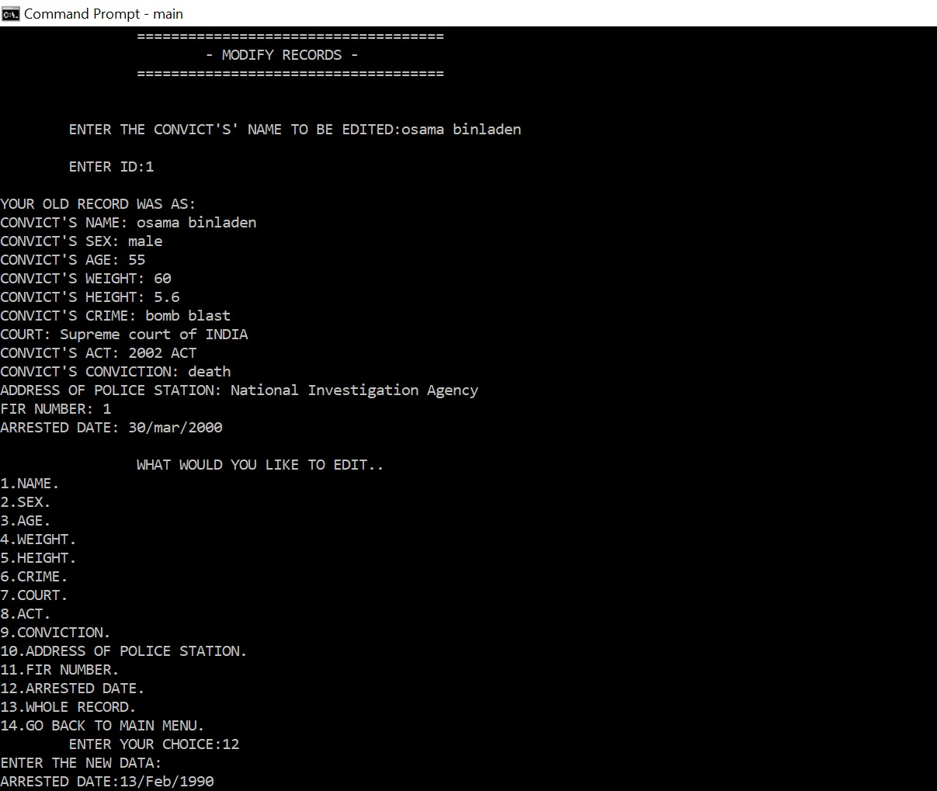

Slide 12
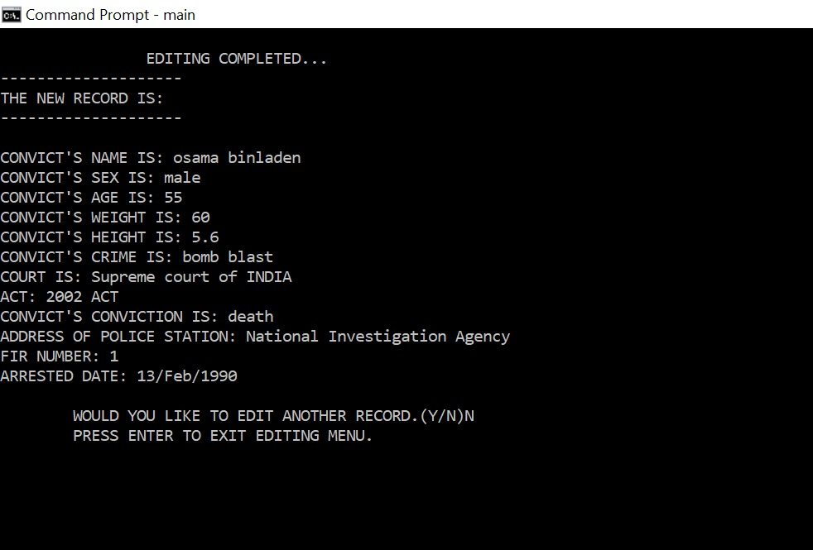

Slide 13
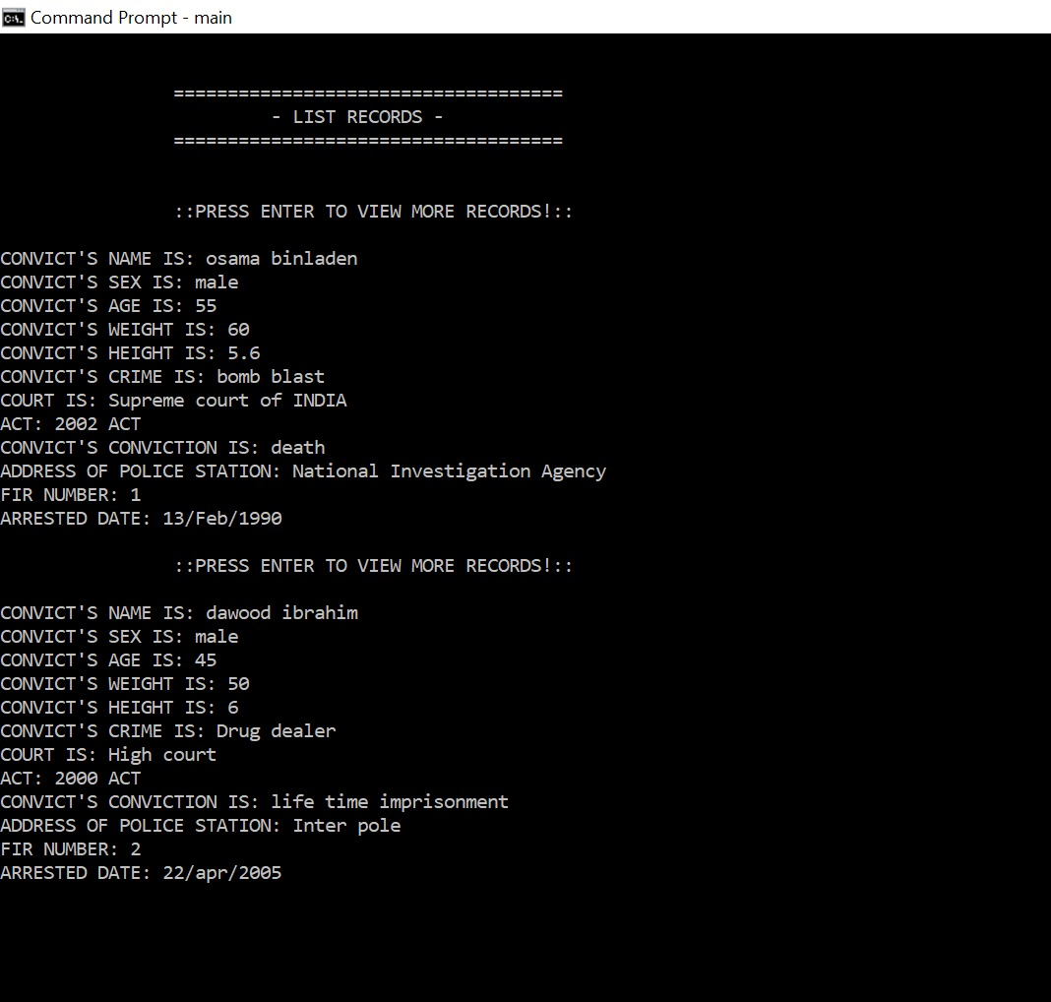

Slide 14
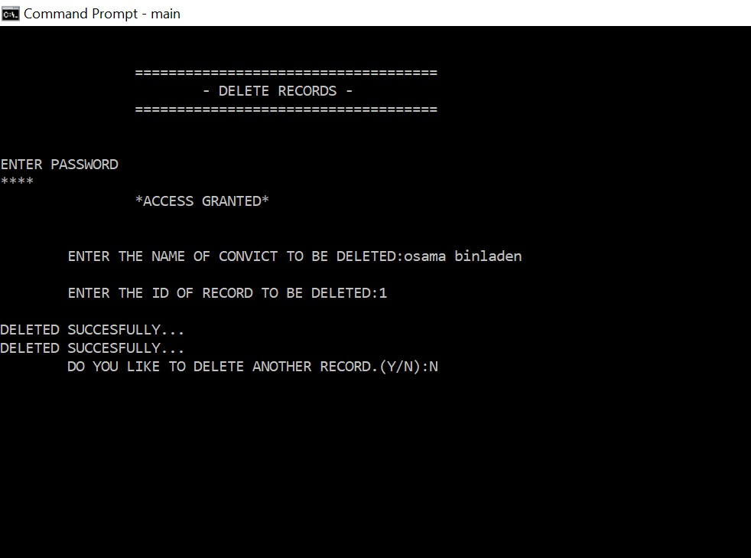

Slide 15
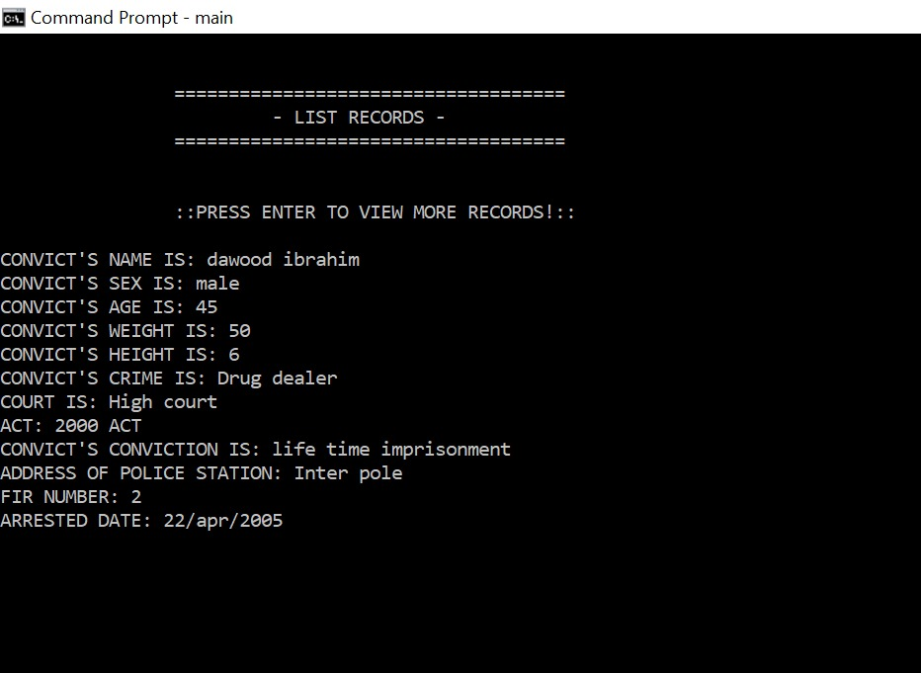

Slide 16
CONCLUSION AND FUTURE WORK:
1.We conclude that this application is useful for cops to view the FIR records of convicts quickly.
2.It can be operated very easily.
3.Future work is that we wanted to make this console application as a web application.

