Slide 1

SMART INDIA HACKATHON 2026
CropX Protocol
Problem Statement ID
SIH26069
Problem Statement Title
National Weather Big Data Analytics Platform
Theme
Disaster Management
PS Category
Software
Team Name (Registered on portal)
CropX Protocol
Team ID
160120
Turning millions of scattered social posts, citizen reports and open datasets into one verified, geotagged national weather-event feed — in minutes instead of hours.

Slide 2
CropX Protocol
PROPOSED SOLUTION & IDEA
One verified national weather-event feed, built on a real-time big data pipeline
PROPOSED SOLUTION
HOW IT ADDRESSES THE PROBLEM
INNOVATION & UNIQUENESS
• A real-time Big Data pipeline that continuously mines social media, open government datasets, weather APIs and first-party citizen reports.
• Every incoming report is de-duplicated, trust-scored, classified by event type and geotagged within minutes of being posted.
• Output is a single live, queryable event feed — not another dashboard of raw, unverified chatter.
• IMD radar and station networks cover regions well, but street-level events — a flooded underpass, a collapsed tree — stay invisible.
• PrakritiPulse layers hyperlocal citizen signals on top of official data instead of competing with it.
• Responders get one verified national feed rather than thousands of scattered, unverifiable posts.
• Multi-signal trust scoring combines source history, corroboration count and IMD cross-check.
• MinHash/LSH collapses near-duplicate posts so one event isn't counted a thousand times.
• Map-based human verification queue keeps a person in the loop, with a full Delta audit trail.
1
SOCIAL / CITIZEN POSTS
2
INGESTION
3
AI VERIFICATION
4
LIVE MAP + ADMIN
SOURCES
INGESTION
VERIFICATION
SERVING
• X/Twitter API v2, Meta Graph, RSS news
• IMD bulletins + data.gov.in datasets
• First-party citizen report app
• WhatsApp / SMS fallback channel
• Apache Kafka streaming bus, partitioned
• Spark Structured Streaming consumers
• Raw landing zone in Delta Lake
• Backpressure + rate control on spikes
• Fake / spam trust scoring via MLflow
• MinHash-LSH near-duplicate collapse
• NLP event class + spaCy geotagging
• Human review queue for low-confidence
• PostgreSQL + PostGIS spatial store
• Redis cache for hot map queries
• REST & WebSocket live APIs
• Leaflet map, admin queue, alert feed
HOURS → MINUTES | GEOTAGGED | VERIFIED | DE-DUPLICATED | QUERYABLE EVIDENCE FOR DISASTER RESPONSE
@SIH Idea submission — Template
2

Slide 3
CropX Protocol
TECHNICAL APPROACH
System architecture — a medallion Lakehouse on Databricks, end to end
ARCHITECTURE — SOURCE TO DECISION
DATA SOURCES
INGESTION
LAKEHOUSE (DATABRICKS)
SERVING
CONSUMERS
X / Twitter API v2
Apache Kafka topics
BRONZE — raw posts + media
metadata in Delta Lake
PostgreSQL + PostGIS
Live Leaflet event map
Meta Graph API
→
Spark Structured
Streaming consumers
→
SILVER — trust score, LSH
de-dupe, NER geotag
→
Redis hot-query cache
→
Admin verification queue
IMD + data.gov.in
Schema check +
backpressure
REST + WebSocket API
Analytics dashboards
Citizen app / SMS
GOLD — Delta Live Tables,
curated event tables
Alert / webhook feed
RSS & news feeds
Cross-cutting: MLflow model registry & retraining • Delta Lake time-travel audit trail • OAuth 2.0 + role-based access • Docker / Kubernetes on Azure or AWS Databricks
CORE STACK
AI / NLP LAYER
FRONTEND & DEPLOYMENT
• Python • SQL • JavaScript / TypeScript
• Databricks • Spark Structured Streaming
• Delta Lake • Delta Live Tables • MLflow
• Apache Kafka • PostgreSQL / PostGIS • Redis
• Airflow-style job orchestration in Databricks
• Transformer misinformation classifier
• MinHash / LSH near-duplicate detection
• spaCy NER for city, ward & state extraction
• Event-type classifier: flood, cyclone, hail, heat
• Multilingual (Hindi + regional) text handling
• React / Flask + Leaflet live map
• Plotly & Chart.js analytics dashboards
• Azure / AWS Databricks • Docker • Kubernetes
• OAuth 2.0 + role-based admin access
• CDN-cached tiles and read replicas at peak
DESIGN TARGETS: POST → VERIFIED EVENT IN UNDER 2 MIN | 10K+ POSTS / MIN AT PEAK | PROTOTYPE DEMOED WITH LIVE INGESTION + ADMIN QUEUE
@SIH Idea submission — Template
3

Slide 4
CropX Protocol
FEASIBILITY AND VIABILITY
Can we build it, will people use it, and does it hold up at disaster scale?
TECHNICAL FEASIBILITY
KEY CHALLENGES & MITIGATION
• Working prototype already built and demoed — simulated live ingestion, event map, filters, admin queue
• Every core component is mature and production-proven: Kafka, Databricks/Spark, Delta Lake, PostGIS, Leaflet
• Cloud-native and auto-scaling, so monsoon and cyclone spikes cost more only while they last
• Managed services keep the ops burden small enough for a lean team to run
• Open standards throughout — no vendor lock-in on data formats or map tiles
Data volume & noise
API access & ToS
Auto-scaling Databricks + Kafka backpressure + pre-filter before storage
Official APIs only, rate-limit aware; first-party app as fallback
Trust / misinformation
Disaster-scale reads
Multi-signal trust score + IMD cross-check + human flags
Layered gold tables + auto-scale + CDN-cached map queries
VIABILITY FROM THE CITIZEN'S POINT OF VIEW
the people who report events are also the people the platform protects
WHY A CITIZEN REPORTS
WHAT THE CITIZEN GETS BACK
ADOPTION & ACCESSIBILITY
TRUST, PRIVACY & RETENTION
• One tap: photo + auto-location, under 30 seconds
• No long forms and no account needed to report
• Sees their own report appear on the public map
• Reporting a hazard helps their own neighbours first
• Ward-level alerts, not city-wide ones
• Verified badge separates fact from rumour
• Waterlogging warnings before commuting
• Safer route and school-closure signals
• Free app + WhatsApp and SMS reporting fallback
• Hindi and regional languages, icon-led UI
• Works on low-end phones and 2G / patchy networks
• Low data usage; offline queue syncs when back online
• Anonymous reporting; no personal data resold
• Contributor score and civic badges for regulars
• Public audit trail of what was verified and why
• Visible outcomes keep people coming back
12-MONTH ROLLOUT
DEMAND & COST SIGNAL
1
MONTHS 1–2
2
MONTHS 3–5
3
MONTHS 6–12
• Citizens already post weather events — we only structure what they share
• Zero cost to the user; value shows on the first alert
• Serverless spend tracks the season, not a fixed year-round bill
Pilot in 2 metros with college & RWA volunteers; tune trust model
IMD regional pilot + civic-body dashboards; add languages
Pan-India scale, open API for state disaster cells
@SIH Idea submission — Template
4

Slide 5
CropX Protocol
IMPACT AND BENEFITS
What changes for responders, institutions and ordinary citizens
HOURS → MINUTES
SCATTERED → UNIFIED
REACTIVE → PROACTIVE
Hyperlocal weather-event detection and verification time
One verified national feed instead of thousands of disconnected posts
Earlier hyperlocal signal enables faster disaster-response decisions
DISASTER MANAGEMENT
ECONOMIC
WHO THE PLATFORM SERVES
• Faster situational awareness for NDMA / SDMA during floods & cyclones
• Hyperlocal ground-truth complements IMD's sensor & radar network
• Supports early-warning escalation with evidence, not just chatter
• Verified map gives field teams a shared picture to act on
• Faster, better-targeted response lowers disaster-relief costs
• Protects agriculture, transport & logistics with hyperlocal alerts
• Verification reduces costly false-alarm mobilisation
• Insurers and utilities get timestamped, location-tagged evidence
SOCIAL
GOVERNANCE & DATA
• Citizens become active contributors to national weather intelligence
• Visible verification status builds public trust in reports
• Multilingual design widens who can participate
• Vulnerable wards get warnings that name their own locality
• Centralized, queryable weather-event history for research & policy
• Open architecture integrates with other e-governance platforms
• Full audit trail via the admin verification panel
• Evidence base for climate-resilience planning and budgeting
Verified national weather-event data feeds every layer of India's disaster-response ecosystem — from IMD and NDMA down to the ward volunteer.
FASTER DECISIONS | LOWER RELIEF COST | HIGHER PUBLIC TRUST | A NATIONAL EVIDENCE BASE
@SIH Idea submission — Template
5

Slide 6
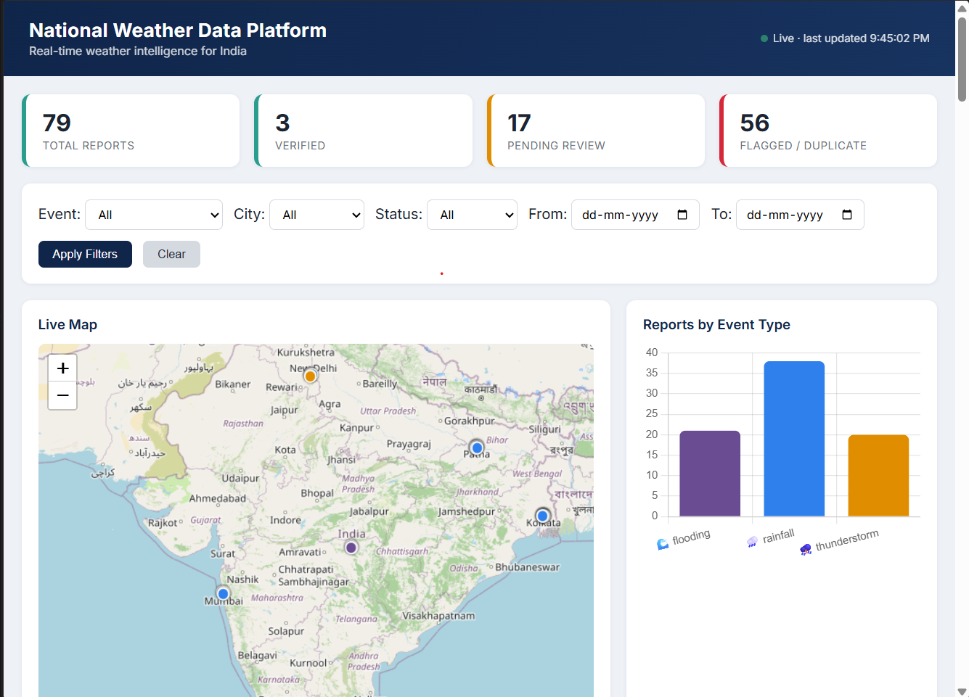
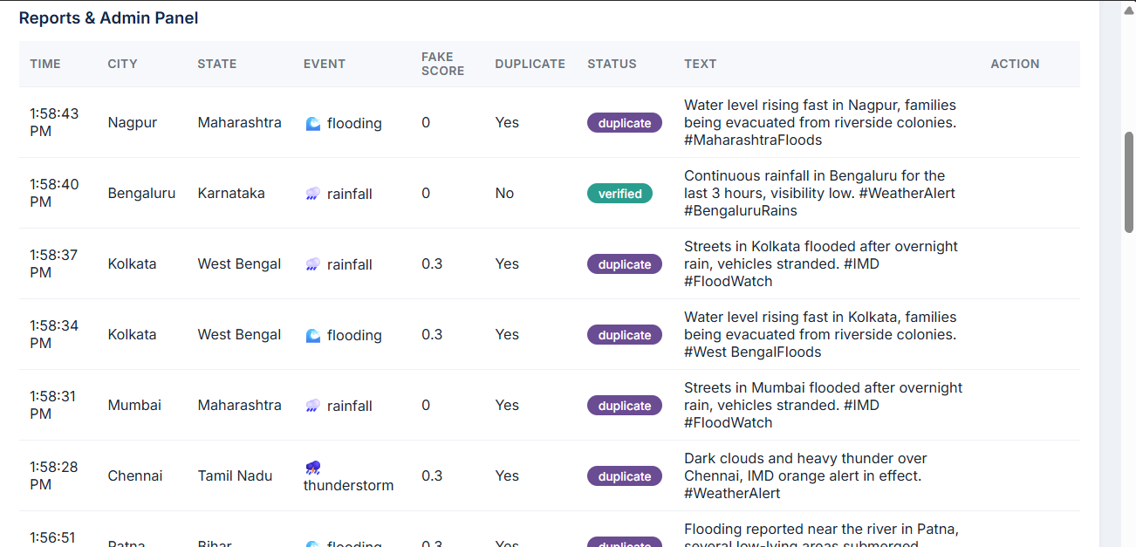
RESEARCH AND REFERENCES
CropX Protocol
Data sources, platform documentation and the research behind the approach
Interface of prototype
IMD WEATHER API
DATABRICKS LAKEHOUSE
• India Meteorological Department — official observations, nowcasts and warnings.
• Used to cross-check citizen reports and anchor trust scoring.
• Warning bulletins polled on a fixed schedule and cached.
• mausam.imd.gov.in
• Delta Lake + Spark Structured Streaming + MLflow architecture reference.
• Basis for the bronze / silver / gold medallion design.
• Delta Live Tables reference for the curated gold layer.
• databricks.com • delta.io
X API v2 & META GRAPH API
DATA.GOV.IN
• Official developer platforms for permitted real-time social ingestion.
• Defines rate limits and terms we design ingestion around.
• Guides consent, attribution and retention handling.
• developer.x.com • developers.facebook.com
• Open Government Data Platform India — weather, rainfall and disaster datasets.
• Supplies historical baselines for event classification.
• Open licence permits redistribution inside our feed.
• data.gov.in
APACHE KAFKA & POSTGIS
NDMA GUIDELINES + RESEARCH
• Reference for the real-time streaming bus and spatial query layer.
• Guides partitioning, backpressure and geo-index choices.
• Spatial indexing reference for ward-level queries.
• kafka.apache.org • postgis.net
• Disaster-response framing; misinformation-detection literature.
• MinHash/LSH near-duplicate methods; Leaflet / OpenStreetMap mapping.
• Framing for escalation thresholds and alert wording.
• ndma.gov.in • ACM Computing Surveys • IEEE • leafletjs.com
ALL SOURCES ARE PUBLIC OR OFFICIALLY LICENSED — NO SCRAPED OR UNPERMITTED DATA IN THE PIPELINE
@SIH Idea submission — Template
6

