Slide 1
DocAssist AI Doctor’s Assistant

Slide 2
Team and Mentor Overview
Team Members :
9459 - Mirza Mohammed Junaid
9378 - Pratham Kambli
9409 – Gladys Gince
Mentor :
Prof. Sarika Davare

Slide 3
Introduction
DocAssist: Welcome to the next era of healthcare communication! This innovative project is poised to redefine the doctor-patient dialogue by seamlessly recording and extracting crucial information like medications and symptoms. Beyond a mere tool, DocAssist embodies a mission to streamline healthcare communication, offering doctors an intuitive platform to access and update patient data effortlessly. Join us on this transformative journey as we reshape medical conversations, prioritizing efficiency, accuracy, and patient-centric care.

Slide 4
Problem Statement
Inefficient healthcare documentation processes hinder patient care, lacking a streamlined method for extracting critical information. Current systems struggle with data retrieval and decision- making.
The problem: a need for a seamless, intelligent solution like DocAssist to transform conversations into organized, actionable data, revolutionizing medical documentation for enhanced efficiency.

Slide 5
Objectives
Why DocAssist?
Healthcare conversations are complex, and vital information often gets lost in the shuffle. DocAssist aims to bridge this gap by seamlessly recording, transcribing, and extracting key data from doctor-patient interactions.
Our Mission: Streamlining Healthcare Communication
DocAssist is not just a tool; it's a mission to streamline healthcare communication. By capturing essential details like medications, symptoms, and patient history, we empower healthcare professionals to deliver more precise and personalized care.
Join Us on this Journey
Embark on a journey with DocAssist as we revolutionize medical conversations, making healthcare communication more efficient, accurate, and patient-centric. Let's explore the future of healthcare together.

Slide 6
Literature Survey
In India, existing literature lacks projects similar to DocAssist, focusing on real-time doctor-patient conversation documentation and data extraction. While Electronic Health Records (EHRs) are studied, the integration of Natural Language Processing (NLP) and speech-to-text technology is notably absent. DocAssist has the potential to address this gap with a tailored solution for the Indian healthcare context.

Slide 7
Existing Systems
Currently, speech-to-text technology stands as the predominant solution for transcribing conversations, catering to a broad user base. These systems serve the general population, allowing users to convert spoken words into written text across various applications. However, the existing systems primarily focus on transcription without a specialized emphasis on healthcare-related data extraction and organization. DocAssist distinguishes itself by introducing a nuanced approach, not limited to transcription alone. It aims to extend the utility of speech-to-text technology by incorporating advanced natural language processing to extract pertinent information such as medication details and symptoms. In this way, DocAssist bridges the gap between generic speech-to-text solutions and the specific needs of users seeking intelligent and context-aware documentation, especially in healthcare contexts.

Slide 8
Theoretical Analysis
User Interface Design:
DocAssist's theoretical foundation prioritizes user interface design principles, creating an intuitive and user-friendly platform with considerations for accessibility, ease of navigation, and a seamless experience for healthcare professionals.
Speech-to-Text Technology:
The project integrates cutting-edge speech-to-text algorithms to accurately transcribe spoken words, forming a reliable foundation for subsequent analysis and data processing.
Information Extraction:
DocAssist utilizes information extraction algorithms for precise identification of key data points, such as medications and symptoms, incorporating pattern recognition, rule-based systems, and machine learning models.
Data Standardization:
The theoretical framework includes a robust system ensuring uniformity in the storage and representation of patient information, facilitating easy retrieval and maintaining consistency across healthcare records.

Slide 9
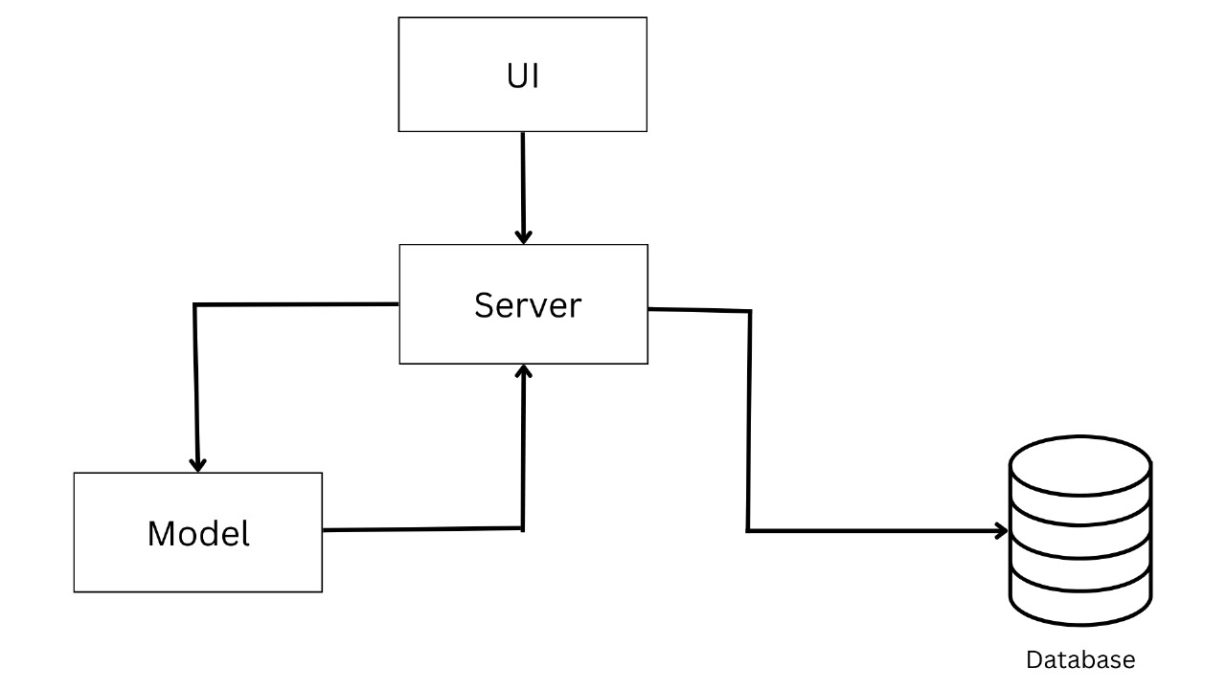
Design / Methodology
Block Diagram :

Slide 10
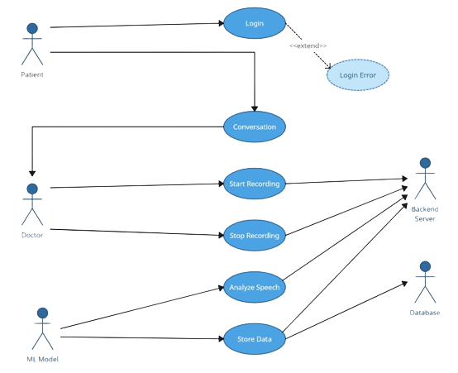
Use Case Diagram :

Slide 11
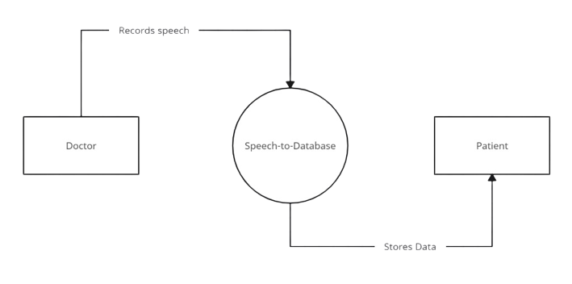
Data Flow Diagram :
Level 0 :

Slide 12
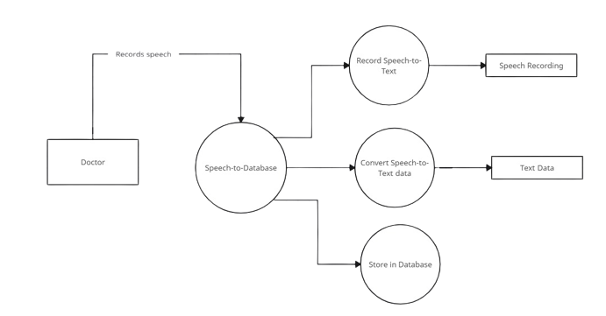
Data Flow Diagram :
Level 1 :

Slide 13
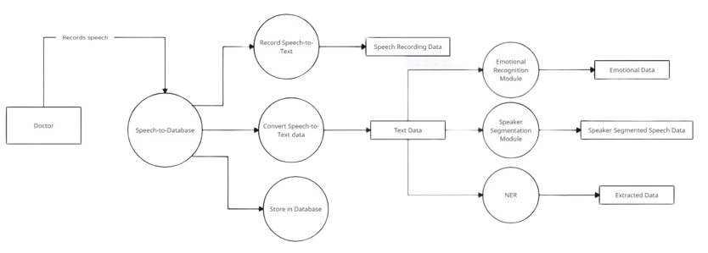
Data Flow Diagram :
Level 2 :

Slide 14
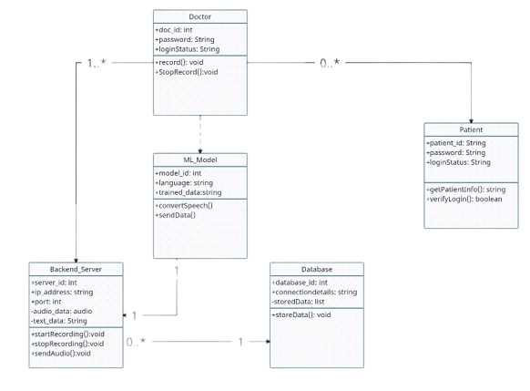
Class Diagram :

Slide 15
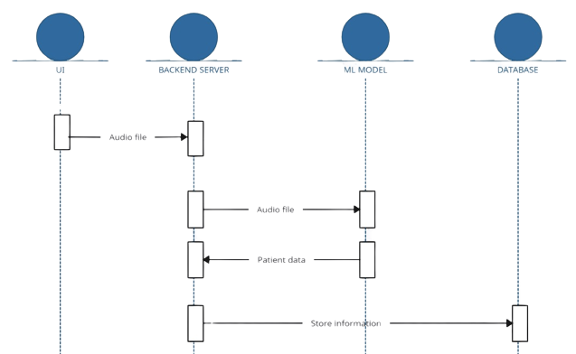
Sequential Diagram :

Slide 16



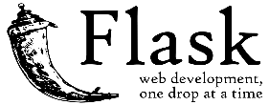

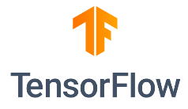






Technological Framework
Frontend :
Backend :
Database :
Tools :

Slide 17
Implementation
Phase 1)
Define the problem statement, search for a dataset with an Indian accent, and choose a suitable machine learning algorithm for Speech- to-Text & Data Extraction.
Phase 2) (Current)
Build the speech-to-text model and test it in different environments (e.g., noisy).
Phase 3)
Build the Data Extraction Model and test it.
Phase 4)
Integrate both the model, then integrate it with the frontend, test, and finally deploy.

Slide 18
References
[1] Kumar, Vijay and Singh, Hemant and Mohanty, Animesh, Real-Time Speech-To-Text / Text-To-Speech Converter with Automatic Text Summarizer Using Natural Language Generation and Abstract Meaning Representation (April 3, 2020). International Journal of Engineering and Advanced Technology (IJEAT) , Volume-9 Issue-4, April, 2020, Page no:2361-2365,
[2] Varathan, Kanya & Geetha, S.. (2008). Information Extraction -a text mining approach. 2007. 1111 - 1118. 10.1049/ic:20070576.
[3] Jain Nikhil, Goyal Manya, Gupta Agravi, Kumar Vivek, Speech to Text Conversion and Sentiment Analysis on Speaker Specific Data, International Research Journal of Modernization in Engineering Technology and Science, Volume:03/Issue:06/June-2021, Impact Factor- 5.354, e-ISSN: 2582-5208
[4] Jeon, Byoungjun & Jeong, Boseong & Jee, Seunghoon & Huang, Yan & Kim, Youngmin & Park, Gee Ho & Kim, Jungah & Wufuer, Maierdanjiang & Jin, Xian & Kim, Sang & Choi, Tae. (2019). A Facial Recognition Mobile App for Patient Safety and Biometric Identification: Design, Development, and Validation. JMIR mHealth and uHealth. 7. e11472. 10.2196/11472.
[5] Zeng Z, Deng Y, Li X, Naumann T, Luo Y. Natural Language Processing for EHR-Based Computational Phenotyping. IEEE/ACM Trans Comput Biol Bioinform. 2019 Jan-Feb;16(1):139-153. doi: 10.1109/TCBB.2018.2849968. Epub 2018 Jun 25. PMID: 29994486; PMCID: PMC6388621.
[6] Adamson M, Choi K, Notaro S, Cotoc C. The Doctor-Patient Relationship and Information-Seeking Behavior: Four Orientations to Cancer Communication. J Palliat Care. 2018 Apr;33(2):79-87. doi: 10.1177/0825859718759881. Epub 2018 Mar 7. PMID: 29514545.

Slide 19


