Slide 1
Explainable Fraud Alert Prioritization
Fraud Alert Control Tower
TEST TRANSACTIONS
5,000
A data analytics project that turns transaction risk scores into investigator-ready queue decisions, explanations, threshold economics, and governance controls.
FRAUD RATE
4.02%
LIVE APP
Vercel
Prepared by Mirza Saif Baig
Synthetic-data capstone. Not affiliated with JPMorgan Chase and not production-approved.

Slide 2
Fraud Alert Control Tower
Operating problem
02
The Problem I Solved
Fraud teams need to decide which alerts deserve scarce investigator attention first.
Alert volume creates noise
False positives create cost
Scores need explanation
Rules can generate many suspicious cases, but not every alert deserves immediate manual review.
Every clean transaction sent to review consumes investigator time and can delay real fraud investigations.
A score is useful only when the investigator can see why the transaction is risky and what action should follow.
TAKEAWAY
I approached the brief as an operating-control problem: rank alerts, explain them, and control the review queue.

Slide 3
Fraud Alert Control Tower
Analytical approach
03
My End-To-End Approach
The project moved from raw data to a deployed decision-support workflow.
1
2
3
4
Clean and join
Engineer signals
Train and validate
Deploy workflow
Transactions, customers, and merchants were joined at transaction grain.
Amount, time, geography, channel, velocity, and merchant context became fraud features.
Models and thresholds were evaluated with held-out data and false-positive awareness.
The Vercel app supports scoring, queue review, metrics, governance, and case export.
TAKEAWAY
The final project is a closed analytical loop: data, feature logic, model evidence, operational decision, and governance.

Slide 4
Fraud Alert Control Tower
Build journey
04
How The Work Improved From First Build To Final Submission
I iterated from a basic model dashboard to a review-ready decision-support control tower.
Stage
What happened
What I changed
First build
The first version proved the concept, but it did not yet tell a strong business-control story.
Reframed the project around investigator triage, threshold policy, and operational decision-making.
Testing gap
Some sections looked static or too generic for a reviewer.
Added transaction lookup, case drilldown, CSV export, presenter mode, and clearer explanation text.
Analyst uplift
The model needed stronger business-control framing.
Added alert economics, break-even logic, governance, limitations, and future pilot roadmap.
Final state
The final version explains the problem, the evidence, the operating decision, and the next step.
Packaged PPT, report, video script, live app, source code, and evidence into one clean submission folder.
TAKEAWAY
This slide is the project journey: I did not stop at a first model; I iterated until the output became review-ready.

Slide 5
Fraud Alert Control Tower
Data foundation
05
Data Preparation And Quality Controls
The model was built on a clean transaction-level dataset.
TRANSACTIONS
FRAUD CASES
FRAUD RATE
SOURCES JOINED
5,000
201
4.02%
3
Cleaning
Auditability
Parsed timestamps, standardized countries, handled tenure issues, and preserved missing-profile flags.
Added SQL feature view and feature documentation so the logic can be reviewed outside Python.
Leakage control
Readiness
Excluded IDs, fraud labels, alert flags, and post-investigation fields from model training.
Exported model, dashboard, and transaction lookup JSON files for the Vercel app.
TAKEAWAY
The data work created a reliable transaction-grain foundation for modelling, explanations, and governance evidence.

Slide 6
Fraud Alert Control Tower
Feature logic
06
Feature Engineering: Fraud Signals, Not Just Columns
The features were designed around fraud signals an investigator can understand.
Signal family
Example features
Why it matters
Transaction
amount, amount_log1p, txn_hour
Captures unusual value and timing.
Location
geo_distance_km, cross-border context
Highlights possible account takeover or travel anomaly context.
Channel
P2P, wire, online, card channels
Shows channel-specific fraud exposure.
Behaviour
velocity_ratio, amt_per_txn_24h
Detects bursts or abnormal spending patterns.
Merchant
merchant category encoding
Adds merchant-level fraud context.
Model-aware feature audit
Mutual information filtered candidate features; validation permutation importance confirmed the signals the model truly relied on.
TAKEAWAY
The feature story is defensible because every input maps to fraud-analyst reasoning.

Slide 7
Fraud Alert Control Tower
Model evidence
07
What The Model Evidence Showed
The strongest retained signals were geographic distance, channel, amount, and transaction timing.
Validation permutation importance
Analyst interpretation
Geographic distance
0.0806
Geographic distance dominated the evidence. In fraud terms, this can indicate account takeover, travel anomaly, or a transaction far from expected customer behaviour.
Channel
0.0138
Amount log
0.0136
Transaction amount
0.0061
Decision rule
Transaction hour
0.0026
Features were not kept just because they appeared in an initial shortlist. The final story follows validation evidence.
TAKEAWAY
The model evidence guided both the explanation layer and the scope of what I chose not to overclaim.

Slide 8
Fraud Alert Control Tower
Threshold discipline
08
Threshold Strategy: A Staffing Decision
The operating threshold determines investigator workload and fraud capture.
THRESHOLD
ROUTED CASES
FRAUDS CAUGHT
QUEUE PRECISION
0.7977
74
10
13.5%
Policy
Reviews
Frauds
False positives
What it means
Existing alert
22
8
14
Narrower review queue.
Risk overlay
74
10
64
Higher fraud capture, but more clean cases reviewed.
TAKEAWAY
My recommendation is a shadow-mode prioritization overlay, not a replacement for existing controls.

Slide 9
Fraud Alert Control Tower
Business economics
09
Alert Economics And Break-Even Logic
The business case is useful because it states the staffing and fraud trade-off clearly.
EXTRA REVIEWS
EXTRA FRAUDS CAUGHT
REVIEW COST
BREAK-EVEN
+52
+2
GBP 416
GBP 208
Calculation
Business conclusion
52 extra reviews at GBP 8 each cost GBP 416. With 2 extra frauds caught, each fraud must avoid at least GBP 208 of loss for the overlay to break even.
The model is valuable when used selectively: it increases fraud capture, but needs capacity control, investigator validation, and weekly false-positive monitoring.
TAKEAWAY
This makes the project finance-ready: fraud capture is linked to cost, capacity, and decision risk.

Slide 10
Fraud Alert Control Tower
Explainability
10
How An Investigator Reads One Alert
The app converts a score into reasons and next actions.
1. Score
2. Explain
3. Act
The transaction receives a fraud-risk score using exported model logic and selected top features.
Local explanation text shows which inputs increased or reduced the score, such as distance, amount, hour, or channel.
The output becomes a recommended action: review, monitor closely, or keep in audit trail.
Why geographic distance is used
Why human review remains required
It is a proxy for unusual transaction context, not proof of fraud by itself.
The app supports prioritization. It does not automatically block customers or approve/deny transactions.
TAKEAWAY
Explainability makes the output usable: the investigator sees the score, the reason, and the next control action.

Slide 11
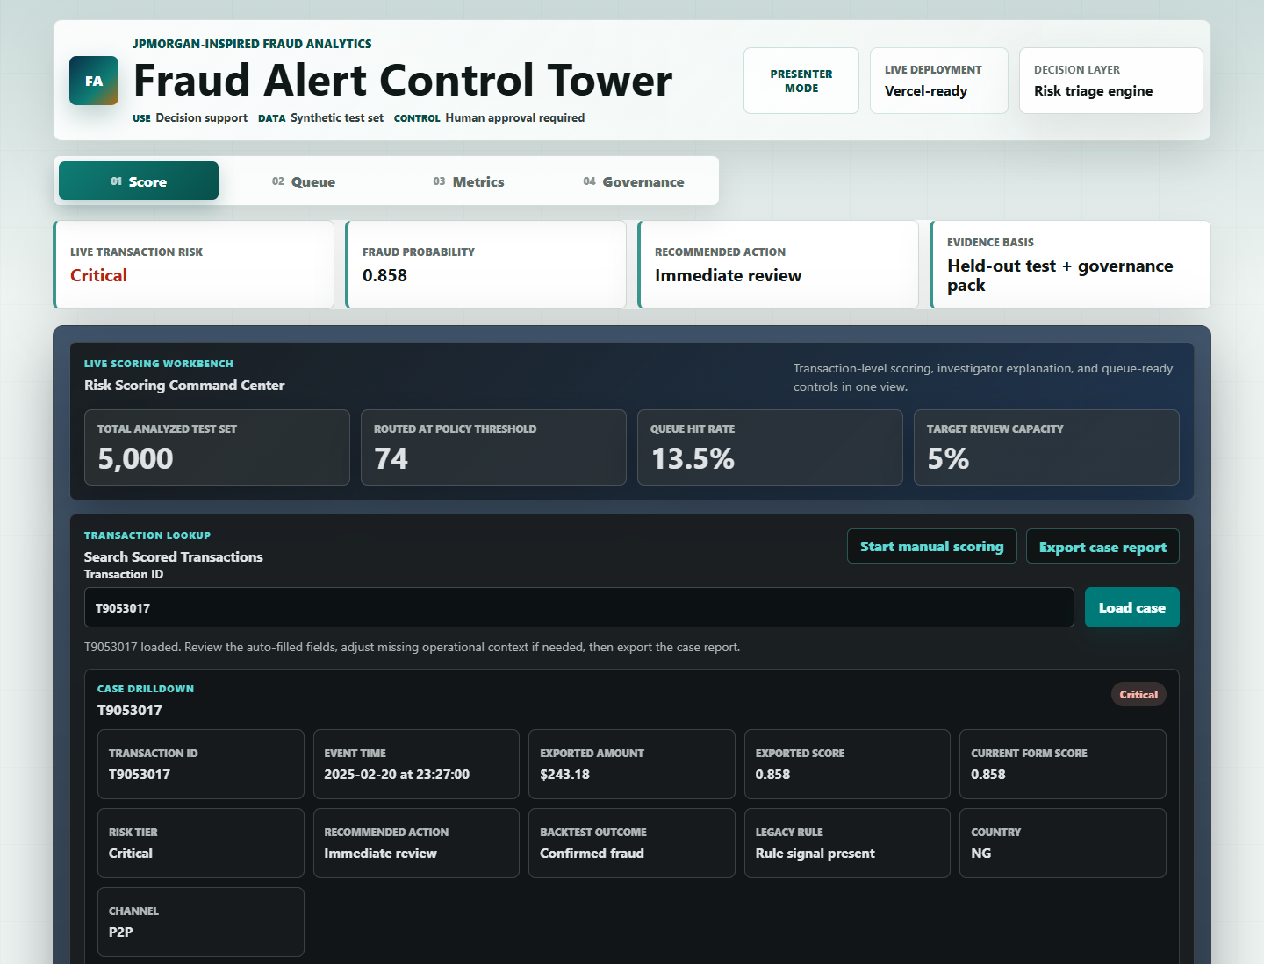
Fraud Alert Control Tower
Live control tower
11
The Vercel App Turns Analysis Into Workflow
The live app is the operating layer built on top of the modelling artifacts.
What the reviewer can test
Score a transaction Search transaction IDs Review risk reasons Inspect queue priority Check threshold metrics Read governance controls Export case evidence
TAKEAWAY
The app is not a decoration layer; it is where the model becomes a fraud-analyst workflow.

Slide 12
Fraud Alert Control Tower
Governance
12
Governance And Production Boundary
A credible fraud model must state its limits as clearly as its capabilities.
Intended use
Not approved for
Monitoring controls
Prioritize review queues and provide investigator-facing explanations.
Automatic blocking, customer eligibility decisions, or production use without real-data validation.
Monitor score drift, segment-level false positives, queue load, fraud capture, and investigator outcomes.
Risk control
Evidence prepared
Model card
Purpose, assumptions, limitations, and monitoring plan.
Threshold memo
Capacity-based threshold and business trade-off.
Validation evidence
Calibration, segment false positives, and SLA coverage.
SQL view
Warehouse-ready feature logic.
TAKEAWAY
The governance layer protects credibility: the prototype is useful, controlled, and explicit about production limits.

Slide 13
Fraud Alert Control Tower
Report card alignment
13
Reviewer Report Card: What This Project Proves
The report card converts the work into clear assessment evidence.
Review area
Evidence in my submission
Why it matters
Fraud relevance
Amount, geography, channel, time, velocity, and merchant-context signals.
The features match real fraud-analysis thinking.
Analytical discipline
Held-out testing, feature audit, threshold comparison, and false-positive awareness.
The model is evaluated as a control, not just a score.
Business usefulness
Queue size, fraud capture, hit rate, review cost, and break-even point.
The output supports an operating decision.
Explainability
Per-case reasons, risk drivers, next actions, and exportable case evidence.
An investigator can understand and challenge the result.
Governance
Model card, production boundary, monitoring plan, and enterprise roadmap.
The prototype is responsible and reviewable.
TAKEAWAY
The report card is the one-page proof that the project is complete across analytics, business value, app delivery, and governance.

Slide 14
Fraud Alert Control Tower
Submission evidence
14
What I Am Submitting
The final package is organized so a reviewer can inspect the work quickly.
Executive presentation
Live demo and GitHub
Problem, approach, model, threshold strategy, app, governance, report card, and roadmap.
Vercel app plus source repository for app code, Python modelling, SQL, and artifacts.
Professional report
Evidence pack
A detailed written report that explains the project journey, evidence, business decision, and next course of action.
Model card, threshold memo, validation evidence, capacity table, feature audit, and SQL view.
Report card
Video guide
A quick reviewer-facing scorecard of what was built, what evidence supports it, and what should happen next.
A natural presentation script for recording and viva-style explanation.
TAKEAWAY
The folder is built as a reviewer package, not a messy project dump.

Slide 15
Fraud Alert Control Tower
Future roadmap
15
Future Roadmap: From Prototype To Bank-Ready Pilot
The next step is controlled validation, not production deployment.
Stage
Next action
Why it matters
Real-data validation
Validate on historical bank transactions.
Confirms whether synthetic patterns generalize.
Calibration
Calibrate probabilities on validation data.
Makes scores easier to defend as risk probabilities.
SHAP upgrade
Add signed local SHAP explanations.
Improves audit-grade explainability.
Investigator outcome loop
Capture investigator outcomes and outcomes.
Reduces false positives and supports retraining.
Enterprise controls
Add roles, audit logs, security controls, and monitoring.
Moves from prototype to pilot-ready system.
TAKEAWAY
Final message: I built a fraud decision-support prototype and defined a responsible path to pilot readiness.

