Slide 1
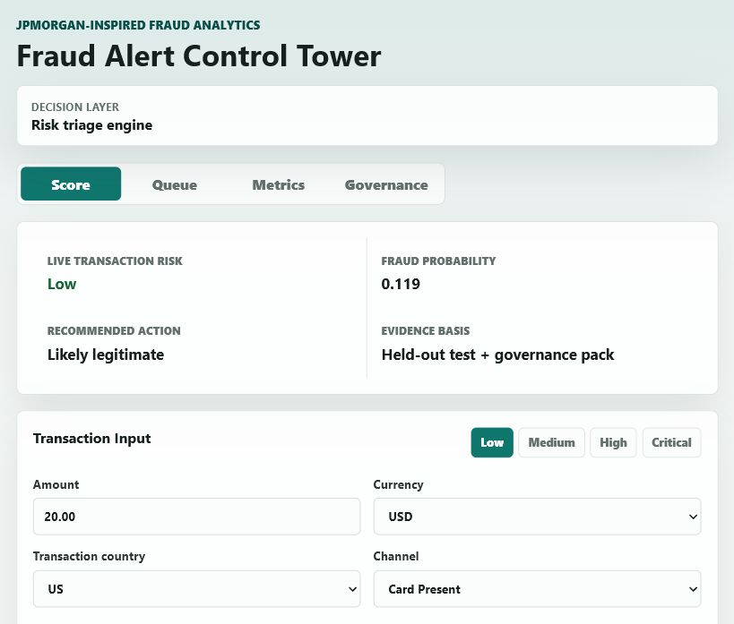
FINAL SUBMISSION
Fraud Alert Control Tower
A fraud-operations decision-support layer that scores transactions, prioritizes investigator queues, explains risk drivers, and documents governance controls.
5,000
4.02%
0.7977
4 tabs
transactions profiled
raw fraud rate
review threshold
deployed workflow
Positioning: synthetic-data capstone, not affiliated with JPMorgan Chase, not production-approved.
Source: final GitHub repo, Vercel app, governance docs
01

Slide 2
BUSINESS PROBLEM
Fraud review is constrained by investigator capacity.
The task is not just predicting fraud. It is deciding which transactions deserve scarce human review first.
22
8
32
Baseline alert behavior
baseline reviews
frauds caught
frauds missed
Hit rate
36.4%
Fraud capture
20.0%
Missed fraud
32
The baseline rule is precise but selective.
The risk triage layer is designed to surface additional suspicious cases.
The final decision remains with human investigators.
Source: held-out test set and threshold strategy memo
02

Slide 3
DATA FOUNDATION
The pipeline turns raw files into a controlled analytic table.
Cleaning, joins, and leakage prevention came before any modeling.
1
Load
2
Clean
3
Join
4
Engineer
5
Control
Transactions, customers, and merchants are read at transaction grain.
Timestamp parsing, country normalization, broken tenure flags, and missing profile flags.
Customer and merchant profiles are left joined without dropping unmatched transactions.
Hour, weekend, amount_log1p, cross-border and distance-based behavior signals.
IDs, target fields, and historical alert outputs are excluded.
Data-cleaning choices I would explain in the interview
I preserved missing joins with flags instead of silently deleting rows.
I treated broken tenure values as a data-quality issue, not as valid customer history.
I removed leakage so the model could not learn from labels or prior alerts.
Source: Step 2 modeling pipeline and progress reports
03

Slide 4
FEATURE STRATEGY
The final model uses explainable risk signals, not hidden black-box inputs.
Top features were selected on training data only, then translated into reviewer-friendly labels.
Rank
Selected feature
Material drivers visible in the app
1
geo_distance_km
Weak near-zero global rows were removed from the public view so reviewers see the strongest operating signals.
2
txn_country
3
synthetic_identity_score
0.081
Geographic distance
4
merchant_risk_score
5
channel
Payment channel
0.014
6
txn_hour
Log-scaled amount
0.014
7
device_risk_score
Transaction hour
0.003
8
merchant_profile_risk_score
9
transaction_amount_usd
10
amount_log1p
Source: mutual information feature selection and app Metrics tab
04

Slide 5
RISK TRIAGE ENGINE
The score becomes a priority tier, an action, and a reason.
The deployed app uses exported model JSON so the demo runs without Streamlit or a Python server.
1
User input
2
Preprocess
3
Score
4
Prioritize
5
Explain
Amount, currency, country, channel, hour, distance, and risk scores.
Currency conversion, log amount, feature mapping, and reference profile.
Risk triage engine converts weighted evidence into a probability-like risk score.
Low, medium, high, and critical bands map to investigation actions.
Local sensitivity produces plain-English reasons.
Score band interpretation
0.119
0.350
0.7977
0.820+
Important: this is a triage score for ranking and review, not an automatic blocking decision.
safe floor
medium watch
review threshold
critical review
Source: exported model JSON and Vercel app scoring logic
05

Slide 6
THRESHOLD STRATEGY
The threshold is a staffing and control decision.
The selected policy balances fraud capture, queue precision, and review volume.
0.7977
74
25.0%
13.5%
recommended threshold
test reviews
fraud capture
queue precision
Capacity
Threshold
Reviews
Hit rate
Capture
Trade-off
1%
0.8118
10
50.0%
12.5%
2%
0.8087
23
21.7%
12.5%
Review load
7.4%
5%
0.7977
74
13.5%
25.0%
64
False positives
10%
0.5742
102
12.7%
32.5%
The app shows this openly so the reviewer sees a business-control decision, not a hidden model claim.
15%
0.5571
164
9.8%
40.0%
Source: threshold strategy memo and capacity threshold table
06

Slide 7
PREDICTION INTERFACE
The Vercel app turns the model into a usable investigator workflow.
A reviewer can enter transaction details and receive a risk tier, probability, action, reasons, and next steps.
What the demo proves
Inputs are practical: amount, currency, country, channel, hour, distance, device and merchant risk.
Outputs are operational: low, medium, high, or critical priority.
The Why section explains the top local drivers.
The What To Do Next section gives investigator actions.
The app is static and deployable on Vercel.
Source: deployed app screenshots and app/index.html
07

Slide 8
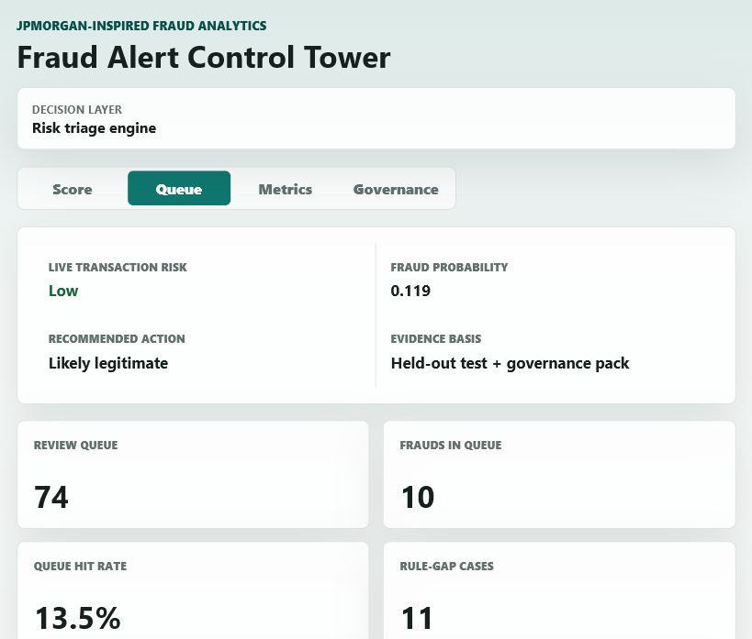
QUEUE ECONOMICS
The control tower connects risk scores to review cost and fraud capture.
This is the analyst layer: not just what the model predicts, but what it costs to operate.
+52
+2
$584
extra reviews
extra fraud caught
illustrative net
Item
Baseline
Triage
Change
Reviewed
22
74
+52
Fraud caught
8
10
+2
False positives
14
64
+50
The point is not claiming production ROI. It is showing how thresholds become cost, capacity, and control decisions.
Source: Business Impact / Alert Economics section and queue view
08

Slide 9
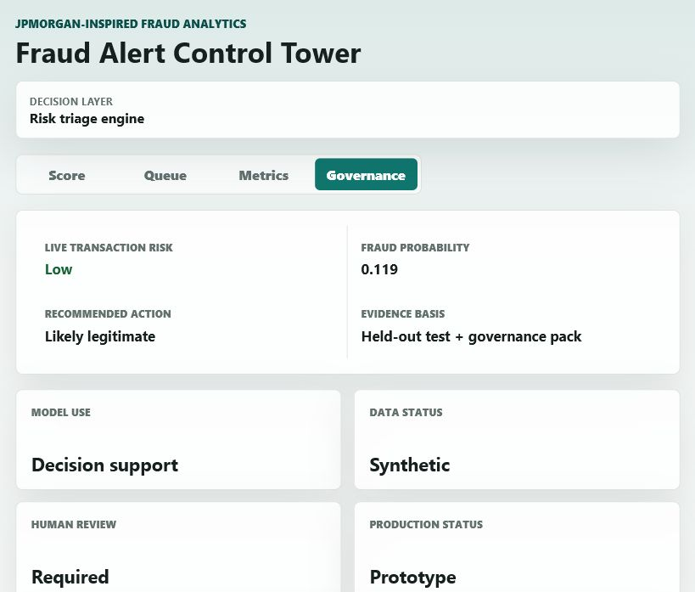
GOVERNANCE
The project is framed as decision support with clear production limits.
This is what makes it feel like a banking analytics project rather than a notebook-only ML exercise.
Decision
Synthetic
Required
Prototype
model use
data status
human review
production status
support
Production approval gates
Validate on representative real transaction data.
Calibrate probability and threshold under actual staffing constraints.
Review segment fairness, proxy risk, and false-positive burden.
Add audit logging, drift monitoring, and investigator outcome feedback.
Source: model card, threshold memo, governance summary, and app Governance tab
09

Slide 10
CLOSE
I built the project as an end-to-end fraud analytics product.
Technical delivery
Business layer
Governance layer
Python pipeline
Threshold strategy
Model card
Cleaning and joins
Queue prioritization
Risk controls
Feature selection
Alert economics
Human review
Risk scoring export
Investigator actions
Monitoring plan
Live demo
GitHub
PPT
Vercel app
clean repo
submission story
Interview line: I treated the model as an operational control, not just a classifier.
Source: final project outputs and submission artifacts
10

