Slide 1
JPMORGAN-INSPIRED FRAUD ANALYTICS
Fraud Alert
Control Tower
TRANSACTIONS
FRAUD RATE
5,000
4.02%
REVIEW QUEUE
FRAUD CAPTURE
Project journey from raw synthetic data to explainable alert prioritization, investigator workflow, threshold controls, and governance.
74
25.0%
Final thesis
The project is not just a fraud classifier. It is a decision-support workflow that ranks alerts, explains risk, and links thresholds to investigator capacity.
Notes:
Open naturally: I started with the project brief, but I treated it as a fraud operations problem, not only a machine learning task.
My aim was to build something an analyst or investigator could actually use: score, queue, explain, and govern.

Slide 2
02
Where The Project Started
The brief was about explainable fraud alert prioritization, so I reframed it as a review-capacity problem.
1
Project brief
2
Business question
3
My success criteria
Build a fraud alert prioritization solution using transaction, customer, and merchant data.
Which cases should investigators review first when the team cannot check every transaction?
Prediction plus explanation, queue usefulness, threshold discipline, and governance evidence.
Why a normal classifier was not enough
Conclusion from the brief
-
Fraud is rare, so accuracy can be misleading.
The useful output is not only fraud vs legitimate. The useful output is a prioritized queue with reasons and operating controls.
-
A bank needs workload and false-positive visibility.
-
Reviewers need clear reasons before taking action.
Notes:
I would explain that I first read the task and asked what a fraud team actually needs from it.
That led me to focus on queue prioritization, thresholding, and explainability.

Slide 3
03
Data Foundation And Cleaning
The pipeline kept one row per transaction, joined profiles, and protected the model from leakage.
Raw inputs
Cleaning controls
Leakage prevention
-
Transactions: amount, time, channel, country
-
Parsed timestamps into time features
-
Removed IDs from predictive features
-
Normalized country labels
-
Removed target field fraud_label
-
Customers: KYC risk, home country, identity score
-
Left joined customer and merchant data
-
Excluded old alert outcome
-
Merchants: category and merchant risk score
-
Created missing-profile flags
-
Selected features on training data only
-
Flagged broken tenure values
Talking point: I did not start by training. I first made the data trustworthy enough to model.
Notes:
This is where I show that the work was not just building a UI.
Explain left joins, missing flags, leakage prevention, and why alert_generated was removed from model inputs.

Slide 4
04
Feature Strategy
I limited the model to the top 10 explainable features so the app stayed usable and defensible.
Top feature set
How features were selected
1. Geographic distance
6. Transaction hour
I used training-only mutual information to rank candidate predictors. That avoids choosing features using future validation or test information.
2. Transaction country
7. Device risk score
3. Synthetic identity score
8. Merchant profile risk score
4. Merchant risk score
9. Transaction amount
Why these features make sense
5. Payment channel
10. Log-scaled amount
-
Geo distance and country capture unusual transaction location patterns.
-
Device, synthetic identity, and merchant signals reflect fraud risk.
-
Amount, channel, and hour add transaction-context behavior.
Notes:
Say that top features were selected for both predictive value and explainability.
The final app uses the same feature set so every score can be explained to a reviewer.

Slide 5
05
Modeling Journey
I moved from a baseline classifier to an operating policy that could support an investigator queue.
1
Baseline
2
Model comparison
3
Risk triage layer
Logistic regression with imputation, scaling, one-hot encoding, and class weighting.
Compared weighted tree and ensemble candidates using PR-AUC, recall, precision, and review load.
Renamed reviewer-facing evidence around a risk-ranking engine instead of a model leaderboard.
What I learned from model comparison
The highest technical score was not the whole answer. Fraud operations need a useful queue: how many cases are reviewed, how many frauds are caught, and how many false positives investigators must handle.
RANKING QUALITY
HELD-OUT REVIEW COUNT
TRUE POSITIVES
FALSE POSITIVES
0.141
74
10
64
Notes:
Do not overclaim the model. Say performance is moderate because fraud is rare.
The key improvement is that the model became a queue-ranking and thresholding workflow, which is closer to bank operations.

Slide 6
06
Threshold Strategy
The conclusion was a review policy, not just a probability score.
RECOMMENDED THRESHOLD
TARGET CAPACITY
QUEUE HIT RATE
FRAUD CAPTURE
0.798
5%
13.5%
25.0%
Why threshold matters
Final policy decision
-
Lower threshold: catches more fraud but creates more false positives.
Use a 0.798 review threshold for the prototype, monitor the actual queue rate, and allow exact top-K selection when staffing is fixed.
-
Higher threshold: smaller queue but more missed fraud.
-
Capacity becomes a business decision, not a hidden model setting.
Benchmark story
Old alert: 22 reviews, 8 frauds, 14 false positives
Risk triage: 74 reviews, 10 frauds, 64 false positives
Trade-off: +2 caught frauds for +52 extra reviews
Notes:
This slide answers how I came to a conclusion.
The conclusion was not just champion model. It was threshold plus human-review policy.

Slide 7
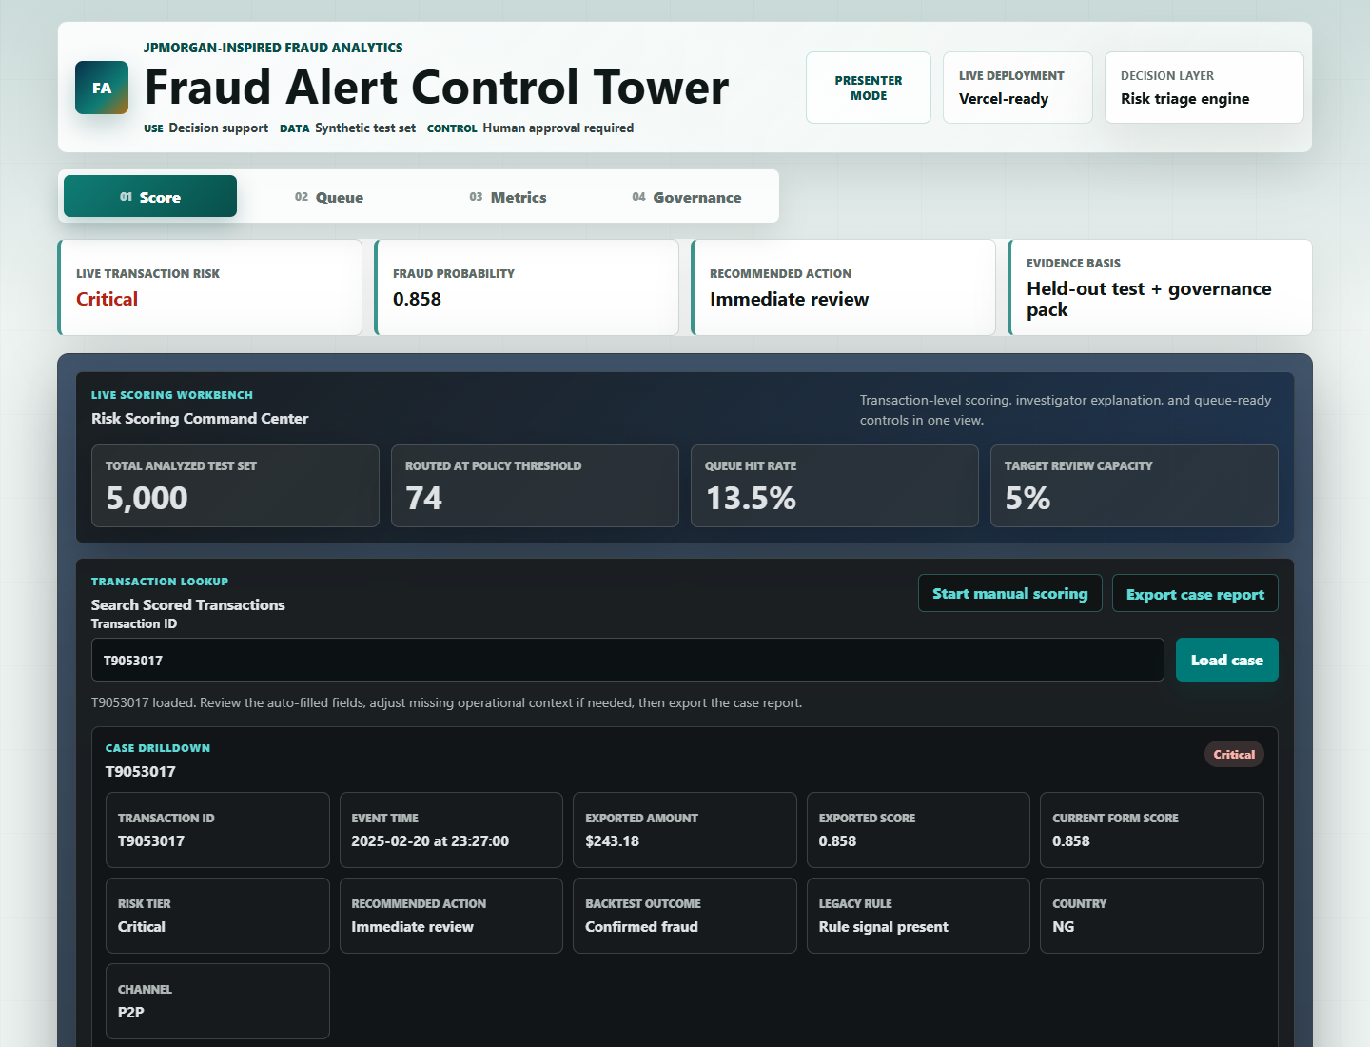
07
From Model To Analyst Workflow
I turned the model into a static Vercel app so the reviewer can score, inspect, and export cases.
Score view
-
Transaction ID lookup and manual scoring
-
Fraud probability and priority tier
-
Plain-English why section
-
Investigator next steps
-
CSV export for case evidence
Notes:
Explain that the first app idea could have been Streamlit, but I moved to a deployable static app for Vercel.
The app is built to look like a fraud operations workbench, not just a form.

Slide 8
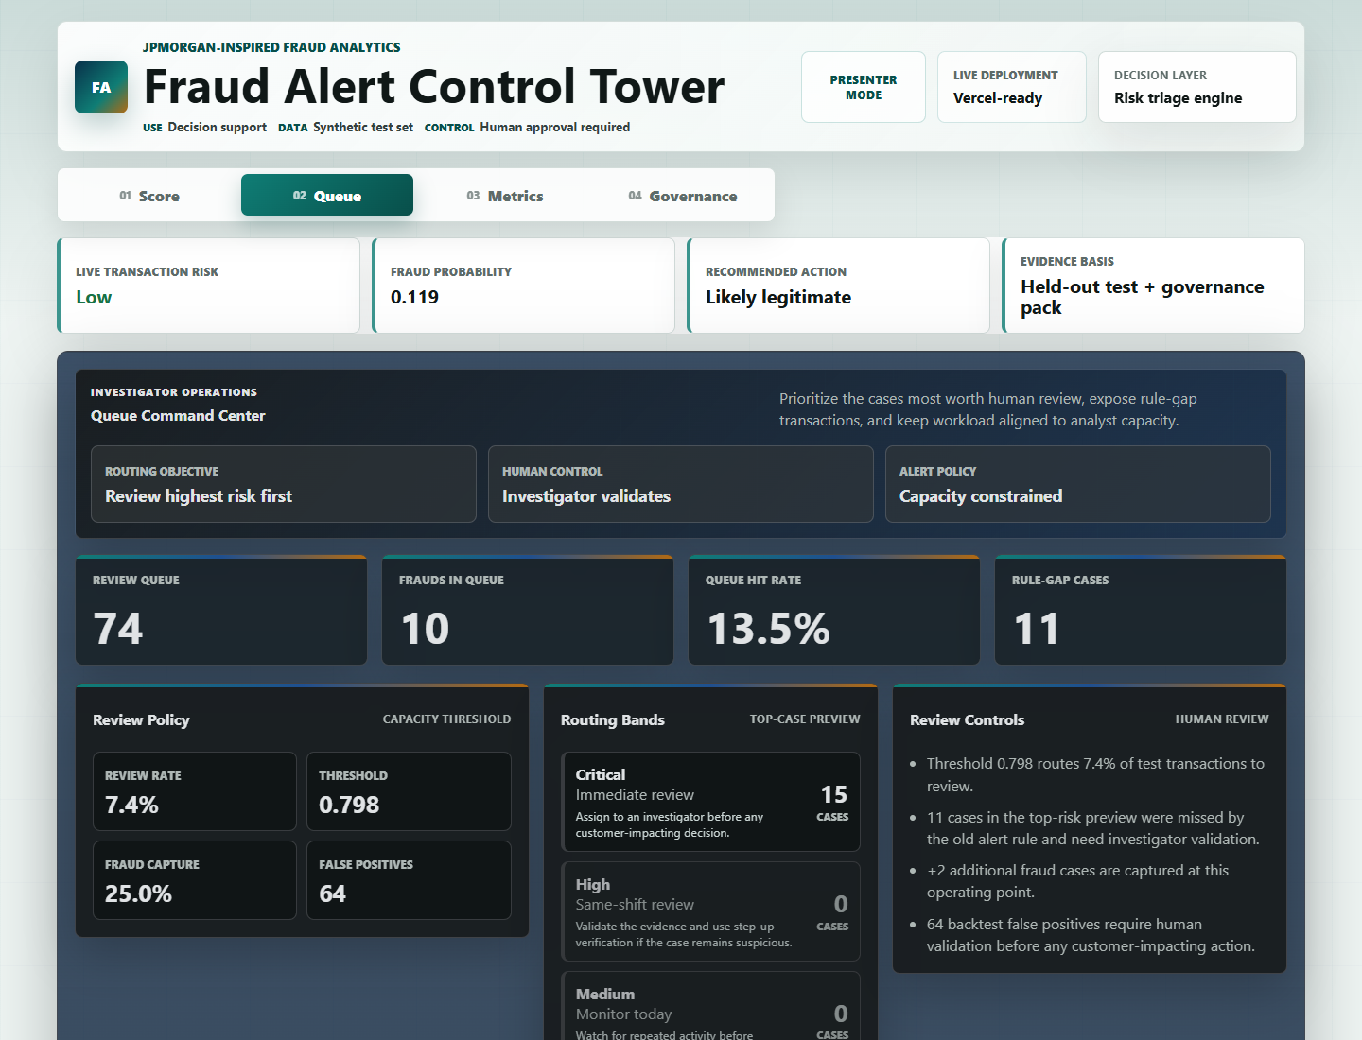
08
Queue And Operating Controls
The app shows workload, false positives, rule gaps, and highest-risk cases for review.
Queue evidence
REVIEW QUEUE
FRAUDS IN QUEUE
74
10
RULE-GAP CASES
FALSE POSITIVES
11
64
This is where the project becomes operational: it tells the investigator what to review now and shows leadership the workload trade-off.
Notes:
Explain the queue as a worklist, not another model chart.
The rule-gap number is important: it shows cases the old alert approach may not have highlighted.

Slide 9
09
Explainability Layer
The system explains which feature values pushed the score up or down for a specific transaction.
Example explanation
How I explain it simply
Critical risk is mainly driven by Geographic distance above the typical reference value, plus transaction amount above the usual amount profile.
The explanation is not saying the feature caused fraud. It is saying the model treated that feature value as unusual and risk-increasing compared with a typical transaction.
-
Global view: strongest broad model drivers
This protects the wording: model behavior, not guaranteed causality.
-
Local view: reasons for this exact case
-
Investigator view: what to check next
Notes:
Use this if the tutor asks about geographic distance.
Say the app compares each transaction against reference values and explains what made the score move.

Slide 10
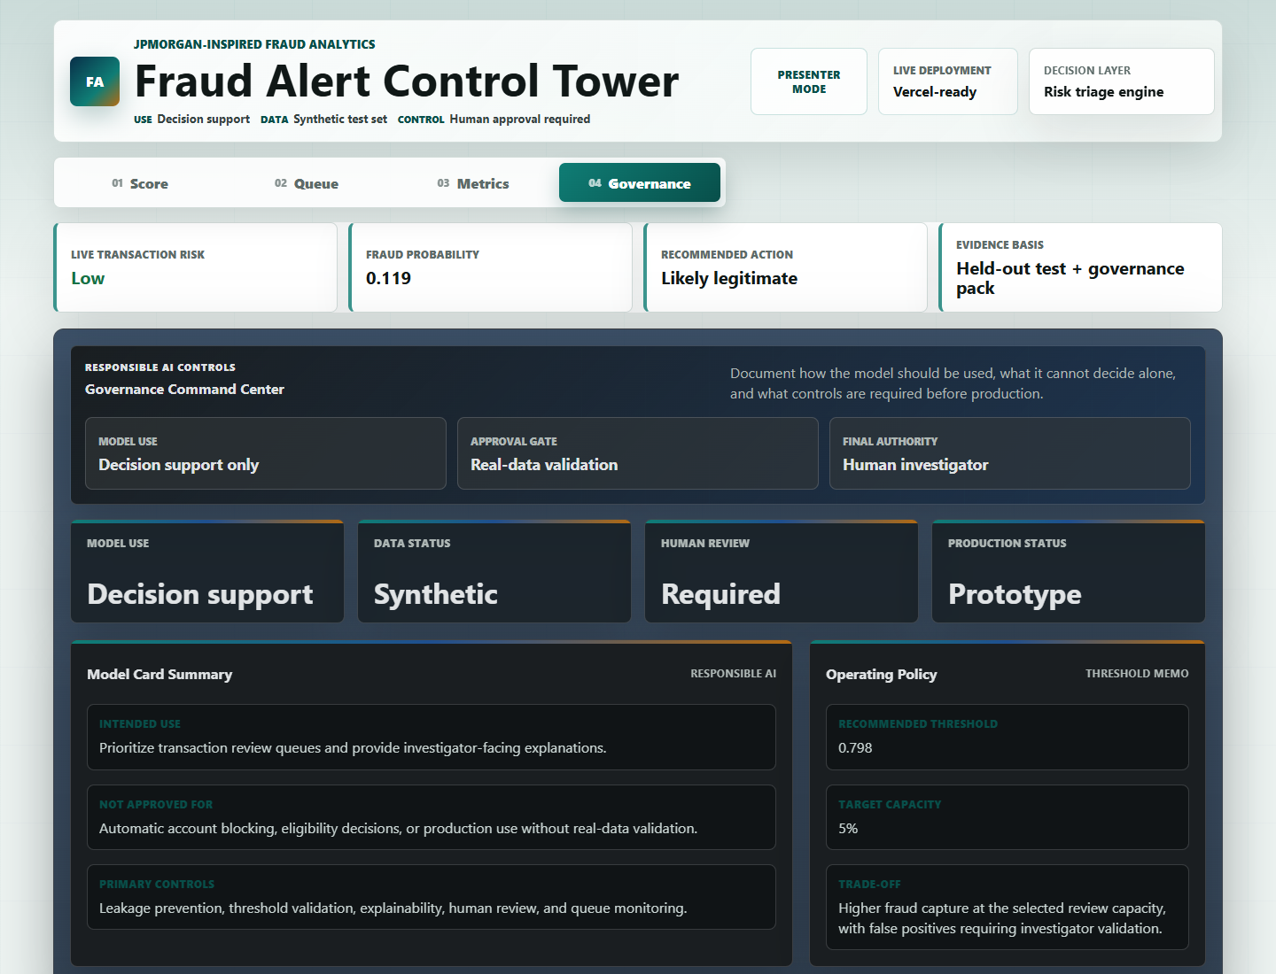
010
Governance And Responsible Use
The final solution is positioned as decision support with human review, not automatic blocking.
Controls I documented
-
Model card and intended use
-
Threshold strategy memo
-
Human-in-the-loop review
-
Segment and drift monitoring plan
-
Risk register and approval gates
-
Production limitation: synthetic data only
Best line: The model can prioritize review, but a human decides action.
Notes:
This slide is important for JPMorgan-style review.
Emphasize that a banking model needs controls, not only accuracy.

Slide 11
011
How This Scales To A Bank-Grade System
The prototype is complete as a decision-support demo; these are the controlled steps required before a real banking rollout.
PROTOTYPE NOW
CONTROLLED PILOT
PRODUCTION READY
Working control tower
Validate model trust
Needs bank infrastructure
Synthetic test data, risk tiers, investigator queue, local reason codes, threshold economics, CSV case export, and governance evidence.
Calibrated probabilities, real SHAP explanations, segment validation, investigator feedback capture, and weekly drift monitoring.
Live transaction streams, customer and device history, graph fraud signals, role-based access, audit logs, and formal model-risk approval.
Scale-up pillars a reviewer should expect
Data
Model
Workflow
Governance
Security
Move from synthetic records to representative transaction, customer, account, and device data.
Add calibration, SHAP, challenger models, and graph/network fraud signals.
Capture analyst dispositions, case lifecycle status, SLA routing, and feedback loops.
Run segment validation, drift monitoring, approval gates, and periodic threshold review.
Add role-based access, audit logs, privacy controls, and controlled deployment review.
Positioning: this project is a strong prototype, not a production fraud engine. The roadmap shows exactly what would be needed to make it bank-grade.

Slide 12
012
Improvements After Feedback
I used review comments to move the project from demo-quality to submission-ready.
Before feedback
After feedback
-
The model and app worked, but the story was too product-summary focused.
-
Cleaner app wording and stronger analyst layout
-
Some app labels were too technical or looked like buttons.
-
Transaction search, drilldown, and CSV case export
-
The export report was not as reviewer-friendly as it should be.
-
Presenter Mode for explaining how each section was built
-
The first PPT did not clearly explain the journey.
-
Journey-based PPT and professional written report
This shows improvement, ownership, and the ability to respond to stakeholder feedback.
Notes:
This is where you tell your tutor what changed since last submission.
Use simple language: I cleaned the story, improved the UI, made the report export useful, and added explanation support.

Slide 13
013
Final Conclusion
The finished project demonstrates analytics, business judgement, deployment, and governance.
What I concluded
What I would do next
A fraud model is most valuable when it helps a bank answer: which cases should be reviewed first, why are they risky, how many false positives will we create, and what controls are needed before use?
-
Calibrate probabilities with real production-like data
-
Add real SHAP explanations for model-level rigor
-
Monitor segment performance by country, channel, and amount band
-
Run the model in shadow mode before any customer-impacting use
That is why my final output is a control tower, not only a prediction notebook.
-
Collect investigator feedback and retrain when patterns drift
Closing line: I built this as an end-to-end fraud analytics project, from data cleaning to a governed investigator workflow.
Notes:
Finish confidently.
Do not say the model is production ready. Say the prototype is complete and production would need real-data validation and governance approval.

