Slide 1
Find Local Volunteer Projects Group Name ---- and Group No-4
Contributions of different members
Member 1 (Mahima Rabbi 18101563): Introduction, Requirement Analysis and Use Case
Member 2 (Saraf Noor Khaled 18141009): Sequence Diagram and Activity Diagram
Member 3 (Mirza Ahmad Shayer 18101496): State Machine Diagram, Data Flow Diagram and Conclusion
Notes:
1

Slide 2
Explain About your Project
Story to make the Project:
We wanted to use the internet to help people solve problems faster
We believe that we can solve problems better by working together
We wanted to show how social networks can be utilized to solve bigger problems
2

Slide 3
Explain About your Project
Planning:
We planned to make it like the current social media website giants of today such as Facebook. We thought of using similar interfaces to make it easier for people to use. We wanted to utilize Facebook’s ability to connect people together and make them work with each other to solve problems that are much larger in scale. We made it to help various communities as part of our mission to reduce suffering and increase happiness in the world.
3

Slide 4
Explain About your Project
Analysis:
The system directly takes ideas form Facebook’s networking system and implements some changes. This way people would be familiar with the interfaces and can easily recruit volunteers, find help and various funding sources to solve social issues. The system will come about in the following months. We intended to make it work for both volunteers and sponsors alike so that anyone can use it on any device be it mobiles, desktops, laptops or tablets.

Slide 5
Explain About your Project
Design:
The system will work like any other social media applications. People can make official accounts and from the get go either work as volunteers for other people by joining social projects or make social projects themselves and recruit others. The in-built payment system will handle all funding and monetary transactions. People can also call for help or ask for funding from both Governments and NGOs.
Analysis of current system: The system needs secure accounts and payment methods, needs to handle large flows of data and run smoothly, needs to have an easy to use interface.
Analysis of Proposed System: The system is more user friendly, can handle large amounts of data without crashing or delay, has secure and easy payment methods and accounts.

Slide 6
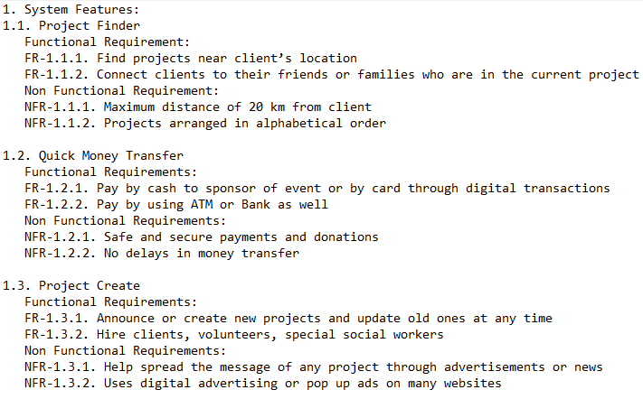
Requirement analysis
6

Slide 7
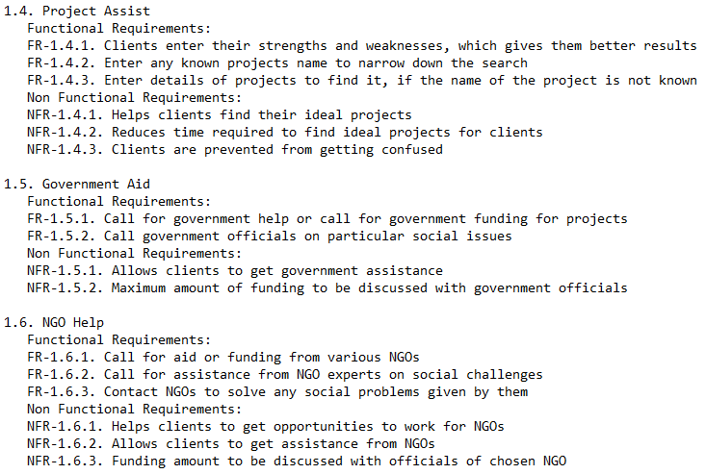
Requirement analysis

Slide 8
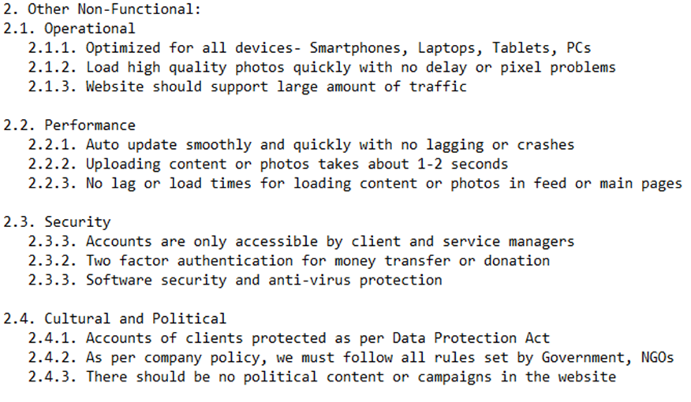
Requirement analysis

Slide 9
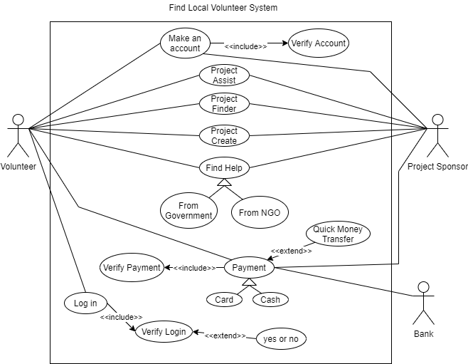
Use Case Diagram
9

Slide 10
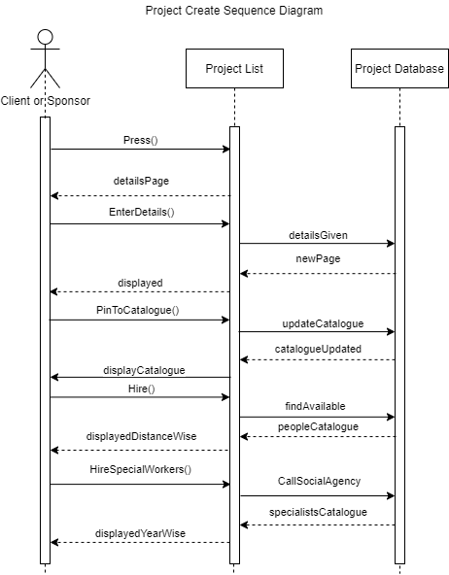
Sequence Diagram
10

Slide 11
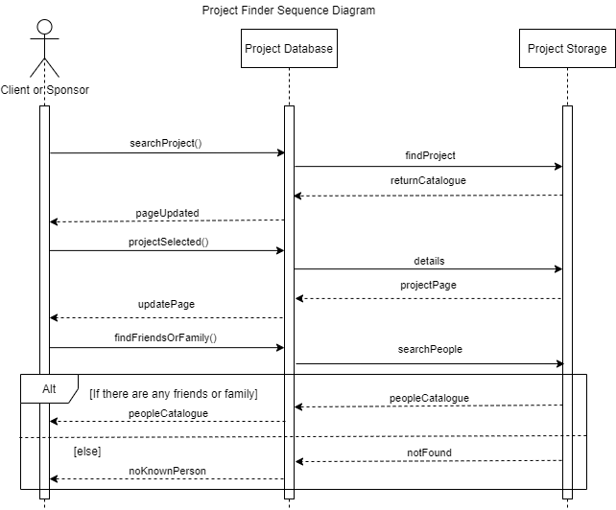
Sequence Diagram

Slide 12
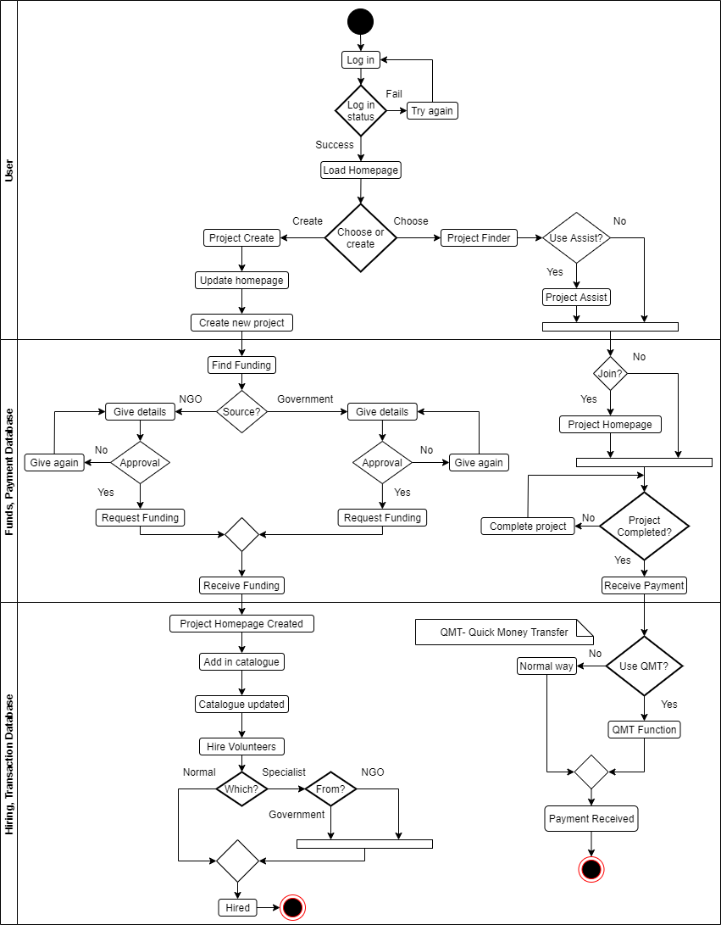
Activity
Diagram
12

Slide 13
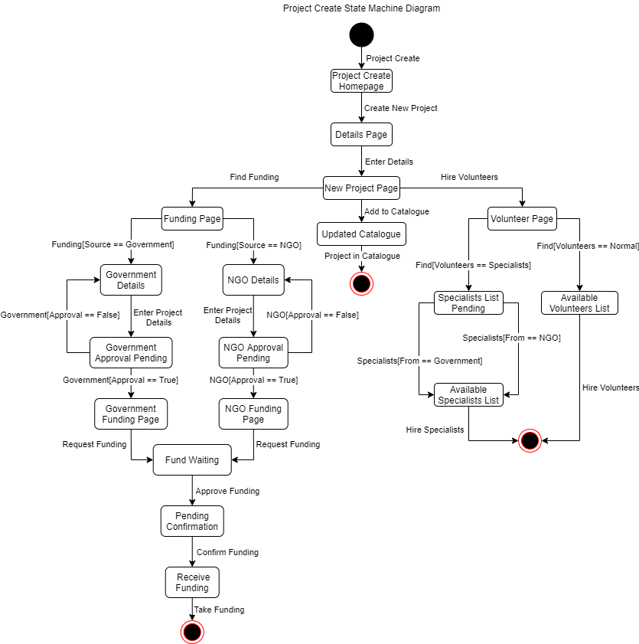
State Machine Diagram
13

Slide 14
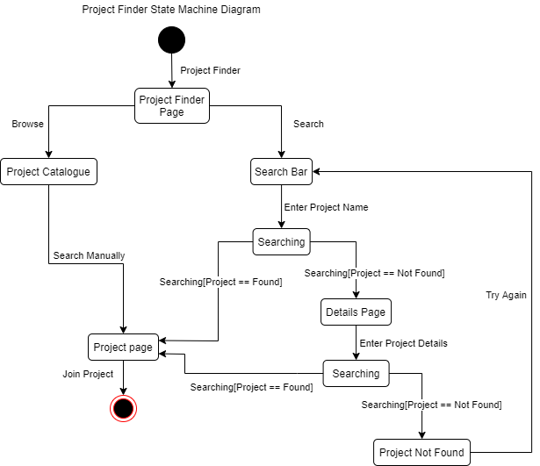
State Machine Diagram

Slide 15
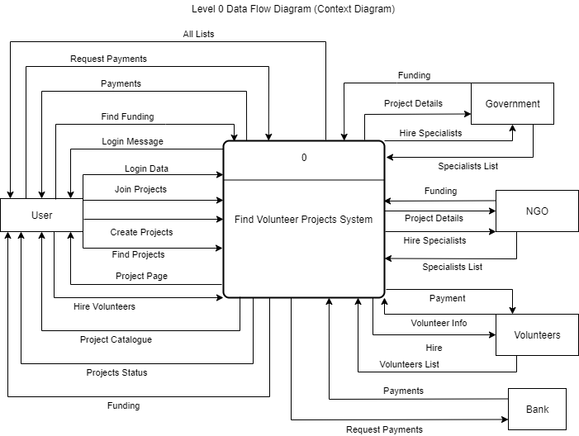
DFD Diagram
15

Slide 16
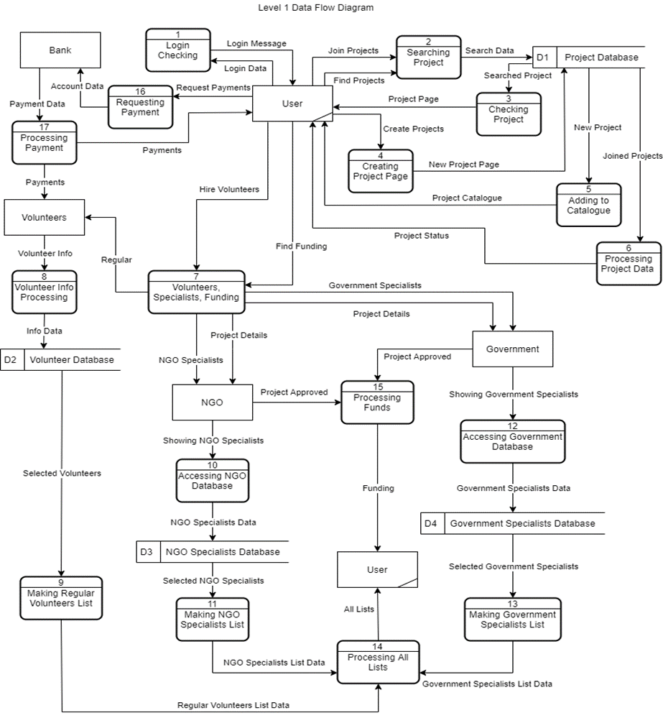
DFD Diagram

Slide 17
Summary and Conclusion
In summary:
We wanted to help people using the internet
We wanted to bring people together to solve problems
We wanted to change society for the better
We proposed a recruiting app similar to Facebook
We planned for the requirements
We made the system possible by using all forms of software analysis, like all the diagrams given above
In conclusion:
We believe in our mission to make society more better than it was before.
We want to bring positive change and show the world how social media can be a force for good. We want people to embrace teamwork and solve problems together as one. Finally, we all wish to be better problem solvers and helpers for our community.
17

