Slide 1
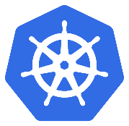




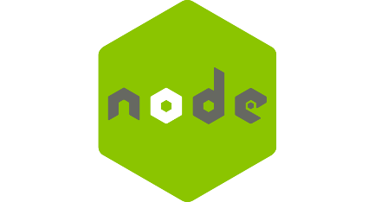

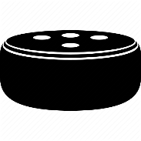
Kubernetes Cluster
Helm Chart
POST
Request
POST
Request
interacts
voice
Get/store
data

Slide 2
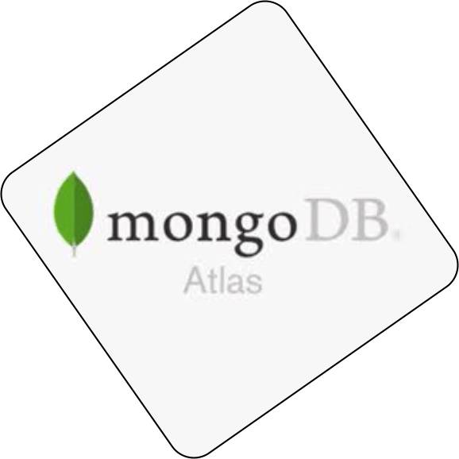
Kubernetes Cluster
Helm Chart
POST
Request
POST
Request
interacts
voice
Get/store data

