Slide 1

Python
Notes:
Explain about Miles

Slide 2

Looking Back
General Introduction
Language Syntax-
Identifiers
Naming rules
Reserved keywords
Comments
Python block Indentation
Python Data Types
Numbers
Strings
List
Tuples
Dictionary
Bool

Slide 3

Before we start- What programmers actually do?

Slide 4
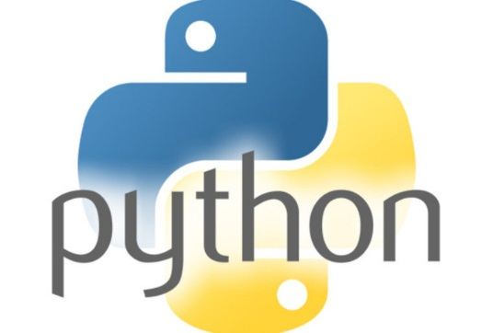
Input techniques
Inside every well-written large program is a well-written small program. -- Charles Antony Richard Hoare, computer scientist

Slide 5
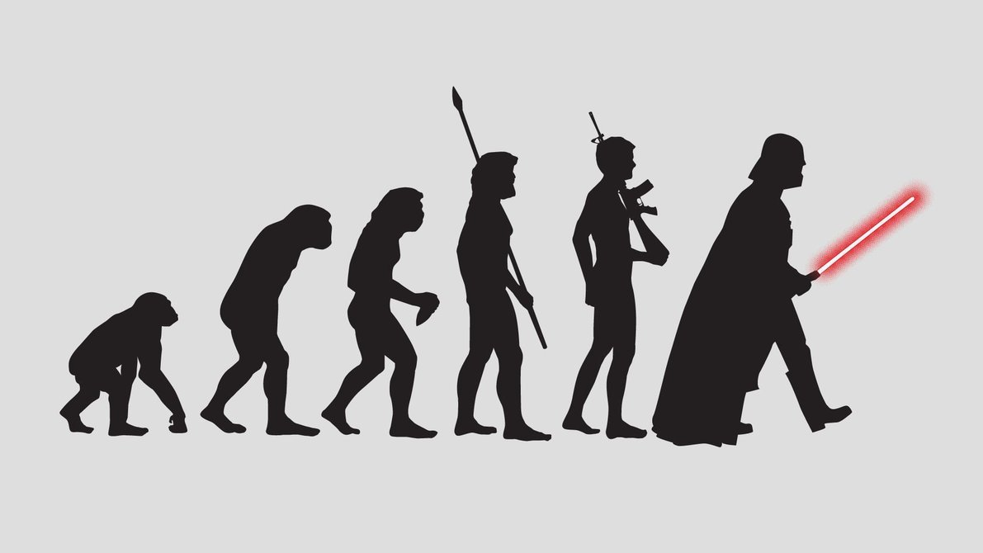
INPUT TECHNIQUES
Way to pass user defined input to a program.
Remember the scanf function in C?
That scanf evolved into input function in python.
The input(string) method returns a line of user input as a string.
The parameter is used as a prompt
The string can be converted by using the conversion methods int(string), float(string), etc.

Slide 6
INPUT TECHNIQUES
Try and Learn
print("What's your name?“)
name = input("> ")
print("What year were you born?“)
birthyear = int(input("> "))
print("Hi %s! You are %d years old!“
% (name, 2015 - birthyear))
Raw_input
Older version of the input function.

Slide 7
Decision Making
When a programming language is created that allows programmers to program in simple English, it will be discovered that programmers cannot speak English. -- unknown

Slide 8

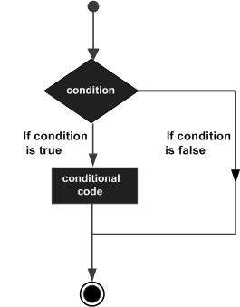
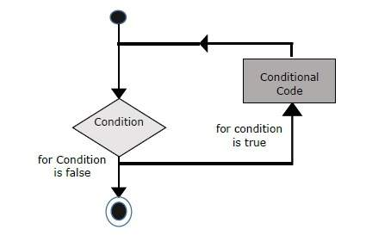
Decision Making & Looping
Decision making structures allow programmers to test one or more conditions and take actions accordingly.
if
elif
DO
WHILE
else
IF-ELSE
DO

Slide 9
Decision Making – IF-ELSE conditions
Try and Learn
var1 = int(input(">"))
if var1:
print("True")
else:
print("False")
Input 3 Values : 10,0, -1 and check the Output.
Hint : Python programming language assumes any non-zero and non-null values as TRUE, and any zero or null values as FALSE value.
Try and Learn
Design and develop a IT calculation system for a company, such that when employee salary is entered, the Income Tax is calculated. Income tax slabs as follows:-
Lower Limit(INR) | Upper Limit(INR) | Income Tax %
100,000 | 300,000 | 0%
300000 | 500,000 | 5%
500,000 | 100,000,0 | 10%
>1000000 |  | 20%
Notes:
Objects are instances of classes which follow certain rules.

Slide 10
Decision Making – IF-ELSE conditions
At runtime, you need to enter atleast 4 employee salaries in all the four income range.
EmpName | Salary(INR)
A | 10,000
B | 100,000
C | 3,99,000
D | 20,00,000
How do you do range test within an IF-ELSE condition?
Range() function is used to iterate through a loop , format being range(start,stop,seq).
Range test can also be done as follows if(a<=b<=c):
Range test can also be done as follows : if(a >= b and a <=c)
Notes:
Objects are instances of classes which follow certain rules.

Slide 11
Decision Making – WHILE & FOR LOOP
WHILE LOOP
While loop, repeats a statement or group of statements while a given condition is TRUE. It tests the condition before executing the loop body.
>>> count = 0
>>> while (count < 9):
print(count is:', count)
count ='The count + 1
FOR LOOP
Executes a sequence of statements multiple times and abbreviates the code that manages the loop variable.
for letter in 'Python': # First Example
print('Current Letter :', letter)
fruits = ['banana', 'apple', 'mango']
for fruit in fruits: # Second Example
print('Current fruit :', fruit)
Notes:
Objects are instances of classes which follow certain rules.

Slide 12
Decision Making –FOR LOOP
FOR LOOP(Contd)
Before we check out this example, we will take up the function range().
A lot of looping and decision making is done based on this function.
The built-in function range() is the right function to iterate over a sequence of numbers. It generates an iterator of arithmetic progressions.
range() generates an iterator to progress integers starting with 0 upto n-1. To obtain a list object of the sequence, it is typecasted to list(). Now this list can be iterated using the for statement.
Example :-
>>> range(5)
range(0, 5)
>>> list(range(5))
[0, 1, 2, 3, 4]
Try and learn
>>> fruits = ['banana', 'apple', 'mango']
>>> for i in range(len(fruits)):
print(fruits[i])

Slide 13
for i in range(10):
print("Nikanksh Jain")
for i in range(1,11):i<11
print(i)
for i in range(1,11,3): #1,4,7
if i==5:
break
print(i)
for i in ("apple"):
if i =="l":
break
print(i)

Slide 14
for i in range(1,21):
if i%5==0:
continue
print(i)
for i in range(1,21):
if i==1:
pass
else:
print(i)
PASS:
a = 33
b = 200
if b > a:
pass
2) pizza_name =2
if pizza_name ==2:
pass

Slide 15
Decision Making – MORE of LOOPS
Nested Loops:
Python programming language allows the usage of one loop inside another loop. The following section shows a few examples to illustrate the concept.
You can put any type of loop inside any other type of loop. For example a for loop can be inside a while loop or vice versa.
Try and learn:
# Program to implement Tables from 1 to 10:-
#Trying a Nested Loop. Printing Multiplication tables from 1 to 10
i = 0
j = 0
for i in range(1,11):#First Loop to input the Table
print("Starting Generating Table, for %d"%(i))
for j in range(1,11): #Second Loop to take the Multiplicants
print("%d X %d ="%(i,j),(i*j))

Slide 16
EXAMPLE 1:
Printing multiplication tables of 1 to 10 using nested for loop:
for i in range(1, 11):
for j in range(1, 11):
print(i*j,end=“\t”)
print()

Slide 17
Printing Star Pattern:
rows = 5
# outer loop
for i in range(1, rows + 1):
# inner loop
for j in range(1, i + 1):
print("*", end=" ")
print(' ')
OUTPUT:
*
* *
* * *
* * * *
* * * * *

Slide 18
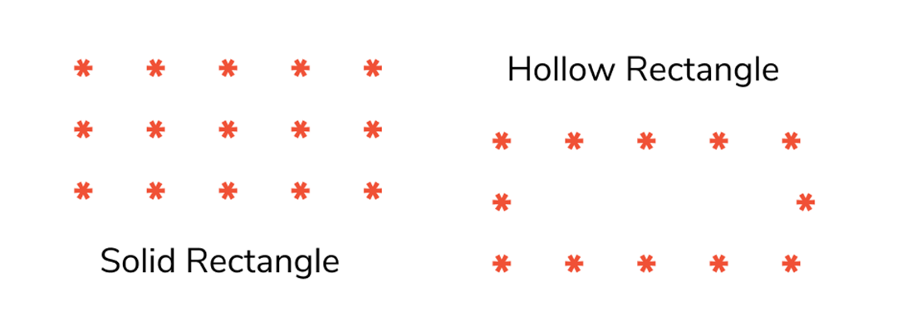
for i in range(3):
for j in range(5):
if(i==0 or i == 2 or j == 0 or j == 4):
print("*" , end=" ")
else:
print(" ", end=" ")
print()

Slide 19
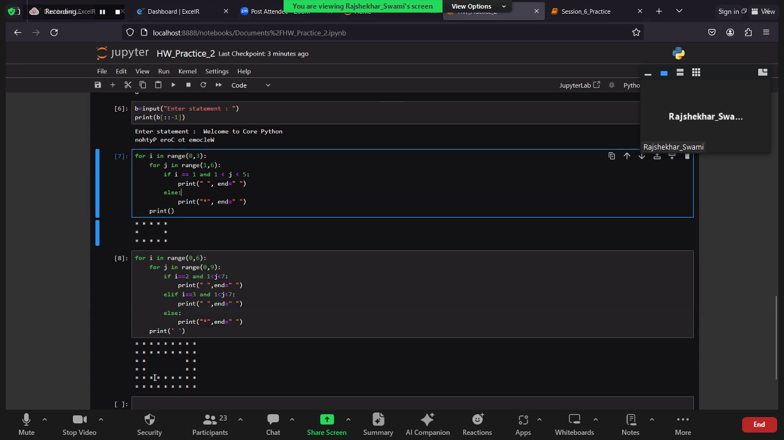

Slide 20
for i in range(3):
for j in range(5):
print("*" , end=" ")
print()

Slide 21
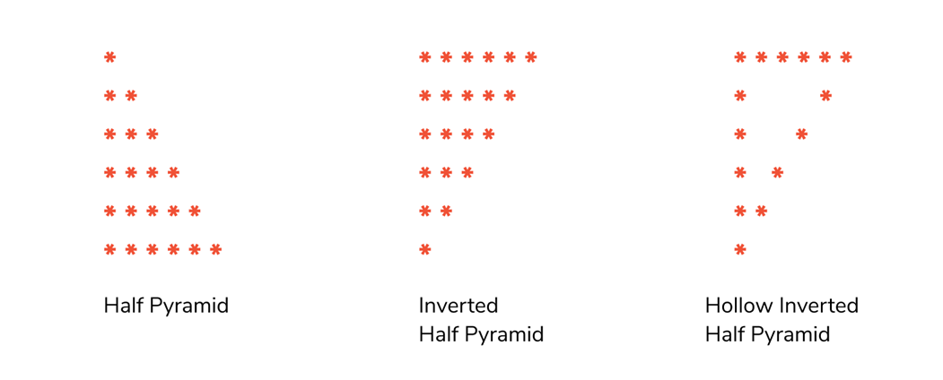
INVERTED HALF PYRAMID:
PROGRAM CODE:
for i in range(6):
for j in range(6-i):
print("*" , end=" ")
print()

Slide 22
PROGRAM CODE:
for i in range(6):
for j in range(6-i):
if ( i == 0 or i == 5 or j == 0 or j == 6-i-1):
print("*" , end=" ")
else :
print(" " , end = " ")
print()

Slide 23
With while loop
Initially, Outer loop test expression is evaluated only once.
When its return true, the flow of control jumps to the inner while loop. The inner while loop executes to completion. When the test expression is false, the flow of control comes out of inner while loop and executes again from the outer while loop only once. This flow of control persists until test expression of the outer loop is false.
If test expression of the outer loop is false, the flow of control skips the execution and goes to rest.

Slide 24
EXAMPLE :
Printing multiplication tables of 1 to 10 using nested while loop:
i=1
while i<=10:
j=1
while j<=10:
print (i*j,end="\t")
j+=1
i+=1
print ("\n")
OUTPUT:
1 2 3 4 5 6 7 8 9 10
2 4 6 8 10 12 14 16 18 20
3 6 9 12 15 18 21 24 27 30
4 8 12 16 20 24 28 32 36 40
5 10 15 20 25 30 35 40 45 50
6 12 18 24 30 36 42 48 54 60
7 14 21 28 35 42 49 56 63 70
8 16 24 32 40 48 56 64 72 80
9 18 27 36 45 54 63 72 81 90
10 20 30 40 50 60 70 80 90 100

Slide 25
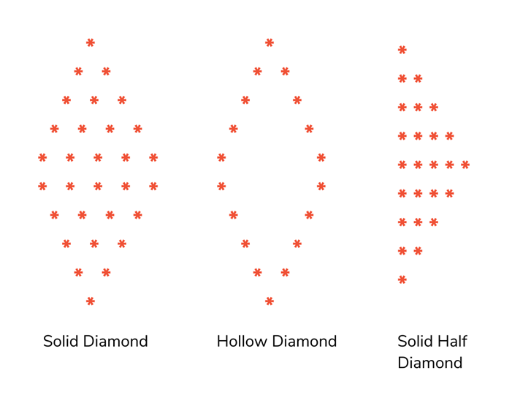
for i in range(5):
for j in range(5-i-1):
print(" " , end="")
for k in range(i+1):
print("*" , end=" ")
print( )
for i in range(5):
for j in range(i):
print(" " , end="")
for k in range(5-i):
print("*" , end=" ")
print( )

Slide 26
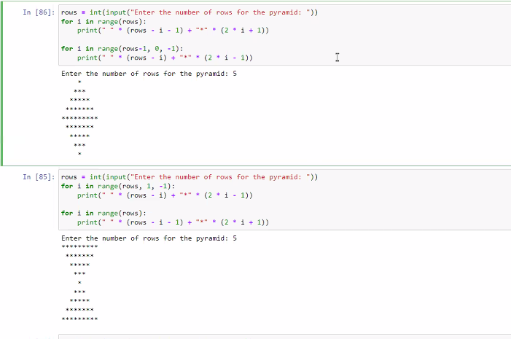
or

Slide 27
SOLID HALF DIAMOND:
PROGRAM CODE:
for i in range(6):
for j in range(i+1):
print("*" , end=" ")
print()
for i in range(5):
for j in range(5-i):
print("*" , end=" ")
print()

Slide 28

SNOOZE MODE

Slide 29
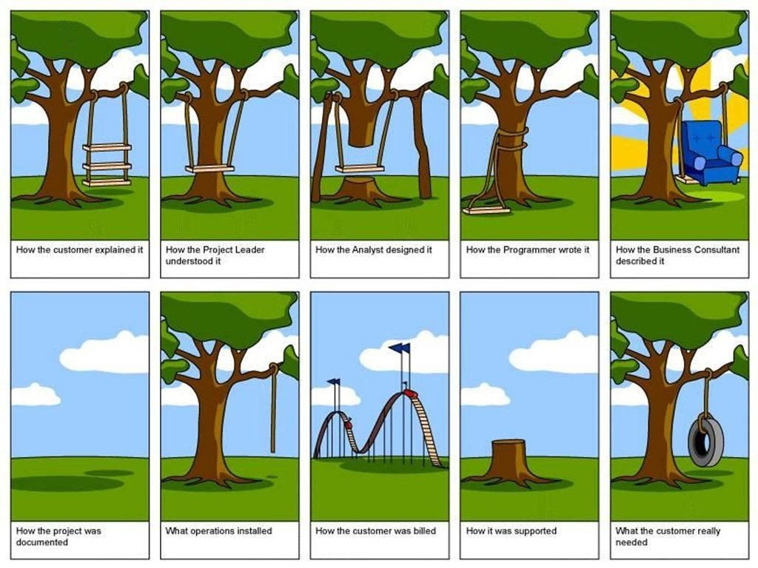
A Joke a Day, Keeps Boredom Away!!
Inside the World of Software Development

Slide 30
More Looping Techniques
Looping through Dictionaries
When looping through dictionaries, the key and corresponding value can be retrieved at the same time using the items() method.
>>> fruits= {’apple’: ’red’, ‘mango’: ’yellow’}
>>> for k, v in fruits.items():
... print(k, v) ... apple red mango yellow
Looping through multiple sequences
A quick look at the Zip function is needed to understand this section.
Zip function, Zips together two Sequences into a sort of Key/Value pair.
Try and Learn
>>> names = ['ben', 'chen', 'yaqin']
>>> names
['ben', 'chen', 'yaqin']
>>> gender = [0, 0, 1]
`

Slide 31

More Looping Techniques
>>> name_age = list(zip(names,gender))
>>> name_age
[('ben', 0), ('chen', 0), ('yaqin', 1)]
>>> name_age = tuple(zip(names,gender))
>>> name_age
(('ben', 0), ('chen', 0), ('yaqin', 1))
>>> name_age = dict(zip(names,gender))
>>> name_age
{'ben': 0, 'chen': 0, 'yaqin': 1}
Can you explain what happened in each of these cases?

Slide 32
More Looping Techniques
Now, how do we loop through such multiple sequences, obtained as part of zip?
Try and Learn
>>> name_age = zip(names,gender)
>>> name_age
<zip object at 0x0231DEE0>
>>> for i,j in name_age:
print(i,j)
ben 0
chen 0
yaqin 1

Slide 33
Loop control Techniques
The Loop control statements change the execution from its normal sequence. When the execution leaves a scope, all automatic objects that were created in that scope are destroyed.
Python supports the following control statements:-
Break: Terminates the loop statement and transfers execution to the statement immediately following the loop.
Continue : Causes the loop to skip the remainder of its body and immediately retest its condition prior to reiterating.
Pass : The pass statement is a null operation; nothing happens when it executes. The pass statement is also useful in places where your code will eventually go, but has not been written yet i.e. in stubs.
Example of pass statement:
for letter in 'Python':
if letter == 'h':
pass
print('This is pass block‘)
print('Current Letter :', letter)

Slide 34
Loop control Techniques
Iterator :
Iterator is an object which allows a programmer to traverse through all the elements of a collection, regardless of its specific implementation. In Python, an iterator object implements two methods, iter() and next().
String, List or Tuple objects can be used to create an Iterator.
list = [1,2,3,4]
it = iter(list) # this builds an iterator object
print (next(it)) #prints next available element in iterator
Iterator object can be traversed using regular for statement
for x in it:
print (x, end=" ")
or using next() function
while True:
try:
print (next(it))
except StopIteration:
sys.exit() #you have to import sys module for this

Slide 35
Loop control Techniques
Generator :
A generator is a function that produces or yields a sequence of values using yield method.
When a generator function is called, it returns a generator object without even beginning execution of the function. When the next() method is called for the first time, the function starts executing until it reaches the yield statement, which returns the yielded value. The yield keeps track i.e. remembers the last execution and the second next() call continues from previous value.
Saves a lot of memory in the process

Slide 36
Loop control Techniques
Generator :
Example
The following example defines a generator, which generates square numbers
>>> def square_numbers(nums):
for i in nums:
yield (i*i)
>>> my_nums = square_numbers([1,2,3,4,5])
>>> type(my_nums)
<class 'generator'>
>>> next(my_nums)
1

Slide 37
PYTHON LOOPING CONCEPTS
Stimulants

Slide 38
What is the output of the following?
x = ['ab', 'cd']
for i in x:
x.append(i.upper())
print(x)
a) [‘AB’, ‘CD’].
b) [‘ab’, ‘cd’, ‘AB’, ‘CD’].
c) [‘ab’, ‘cd’].
d) none of the mentioned
2. What is the output of the following?
i = 1
while True:
if i%3 == 0:
break
print(i)
i = i+1
a) 1 2
b) 1 2 3
c) error
d) none of the mentioned

Slide 39
3. What is the output of the following?
i = 2
while True:
if i%3 == 0:
break
print(i)
i = i + 2
a) 2 4 6 8 10 …
b) 2 4
c) 2 3
d) Error
4. What is the output of the following?
x = "abcdef"
i = "i"
while i in x:
print(i, end=" ")
a) no output
b) i i i i i i …
c) a b c d e f
d) abcdef

Slide 40
5. What does print(i) return in the following?
x = 'abcd'
for i in x:
print(i)
x.upper()
a) a B C D
b) a b c d
c) A B C D
d) error
6. What is the output of the following?
x = 'abcd'
for i in range(x):
print(i)
a) a b c d
b) 0 1 2 3
c) error
d) none of the mentioned

Slide 41
7. What will be the output of the below :
for i in range(float('inf')):
print (i)
a) 0.0 0.1 0.2 0.3 …
b) 0 1 2 3 …
c) 0.0 1.0 2.0 3.0 …
d) none of the mentioned
8. What is the output of the following?
x = 'abcd'
for i in range(x):
print(i)
a) a b c d
b) 0 1 2 3
c) error
d) none of the mentioned

Slide 42
1. An online essay writing competition was held in a school. The students were required to write at least 250 words. According to the rule, only that essay should be checked which contains at least 250 words. Teachers were just guessing the number of words in the essay but that was not an accurate way to count the number of words. So write a program that can count the number of words in an essay ( Hint: Take input and count the number of words using for loop)
Note: to count the number of words you can just count the number of blank spaces given in the input.
2 .Shubh forgot to complete his computer science homework. His teacher got angry and told him to type “I will complete my homework” 100 times as punishment. To help Shubh write a python program that can print this statement 100 times using loops.

Slide 43
3. A computer teacher in a school wanted to take rest and that’s why he told students to calculate the sum of the first 1000 numbers. Even students were allowed to use a calculator, still it will take at least 15 minutes to add all the numbers. Sonali used python and she was able to answer the question within 2 minutes. Write a code in python same as Sonali.
4. A teacher gave a challenge to all the students in a class. He said to create a word that contains vowels. The student who will write a meaningful word with the maximum number of vowels present in it will win the challenge. There were around 30 students in the class and each student was trying to create the word multiple times. So Subh decided to create a python program that can take words as input and can print the number of vowels present in the word. But Shubh doesn’t know how to use for loop in python. Help Shubh to create a program that can print the number of vowels present in the word.

Slide 44
FUNCTIONS
"To err is human, but to really foul things up you need a computer." (Paul R. Ehrlich)

Slide 45
Function is a group of related statements that performs a specific task.
It helps to break our program into smaller and modular chunks.
It makes the code more organized and manageable.
It avoids repetition and makes the code reusable.

Slide 47
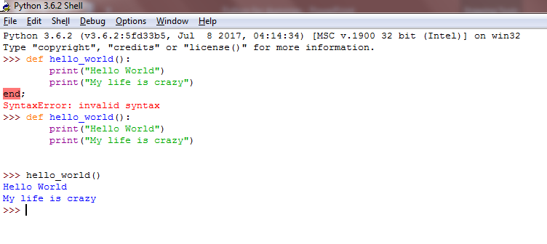
What is a Function?
Lets try writing a function and calling it. We will get to understand a function first hand , by writing it.
As the above example proves, a function is thus a group of statements clubbed together , reusable and used to perform a specific task.
Function begins with a keyword def(remember reserved keywords in the previous sections?? ) and are enclosed with parantheses() and a :

Slide 48
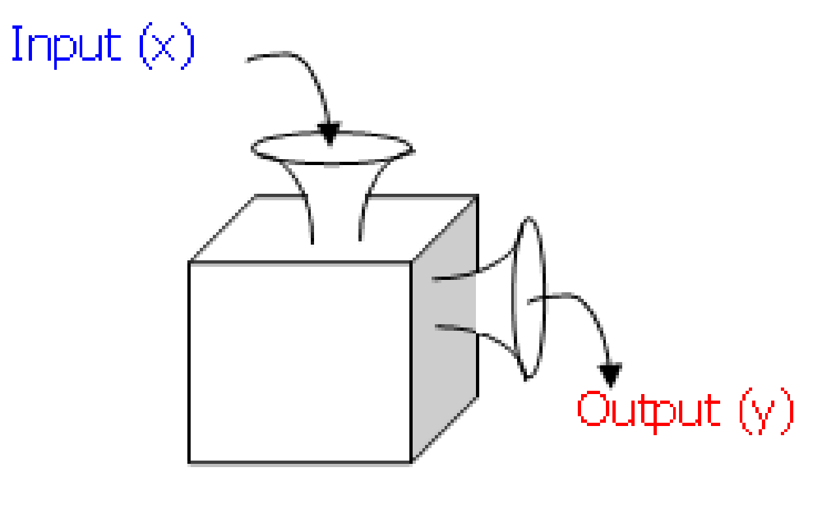
What is a Function?

Slide 49
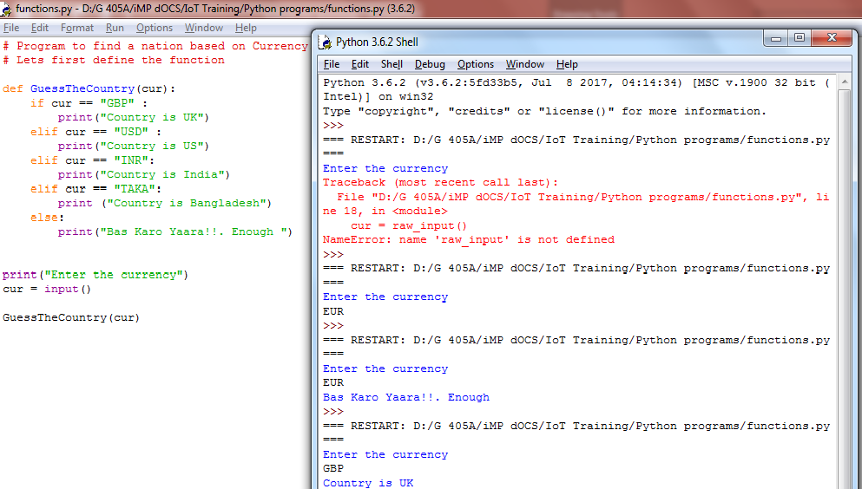
What is a Function?

Slide 50
What is a Function?
Why did we do all this? Just to show how functions “function”, how we can pass certain inputs , and then invoke a function.
Defining a function only gives it a name, specifies the parameters that are to be included in the function and structures the blocks of code.
Once the basic structure of a function is finalized, you can execute it by calling it from another function or directly from the Python prompt.
You can call it again and again. You pass inputs to a function by means of passing by reference or by values. We will come to these details shortly. Quick few more points.
Any input parameters or arguments should be placed within these parentheses.
A function can also invoke another function from within it.
A function can also return back values.(more of it in the next few pages).
The statement return [expression] exits a function, optionally passing back an expression to the caller. A return statement with no arguments is the same as return None.

Slide 51
Calling a function
Defining a function only gives it a name, specifies the parameters that are to be included in the function and structures the blocks of code.
Once the basic structure of a function is finalized, you can execute it by calling it from another function or directly from the Python prompt.
# Function definition is here
def printme( str ):
print(str)
return
# Now you can call printme function
printme("I'm first call to user defined function!")
printme("Again second call to the same function")

Slide 52
Pass by ref Vs Pass by reference
All parameters in the Python language are passed by reference. Any change within a function also reflects back in the calling function.
Example of pass by reference:
>>> l =[1,2,3]
>>> def changeList(list):
print(id(list))
list = list.append('A')
return
>>> l
[1, 2, 3]
>>> id(l)
38227080
>>> changeList(l)
38227080
>>> l
[1, 2, 3, ‘A’]
https://www.youtube.com/watch?v=kjSWIriDe9A
https://www.youtube.com/watch?v=hXqsGlWyhL8
Notes:
Let's assume, we are passing a list to a function. We expect that the function is not changing this list. First let's have a look at a function which has no side effects. As a new list is assigned to the parameter list in func1(), a new memory location is created for list and list becomes a local variable.>>> def func1(list): ... print list ... list = [47,11] ... print list ... >>> fib = [0,1,1,2,3,5,8] >>> func1(fib) [0, 1, 1, 2, 3, 5, 8] [47, 11] >>> print fib [0, 1, 1, 2, 3, 5, 8] >>> This changes drastically, if we include something in the list by using +=. To show this, we have a different function func2() in the following example:>>> def func2(list): ... print list ... list += [47,11] ... print list ... >>> fib = [0,1,1,2,3,5,8] >>> func2(fib) [0, 1, 1, 2, 3, 5, 8] [0, 1, 1, 2, 3, 5, 8, 47, 11] >>> print fib [0, 1, 1, 2, 3, 5, 8, 47, 11] >>>

Slide 53
Example 1: Call by Value in Python
In this example, the Python code demonstrates call by value behavior. Despite passing the string variable “Tata” to the function, the local modification inside the function does not alter the original variable outside its scope, emphasizing the immutability of strings in Python.
string = "Tata"
def test(string):
string = "I love Tata"
print("Inside Function:", string)
# Driver's code
test(string)
print("Outside Function:", string)

Slide 54
Example 2: Call by Reference in Python
In this example, the Python code illustrates call by reference behavior. The function add_more() modifies the original list mylist by appending an element, showcasing how changes made inside the function persist outside its scope, emphasizing the mutable nature of lists in Python.
def add_more(list):
list.append(50)
print("Inside Function", list)
# Driver's code
mylist = [10, 20, 30, 40]
add_more(mylist)
print("Outside Function:", mylist)

Slide 55
Keyword Arguments
Keyword arguments are related to the function calls. When you use keyword arguments in a function call, the caller identifies the arguments by the parameter name.
This allows you to skip arguments or place them out of order because the Python interpreter is able to use the keywords provided to match the values with parameters. You can also make keyword calls to the printme() function in the following ways −
Try and Learn:
def printinfo( name, age ):
"This prints a passed info into this function"
print ("Name: ", name)
print ("Age ", age)
return
# Now you can call printinfo function
printinfo( age = 50, name = "miki" )

Slide 56
Default Arguments
A default argument is an argument that assumes a default value if a value is not provided in the function call for that argument. The following example gives an idea on default arguments, it prints default age if it is not passed −
Try and Learn
def printinfo( name, age = 35 ):
"This prints a passed info into this function"
print ("Name: ", name)
print ("Age ", age)
return
# Now you can call printinfo function
printinfo( age = 50, name = "miki" )
printinfo( name = "miki" )

Slide 57
Variable Arguments
User may need to process a function for more arguments than specified while defining the function. They are called variable-length arguments
An asterisk (*) is placed before the variable name that holds the values of all non-keyword variable arguments. This tuple remains empty if no additional arguments are specified during the function call.
# function definition
def print_student_marks( name, *student_marks):
print(name)
for marks in student_marks:
print(marks)
# function invocation
print_student_marks(‘xyz’, 90,80,70)
print_student_marks(‘abc’, 90, 88)

Slide 58
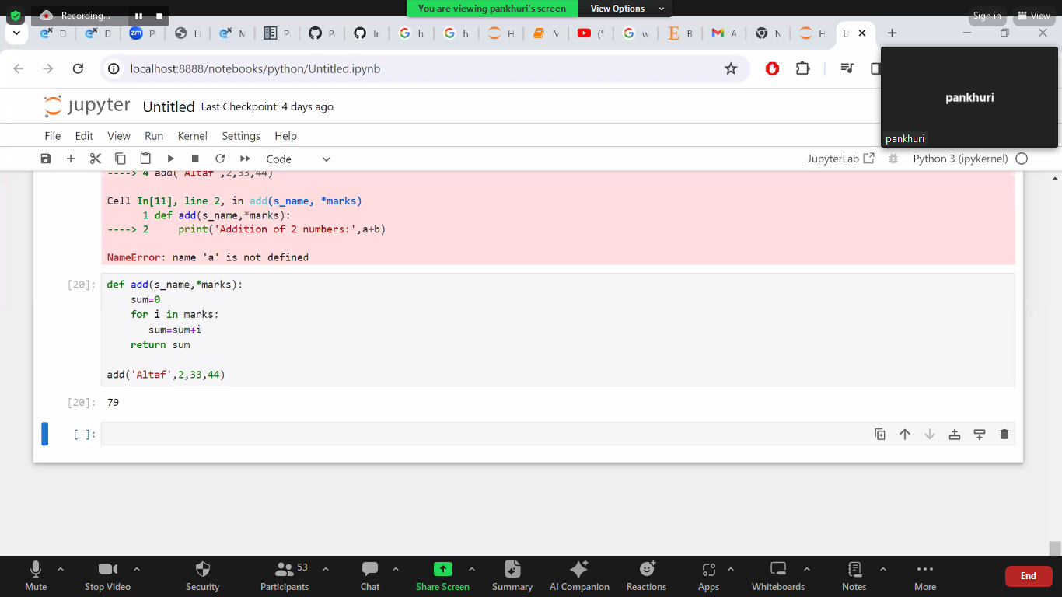

Slide 59
Anonymous Functions
You can use the lambda keyword to create small anonymous functions. These functions are called anonymous because they are not declared in the standard manner by using the def keyword.
Lambda forms can take any number of arguments but return just one value in the form of an expression. They cannot contain commands or multiple expressions.
An anonymous function cannot be a direct call to print because lambda requires an expression.
Lambda functions have their own local namespace and cannot access variables other than those in their parameter list and those in the global namespace.
Although it appears that lambda's are a one-line version of a function, they are not equivalent to inline statements in C or C++, whose purpose is by passing function stack allocation during invocation for performance reasons.

Slide 60
Anonymous Functions
Syntax:
lambda [arg1 [,arg2,.....argn]]:expression
Example:
# Function definition is here
sum = lambda arg1, arg2: arg1 + arg2
# Now you can call sum as a function
print("Value of total : ", sum( 10, 20 ))
print("Value of total : ", sum( 20, 20 ))
1)x = lambda a : a + 10 print(x(5))
2) x = lambda a, b : a * b print(x(5, 6))
3) Use that function definition to make a function that always doubles the number you send in:
def myfunc(n):
return lambda a : a * n
mydoubler = myfunc(2)
print(mydoubler(11))
4) Or, use the same function definition to make both functions, in the same program:
def myfunc(n):
return lambda a : a * n
mydoubler = myfunc(2)
mytripler = myfunc(3)
print(mydoubler(11))
print(mytripler(11))

Slide 61
Return statement
Syntax:
The statement return [expression] exits a function, optionally passing back an expression to the caller. A return statement with no arguments is the same as return None.
Try and learn :-
Write a function which takes the length and breath of a rectangle and returns the area.

Slide 62
Scope of variables
All variables in a program may not be accessible at all locations in that program. This depends on where you have declared a variable.
The scope of a variable determines the portion of the program where you can access a particular identifier. There are two basic scopes of variables in Python −
Global variables : Variables defined outside all functions are global
Local variables : Variables defined in a function are local and cannot be accessed outside it
Therefore same names can be used for local and global variables. Local variable shadows global variable.

Slide 63
Global variable Vs Local variable
Try and learn:
a = 99 # Global variable
def func():
a= 88#Local variable
print(a)
func()
print(a)
a=99
def fun():
global a
a=88
print(a)#88
fun()
print(a)#99
Invoking a global variable inside a function:
To access a global variable inside a function, use the statement global <<Variable Name>>.
Try and learn:
Try the above example again, only make sure that this time the value of “a” is same as the global a

Slide 64
MAP()
The map() function applies a given function to each item of an iterable (list, tuple etc.) and returns a list of the results.
The syntax of map() function is:
map() Parameters
function - map() passes each item of the iterable to this function.
iterable iterable which is to be mapped
We can pass multiple iterable to the map() function.
Return Value from map()
The map() function applies a given to function to each item of an iterable and returns a list of the results.
The returned value from map() (map object) then can be passed to functions like list() (to create a list), set() (to create a set) and so on.
map(function, iterable)

Slide 65
EXAMPLE OF MAP()
How map() works
def calculateSquare(n):
return n*n
numbers = (1, 2, 3, 4)
result = map(calculateSquare, numbers)
print(result)
# converting map object to list
numbersSquare = list(result)
print(numbersSquare)
Result :
<map object at 0x7f722da129e8>
[16, 1, 4, 9]
Using Lambda function with map()
numbers = (1, 2, 3, 4)
result = map(lambda x: x*x, numbers)
print(result)
# converting map object to set
numbersSquare = list(result)
print(numbersSquare)
Result :
<map object at 0x7f722da129e8>
[16, 1, 4, 9]

Slide 66
EXAMPLE OF MAP()
Passing multiple iterators to map()
In this example, corresponding items of two lists are added.
num1 = [4, 5, 6]
num2 = [5, 6, 7]
result = map(lambda n1, n2: n1+n2, num1, num2)
print(list(result))
Result :
[9, 11, 13]

Slide 67
FILTER()
The filter() function constructs an iterator from elements of an iterable for which a function returns true.
In simple words, the filter() method filters the given iterable with the help of a function that tests each element in the iterable to be true or not.
The syntax of filter() method is:
filter() Parameters
The filter() method takes two parameters:
function - function that tests if elements of an iterable returns true or false
If None, the function defaults to Identity function - which returns false if any elements are false
iterable - iterable which is to be filtered, could be sets, lists, tuples, or containers of any iterators
filter(function, iterable)

Slide 68
FILTER()
Return Value from filter()
The filter() method returns an iterator that passed the function check for each element in the iterable.
The filter() method is equivalent to:
# when function is defined
(element for element in iterable if function(element))
# when function is None
(element for element in iterable if element)
ages = [5, 12, 17, 18, 24, 32] def myFunc(x):
if x < 18:
return False
else:
return True
adults = filter(myFunc, ages)
for x in adults:
print(x)
https://www.w3schools.com/python/ref_func_filter.asp

Slide 69
Reduce()
The reduce(fun,seq) function is used to apply a particular function passed in its argument to all of the list elements mentioned in the sequence passed along.This function is defined in “functools” module.
Working :
At first step, first two elements of sequence are picked and the result is obtained.
Next step is to apply the same function to the previously attained result and the number just succeeding the second element and the result is again stored.
This process continues till no more elements are left in the container.
The final returned result is returned and printed on console.
import functools # initializing list lis = [1, 3, 5, 6, 2] # using reduce to compute sum of list print("The sum of the list elements is : ", end="") print(functools.reduce(lambda a, b: a+b, lis)) # using reduce to compute maximum element from list print("The maximum element of the list is : ", end="") print(functools.reduce(lambda a, b: a if a > b else b, lis))
OutputThe sum of the list elements is : 17 The maximum element of the list is : 6

Slide 70
Reduce()
Reduce()
from functools import reduce
>>> nums = (1,2,3,4,5,6)
>>> sum = reduce(lambda a,b: a+b, nums)
>>> sum
21

Slide 71
SHALLOW COPY VS DEEP COPY OF OBJECTS
Assignment statements in Python do not create copies of objects, they only bind names to an object. For immutable objects, that usually doesn’t make a difference.
But for working with mutable objects or collections of mutable objects, you might be looking for a way to create “real copies” or “clones” of these objects.
Essentially, you’ll sometimes want copies that you can modify without automatically modifying the original at the same time. In this article I’m going to give you the rundown on how to copy or “clone” objects in Python 3 and some of the caveats involved.

Slide 72
SHALLOW COPY VS DEEP COPY OF OBJECTS
Let’s start by looking at how to copy Python’s built-in collections. Python’s built-in mutable collections like lists, dicts, and sets can be copied by calling their factory functions on an existing collection:
new_list = list(original_list)
new_dict = dict(original_dict)
new_set = set(original_set)
However, this method won’t work for custom objects and, on top of that, it only creates shallow copies. For compound objects like lists, dicts, and sets, there’s an important difference between shallow and deep copying:
A shallow copy means constructing a new collection object and then populating it with references to the child objects found in the original. In essence, a shallow copy is only one level deep. The copying process does not recurse and therefore won’t create copies of the child objects themselves.
A deep copy makes the copying process recursive. It means first constructing a new collection object and then recursively populating it with copies of the child objects found in the original. Copying an object this way walks the whole object tree to create a fully independent clone of the original object and all of its children.

Slide 73
SHALLOW COPY VS DEEP COPY OF OBJECTS
Let’s look at some examples to drive home this difference between deep and shallow copies.
Making Shallow Copies :
In the example below, we’ll create a new nested list and then shallowly copy it with the list() factory function:
>>> xs = [[1, 2, 3], [4, 5, 6], [7, 8, 9]]
>>> ys = list(xs) # Make a shallow copy
This means ys will now be a new and independent object with the same contents as xs. You can verify this by inspecting both objects:
>>> xs
[[1, 2, 3], [4, 5, 6], [7, 8, 9]]
>>> ys
[[1, 2, 3], [4, 5, 6], [7, 8, 9]]
To confirm ys really is independent from the original, let’s devise a little experiment. You could try and add a new sublist to the original (xs) and then check to make sure this modification didn’t affect the copy (ys):

Slide 74
SHALLOW COPY VS DEEP COPY OF OBJECTS
>>> xs.append(['new sublist'])
>>> xs
[[1, 2, 3], [4, 5, 6], [7, 8, 9], ['new sublist']]
>>> ys
[[1, 2, 3], [4, 5, 6], [7, 8, 9]]
As you can see, this had the expected effect. Modifying the copied list at a “superficial” level was no problem at all.
However, because we only created a shallow copy of the original list, ys still contains references to the original child objects stored in xs.
These children were not copied. They were merely referenced again in the copied list.
Therefore, when you modify one of the child objects in xs, this modification will be reflected in ys as well—that’s because both lists share the same child objects. The copy is only a shallow, one level deep copy:

Slide 75
SHALLOW COPY VS DEEP COPY OF OBJECTS
>>> xs[1][0] = 'X'
>>> xs
[[1, 2, 3], ['X', 5, 6], [7, 8, 9], ['new sublist']]
>>> ys
[[1, 2, 3], ['X', 5, 6], [7, 8, 9]]
In the above example we (seemingly) only made a change to xs. But it turns out that both sublists at index 1 in xs and ys were modified. Again, this happened because we had only created a shallow copy of the original list.
Had we created a deep copy of xs in the first step, both objects would’ve been fully independent. This is the practical difference between shallow and deep copies of objects.
Now you know how to create shallow copies of some of the built-in collection classes, and you know the difference between shallow and deep copying. The questions we still want answers for are:
How can you create deep copies of built-in collections?
How can you create copies (shallow and deep) of arbitrary objects, including custom classes?
The answer to these questions lies in the copy module in the Python standard library. This module provides a simple interface for creating shallow and deep copies of arbitrary Python objects.

Slide 76
SHALLOW COPY VS DEEP COPY OF OBJECTS
Making Deep Copies :
Let’s repeat the previous list-copying example, but with one important difference. This time we’re going to create a deep copy using the deepcopy() function defined in the copy module instead:
>>> import copy
>>> xs = [[1, 2, 3], [4, 5, 6], [7, 8, 9]]
>>> zs = copy.deepcopy(xs)
When you inspect xs and its clone zs that we created with copy.deepcopy(), you’ll see that they both look identical again—just like in the previous example:
>>> xs
[[1, 2, 3], [4, 5, 6], [7, 8, 9]]
>>> zs
[[1, 2, 3], [4, 5, 6], [7, 8, 9]]
However, if you make a modification to one of the child objects in the original object (xs), you’ll see that this modification won’t affect the deep copy (zs).

Slide 77
SHALLOW COPY VS DEEP COPY OF OBJECTS
Both objects, the original and the copy, are fully independent this time. xs was cloned recursively, including all of its child objects:
>>> xs[1][0] = 'X'
>>> xs
[[1, 2, 3], ['X', 5, 6], [7, 8, 9]]
>>> zs
[[1, 2, 3], [4, 5, 6], [7, 8, 9]]

Slide 78
Stimulants

Slide 79
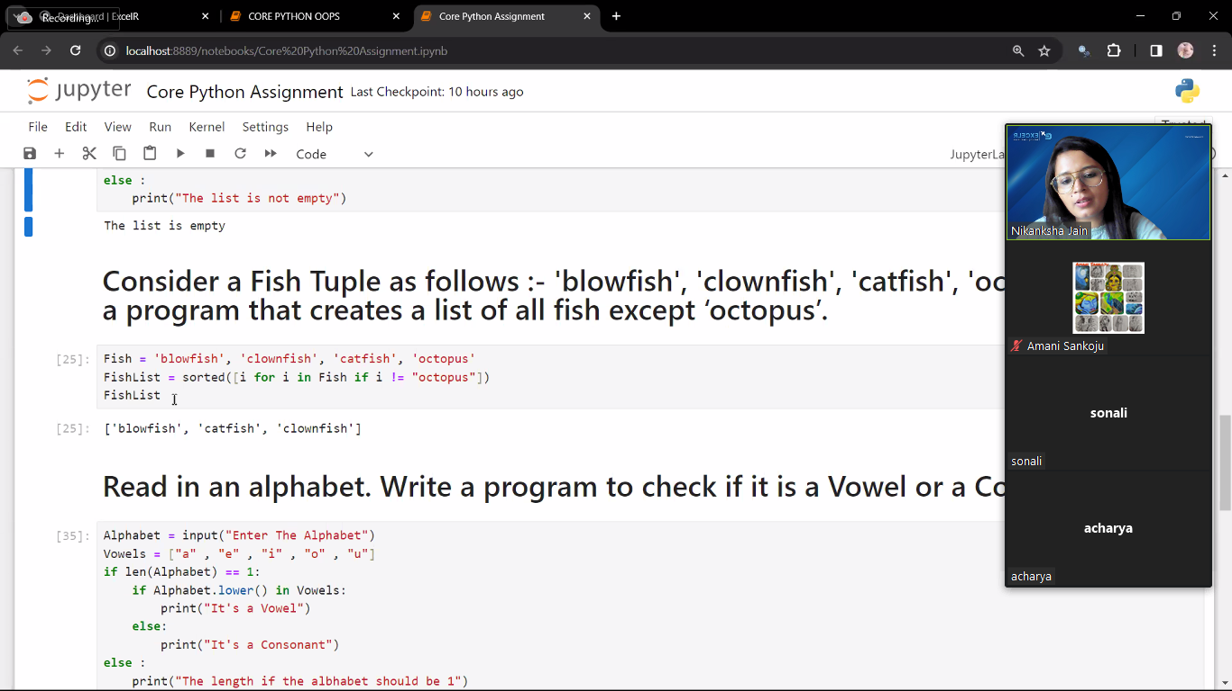
Write a Python program to check if a list is empty (Hint : Try using a Lambda Function)
Consider a Fish Tuple as follows :- 'blowfish', 'clownfish', 'catfish', 'octopus‘. Write a program that creates a list of all fish except ‘octopus’.
Read in an alphabet. Write a program to check if it is a Vowel or a Consonant.
Write a Python program to construct the following pattern, using a nested loop number.
1
2 2
3 3 3
4 4 4 4
5. What does the following lines of code do?
A0 = dict(zip(('a','b','c','d','e'),(1,2,3,4,5)))
A1 = range(10)
A2 = sorted([i for i in A1 if i in A0])
A3 = sorted([A0[s] for s in A0])
A4 = [i for i in A1 if i in A3]
A5 = {i:i*i for i in A1}
A6 = [[i,i*i] for i in A1]

Slide 80
1)my_list = []
if not my_list:
print("the list is empty")
or
my_list = []
if not len(my_list):
print("the list is empty")
3)def vowelOrConsonant(x):
if (x == 'a' or x == 'e' or x == 'i' or
x == 'o' or x == 'u' or x == 'A' or
x == 'E' or x == 'I' or x == 'O' or
x == 'U'):
print("Vowel")
else:
print("Consonant")
vowelOrConsonant('c')
vowelOrConsonant('E')

Slide 81
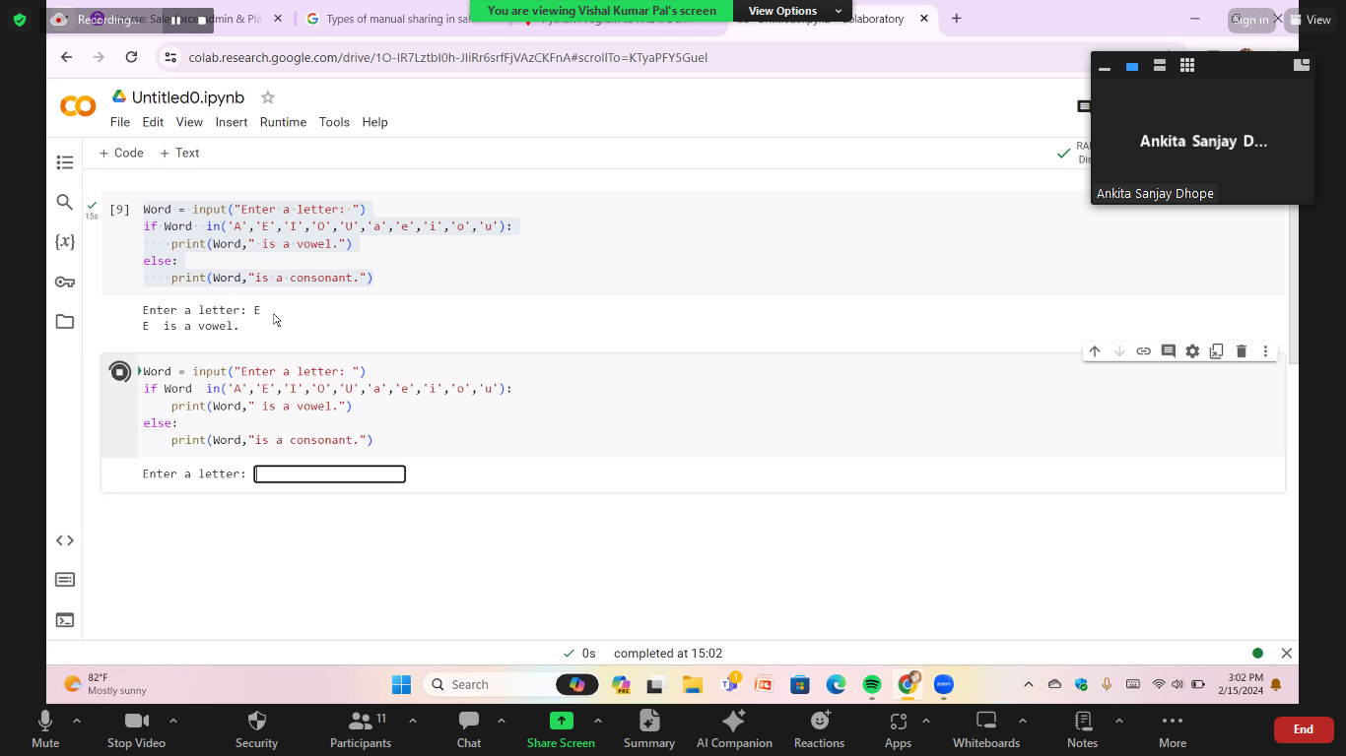

Slide 82
6. Which are the advantages of functions in python?
a) Reducing duplication of code
b) Decomposing complex problems into simpler pieces
c) Improving clarity of the code
d) All of the mentioned
7. What is the output of the below program?
x = 50
def func():
global x
print('x is', x)
x = 2
print('Changed global x to', x)
func()
print('Value of x is', x)
a) x is 50
Changed global x to 2
Value of x is 50
b) x is 50
Changed global x to 2
Value of x is 2
c) x is 50
Changed global x to 50
Value of x is 50
d) None of the mentioned

Slide 83
8. What is the output of below program?
def say(message, times = 1):
print(message * times)
say('Hello')
say('World', 5)
a) Hello
WorldWorldWorldWorldWorld
b) Hello
World 5
c) Hello
World,World,World,World,World
d) Hello
9. Where can a function be defined?
a) Module
b) Class
c) Another function
d) All of the mentioned

