Slide 1
Javascript

Slide 2
Table of Contents
Introduction
Usage
Output
Syntax
Operators
Data Types
If Else
Loops

Slide 3
Introduction
Most Popular Programming Language
JS frameworks i.e Node JS, ReactJS is highly in demand in industry
Used mainly for front end validation and more powerful than html and css
Other usage includes HTML5 Gaming, Animations , API calling e.t.c

Slide 4
How to use
Create any html file
Open in text editor
Use <script> </script> tag to write JS code (just like you use <style> tag to write css in between)
Note: Every statement (Apart from few) must ends with “;” in javascript similar to c++ otherwise your js code will not run properly.

Slide 5
How to use
1) In between script tag write document.write(“This is my first javascript program”)
<html>
<body>
<script>
document.write("This is my first Javascript
program");
Document.write is builtin javascript function which acts similar to cout in c++. It prints the data in html
</script>
</body>
</html>

Slide 6
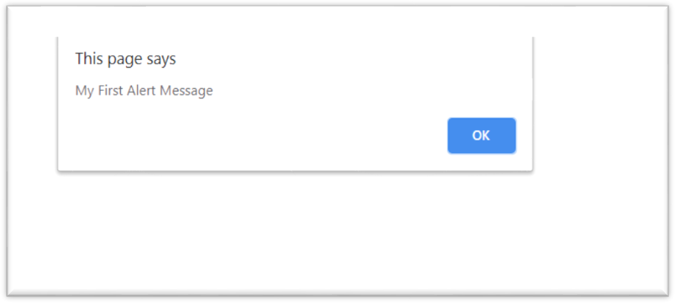
Output using alert()
<html>
<body>
<script>
alert("Hello! I am an alert box!");
</script>
</body>
</html>
alert() is builtin javascript function which outputs the data in form of popup message. It is commonly used for alert messages or for debug purposes

Slide 7
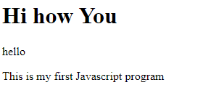
Output using document.write()
<!DOCTYPE html>
<head>
</head>
<html>
<body>
<h1>Hi how You </h1>
<p> hello </p>
</body>
<script>
document.write("This is my first Javascript program"); </script> </html>

Slide 8
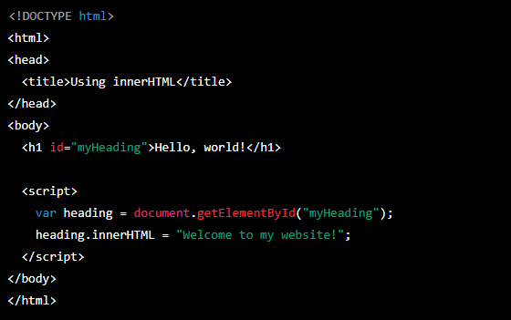
Output using document.getelementbyid().innerhtml
In this example, document.getElementById() method is used to retrieve the <h1> element with the id attribute of "myHeading". The .innerHTML property is then used to set the content of the element to "Welcome to my website!".

Slide 9

Basic Syntax
Every statement other then if,else,while,switch will end with semicolon “;”
You don’t mention data types with variables i.e if you want to declare a variable x the simple way will be var x=0;
<!DOCTYPE html>
<html>
<body>
<h2>JavaScript Syntax</h2>
<script>
var x,y,z;
x=0;
y=12;
z=15;
var x, y, z;
x = 5; y = 6;
z = x + y; Values
// Declaration
// Assign Values
// Compute
var result=x+y*z;
document.write("Result of X+Y*Z:");
document.write(result);
</script>
</body>
</html>

Slide 10
Operators
// assign the value 5 to x
// assign the value 2 to y
// assign the value 7 to z (5 + 2)
// Multiply x and y and assign value to z
var x = 5; var y = 2; var z = x + y;
var z = x * y;
The + operator can also be used to add (concatenate) strings.
var txt1 = "John";
var txt2 = "Doe";
var txt3 = txt1 + " " + txt2; //output will be John Doe

Slide 11
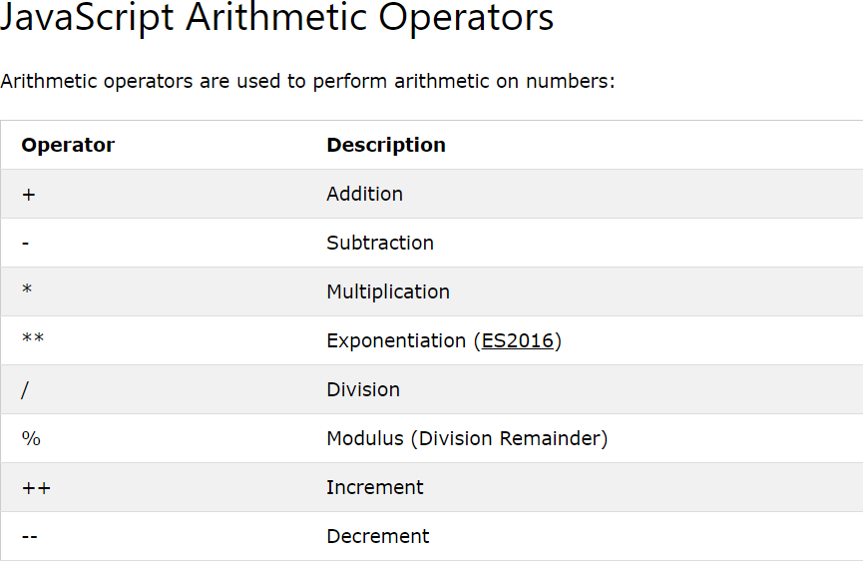
Operators

Slide 12
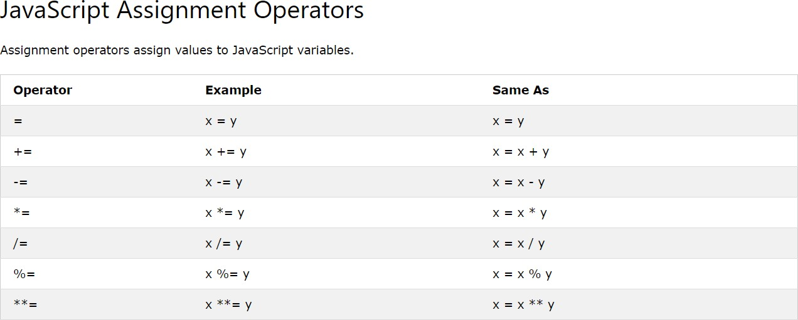
Operators

Slide 13
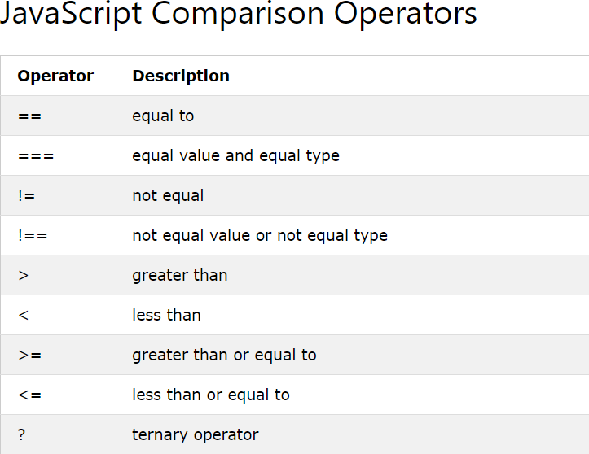
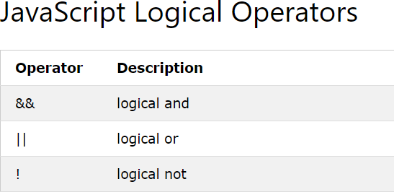
Operators

Slide 14
Data Types
By default JavaScript uses implicit data types
E.g in c++ you explicitly write data type with variables
i.e int c=0; string str=“this is string”; float flt=10.9;
But in JavaScript you don’t explicitly write data types like in c++ instead you just write var then variable name i.e var x=0; var str=“this is string”; var flt=10.9;
JavaScript automatically or in other others implicitly detects what value is inside any variable (either its integer,float,string) and deal it accordingly
Notes:
An implicit type conversion is automatically performed by the compiler when differing data types are intermixed in an expression. An explicit type conversion is user-defined conversion that forces an expression to be of specific type.

Slide 15
Data Types
JavaScript variables can hold many data types: numbers, strings, objects and more:
JavaScript is dynamic, that means same variables can hold different data types.
Recall c++ if you have ever defined int x=0; you can never put string or integer value in x variable. It will always be integer but in javaScript you can change the value later
var x; x = 5;
x = "John";
// Now x is undefined
// Now x is a Number
// Now x is a String

Slide 16
Data Types
var x = 100 + “NUML"; Does this makes any sense to add 100 to NUML (An integer adding to a string)?
Instead javaScript will treat same thing as var x
= “100" + “NUML"; so output will be 100NUML (The 100 will also treated as string by javascript and will be concatenated with NUML)
var x = 100 + 4 + “NUML"; // What will happen with this statement?

Slide 17
Data Types
Output will be 104NUML . But how?
JavaScript reads the statement from left to right so when it will start reading statement it will first read 100 which is integer and then when it will reach 4 it will immediately add 100+4=104 but when it will reach NUML it will automatically convert 104 into string and concatenate it with NUML
var x=“NUML”+100+4; // What will happen now?

Slide 18
Data Types
NUML1004
Again since we talked about javaScript read the statement from left to right. It will first read a string so immediately every thing after than will be treated as string and will be concatenated with NUML
var x=“NUML”+100+4;

Slide 19

Data Types (Strings)
You can use quotes inside a string, as long as they don't match the quotes surrounding the string
var answer1 = "It's alright";
var answer2 = "He is called 'Johnny'"; var answer3 = 'He is called "Johnny"';

Slide 20
Arrays
var cars = ["Saab", "Volvo", "BMW"];
If you want to get anything at specific index you can use cars[0];cars[1];cars[2];
What will you get if you write cars[1];?

Slide 21
If condition
Syntax
if (condition) {
// block of code to be executed if the condition is true
}
<script> var x=10;
if (x < 18) {
document.write("number is less than 18");
}
</script>

Slide 22
If else condition
Syntax
if (condition) {
// block of code to be executed if the condition is true
}
else{
// block of code to be executed if the condition is false
}
<script> var x=10; if (x < 18) {
document.write("number is less than 18");
}
else
{
document.write("number is greater than or equal 18");
}
</script>

Slide 23
Mutiple If else condition
Syntax
if (condition1) {
// block of code to be executed if condition1 is true
} else if (condition2) {
// block of code to be executed if the condition1 is false and condition2 is true
} else {
// block of code to be executed if the condition1 is false and condition2 is false
}

Slide 24
Example Multiple if else
<script>
var greeting;
var time = new Date().getHours(); //builtin javascript function that gets current
hours of time;
if (time < 10) {
greeting = "Good morning";
} else if (time < 20) {
greeting = "Good day";
} else {
greeting = "Good evening";
}
document.write(greeting);
</script>

