Slide 1

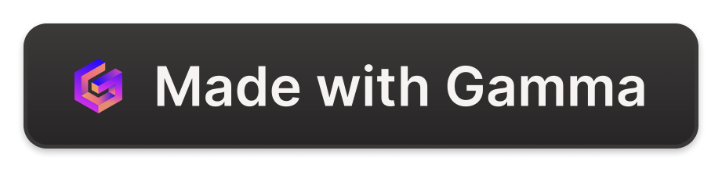
Understanding Ad Rank and Bidding Strategies
Ad rank is a metric used by search engines to determine the placement and visibility of ads on a search results page. It considers factors like your bid amount, ad quality, and relevance to the user's search query.
wa
by wenoxe1813 wenoxe

Slide 2
Ad Formats Explained
Display Ads
Search Ads
Video Ads
Visually engaging ads that appear on websites, apps, and social media platforms, often using images, videos, or interactive elements.
Text-based ads that show up at the top or side of search engine results, targeted to specific keywords and user intent.
Ads that play before, during, or after video content on platforms like YouTube, often skippable or non-skippable.

Slide 3
Mastering Display Ads
Dynamic Ads
Retargeting Ads
Automatically generated ads that adapt to the user's browsing history and interests.
Ads that follow users who have previously interacted with your website or brand.
Contextual Ads
Responsive Ads
Ads that are displayed based on the content of the webpage the user is viewing.
Ads that automatically adjust their size and format to fit different device screens and placements.

Slide 4

The Power of Search Ads
1
Targeted Visibility
2
Intent-Based Targeting
3
Measurable Performance
Search ads appear at the top of search results, ensuring high visibility for your products or services.
Search ads can be tailored to specific keywords, allowing you to reach users who are actively searching for what you offer.
Search ads provide detailed metrics on clicks, conversions, and ROI, enabling you to optimize your campaigns.

Slide 5



Harnessing the Power of Video Ads
Increased Visibility
Immersive Experience
Improved Conversions
Video ads can reach a wide audience and generate high levels of engagement.
Video ads provide an engaging and memorable way to showcase your products or services.
Video ads can effectively drive user actions, such as website visits or product purchases.

Slide 6

Bidding Strategies Explained
1
Manual Bidding
Manually set your maximum bid for each ad auction, adjusting as needed to achieve your goals.
2
Automated Bidding
Let the platform's algorithms optimize your bids to maximize your desired outcome, such as conversions or clicks.
3
Audience Targeting
Tailor your bids to specific audiences based on demographics, interests, or behaviors to improve targeting and efficiency.

Slide 7
Understanding Auction-Based Bidding
Bid Amount
The maximum price you're willing to pay for a click or conversion.
Ad Quality
The relevance, expected clickthrough rate, and user experience of your ad.
Ad Rank
A score that determines your ad's position and visibility in search results or on a website.

Slide 8
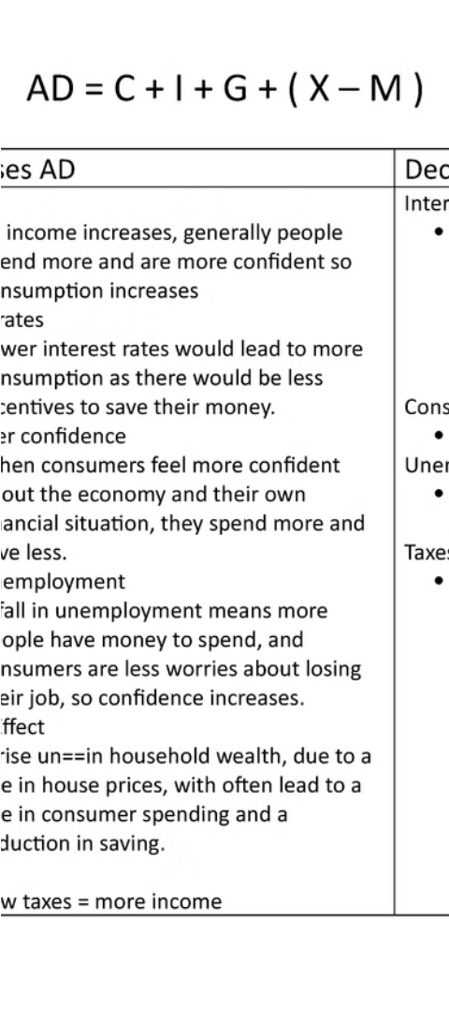



Factors Affecting Ad Rank
Bid Amount
The maximum price you're willing to pay for a click or conversion.
Ad Quality
The relevance, expected clickthrough rate, and user experience of your ad.
Ad Extension
Additional information and features that can improve the ad's visibility and appeal.

