Slide 1
Introduction to Search Marketing and AdWords
Search marketing is a powerful tool for driving targeted traffic to your website. This introduction will cover the fundamentals of Google AdWords, the leading search advertising platform, and how to leverage it effectively to reach your business goals.

Slide 2
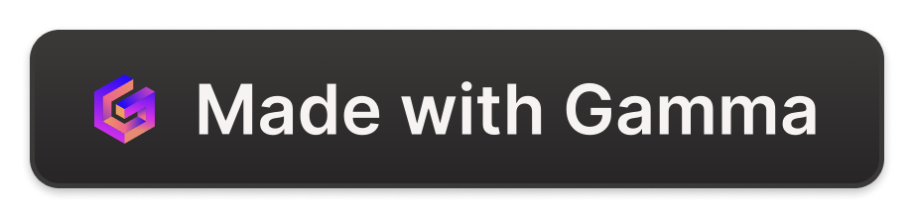
Fundamentals of Ad Making
Crafting Compelling Copy
Designing Eye-Catching Visuals
Optimizing for Mobile
Write ad text that grabs attention and compels users to click. Focus on benefits, unique selling points, and a clear call-to-action.
Use high-quality images, graphics, and videos to make your ads visually appealing and stand out in the search results.
Ensure your ads are mobile-friendly and provide a seamless user experience across all devices.

Slide 3
Ad Position Strategies
1
Top of Page
2
Competitive Bidding
Aim for the top ad position to maximize visibility and click-through rates.
Adjust your bids to stay competitive and secure the best ad placements.
3
Rotation Optimization
4
Prominence Placement
Experiment with rotating your ads to find the most effective placements.
Strategically place your ads in prominent positions to increase their impact.

Slide 4
The Ad Auction Process
Keyword Bidding
Ad Serving
Advertisers bid on keywords they want to target with their ads.
The highest-ranking ads are displayed to users searching for the targeted keywords.
1
2
3
Ad Ranking
Google evaluates the quality and relevance of each ad to determine its placement.

Slide 5
Keyword Research and Targeting
Identify Relevant Keywords
Understand User Intent
Use keyword research tools to find the most relevant and high-performing keywords for your business.
Analyze the search intent behind each keyword to ensure your ads are highly relevant.
Negative Keyword Targeting
Ongoing Optimization
Exclude irrelevant keywords to prevent your ads from appearing for unrelated searches.
Continuously monitor and refine your keyword strategy to improve performance over time.

Slide 6




Ad Copywriting Best Practices
Compelling Headline
Clear Call-to-Action
Highlight Benefits
Maintain Relevance
Craft a powerful headline that captures attention and communicates your unique value proposition.
Include a strong call-to-action that encourages users to take the desired action, such as clicking or making a purchase.
Focus on the benefits your product or service offers to the customer, not just the features.
Ensure your ad copy is highly relevant to the user's search query and their intent.

Slide 7
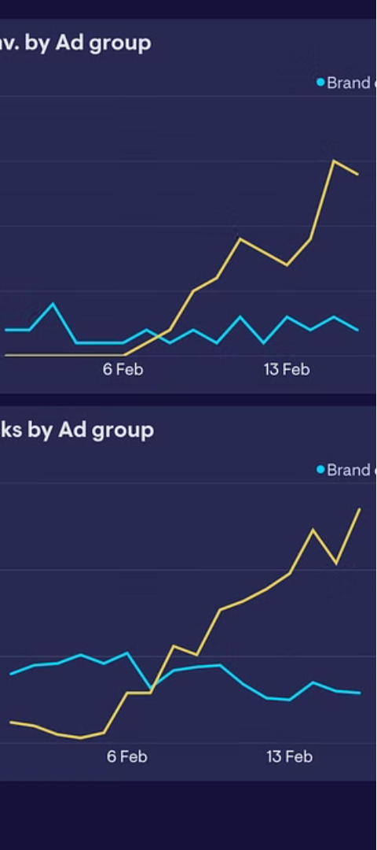



Measuring and Optimizing Ad Performance
Metrics Analysis
Review key performance metrics such as click-through rate, conversion rate, and cost-per-click to identify areas for improvement.
Audience Targeting
Refine your audience targeting to reach the most relevant and responsive users.
Ad Optimization
Continuously test and optimize your ad copy, images, and landing pages to improve performance.

Slide 8
Understanding Ad Rank and Bidding Strategies
Ad rank is a metric used by search engines to determine the placement and visibility of ads on a search results page. It considers factors like your bid amount, ad quality, and relevance to the user's search query.
wa

Slide 9
Ad Formats Explained
Display Ads
Search Ads
Video Ads
Visually engaging ads that appear on websites, apps, and social media platforms, often using images, videos, or interactive elements.
Text-based ads that show up at the top or side of search engine results, targeted to specific keywords and user intent.
Ads that play before, during, or after video content on platforms like YouTube, often skippable or non-skippable.

Slide 10
Mastering Display Ads
Dynamic Ads
Retargeting Ads
Automatically generated ads that adapt to the user's browsing history and interests.
Ads that follow users who have previously interacted with your website or brand.
Contextual Ads
Responsive Ads
Ads that are displayed based on the content of the webpage the user is viewing.
Ads that automatically adjust their size and format to fit different device screens and placements.

Slide 11
The Power of Search Ads
1
Targeted Visibility
2
Intent-Based Targeting
3
Measurable Performance
Search ads appear at the top of search results, ensuring high visibility for your products or services.
Search ads can be tailored to specific keywords, allowing you to reach users who are actively searching for what you offer.
Search ads provide detailed metrics on clicks, conversions, and ROI, enabling you to optimize your campaigns.

Slide 12



Harnessing the Power of Video Ads
Increased Visibility
Immersive Experience
Improved Conversions
Video ads can reach a wide audience and generate high levels of engagement.
Video ads provide an engaging and memorable way to showcase your products or services.
Video ads can effectively drive user actions, such as website visits or product purchases.

Slide 13
Bidding Strategies Explained
1
Manual Bidding
Manually set your maximum bid for each ad auction, adjusting as needed to achieve your goals.
2
Automated Bidding
Let the platform's algorithms optimize your bids to maximize your desired outcome, such as conversions or clicks.
3
Audience Targeting
Tailor your bids to specific audiences based on demographics, interests, or behaviors to improve targeting and efficiency.

