Slide 1
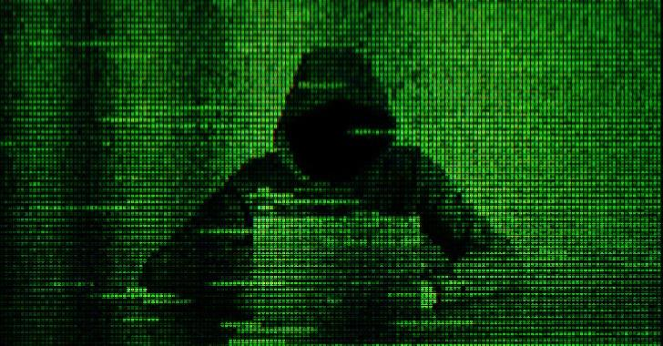
PHISHING ATTACK PROJECT
Presented By :
Ayaz Hassan (20k-1044)
Kazi Zain (20k-1038)
Zain ul Abdin (20k-1672)

Slide 2
What is Phishing Attack ?
Phishing is when attackers send malicious emails designed to trick people into falling for a scam. Typically, the intent is to get users to reveal financial information, system credentials or other sensitive data.
Phishing is a form of social engineering attack that involves the fraudulent sending of emails, text messages, or other communications

Slide 3
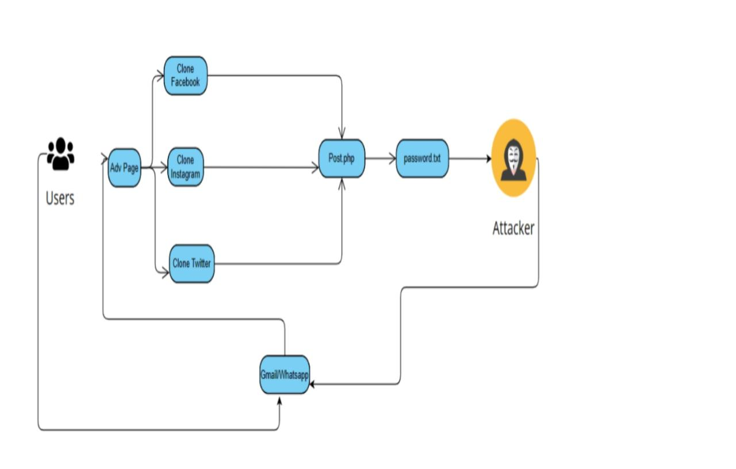
Structural Diagram

Slide 4
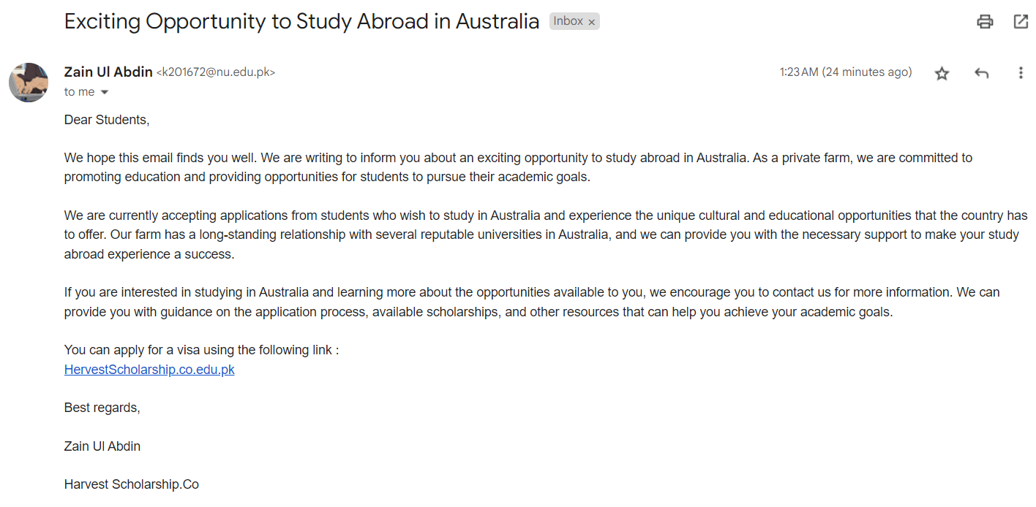
Sended Email.

Slide 5
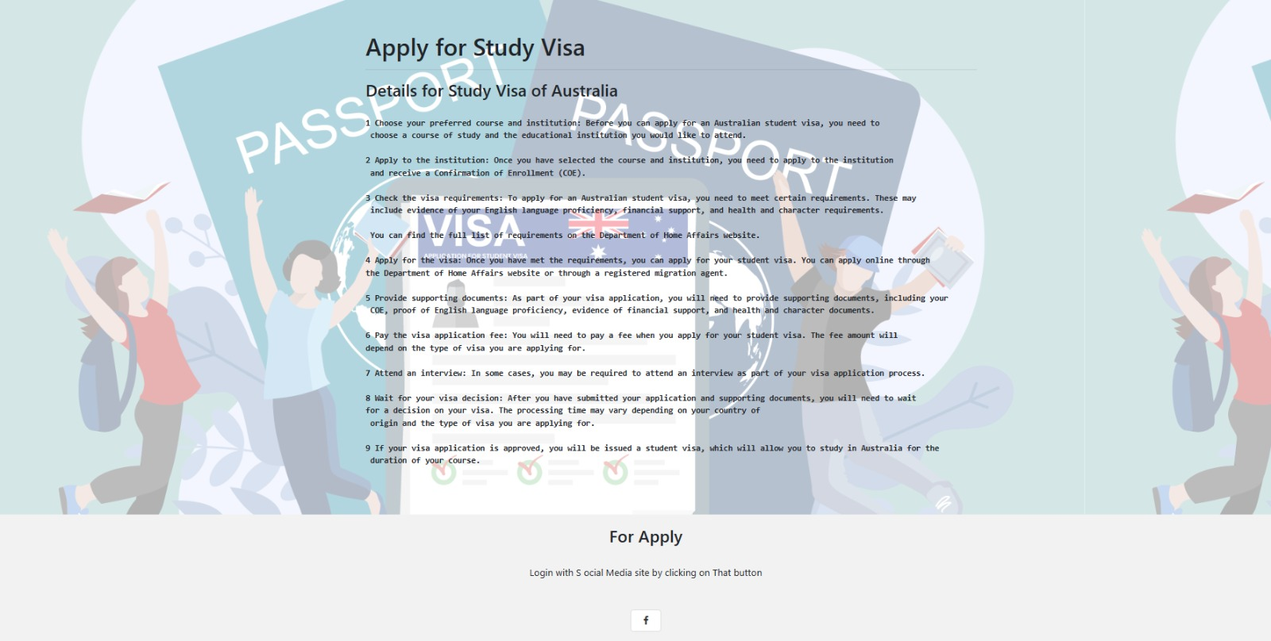
Apply for Visa Page
Click For Apply

Slide 6
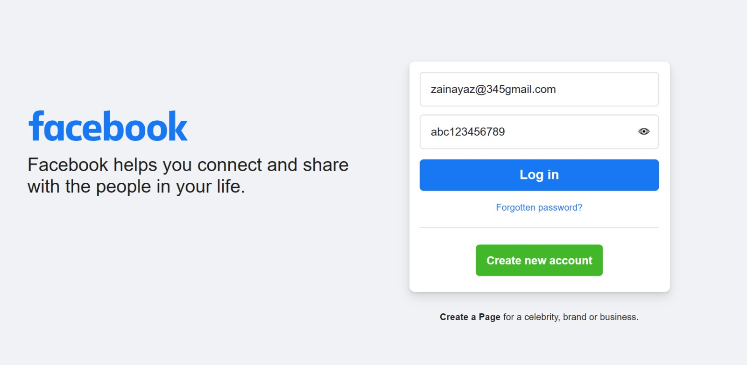
Facebook Fake Login Page.

Slide 7
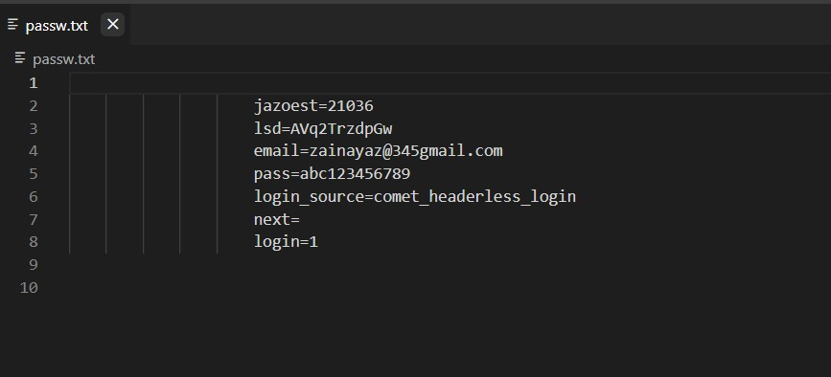
Save Details

Slide 8
Counter measured
Use strong passwords and enable two-factor authentication.
Install anti-phishing software or browser extensions to detect and block phishing attacks.
Follow security best practices such as verifying the authenticity of email senders and avoiding clicking on suspicious links or downloading unknown attachments.

Slide 9
THE END

