Slide 1
陣列取不重複的值

Slide 2
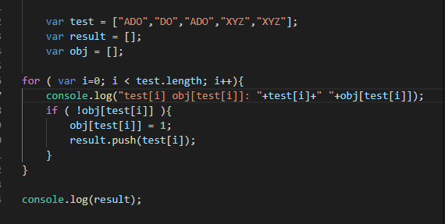
var test = ["ADO","DO","ADO","XYZ","XYZ"];
Obj[ADO]=1 =>push
Obj[DO]=1 =>push
Obj[ADO]=1 =>已經存在了，不push
Obj[XYZ]=1 =>push
Obj[XYZ]=1 =>push=>已經存在了，不push

Slide 3
XSS 跨網站指令碼注意事項(Cross-site scripting)

Slide 4
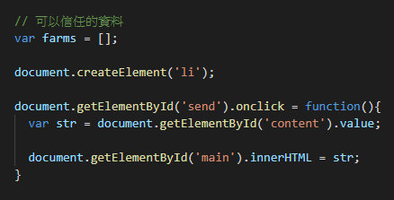
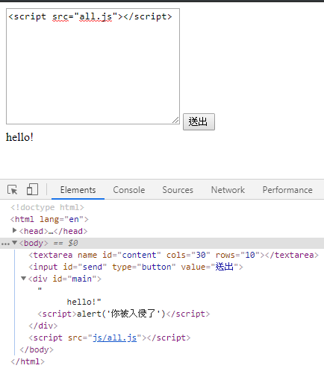
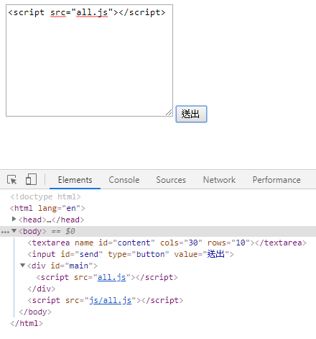

Slide 5
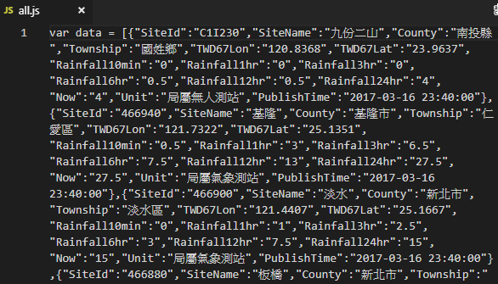
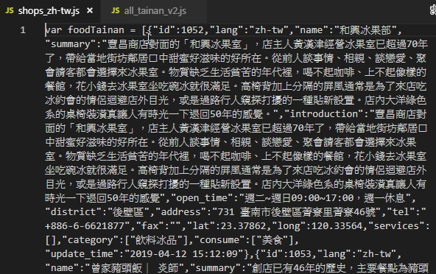
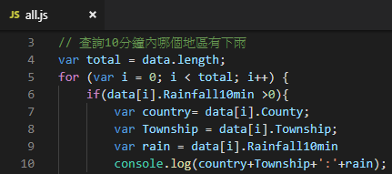
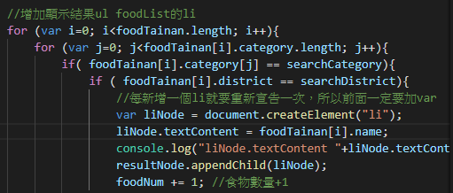
68講座「opendata 範例(下)」 課堂範例
我的作業練習
Notes:
04/25問題

